Slide 1

Game Nexus: Exploring Rock- Paper-Scissors, Tic-Tac-Toe, and Number Guess Games Using HTML, CSS, JS, and Flask

Slide 2
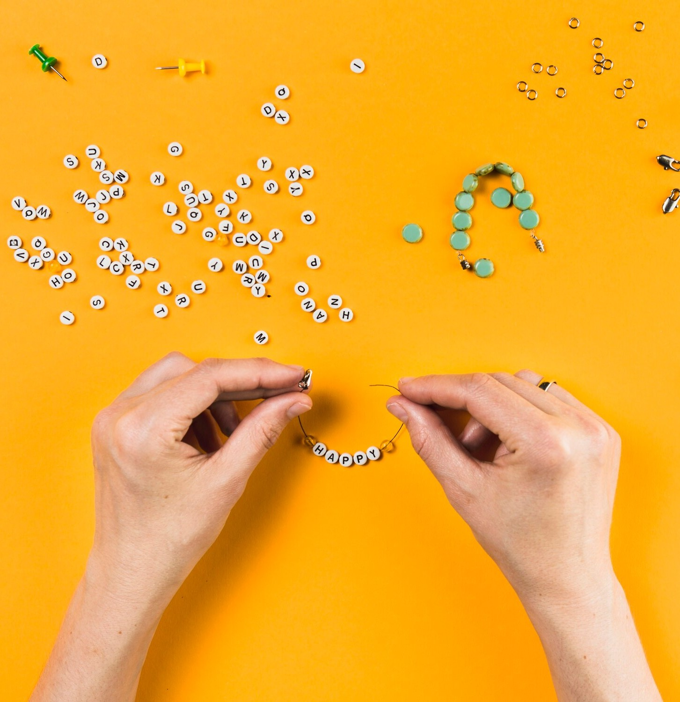
Introduction
Welcome to Game Nexus where we explore the classic games of Rock-Paper-Scissors, Tic-Tac-Toe, and Number Guess using HTML, CSS, JS, and Flask. Get ready to delve into the world of interactive gaming and web development.

Slide 3

Rock-Paper-Scissors
Learn the fundamentals of Rock- Paper-Scissors game and how to implement it using HTML, CSS, and JS. Explore the logic behind the game and the interactive user interface design.

Slide 4
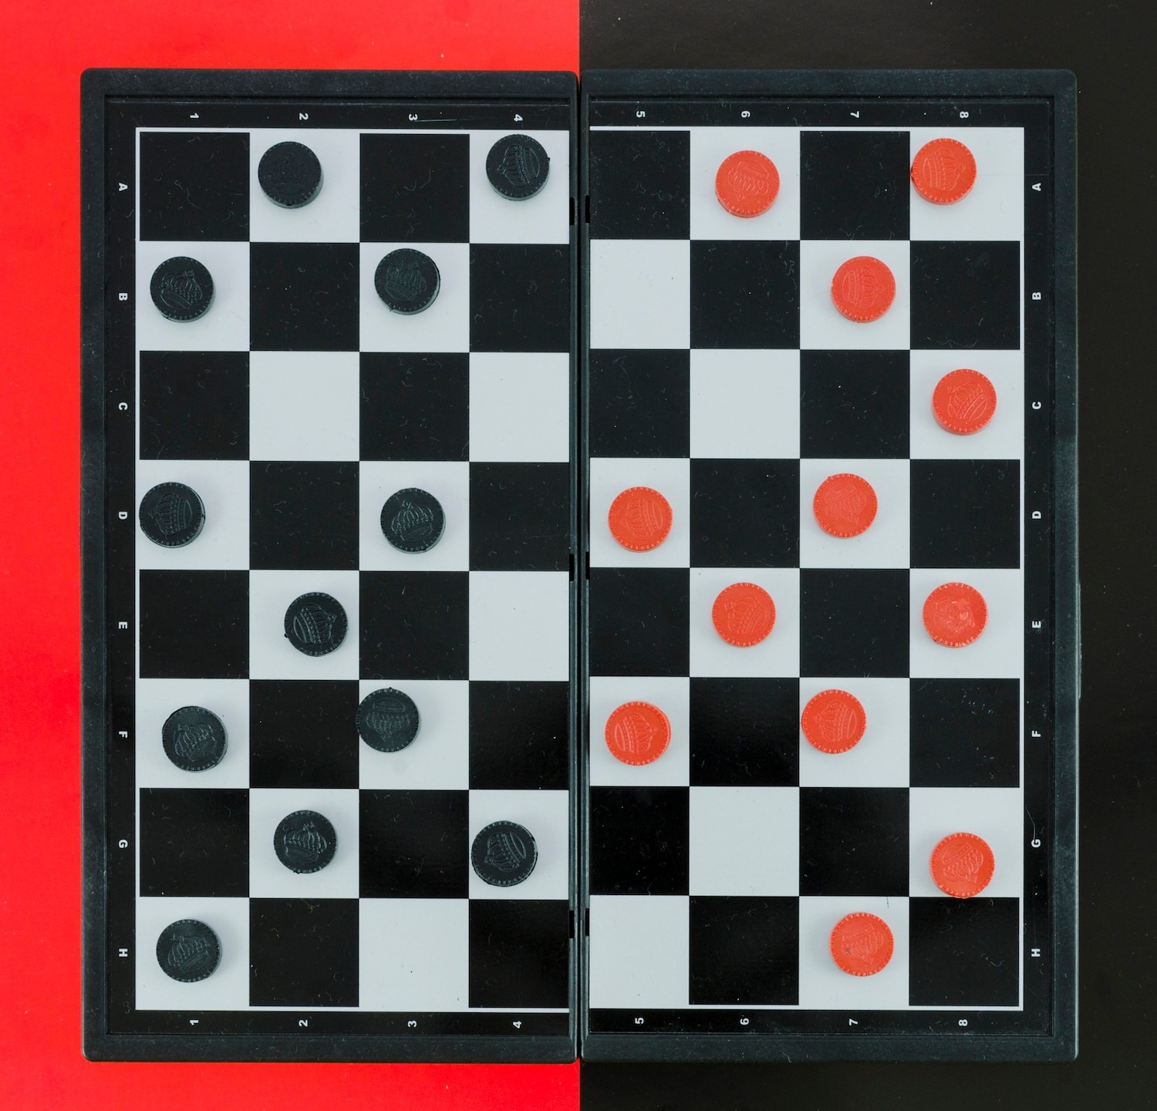
Tic-Tac-Toe
Discover the strategies and implementation of the classic Tic- Tac-Toe game using HTML, CSS, and JS. Dive into the grid-based game logic and the design of an engaging game board.

Slide 5
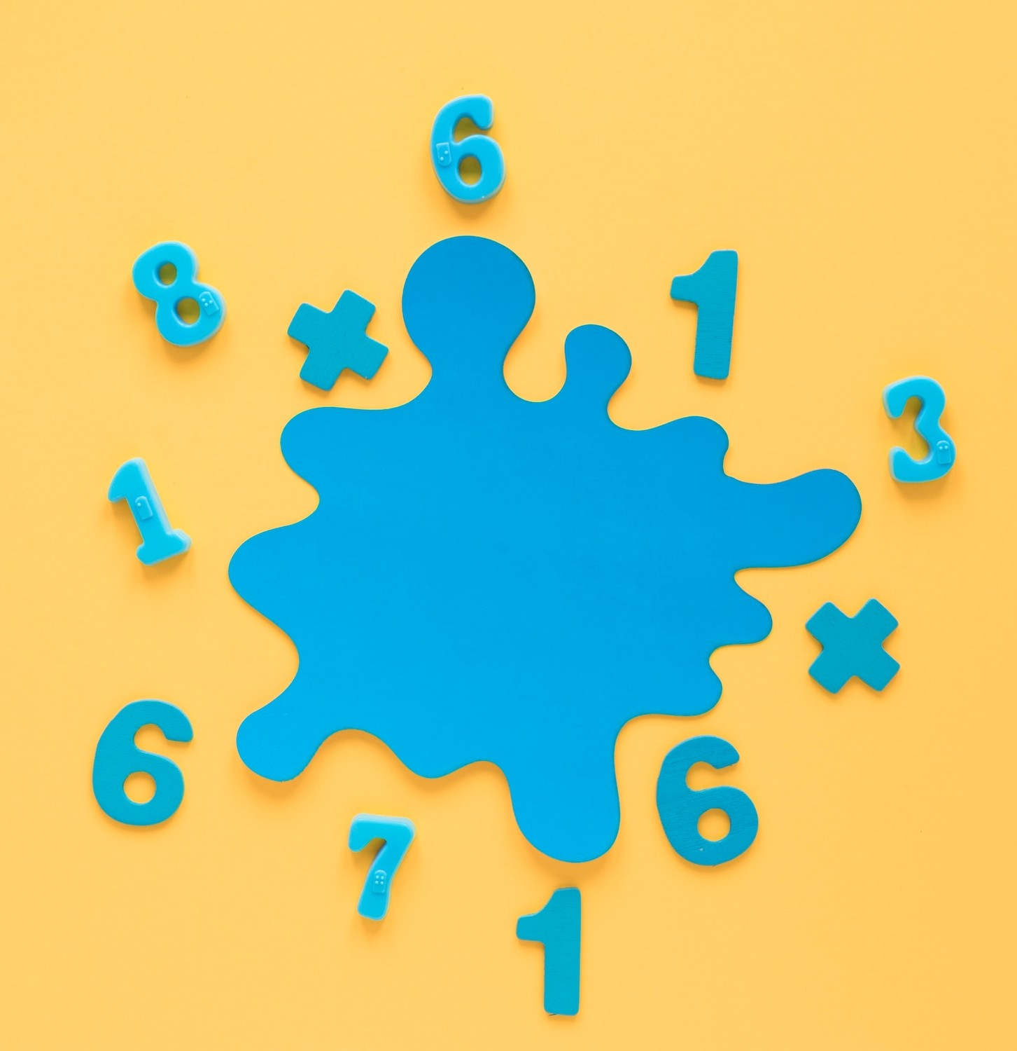
Number Guess Game
Uncover the challenges and techniques of creating a Number Guess game using HTML, CSS, and JS. Explore the generation of random numbers and the user interaction for guessing.

Slide 6

IMPLEMENTING GAMES IN HTML/CSS
In this HTML project, the code defines a webpage titled "Game Nexus" that features a responsive and stylish layout. The page includes a fixed header with the title, "Game Nexus," and three game containers each containing a button linking to different game pages. The games include Rock, Paper, Scissors, Tic Tac Toe, and a Number Guess Game.

Slide 7

Use Of Java Script
JavaScript is employed in this project to enhance user interactivity and functionality. It enables dynamic features such as button hover effects, providing a visually appealing experience. Additionally, JavaScript facilitates smooth navigation between game pages through the use of anchor tags, ensuring a seamless transition for users.

Slide 8

Conclusion
Game Nexus, crafted with HTML, CSS, and JavaScript, delivers a seamless and engaging gaming platform. Featuring classics like Rock, Paper, Scissors and Tic Tac Toe, it combines sleek design with dynamic interactivity. Explore and enjoy the games, showcasing the power of web technologies.

Slide 9
Thanks!
Done BY:
21124-cs-063
21124-cs-086
21124-cs-117

