Slide 1

IMAGE CLASSIFICATION USING
CONVOLUTIONAL NEURAL NETWORKS
Final Project Review | Department of Computer Science & Engineering | [Institution Name]
TEAM MEMBERS
Padamati Lokesh Reddy – 2420030128
Mantri Bhargav Kumar – 2420030124
Lingampalli Sreecharan – 2420030255
Guide: [Dr N Sunanda, Associate Professor] | Academic Year: 2026–27
Notes:
Title slide. Replace all bracketed text. Use the full project title, list every team member with registration number, and name your guide. Insert the institution logo in the dashed box.

Slide 2

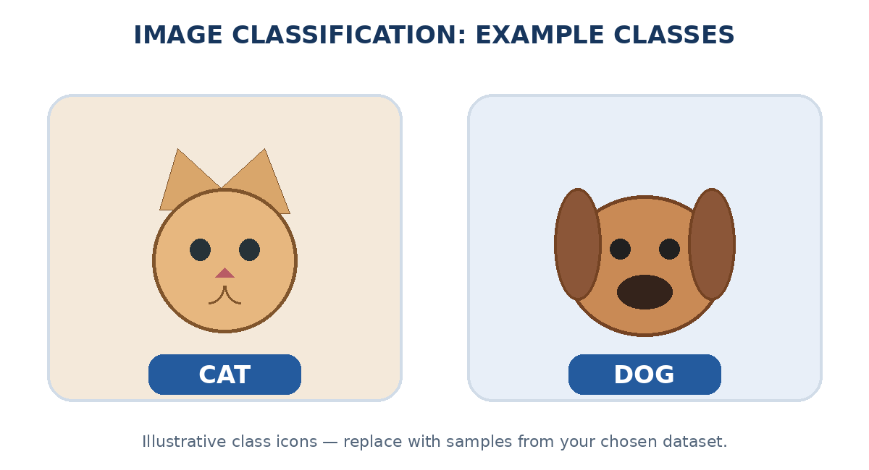


Introduction & Problem Statement
Image → preprocessing → CNN feature learning → class prediction
Background
Image classification assigns a label to an image. CNNs learn visual patterns—edges, textures, shapes and object parts—from pixel data.
Problem Statement
Manual image sorting is slow and inconsistent at scale. This project builds a model that predicts the most likely class for an input image.
Motivation / Need
Automated classification reduces repetitive work and supports faster, consistent image analysis for researchers and organisations.
Notes:
State the domain, the exact problem and why it matters. Keep it to about 2 minutes. Add one real-world statistic if you can, with a citation.

Slide 3


Objectives & Scope
Objectives
1
Design an end-to-end image-classification pipeline using labelled image data.
2
Preprocess images through resizing, pixel normalisation and label encoding.
3
Train and validate a CNN to learn discriminative spatial features from images.
4
Evaluate the classifier using accuracy, precision, recall, F1-score and a confusion matrix.
Scope: supervised classification of the selected labelled image dataset. Object detection, segmentation and real-time video analysis are outside this project scope.
Notes:
Objectives should be measurable and start with action verbs. The scope slide tells the panel what you did and did not attempt.

Slide 4

Literature Survey
S.No | Author(s) & Year | Method / Technique | Key Findings | Limitation / Gap
1 | LeCun et al. (1998) | LeNet; convolution + pooling | Established CNNs for learning visual patterns from images. | Early architecture; limited scale for complex modern datasets.
2 | Krizhevsky et al. (2012) | AlexNet; deep CNN + GPU training | Demonstrated strong gains from deep CNNs on large-scale image recognition. | High compute demand; large labelled dataset required.
3 | Simonyan & Zisserman (2014) | VGG; small 3×3 convolution filters | Showed that increased network depth can improve image representation. | Many parameters and substantial memory / compute cost.
4 | He et al. (2016) | ResNet; residual connections | Skip connections enable training of very deep networks. | Model complexity and deployment cost may be high.
Research Gap
Existing research shows that CNNs learn powerful image features. However, results depend on dataset quality, class balance and computing resources. This project builds a reproducible pipeline for the selected dataset: preprocessing, CNN training, evaluation and error analysis.
Notes:
Summarise four to six relevant papers or existing systems. End with the research gap, because that gap justifies your project.

Slide 5





Proposed System & Methodology
STEP 1
STEP 2
STEP 3
STEP 4
STEP 5
Define Problem
Collect Data
Design
Implement
Test & Evaluate
Define the target classes, input format and success metrics. Set a clear train / validation / test protocol.
Collect labelled images. Record the source, class names, image counts, formats and usage licence.
Build a pipeline for preprocessing, CNN feature learning and class prediction.
Implement data loading, augmentation, training, model saving and image inference.
Evaluate on unseen images using accuracy, precision, recall, F1-score and a confusion matrix.
Key Novelty / Contribution
A reproducible workflow connects data preparation, CNN training and transparent evaluation. The pipeline can be adapted to other image domains.
Notes:
Walk through the five steps left to right. Rename the steps to match your project (for example, Requirement Analysis, Design, Coding, Testing, Deployment). End with your novelty.

Slide 6
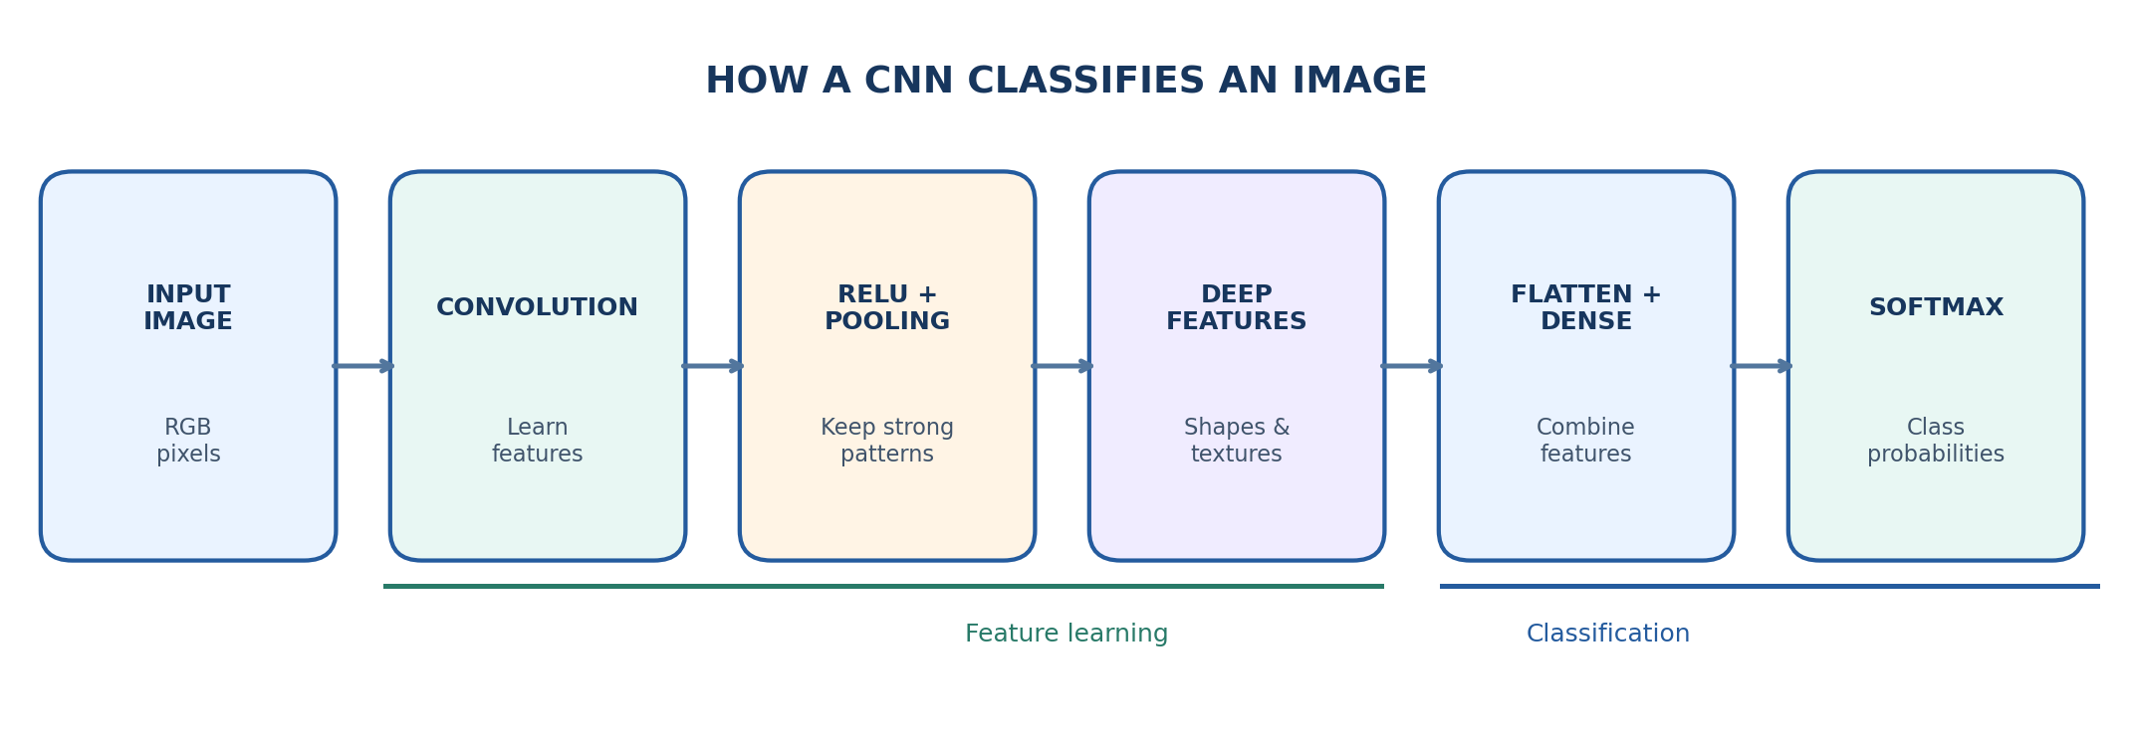
System Architecture
Components
1
Image Input
Accepts a user-selected image in a supported format and checks that it can be decoded.
2
Preprocessing
Resizes images to a fixed input shape and applies the same normalisation used during training.
3
CNN Model
Learns hierarchical visual features and maps them to class-specific representations.
4
Prediction & Evaluation
Returns the predicted label and confidence; evaluation compares predictions with true labels.
Notes:
Insert a clear block diagram: input, processing, storage, output. Number each block and explain them on the right. Redraw the figure yourself rather than copying it.

Slide 7


Hardware & Software Requirements
Hardware
Software & Tools
Libraries / Frameworks
Processor: modern multi-core CPU
RAM: 8 GB minimum recommended
GPU: optional; NVIDIA GPU accelerates training
Storage: enough space for dataset, checkpoints and outputs
Network: required for dataset / package downloads
Operating system: Windows / Linux
Language: Python 3.x
IDE: Jupyter Notebook / VS Code
Version control: Git and GitHub
Execution: local machine or Google Colab
Deep learning: TensorFlow 2.x / Keras
Image loading: Pillow / TensorFlow image utilities
Numerical processing: NumPy
Visualisation: Matplotlib
Evaluation: scikit-learn
Deployment / Platform: Local Python application or Google Colab; optional Streamlit interface for image upload and prediction.
Notes:
List only what you actually used, with versions. For a pure software project, shorten the hardware list and add cloud or deployment resources.

Slide 8
Dataset / Data Understanding
[N]
[C]
Total labelled images
Number of classes
[N]
[W × H]
Unreadable / corrupt files
Model input dimensions
Source: [Dataset name and URL]
Data: labelled JPG / PNG images
Target: one class per image
Quality checks: duplicates, corrupt files and class balance
Split: separate training, validation and test sets
Notes:
Explain where the data came from and what it contains. Show a screenshot of the first rows or the info summary. For non-data projects, replace this slide with “Requirement Analysis” or “Input Specification”.

Slide 9
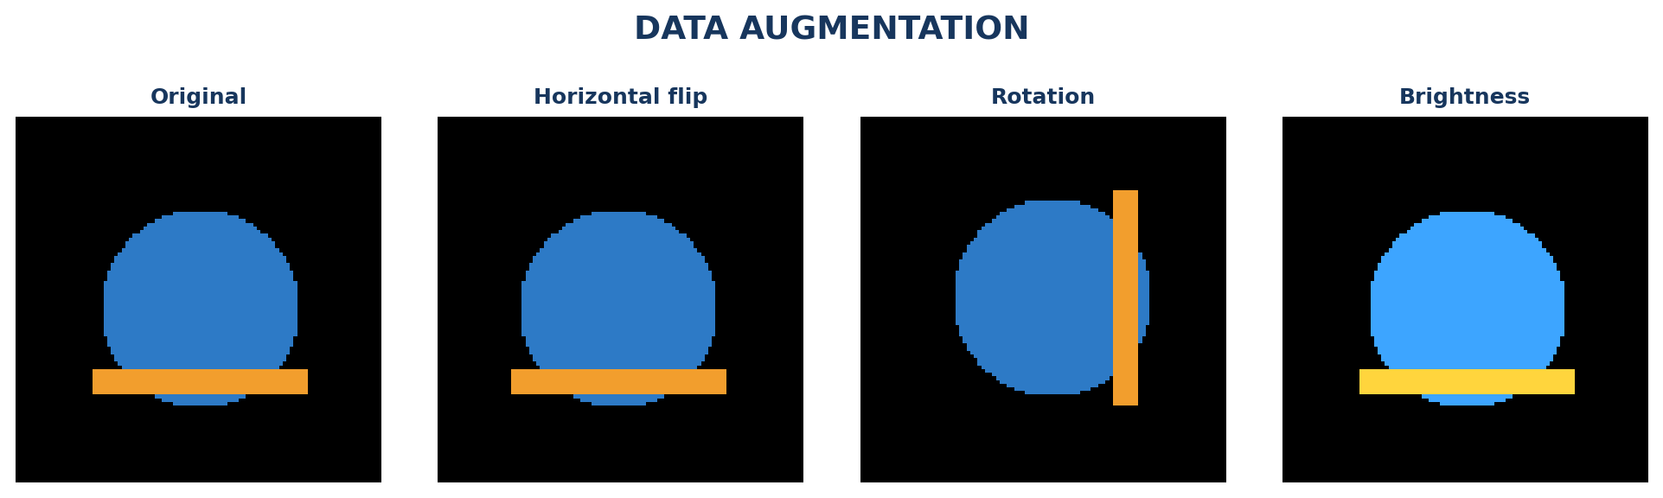



Data Preprocessing & Exploratory Analysis
Class balance
Add your measured images-per-class chart here.
Augmentation examples
Training images can be flipped, rotated or brightness-adjusted.
Cleaning
Transformation
Feature Selection
Remove corrupt files, verify labels and check duplicates. Record any excluded images.
Resize images to one input size. Convert pixels to floats and normalise consistently (for example, 0–1).
CNNs learn features automatically. Use all image channels; apply augmentation only to training images.
Notes:
Show two or three plots that tell a story: distributions, correlations, outliers. Explain what each plot told you and what you did about it.

Slide 10
Module-wise Description
1
Dataset & Input
2
Preprocessing
Purpose: load labelled images and validate file paths / labels.
Input → Output: image folders → batches with labels.
Developed by: [Member name]
Purpose: resize, normalise and augment training images.
Input → Output: raw images → model-ready tensors.
Developed by: [Member name]
3
CNN Training
4
Prediction & Evaluation
Purpose: learn visual representations and class boundaries.
Input → Output: training batches → saved model weights.
Developed by: [Member name]
Purpose: infer class probabilities and calculate metrics.
Input → Output: unseen image → label, confidence and report.
Developed by: [Member name]
Notes:
Divide the project into three to five modules. For each, state its purpose, inputs, outputs and who built it. Duplicate a card if you have more modules.

Slide 11

Algorithms & Technologies Used
Convolutional Neural Network (CNN)
Data Augmentation
Softmax + Cross-Entropy
Why: CNNs preserve spatial information and learn patterns from pixels.
Settings: filters, 3×3 kernels, stride, padding and network depth.
Why: augmentation can improve generalisation and reduce overfitting.
Settings: flip, rotate, crop and brightness ranges. Keep labels valid.
Why: softmax gives class probabilities; cross-entropy measures prediction error.
Settings: optimiser, learning rate, batch size and epochs.
Choose using validation performance, model size and inference speed. Report final metrics on the held-out test set.
Notes:
Name each model, algorithm or technology, say why you chose it, and list the key settings. Then explain how you picked the final one.

Slide 12
Implementation / Model Building
Feature Selection
Code snippet / pseudocode
Input: image pixels and class labels. CNN layers learn useful visual features automatically.
model = build_cnn(input_shape=(H, W, 3),
num_classes=NUM_CLASSES)
model.compile(optimizer='adam',
loss='categorical_crossentropy',
metrics=['accuracy'])
model.fit(train_data,
validation_data=val_data,
epochs=EPOCHS)
model.evaluate(test_data)
Preprocessing Pipeline
Load → verify → resize → tensor → normalise. Augment training data only.
Data Splitting
Example split: 70% train, 15% validation, 15% test. Replace with your actual split.
Configuration
Record image size, architecture, batch size, epochs, optimiser, learning rate and random seed.
Notes:
Describe the build in the order you did it. Paste only the most important code or pseudocode, not entire files. For hardware projects, show the circuit or wiring summary instead.

Slide 13
Working Prototype / Output Screens
ADD SCREENSHOT 3
Actual prediction output for a test image
Dataset Preview
Shows representative labelled images from each target class.
Training Dashboard
Shows training / validation accuracy and loss across epochs.
Model Prediction
Shows uploaded image, predicted class and confidence score.
Notes:
Show real screenshots, photos of the hardware or a short demo video link. Caption each one with what the viewer should notice.

Slide 14
Results & Performance Comparison
RESULTS TO BE ADDED AFTER MODEL TESTING
• Compare the baseline CNN with the improved CNN / transfer-learning model, if implemented.
• Use the same held-out test set for every model.
• Report measured accuracy, precision, recall and F1-score.
• Add a bar chart using your actual results.
Do not copy sample values from the original template.
Metric | Baseline CNN | Improved CNN | Transfer Learning
Accuracy | [enter measured value] | [enter measured value] | [enter measured value]
Precision | [enter measured value] | [enter measured value] | [enter measured value]
Recall | [enter measured value] | [enter measured value] | [enter measured value]
F1-score | [enter measured value] | [enter measured value] | [enter measured value]
Optional metric | Not reported | Not reported | Not reported
Best: [Model name] – Test accuracy: [measured value]
Do not use illustrative values as project results. Train the compared models under the same data split and report measured test metrics. If only one model is implemented, replace the comparison with its baseline-versus-final results.
Notes:
Right-click the chart and choose Edit Data to enter your real numbers. Replace the metrics with the ones that fit your project (accuracy, latency, power, throughput, user rating). State clearly which option performed best.

Slide 15
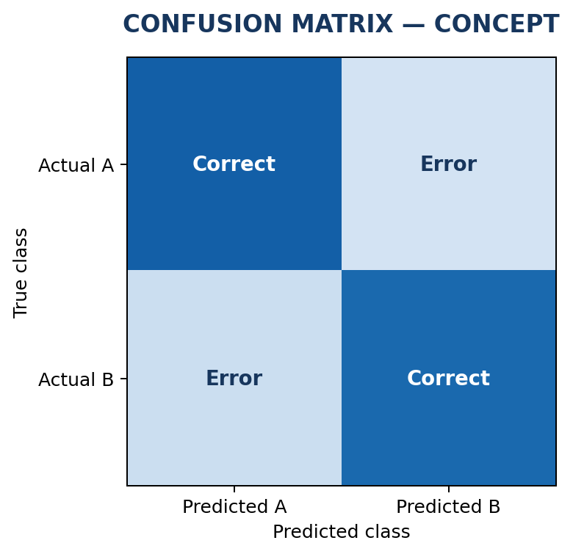
Analysis & Key Findings
[XX.X%]
Measured test accuracy (replace after evaluation)
Interpretation: which classes are easiest or hardest?
Errors: blur, occlusion, lighting and similar shapes.
Optional: Grad-CAM can highlight image regions influencing a prediction.
Notes:
Explain what the numbers mean. Use a confusion matrix, ROC curve, feature-importance chart or output comparison. Be honest about weak results; panels value that.

Slide 16

Testing & Validation
Test ID | Test Description | Expected Result | Actual Result | Status
TC-01 | Load valid image | Image decoded and tensor created | [Record result] | [Pass/Fail]
TC-02 | Input unsupported / corrupt file | Clear validation error shown | [Record result] | [Pass/Fail]
TC-03 | Run prediction | One valid class label and scores returned | [Record result] | [Pass/Fail]
TC-04 | Evaluate unseen samples | Metrics calculated without data leakage | [Record result] | [Pass/Fail]
Functional Testing
Validation Method
Performance Testing
Check valid, corrupt and unsupported images. Confirm preprocessing shape and valid prediction output.
Use a held-out test set. Keep related or duplicate images in the same split to avoid data leakage.
Measure accuracy, precision, recall, F1-score, inference time and model size.
Notes:
List representative test cases with expected and actual outcomes. Name the validation methods you used. Delete rows you do not need.

Slide 17


Challenges & Limitations
Challenges Faced
Limitations
Class imbalance → balanced sampling or class weights.
Overfitting → augmentation, dropout and early stopping.
Limited compute → smaller batches or GPU runtime.
Results depend on data quality and diversity. The model may struggle with unfamiliar image conditions. It classifies whole images; it does not locate multiple objects.
Notes:
Be candid. Pair every challenge with how you solved it, and list limitations that the panel would otherwise spot themselves.

Slide 18

Conclusion
Built a pipeline that preprocesses an image and predicts its category using a CNN.
1
Final Outcome
Evaluate with held-out accuracy, precision, recall and F1-score. Insert measured results after experiments.
[XX%]
2
Replace with measured test accuracy / headline result.
Objectives achieved: [x of 4 – based on completed work]
The workflow demonstrates how deep learning can automate visual categorisation and be retrained for new datasets.
3
Notes:
Revisit each objective and say whether you met it. Quote your headline result with numbers. Do not introduce new material here.

Slide 19



Future Scope & Applications
Try transfer learning, tune learning rates and reduce overfitting.
Applications
Applications:
• Agriculture: leaf / crop classification
• Industry: product and defect sorting
• Research: visual dataset analysis
Collect more varied images and improve under-represented classes.
Build a web interface for image upload, prediction and confidence display.
Package the model, validate uploads and protect stored images.
Notes:
Give concrete next steps, ideally tied to the limitations. Then name two or three real-world uses.

Slide 20
Team Contribution
Reg. No. | Name | Contribution / Modules Handled
[Reg. No.] | [Member 1] | Dataset collection, cleaning and documentation
[Reg. No.] | [Member 2] | Preprocessing, augmentation and data pipeline
[Reg. No.] | [Member 3] | CNN design, training and tuning
[Reg. No.] | [Member 4] | Testing, evaluation, interface and presentation
Notes:
Show that work was planned and shared. Every member should be able to explain their own module.

Slide 21

References
[1] Y. LeCun, L. Bottou, Y. Bengio and P. Haffner, “Gradient-Based Learning Applied to Document Recognition,” Proceedings of the IEEE, vol. 86, no. 11, pp. 2278–2324, 1998.
[2] A. Krizhevsky, I. Sutskever and G. E. Hinton, “ImageNet Classification with Deep Convolutional Neural Networks,” NeurIPS, 2012.
[3] K. Simonyan and A. Zisserman, “Very Deep Convolutional Networks for Large-Scale Image Recognition,” ICLR, 2015.
[4] K. He, X. Zhang, S. Ren and J. Sun, “Deep Residual Learning for Image Recognition,” CVPR, 2016.
[5] F. Chollet, Deep Learning with Python, 2nd ed., Manning, 2021.
[6] [Dataset owner], “[Exact dataset title],” [URL and access date].
[7] [Framework] official documentation, [version / URL].
Project Links
GitHub: https://github.com/charan-hub404/DS_Project
Dataset: https://www.tensorflow.org/datasets/catalog/cats_vs_dogs?utm_source=chatgpt.com
Notes:
Use IEEE style, numbered in order of first citation in the deck. Include datasets, documentation and code repositories.

Slide 22
THANK YOU
Team contact: 2420030128@klh.edu.in , 2420030124@klh.edu.in , 2420030255@klh.edu.in .
Guide: [Dr N Sunanda] | Department of Computer Science & Engineering
Notes:
Leave this slide up during questions. Make sure every team member can answer questions about their own module.

