Slide 1
Integrated Health Records Management System
Student Name: D Charan Kumar
ID No: 2020WA15718
Supervisor Name: Muthu Kumar M
BITS examiner: Dolly Gupta

Slide 2
Bibliography used in report
• PyMongo documentation - https://pymongo.readthedocs.io/en/stable/tutorial.html
• Flask framework installation - https://flask.palletsprojects.com/en/stable/quickstart/
• Jinja template documentation - https://jinja.palletsprojects.com/en/stable/templates/
• Tailwindcss - https://tailwindcss.com/docs/installation

Slide 3
Introduction
In the medical field, stabilizing the patient before medically operating on them is very important and essential when they are admitted during an emergency. But due to lack of the medical history of the patient, stabilising the patient turns difficult. This project introduces a sophisticated system that merges the way the doctors, patients, pharmacists and lab technicians share the data. The main objective of this website is to help doctors and patients view the medical history of the patients simply by inputting the unique id of the patient. All the medical data from patients’ diagnostics to prescriptions to lab tests are stored on the website.

Slide 4
Existing Process
Currently, the hospitals do not keep any records of patients who have not yet visited; only those who visit frequently are kept up to date. Patients rarely take their medical records from the hospital they usually visit when they are transferred to another facility.

Slide 5
Resolution
We want to resolve this issue of unavailability of medical history of the patient by creating a centralised website that can display the patient’s medical history to the operating doctor. We will combine all the branches like Doctors, Pharmacies, Labs and patients in this project and provide a centralized website where the required data can be viewed by the medical professions as required.

Slide 6
Estimate of the project
Sl. Task | Tasks or subtasks to be done | Planned duration in weeks | Specific Deliverables in terms of the project
1 | Requirement Gathering | Week 1 | Sprint 1
2 | Documentation of design for the website | Week 2 -3 | Sprint 2
3 | Development of Dashboard of the website | Week 4 | Sprint 3
4 | Development of Doctor’s module | Week 5 - 6 | Sprint 4
5 | Development of Pharmacist’s module | Week 7 - 8 | Sprint 5
6 | Development of Lab’s module | Week 9 - 10 | Sprint 6
7 | Development of Patient’s module | Week 11 - 12 | Sprint 7
8 | Customizations | Week 13 | Sprint 8
9 | Integration of Dashboard, Doctor’s module, Pharmacist’s module, Lab’s module and Patient’s module | Week 14 - 15 | Sprint 9
10 | Integration of Database at the back end | Week 16 | Sprint 10

Slide 7
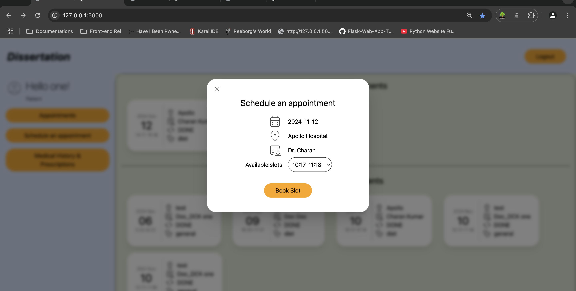
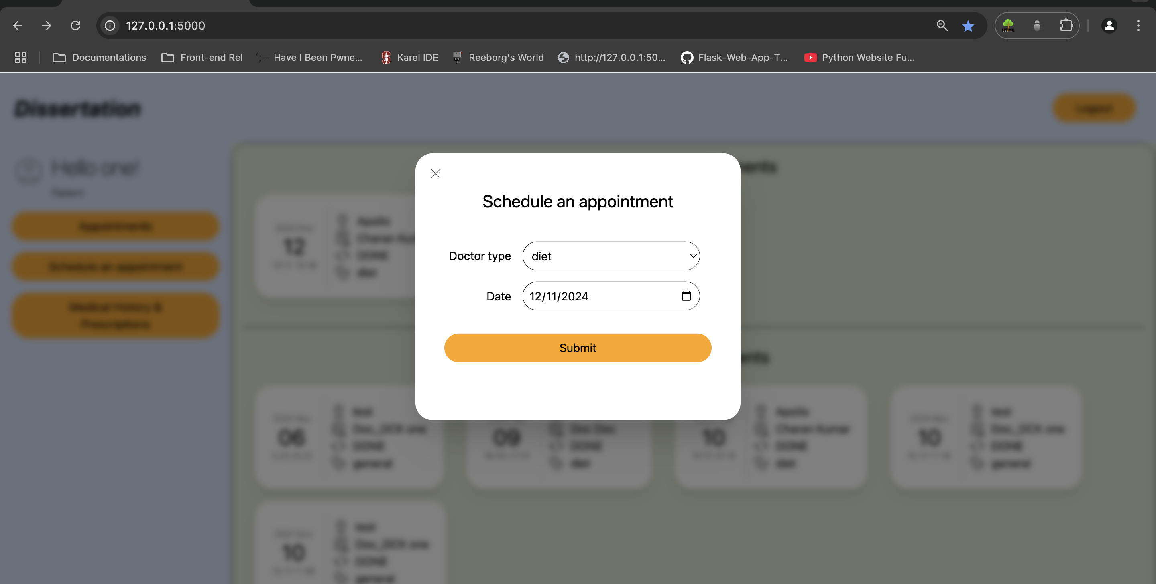
Results from the user screen
User can now book appointments based on doctor’s reporting time.
All they need to do is click on the ‘Schedule an appointment’ button, select the doctor type and the date. Click on the ‘Submit’ button.
On the next page, verify the details and select the time slot, and click on the ‘Book slot’ button.

Slide 8
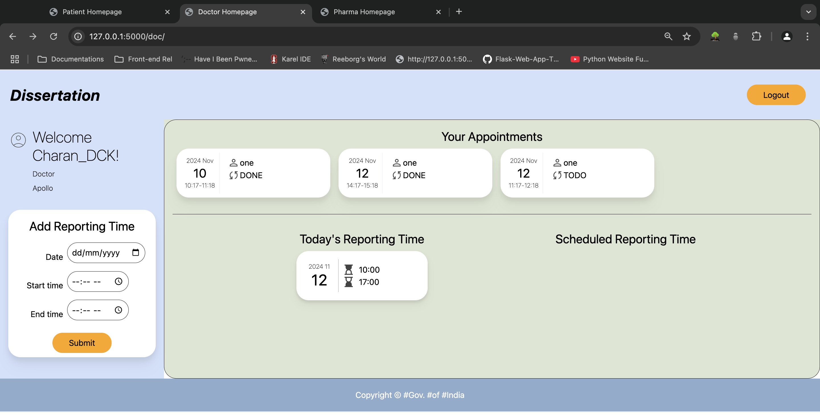
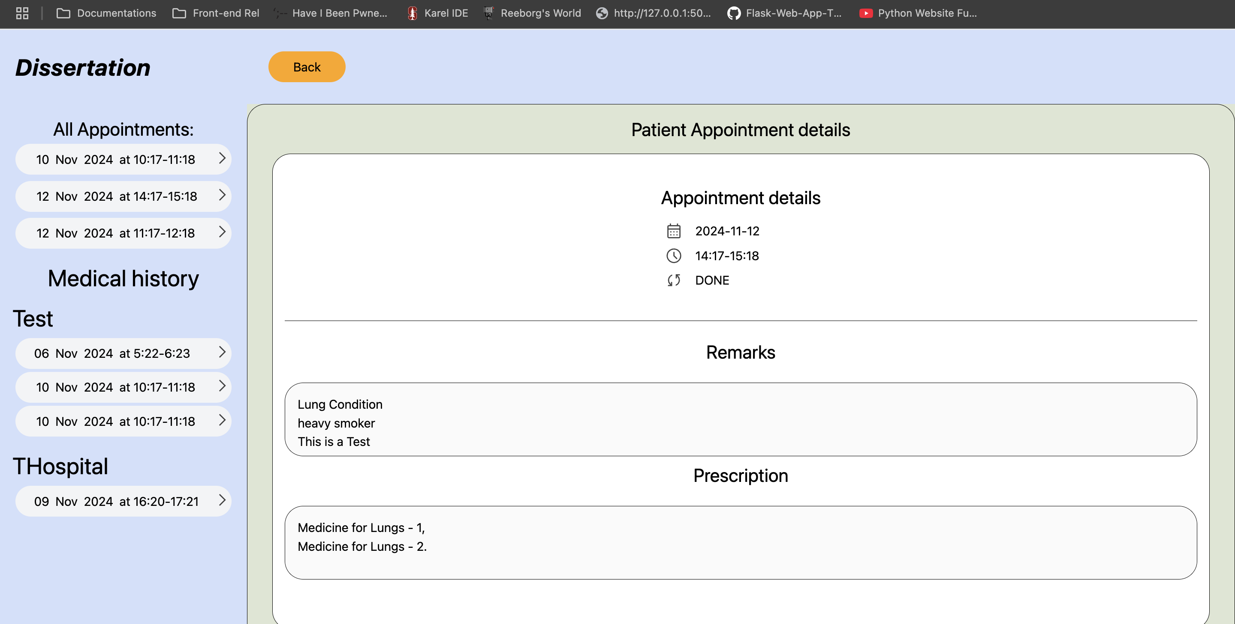
Results from the Doctor screen
Once the user schedules an appointment, the respective doctor will be able to see the user’s appointment on their screen. The doctor then clicks on the appointment. Now, the doctor has an option to change the status of the appointment to ‘In Progress’ and provide remarks which is displayed as Medical History and prescribe medicine. Once done, doctor can change the status to done. Upon which remarks and prescription cannot be changed.

Slide 9
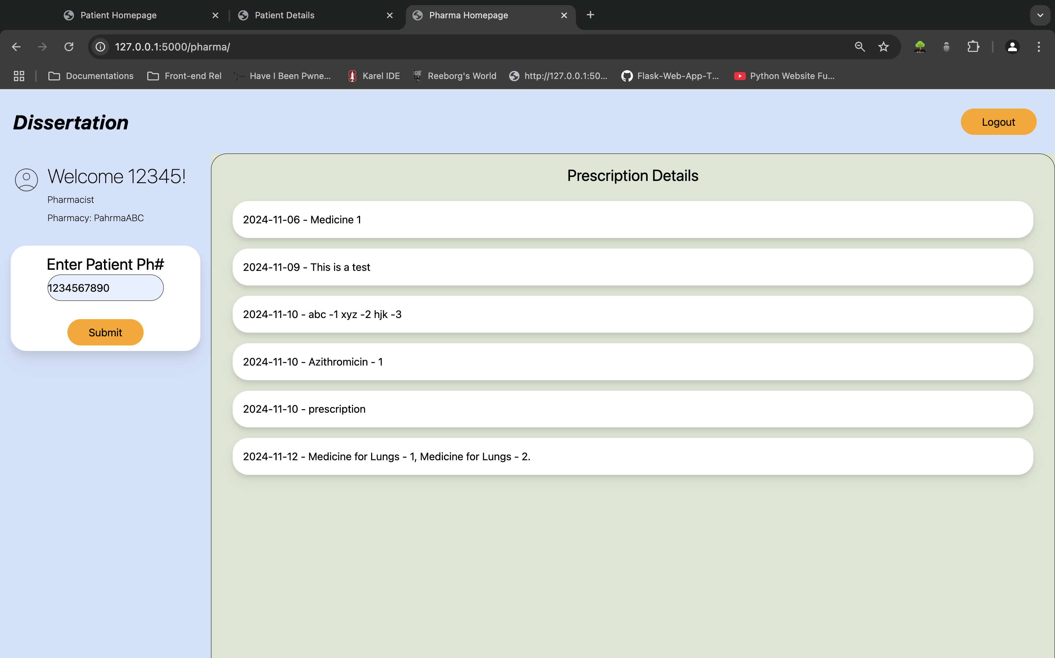
Results from the Pharma screen
Once the user is prescribed with the medicine, the Pharmacist can access the user’s prescription by the user’s phone number.

Slide 10
current status of the project
Integration of all the three branches, i.e., Patient, Doctor and Pharmacist is complete.
The website is able to write the data to the DB and retrieve the same.
We have a working model of the website.
The Lab module has been moved to the future scope.

Slide 11
Reference
Flask Installation - https://flask.palletsprojects.com/en/stable/quickstart/
Jinja Template Documentation - https://jinja.palletsprojects.com/en/stable/templates/
Py Mongo Installation - https://pymongo.readthedocs.io/en/stable/installation.html
Tailwindcss Installation - https://tailwindcss.com/docs/installation

Slide 12
Acknowledgement
I express my gratitude to Muthu Kumar M, my project supervisor, for his tireless work, wise counsel, assistance, and patience. His advice and assistance with this endeavour is indisputable in my opinion. His insightful remarks were helpful in raising the calibre of the output.
I want to sincerely thank Saraneya Boopathi and Jeya Priya M for taking the time out of their busy schedules to review my progress.
I want to express my gratitude to my project's partners for their assistance and cooperation.
I also want to express my gratitude to my friends and family for their encouragement and support throughout the dissertation.
I am incredibly grateful to WIPRO Technologies for providing me with the M. Tech. Software Systems program training opportunity and all the materials I needed for this dissertation
I appreciate everything that BITS, Pilani, and the Training department did to make this course possible.

Slide 13
THANK YOU

