Slide 1

CREDIT CARD FRAUD DETECTION
TEAM MEMBERS
2010030047 - E CHARAN KUMAR
2010030160 – S SAI ARCHANA
2010030164 – G SUSRITHA
2010030206 – M SUJITH REDDY

Slide 2

TABLE OF CONTENTS
S.NO | CONTENT | SLIDE NO
1 | INTRODUCTION | 3
2 | OBJECTIVE | 4
3 | PROBLEM STATEMENT | 5
4 | LITERATURE SURVEY | 6 - 7
5 | HARDWARE & SOFTWARE | 8
6. | PROCESS, MODELS & TECHNIQUES | 9 - 17
7. | ADV. SPARK ANALYSIS | 18 - 20
8. | CONCLUSION | 21

Slide 3
INTRODUCTION
Credit card fraud means unauthorized operation of an account that is used to make transactions without the actual owner of the account or the bank authority’s knowledge. We need to take necessary precautions while doing these transactions to avoid these frauds. This is a very complex problem that needs the attention of the account holder as well as the bank authorities so that their other customers need not suffer from the same problem.
Credit card fraud is a wide-ranging term for theft and fraud committed using a credit card as a fraudulent source of funds in a given transaction. Generally, the statistical methods and many algorithms are used to solve this fraud detection problem.
The payment requests sent are checked by automatic tools that confirms which request need to be confirmed. These algorithms check these requests and report suspicious requests to professionals who operate behind and they in turn investigate them by contacting the owners of the accounts whether the transactions are genuine or not.

Slide 4
PROJECT OBJECTIVE
Identify the frauds accurately.
Should detect the frauds quickly.
Should not classify a genuine transaction as fraud.

Slide 5
PROBLEM STATEMENT
Our Project main purpose is to make Credit Card Fraud Detection to aware people from credit card online frauds. the main point of credit card fraud detection system is necessary to safe our transactions & security. With this system, fraudsters don't have the chance to make multiple transactions on a stolen or counterfeit card before the cardholder is aware of the fraudulent activity. This model is then used to identify whether a new transaction is fraudulent or not.
The Credit Card Fraud Detection Problem includes modelling past credit card transactions with the knowledge of the ones that turned out to be fraud. This model is then used to identify whether a new transaction is fraudulent or not.

Slide 6
Literature Survey
SNO. | TITLE | AUTHOR | PUBLISHER | TECHNIQUES
1. | Fraud analysis and prevention in e-commerce transactions | Caldeira, Evandro, Gabriel Brandao, and Adriano CM Pereira | IEEE | Computational intelligence
2. | Analysis on credit card fraud detection methods | Raj, S. Benson Edwin, and A. Annie Portia | International Conference on Computer, Communication and Electrical Technology (ICCCET), IEEE, 2011. | Artificial neural networks, Bayesian methods
3. | A review of fraud detection techniques: Credit card | Chaudhary, Khyati, Jyoti Yadav, and Bhawna Mallick. | International Journal of Computer Applications 45,. | genetic algorithms , neural networks , outlier detection
4. | Credit card fraud: awareness and prevention | Barker, Katherine J., Jackie D'amato, and Paul Sheridon | Journal of financial crime | DL-convolutional neural network

Slide 7
SNO. | TITLE | AUTHOR | PUBLISHER | TECHNIQUES
5. | Credit card fraud detection using machine learning | Tiwari, Pooja, Simran Mehta, Nishtha Sakhuja, Ashutosh Kumar Singh. | arXiv preprint arXiv:2108.10005 | Computational intelligence
6. | Review of Machine Learning Approach on Credit Card Fraud Detection | Bin Sulaiman, Rejwan, Vitaly Schetinin, and Paul Sant | International Journal of Computer Applications | Human-Centric Intelligent Systems,Bayesian belief
7. | Ensemble of deep sequential models for credit card fraud detection | Forough, Javad, and Saeedeh Momtazi. | pplied Soft Computing 99 (2021) | genetic algorithms , neural networks , outlier detection
8. | Credit card fraud and detection techniques | Delamaire, Linda, Hussein Abdou, and John Pointon | Banks and Bank systems 4, no. 2 | LSTM, logistic and linear regression

Slide 8
Hardware and Software Requirements
Processor: Minimum 1 GHz; Recommended 2GHz or more
Ethernet connection (LAN) OR a wireless adapter (Wi-Fi)
Hard Drive: Minimum 256 GB; Recommended 500 GB or more
Memory (RAM): Minimum 8 GB; Recommended 16 GB or above
Java
Chrome or Any other Browser

Slide 9
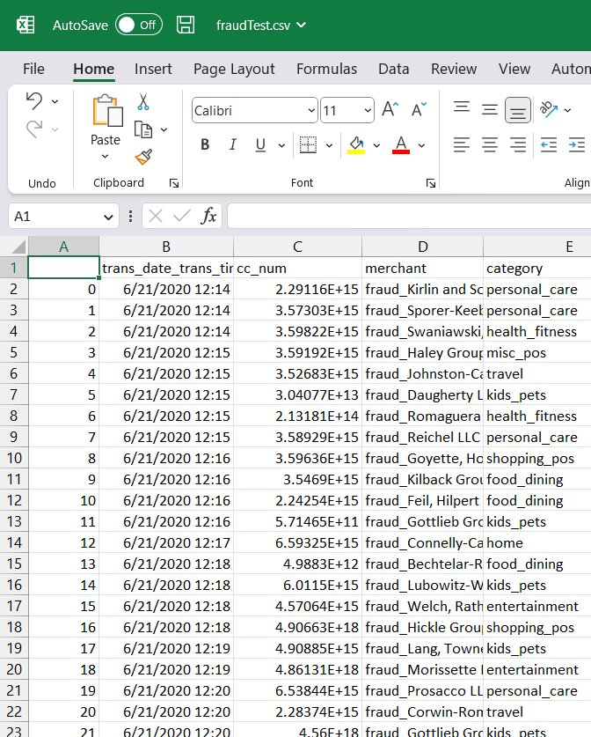
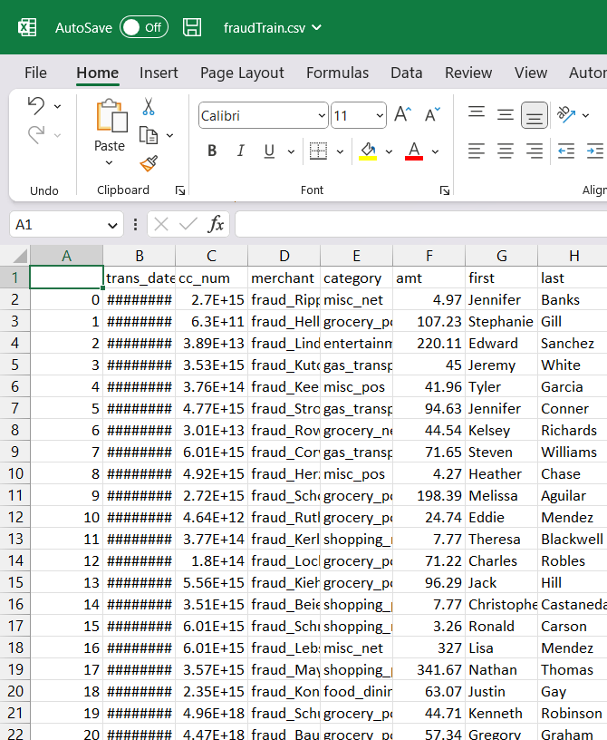

Datasets

Slide 10
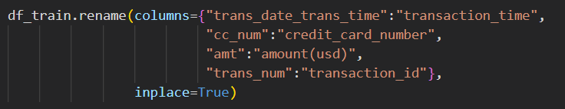
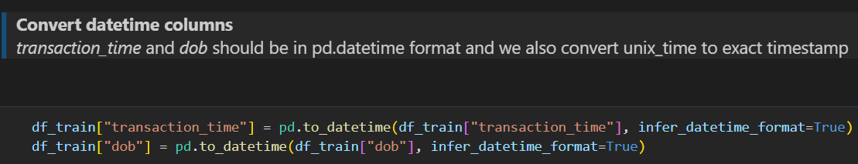
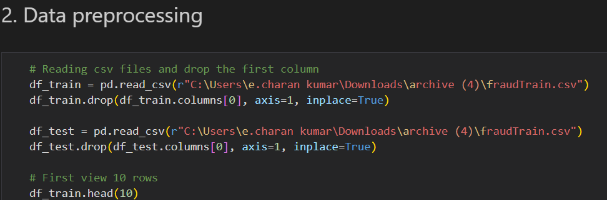
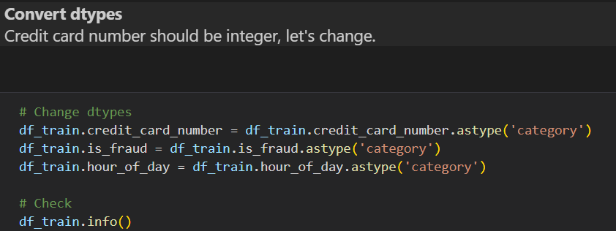
Data Preprocessing

Slide 11
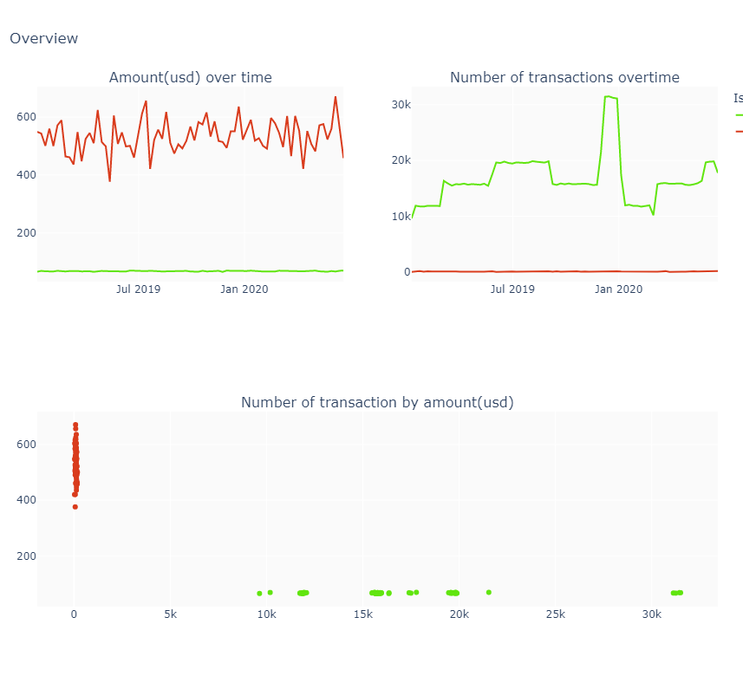
Data Modeling

Slide 12
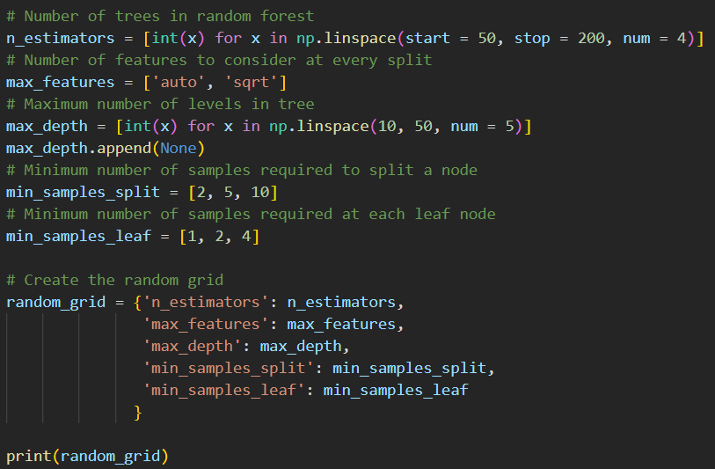
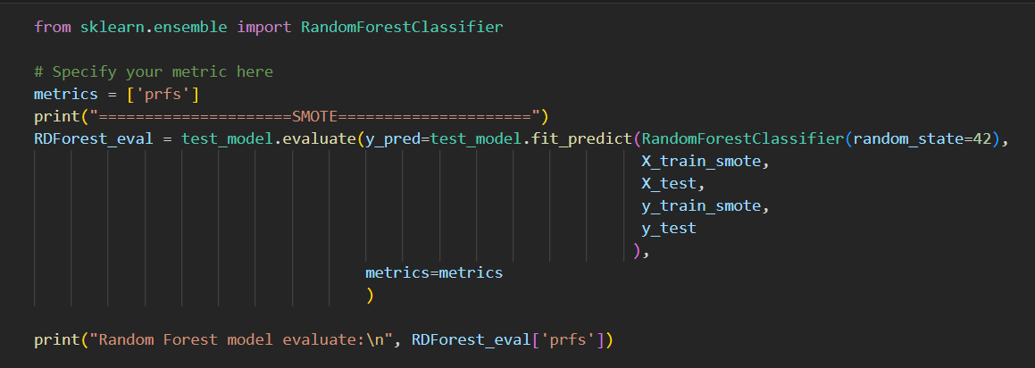
Model Building

Slide 13
Algorithm Explanation
Random Forest Classifier is a machine learning algorithm that is used for classification problems. It is an ensemble learning method that combines multiple decision trees to create a single classifier.
The following are the steps involved in the Random Forest Classifier algorithm:
Collect the training data set: The first step in the algorithm is to collect the training data set which consists of a set of labeled data. The labeled data means that the data has a known output value, which is used to train the model.
Randomly select a subset of features: In the next step, the algorithm randomly selects a subset of features from the input data set.
Grow decision trees: After selecting the features, the algorithm grows multiple decision trees, where each tree is trained on a different subset of the data set and a different subset of features.
Evaluate decision trees: Once the decision trees are grown, the algorithm evaluates each tree's accuracy by predicting the output value of the data points in the validation set.
Aggregate results: Finally, the algorithm combines the outputs of all the decision trees to create the final classifier. The decision trees' outputs are aggregated using either a majority vote or weighted vote to predict the output value for a given input data point.
Random Forest Classifier is an effective algorithm that can handle large data sets, noisy data, and can handle missing data. It also provides a way to rank the importance of each feature in the data set.

Slide 14
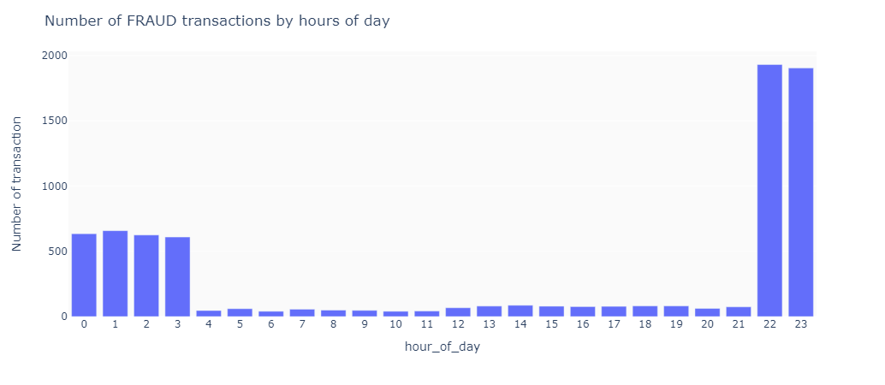
Outputs

Slide 15
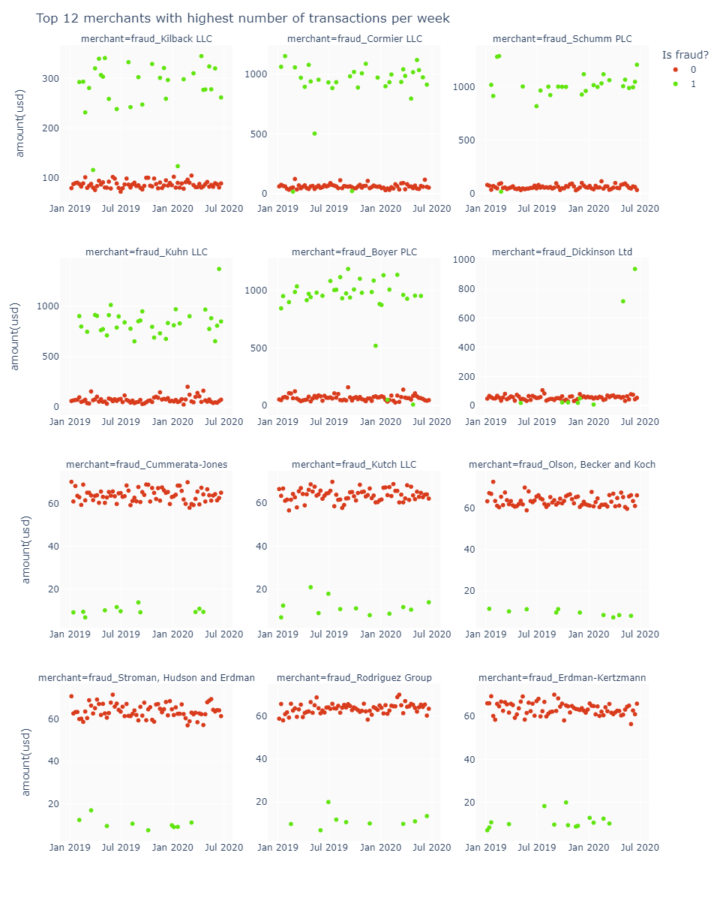

Slide 16
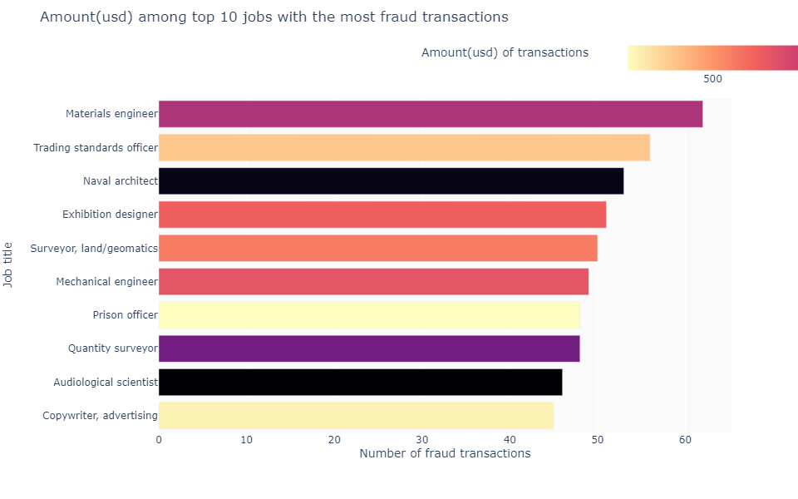

Slide 17
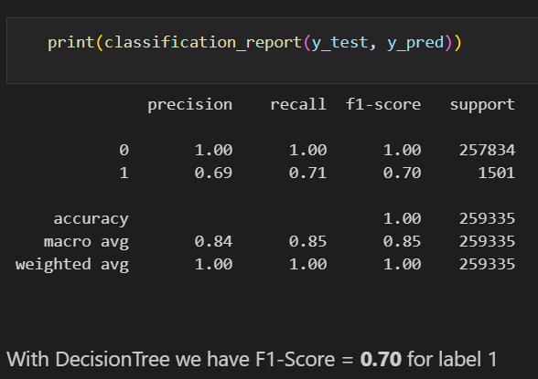
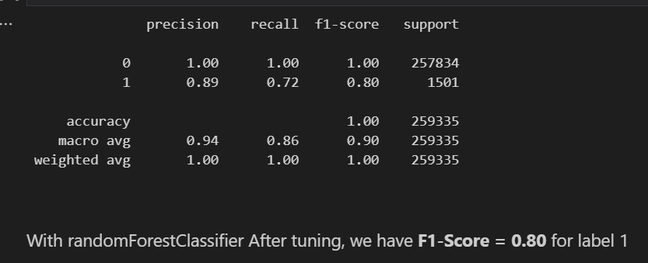

Slide 18
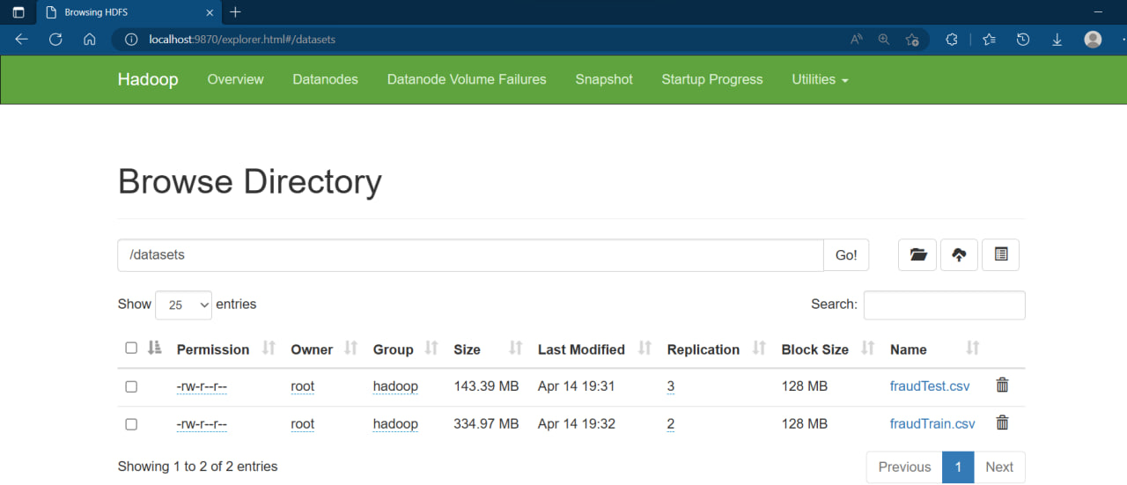
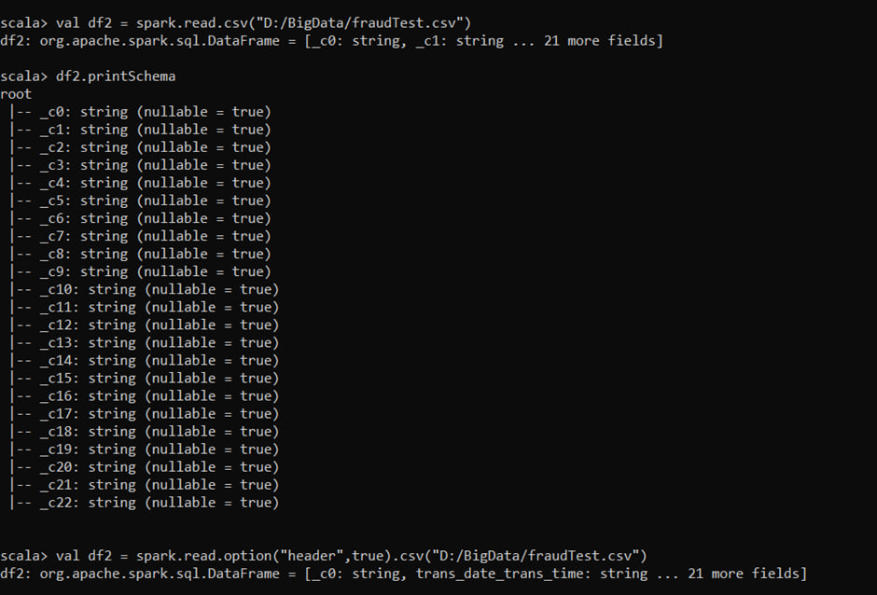
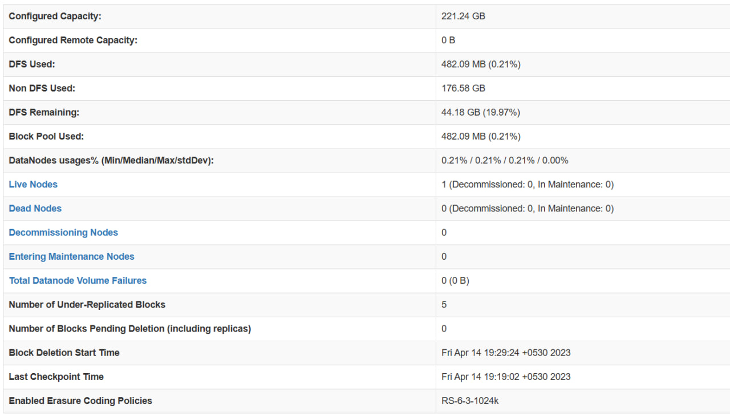

Slide 19
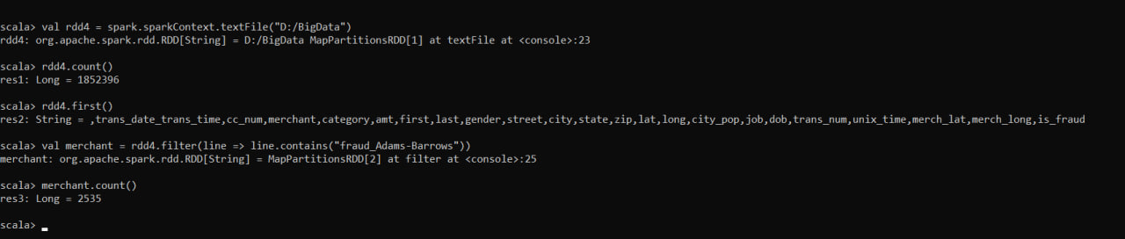
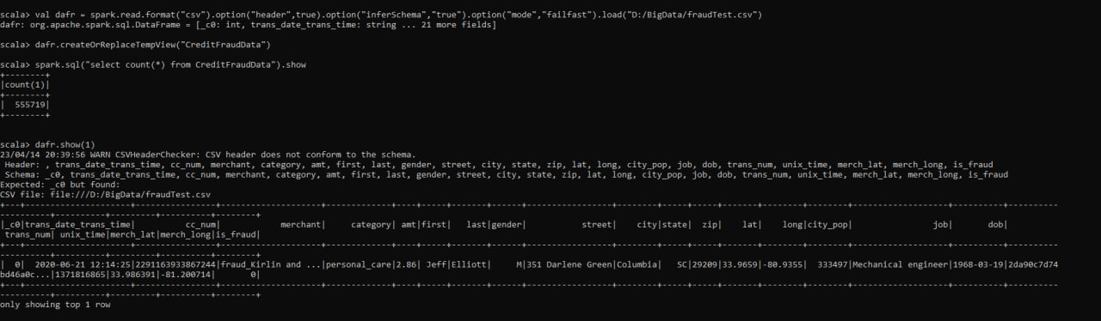
Creating an RDD, checking count of Tot.Lines, Different Merchants count

Slide 20
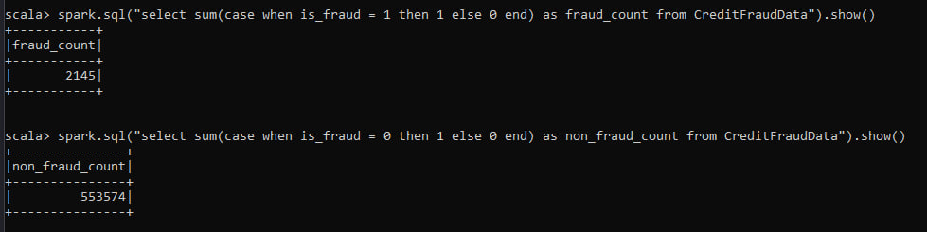
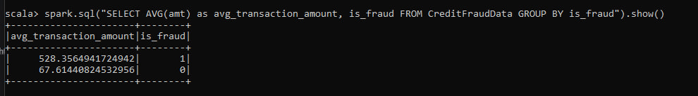
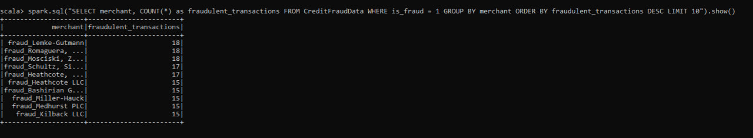
Count of both fraud and non-fraud transactions
Average transaction amount for both fraudulent and non-fraudulent transactions
Top 10 merchants with most Fraudulent Transactions

Slide 21
CONCLUSION
Credit card fraud is the biggest frauds that are being happened right now around the whole ground. In our project we are going to implement a model for these frauds using transactions made in the real world to detect the frauds happening.

Slide 22
References/Bibilography
https://ieeexplore.ieee.org/abstract/document/5762457/
https://www.academia.edu/download/74530838/pxc3878991.pdf
https://ieeexplore.ieee.org/abstract/document/4358713/

Slide 23

THANK YOU

