Slide 1





Thynk Unlimited
CYBERSHIELD: FORTIFYING BETTING SECURITY THROUGH INTRUSION DETECTION SYSTEM (IDS) AND ELASTICSEARCH, LOGSTASH AND KIBANA (ELK)
Charan Kumar Naidu Mallarapu
Under Supervision of
Dr. Soonleh Ling
Student ID: 220166249

Slide 2



Thynk Unlimited
ABSTRACT
"Fortifying Betting Security Through IDS & ELK Integration" focuses on enhancing the cybersecurity measures in the iGaming and online sports betting industry. This is achieved by integrating two key technologies: Intrusion Detection System (IDS) and Elasticsearch, Logstash, Kibana (ELK). (Dotan n.d.)
The online gambling industry is increasingly vulnerable to a wide range of cybersecurity threats, including DDoS and ransomware attacks, account takeovers, and data breaches. These threats can result in significant financial losses, reputational damage, and a loss of customer trust.
. Recent cyber incidents at leading casino and hotel chains have underscored the importance of robust cybersecurity measures
The core focus of the project lies in real-time unauthorized access detection, continuous monitoring, automated responses, and robust logging. Utilizing Snort, the system actively identifies and responds to potential security threats, ensuring rapid mitigation and minimizing the impact of security incidents. The integration with ELK brings an additional layer of sophistication by providing a centralized platform for data analysis and visualization.
02
www.reallygreatsite.com

Slide 3

An Intrusion Detection System (IDS) is a vital network security technology designed to detect vulnerability exploits against a target application. The IDS is used to monitor network traffic for patterns indicative of cyberattacks, such as unusual login attempts, outbound connections to known malicious domains, or sudden spikes in traffic. It operates as a defence for systems security when other technologies fail, providing an additional layer of protection against cyber threats. The IDS monitors network traffic and reports results to an administrator, but it cannot automatically take action to prevent a detected exploit from taking over the system. (Bace and Mell, n.d.)
INTRODUCTION
03

Slide 4
RESEARCH OBJECTIVES
·Can integration of Intrusion Detection System (IDS) and Elasticsearch, Logstash, Kibana (ELK) enhance the cybersecurity measures in the online sports betting industry?
·How can we implement an effective real-time unauthorized access detection technique, to promptly identify and respond to potential security threats in a computer system or network?
·What are the potential benefits of IDS and ELK integration for online sportsbooks beyond cybersecurity enhancement?
04

Slide 5

With the increasing prevalence of cyber threats, it is crucial for industries like online betting, which handle sensitive data, to implement robust security measures. This literature review examines the integration of Intrusion Detection Systems (IDS) with the Elasticsearch, Logstash, and Kibana (ELK) stack to enhance security in betting environments. It focuses on the principles and methods discussed in "Generating Artificial Snort Alerts and Implementing SELK: The Snort-Elasticsearch-Logstash-Kibana Stack" by Daniel E. Krych, Joshua Edwards, and Tracy Braun.
The document by Krych et al. details the integration of Snort with the ELK stack, known as the Snort-Elasticsearch-Logstash-Kibana (SELK) stack. This integration is key to fully leveraging the capabilities of IDS and ELK, providing a unified platform for intrusion detection, data aggregation, and visualization.
Integrating IDS with the ELK stack offers significant benefits for the security of online betting platforms. Leveraging the methodologies presented in Krych et al.'s work, betting operators can achieve:
-Real-Time Threat Detection: Continuous monitoring and alerting capabilities of Snort, combined with real-time indexing and search functionalities of Elasticsearch, enable swift detection of potential threats.
-Comprehensive Data Analysis: Logstash's ability to parse and enrich data ensures that all relevant information is captured and structured, enhancing the quality of analysis.
-Intuitive Visualizations: Kibana's dashboards provide security teams with clear and actionable insights into the network's security status, facilitating prompt response to incidents.
LITERATURE REVIEW
05

Slide 6

CONTINUE
· Key Features and Implementation:
-Use of Snort as an IDS: The study capitalizes on Snort, an open-source network intrusion detection system, known for its effectiveness in monitoring network traffic in real-time and identifying potential threats based on a database of known attack signatures.
-Cloud Environment Adaptation: Snort is adapted to operate within cloud computing environments, which often host a variety of services such as data storage, servers, and databases. This adaptation allows Snort to inspect traffic moving to and from cloud services, offering a layer of security that is often lacking in traditional cloud setups.
· Challenges in Cloud Security Addressed:
-High Volume of Network Traffic: Cloud environments experience massive amounts of data transfer, which can obscure signs of intrusion. Snort’s capability to process and analyse large volumes of network traffic in real time helps to mitigate this issue.
-Dynamic Nature of Cloud Services: The ephemeral and scalable nature of cloud services can complicate consistent monitoring. Implementing Snort within the cloud helps maintain continuous surveillance regardless of the dynamic scaling of cloud resources.
The paper by Fahmida Rafa and colleagues focuses on enhancing cyber-security in cloud environments using Snort, a well-known intrusion detection system (IDS). The study underscores the vulnerabilities inherent in cloud computing platforms and proposes a robust IDS solution to monitor and prevent potential cyber threats effectively.
06

Slide 7
RESEARCH METHODOLOGY
The "CyberShield" project architecture for a gambling website involves several key components designed to secure the platform against cyber threats. The gambling website, which handles user interactions, transactions, and data management, is exposed to various risks through the internet. This open network not only connects the website to its users but also serves as a potential conduit for malicious activities like hacking attempts and data breaches.
To protect the gambling platform, Snort, an Intrusion Detection System (IDS), is deployed. Snort monitors all traffic between the internet and the website, analysing it for signs of suspicious activity. This includes identifying known attack patterns, detecting unusual behaviours, and flagging potential threats. When Snort detects something suspicious, it generates alerts that detail the nature of the threat, which are crucial for initiating timely responses.
The ELK stack—comprising Elasticsearch, Logstash, and Kibana—forms the core of the data processing and analysis framework. Logstash collects and processes logs from Snort, transforming the raw data into a structured format. This processed data is then stored in Elasticsearch, which allows for efficient querying and real-time analytics. Kibana provides a visual interface for this data, enabling security teams to create dashboards, monitor trends, and perform detailed analyses to understand and respond to threats.
Finally, an alerting mechanism is integrated into this system to ensure that critical security events are communicated promptly. Alerts, triggered by specific conditions detected in the data, are sent to security personnel via various channels, such as email or SMS. This system ensures that the security team can quickly respond to potential incidents, thereby enhancing the overall security posture of the gambling website.
07

Slide 8
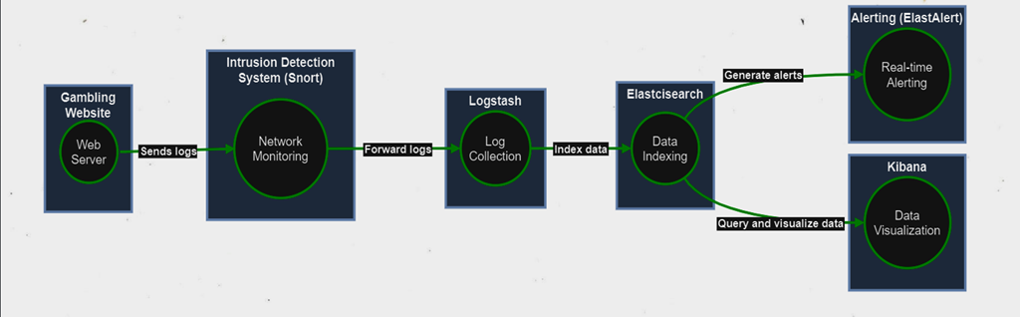
ARCHITECTURE OF CYBERSHIELD
08

Slide 9
ALGORITHM PROPOSED
Snort
ELK
ElastAlert
Snort is an open-source network intrusion detection and prevention system (IDS/IPS) software for Linux and Windows which is used to detect emerging threats and can be deployed as a packet sniffer, packet logger, or a full-blown network intrusion prevention system.
ELK, which stands for Elasticsearch, Logstash, and Kibana, is a consolidated data analysis system that provides a range of capabilities for log analytics, document search, security information and event management (SIEM), and observability
ElastAlert is a tool used to generate alerts for anomalies, spikes, or other significant patterns in data indexed by Elasticsearch. It operates by querying Elasticsearch, analyzing the results, and issuing alerts according to predefined rules
09

Slide 10
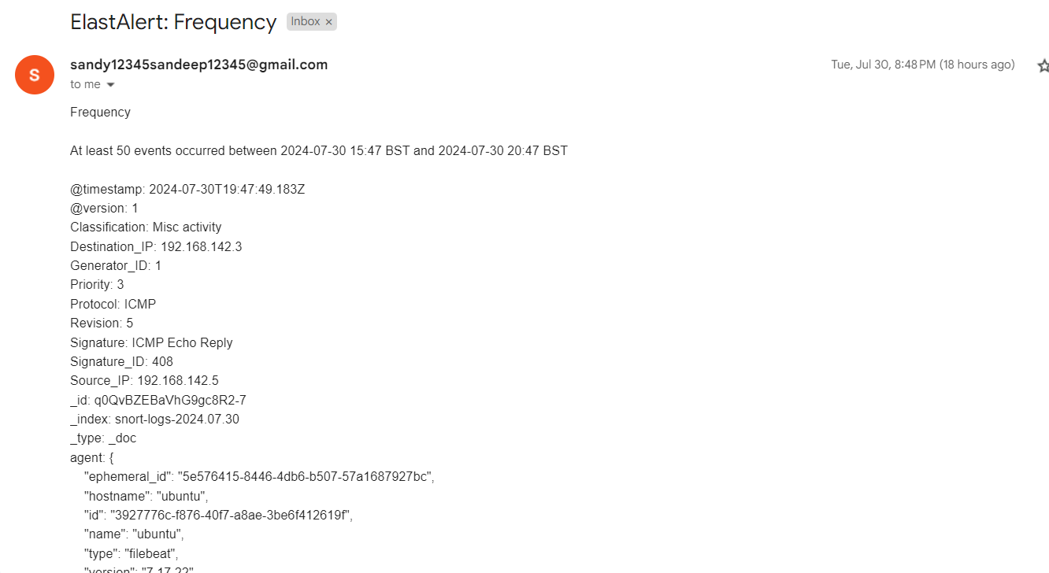
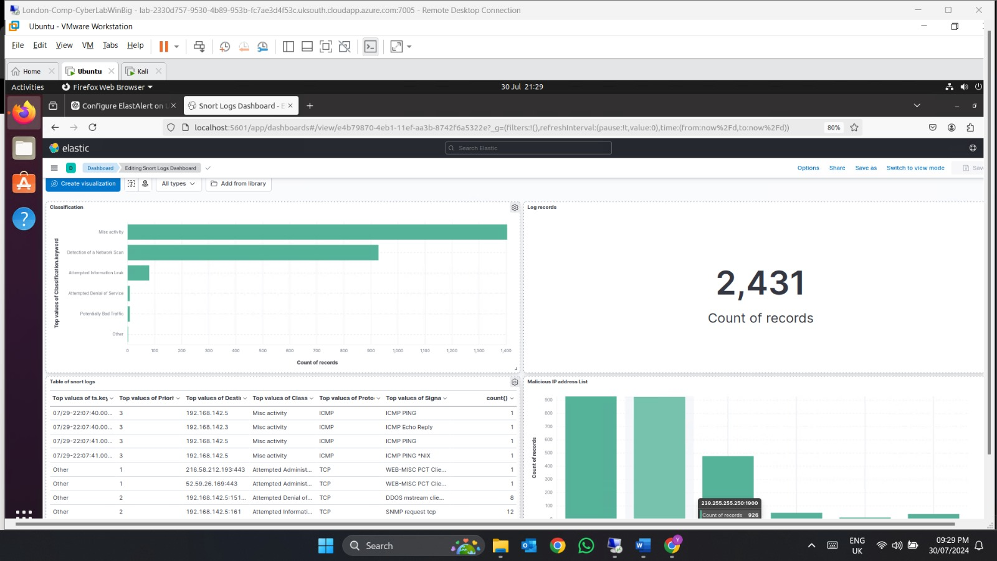
RESULT
The integration of Snort as an Intrusion Detection System (IDS) with the Elastic Stack (ELK) and Elastalert, referred to as "CyberShield," has demonstrated significant enhancements in securing online betting platforms. This combined system leverages Snort's robust detection capabilities with ELK's powerful data aggregation, indexing, and visualization tools, alongside Elastalert for alerting. Key results from the implementation of CyberShield include:
Enhanced Threat Detection:
Real-time Monitoring and Alerting
Comprehensive Log Analysis
Improved Security Posture
Scalability and Flexibility
The results underscore the effectiveness of integrating Snort IDS with ELK and Elastalert, showcasing a robust solution for protecting critical online infrastructures in high-risk sectors like online betting.
10

Slide 11
CONCLUSION
In conclusion, the "CyberShield" project represents a pivotal advancement in fortifying cybersecurity within the betting industry through the innovative integration of IDS and ELK stack technologies. By addressing critical security challenges and leveraging advanced analytics, this dissertation contributes to enhancing the resilience and integrity of online betting platforms.
The integration of Intrusion Detection Systems (IDS) like Snort with advanced data processing and visualization tools such as the ELK Stack and Elastalert significantly enhances the security posture of networked systems. This combination not only improves real-time threat detection and response but also offers comprehensive data analysis capabilities that are crucial for identifying and mitigating sophisticated cyber threats. The case study of "CyberShield" demonstrates the practical benefits of this integration, particularly in environments where security and data integrity are paramount, such as online betting platforms. The use of SIEM principles within this framework further enhances its effectiveness by enabling centralized log management, correlation of disparate data sources, and timely alerting, thereby supporting both operational security and compliance requirements.
This literature review highlights the critical role of IDS in modern cybersecurity strategies, especially when augmented by powerful analytics and alerting frameworks like ELK and Elastalert. As cyber threats continue to evolve, the integration of these technologies provides a scalable, flexible, and robust solution that can adapt to new challenges and safeguard sensitive information. Future developments in this area may focus on refining detection algorithms, enhancing automated response capabilities, and improving user-friendly interfaces for security analysts, thereby ensuring that organizations can continue to effectively protect against both current and emerging cyber threats.
11

Slide 12
REFERENCES
Anon (2022) Gambling Industry Statistics [Internet]. Available from https://www.gamblingcommission.gov.uk/statistics-and-research/publication/industry-statistics-november-2022. [Accessed 7th May 2024].
Anon (2023) The Importance of Cybersecurity in the Gaming and Casino Industry [Internet]. Available from https://www.rubinbrown.com/insights-events/insight-articles/the-importance-of-cybersecurity-in-the-gaming-and-casino-industry/. [Accessed 22nd June 2024].
Anon (n.d.) Gambling with cyber security [Internet]. Available from https://www.ncsc.gov.uk/section/information-for/gambling-sector. [Accessed 9th May 2024].
Bace, R. and Mell, P. (n.d.) NIST Special Publication on Intrusion Detection Systems Intrusion Detection Systems.
Boniecki, P. (n.d.) Positioning of online betting services: A case study of finding the gap between companies’ view versus customers’ view.
Cinque, M., Cotroneo, D. and Pecchia, A. (2018) Challenges and Directions in Security Information and Event Management (SIEM). In: Proceedings - 29th IEEE International Symposium on Software Reliability Engineering Workshops, ISSREW 2018. Institute of Electrical and Electronics Engineers Inc., pp. 95–99.
CyberQ Group (2023) Cyber Security- in the Gaming Industry [Internet]. Available from https://www.linkedin.com/pulse/cyber-security-gaming-industry-cyberqgroup. [Accessed 22nd June 2024].
digiALERT (2023) Unmasking Cyber Threats in Online Gambling: A Comprehensive Cybersecurity Guide.
ElastAlert2 (n.d.) ElastAlert 2 - Automated rule-based alerting for Elasticsearch [Internet]. Available from https://elastalert2.readthedocs.io/en/latest/running_elastalert.html#as-a-docker-container. [Accessed 30th July 2024].
Kumar, H.S. (2019) Intrusion Detection System using ELK Stack. International Journal for Research in Applied Science and Engineering Technology, 7 (6), pp. 667–670.
Zenarmor (2023) Snort IDS/IPS Explained: What - Why you need - How it works.
11

