Slide 1

VARDHAMAN COLLEGE OF ENGINEERING, HYDERABAD Autonomous institute affiliated to JNTUH DEPARTMENT OF CSE(AI&ML) Mini Project (A8041)
Title: Real-Time Intrusion Detection Using Bi-Directional LSTM and GRU Networks
BATCH ID :22CSMPW-57
S. No | Roll. No | Student Name
1 | 22881A66E3 | D. Sai Charan
2 | 22881A66E6 | G. Praneeth
3 | 22881A66H0 | P. ArshadKhan
-
Supervisor
Dr. M.A. Jabbar
Head of the Department
Department of CSM

Slide 2
Outlines
Abstract
Introduction
Existing System
Existing System Pros and Cons
Proposed Model
Specifications of dataset
Proposed Model Results
Comparision between existing model and proposed model
Sustainability development goals
Conclusion
Future Directions

Slide 3
Abstract
In recent years, the surge in Distributed Denial of Service (DDoS) attacks has posed significant challenges to network security and reliability. Traditional machine learning models often fall short in detecting evolving and complex attack patterns due to their static nature and limited contextual learning. To address these limitations, this project proposes a hybrid deep learning model that combines Bidirectional Long Short-Term Memory (Bi-LSTM) and Gated Recurrent Unit (GRU) layers for real-time anomaly detection in network traffic. The Bi-LSTM layer captures both forward and backward temporal dependencies, enhancing context awareness, while the GRU layer improves computational efficiency. Preprocessing techniques such as normalization, sequence formatting, and feature selection are applied to prepare the data. This work demonstrates the potential of hybrid recurrent architectures in creating scalable and adaptive cybersecurity solutions.

Slide 4
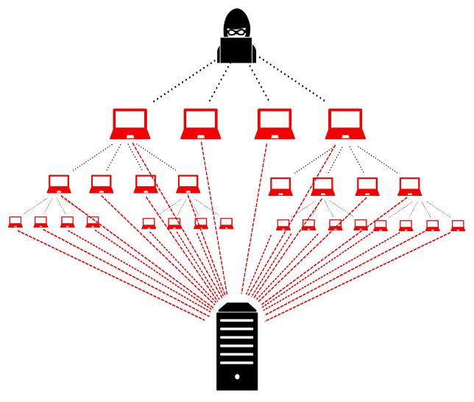
Introduction
Cybersecurity threats, especially Distributed Denial of Service (DDoS) attacks, are increasing in frequency and sophistication.
Traditional machine learning models struggle with real-time detection and often fail against new or evolving attack patterns.
Deep learning models, particularly those capable of handling sequential data, offer better insights into traffic behavior over time.

Slide 5
Existing System
Commonly Used Methods:
Machine Learning: Support Vector Machines (SVM), Random Forest
Deep Learning: Convolutional Neural Networks (CNN), Long Short-Term Memory (LSTM), Gated Recurrent Unit (GRU)
Popular Datasets:
CICIDS2017,CICDDoS2019
Limitations:
Inability to adapt to evolving or unknown attack types
High false positive rates in dynamic environments
Poor scalability for real-time large-scale deployments

Slide 6
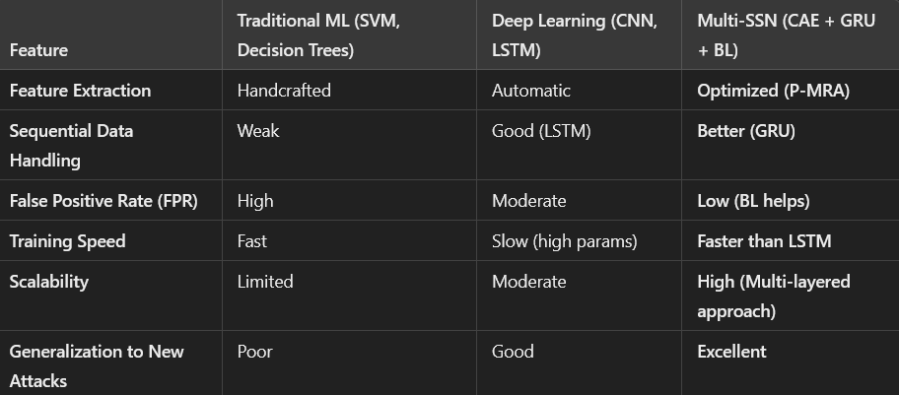
Pros and Cons of Existing Systems

Slide 7
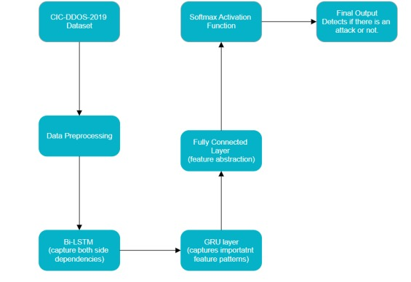
Proposed Model
Architecture:
Input → Bi-LSTM → GRU → Dense → Softmax
Why hybrid?
Bi-LSTM → forward & backward learning
GRU → lighter, faster training

Slide 8
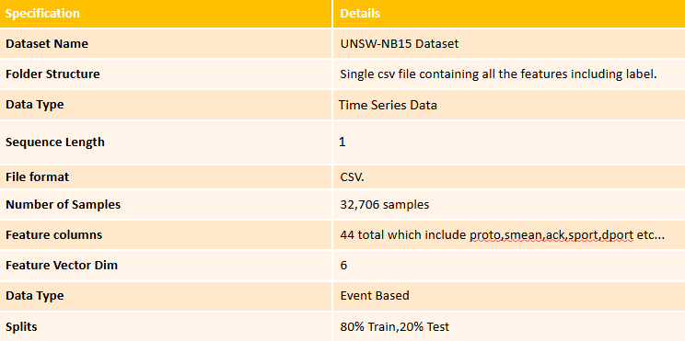
Dataset Specifications

Slide 9
Comparison Table and Graph
Model | Accuracy | F1-Score | FPR
CNN | 85% | 84.2% | 4.5%
LSTM | 88.5% | 87.9% | 2.3%
GRU | 89% | 88.4% | 1.7%
Bi-LSTM+GRU | 91% | 90.6% | 0.01%

Slide 10
Proposed Model Results
Metric | Score
Accuracy | 91%
Precision | 90.5%
Recall | 89.1%
F1-Score | 90.6%
FPR | 0.01%

Slide 11
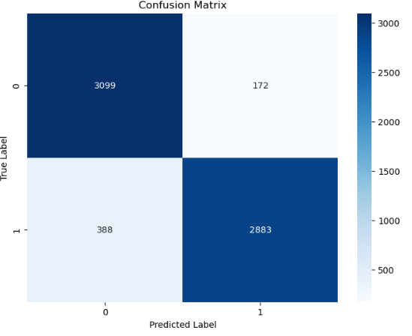
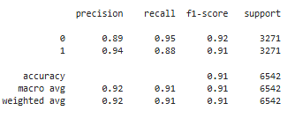

Slide 12
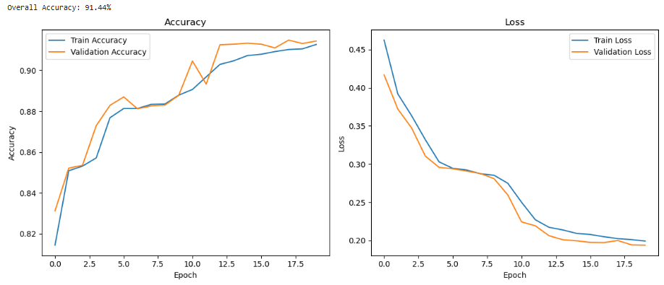

Slide 13
Sustainability Development Goals (SDGs)
SDG 9 – Industry, Innovation and Infrastructure Promotes resilient infrastructure and fosters innovation in secure technologies like cybersecurity.
SDG 16 – Peace, Justice and Strong Institutions Supports development of robust security systems to ensure digital safety and institutional integrity.
SDG 12 – Responsible Consumption and Production (additional relevant goal) Encourages efficient use of computing resources and reduction of environmental impact in AI applications
Sustainability Aspects:
Lightweight GRU → low energy use
Uses open-source & efficient preprocessing
Cloud/edge deployable

Slide 14
Conclusion
The Bi-LSTM + GRU model:
Outperforms standalone LSTM, CNN
Achieves strong real-time detection
Maintains low false positives
Ready for integration in real-world systems
The proposed Bi-LSTM + GRU hybrid model effectively detects DDoS attacks with high accuracy and low false positives.
It outperforms traditional and standalone deep learning models in both performance and efficiency.
The model is scalable, adaptable, and suitable for real-time deployment in modern network environments.

Slide 15
Future Directions
Adaptive / Online Learning to handle evolving and dynamic cyber-attacks in real time
Multi-Class Classification to detect various attack types (e.g., SQL injection, MITM, Botnet)
Integration with SDN, IoT, and Edge Networks for scalable and distributed deployment
Explainable AI (XAI) to increase transparency, trust, and regulatory compliance in model decisions

