Slide 1
Team Members: Saikiran-17N31A12F0 Vani-17n31a12e8 Karthik-17n31a12f5 Guide: V. Narsing Rao associate professor
Density Based Smart traffic Control System Using Canny Edge Detection Algorithm

Slide 2
INTRODUCTION
As the world is growing older, life is also getting tougher. People are increasing with huge number despite the fact that lands are not increasing and so traffic jam to.
This problem can be sorted out by making good decision on infrastructure, limiting numbers of signal and introducing some new technique on traffic control system.

Slide 3
OBJECTIVE OF THIS WORK
The project proposed a system for controlling the traffic light by image processing.
In this system the vehicles are not being detected by sensors rather it is detected by images.
In this process initially the system will have a picture of the empty road.
By detecting the density of the vehicles , light will glow, controlling the traffic.

Slide 4
IMAGE PROCESSING
Image processing is a method to convert an image into digital form and perform some operation on it.
It is type of signal dispensation in which input image, like video frame photograp.

Slide 5
IMPLEMENTATION
It can be implemented by 4 steps
Image acquisition
RGB to Grayscale Conversion
Image enhancement
Image matching using edge detection

Slide 6
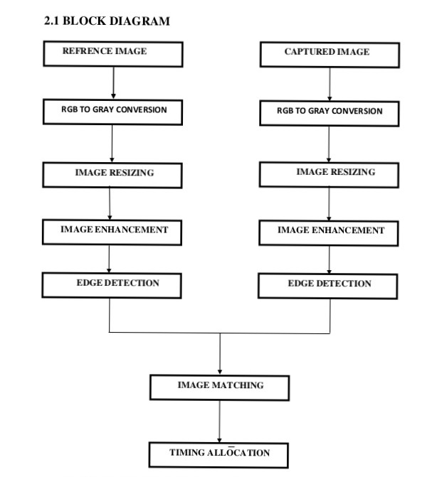

Slide 7
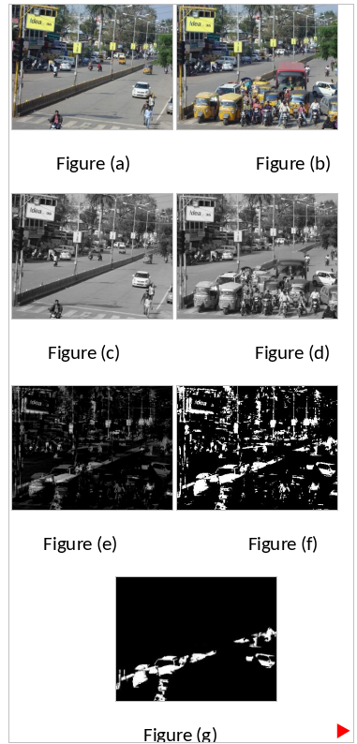

Slide 8
LITERATURE REVIEW-1
Miss.Gauritha, R.Choukekar, Mr.Ashay, student from electronic department of Ghadawat university, kolhapur and Asst,Prof,Electronic department.
There are two standard traffic control system such as
Manual control
Automatic controlling
They proposed a new system for controlling, density based smart traffic control system.
The tool they used, Webcam, MATLAB, USART module, low power CMOS 8-bit microcontroller

Slide 9
LITERATURE REVIEW-2
Uthra E. prakash , athira thankappan , VishnuPriya from Department of Electronics, Cochin University Science and Technology, India.
The vehicles will be detected using image instead of sensors, The camera are installed along with capture image sequence for every 40 seconds.
They added a features , detection of emergency vehicles like ambulance, fire engine, etc.
Tools, ucb web camera , pc , mcu , arduino board

Slide 10
LITERATURE REVIEW-3
Adwait Sharma, Aayush Soni, Rahul Rajurohit,Angelin Florence ,from Computer Department of st.John college of Engineering Mumbai, India.
This paper focus on problems generated due to increase in traffic volume in urban areas.
The author offer a solution to this problem by use binary image captured at real time and reference image will be stored in the system.

Slide 11
REFERENCES
Pallavi Choudekar, satya janti, M.K.Muju, “Implementation Of Image Processing In Real Time Traffic Light Control”, 978- 1- 4244- 8679- 3/11/ 2011, IEEE.
2. Uma Nagaraj , Jinendra Rathod , Prachi Patil, Sayali Thakur, Utsav Sharma, “Traffic Jam Detection Based On Image Processing”, International Journal Of Engineering Research And Applications (IJERA), Vol.

