Slide 1
RESTAPI

Slide 2
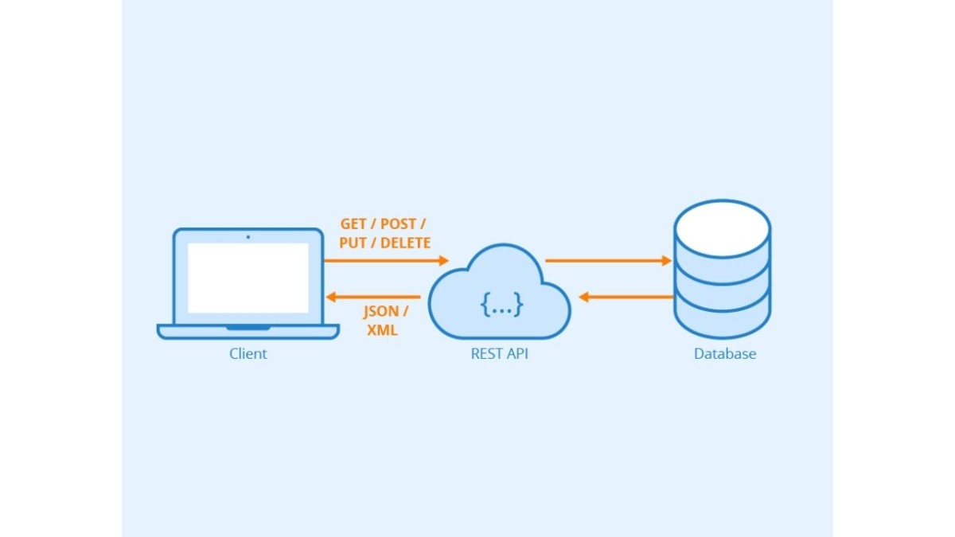
Stands for Application Program Interface.
A way for applications to communicate with the backend.
The connection between the back and front end.

Slide 3
A way to communicate with API :
Contains :
Destination
Method (GET, POST, PUT, DELETE)
Address (EXTRA INFORMATION)
Returns a status code that indicates the success:
Grouped by hundreds (ex- 100-199, 200-299,...) to classify group of status codes.

Slide 4
Rest stands for Representational State Transfer
It is the way of organizing the API (rest architecture).
Primarily used(get, post, put, delete).
Gets and returns data in some standard format, usually JSON.
C R U D
CRUD stands for Create, Read, Update, Delete.
Operations used to interact with data in database.
Primary Operations of restapi :-
Create : Post
Read : Get
Update : Put
Delete : Delete

