Slide 1


Department of Information Technology
V R Siddhartha Engineering College
A Hybrid YOLO-EfficientNet Framework with RAG-Based Intelligence for Personalized Dental Diagnosis and Care Recommendations
Application Field : Healthcare Diagnostics
B.Tech in Information Technology
MINI-1 Project Review Presentation
PRESENTED BY
CHARAN SAI CHINTA(238W5A1203)
TEJOSH TELLA(228W1A1260)
Under the guidance of
Dr.S.Suhasini
Associate Professor

Slide 2
Agenda
Introduction and Problem Statement
Objectives and Outcomes of the Project
Literature Review and Summary
Datasets and Requirements
Algorithms used in the Project
Architecture Diagram
Implementation Steps and Execution
Results Obtained
Result Analysis
Conclusion and Future Work
References

Slide 3
Introduction
Oral diseases are among the most prevalent health issues, where early detection is crucial but often missed due to subtle visual variations.
Conventional diagnostic methods are manual, time-intensive, and highly dependent on clinical expertise, leading to inconsistencies.
Advanced deep learning models enable automated detection and classification of diseases from dental images, improving diagnostic reliability and scalability.
This work presents a hybrid deep learning framework integrating YOLO, EfficientNet, and RAG for precise detection, multi-class classification, and personalized recommendations.

Slide 4
Problem Statement
This project develops a hybrid model that detects oral diseases using YOLO and EfficientNet and utilizes their outputs for further analysis.
It evaluates severity and tracks disease progression based on bounding box regions and historical data.
Using these results along with patient lifestyle data, a RAG-based module generates personalized recommendations and daily care routines.

Slide 5
Objectives and Outcomes
Objectives | Outcomes
Develop an accurate dental disease detection system using YOLO and EfficientNet from images. | Accurate detection with severity estimation of dental conditions.
Track disease progression over time using bounding box–based analysis. | Continuous monitoring of disease progression for early intervention.
Generate personalized and context-aware care recommendations using RAG-based intelligence. | Personalized dental care recommendations improving patient outcomes and compliance.

Slide 6
Literature Review and Summary
S.No | Title | Authors | Dataset | Key Results | Limitations
1 | Enhanced Dental Disease Detection with YOLOv8: A Deep Learning Approach, 2025, IEEE Conference | Naveen S M B, R. Krishnaveni, Vidhyaasaravan S, | 5000+ panoramic dental X-ray images | Achieved high precision, recall, and mAP using YOLOv8 for real-time dental disease detection and localization | Performance depends on annotation quality and struggles with multi-class complexity in diverse datasets
2 | Dental Disease Detection using EfficientNet, 2025, IEEE Conference | Radha Wasudeo Wande, Utkarsha Pacharaney, Roshni Rathour | Panoramic dental X-ray dataset | Achieved ~95% accuracy using EfficientNet (B0–B3), with EfficientNet-B2 giving best performance for classification | Limited interpretability and requires large datasets; struggles with overlapping disease conditions
3 | Advancing Oral Disease Diagnosis with Deep Learning and DenseNet Architecture, 2024, IEEE Conference | Dr. M. Vijayalakshmi, Sajal Tandon, Sam T. James, Tanay Gupta | Kaggle dataset (5 oral diseases) | DenseNet improves feature reuse and classification accuracy for diseases like caries, gingivitis, ulcers, hypodontia | Affected by class imbalance, dataset inconsistency, and lack of explainability
4 | Hybrid-Based Deep Learning Framework for Pill Detection, Multi-Attribute Classification and Prediction with Metadata Retrieval, 2026, IEEE Acces | A. Sai Sachin, J. Karthikeyan | Custom dataset (20,000 pill images, 200 classes) | Hybrid pipeline (YOLOv12n + ConvNeXt-Tiny + metadata) achieved ~99% accuracy with strong precision and recall | High computational complexity and reliance on controlled conditions limits real-world adaptability
5 | Diagnosis and Treatment of Dermatological Diseases by Integration of Visual Diagnosis and Retrieval-Augmented Generation (RAG) Technologies, 2025, IEEE Access | Emre Atlier Olca | Multi-source medical datasets with RAG-based retrieval | Combines deep learning with RAG to generate personalized recommendations and dynamic medical insights | High system complexity and dependency on continuously updated knowledge base

Slide 7
Existing works show that YOLO-based models are highly effective for real-time detection, but they mainly focus on localization and lack deeper disease analysis and progression tracking.
EfficientNet and DenseNet models improve classification accuracy, yet they struggle with multi-class complexity, overlapping disease features, and real-world generalization.
Recent studies highlight the advantage of hybrid pipelines combining detection and classification, achieving higher accuracy, but they often ignore patient-specific insights and temporal disease progression.
Emerging approaches using RAG enable personalized recommendations, but integration with vision-based dental diagnosis systems is still limited, creating a gap addressed by this work.
To overcome these challenges, this work introduces an integrated hybrid framework combining YOLO, EfficientNet, and RAG for accurate multi-class detection, disease progression tracking, and personalized recommendations.

Slide 8
Datasets and Requirement Specifications
Dataset:
Oral Disease Dataset
Source: Kaggle – Oral Disease Dataset
Dental Knowledge Base
Source: Clinical dental guidelines, research articles, and curated oral healthcare resources for RAG-based recommendations
System Requirements:
Programming: Python
Object Detection: YOLOv8
Image Classification: EfficientNet
Web Interface: Flask
RAG Module: Local LLM, FAISS
Image Processing: OpenCV
Environment: Kaggle Notebook
Database: MongoDB
Hardware: 8GB RAM, Intel i5

Slide 9
Algorithms used in the Project
1. YOLOv8n
Input images are preprocessed to ensure faster and lightweight inference.
YOLOv8n uses a compact architecture for real-time detection with reduced computational cost.
The model provides quick predictions with bounding boxes and class probabilities suitable for deployment on low-resource devices.
2. YOLOv8m
Input images are resized and normalized for efficient object detection.
YOLOv8m performs feature extraction using convolutional layers and detects regions of interest (bounding boxes) in dental images.
The model outputs class labels, bounding box coordinates, and confidence scores for detected oral diseases.
3. YOLO + EfficientNet (Hybrid Model)
YOLO detects affected regions in the input dental images and extracts bounding box areas.
The cropped regions are passed to EfficientNet for deep feature extraction and multi-class classification.
Global pooling, dropout, and Softmax layer generate final predictions, enabling accurate disease detection and analysis.

Slide 10
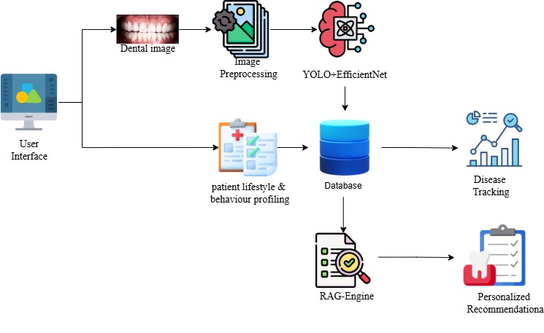
Architecture Diagram

Slide 11
Implementations Steps and Execution
Step1–Input Image Acquisition:
The system accepts a dental image uploaded by the user through the web interface along with lifestyle details such as brushing habits, diet, and medical history.
Step 2 – Image Preprocessing:
The uploaded image is resized to 640 × 640 resolution and normalized according to YOLOv8 preprocessing standards to ensure compatibility with the trained object detection model.
Step 3 – YOLOv8 Object Detection:
A pretrained YOLOv8 model detects and localizes oral diseases from clinical dental images, predicting bounding boxes, class labels, and confidence scores for each condition.
Step 4 – Region of Interest Extraction:
Detected bounding box regions are extracted from the image to focus on affected areas for further analysis.
Step 5 – EfficientNet Classification:
Each extracted region is passed through an EfficientNet model to classify the severity level (mild, moderate, severe) of the detected condition.
Step 6 – Severity Estimation:
Severity is quantified using:
Bounding box area
Classification output
Confidence score

Slide 12
Step 7 – Disease Progress Tracking:
The system compares current detection results with previous records to analyze changes in bounding box size and severity, enabling progression tracking.
Step 8 – Knowledge Retrieval (RAG Module):
Relevant dental knowledge is retrieved from a local knowledge base based on detected conditions and severity.
Step 9 – Rule-Based Recommendation Engine:
A rule-based engine processes:
Detected conditions
Lifestyle data (brushing, sugar intake, tobacco, etc.)
It generates:
Personalized recommendations
Daily routines (morning, afternoon, night)
Treatment suggestions
Risk level (Low/Medium/High)
Step 10 – Context Processing:
Retrieved knowledge and rule-based outputs are combined to generate structured, context-aware recommendations.
Step 11 – Final System Output:
The system displays:
Original dental image with bounding boxes
Detected conditions with severity
Risk level assessment
Personalized recommendations and daily care routine

Slide 13
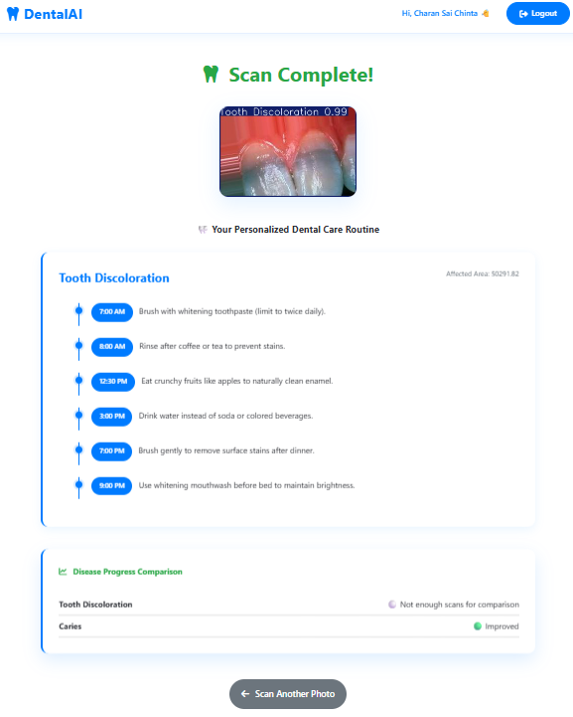
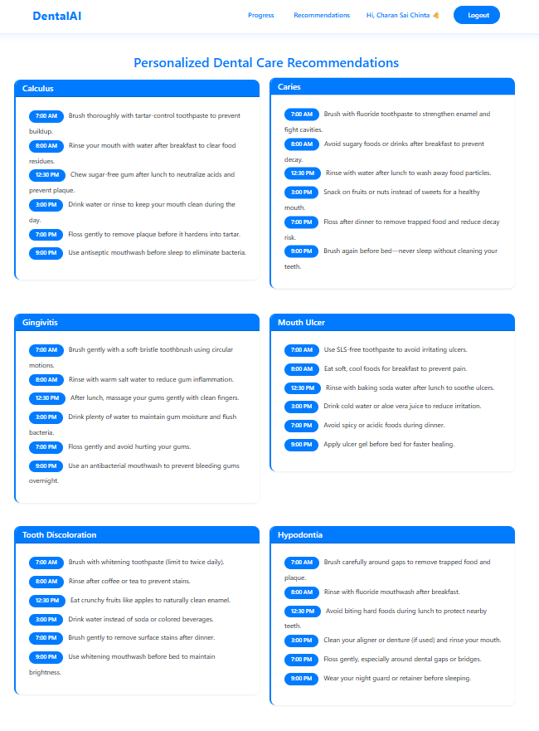
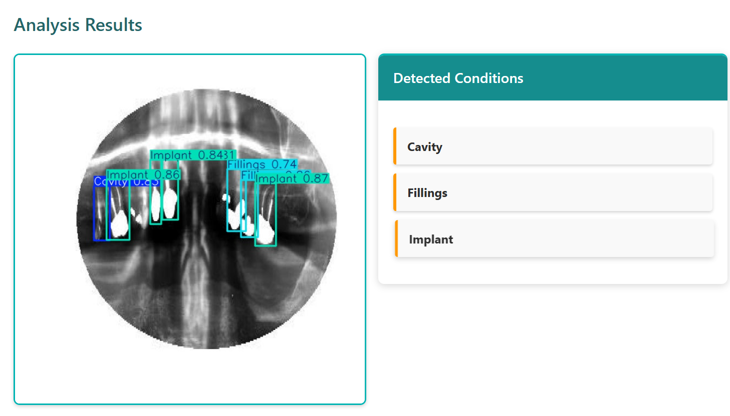
Results Obtained
1.YOLOv8n-Based Dental X-Ray Detection
2. YOLOv8m-Based Intraoral Image Detection and Recommendations

Slide 14
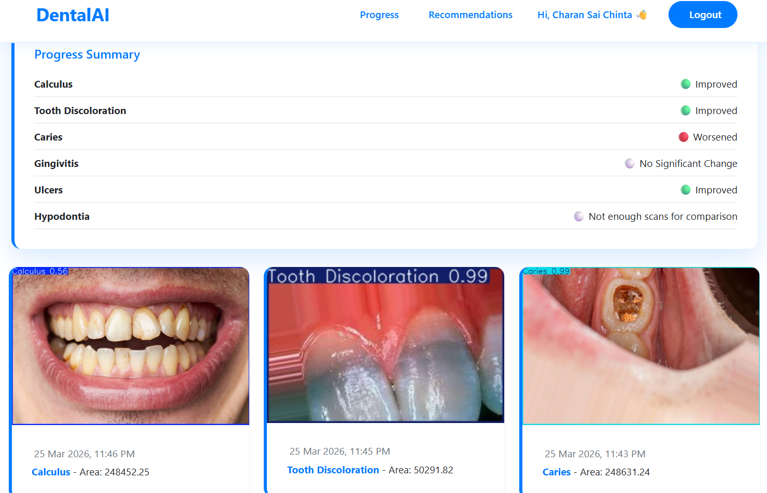
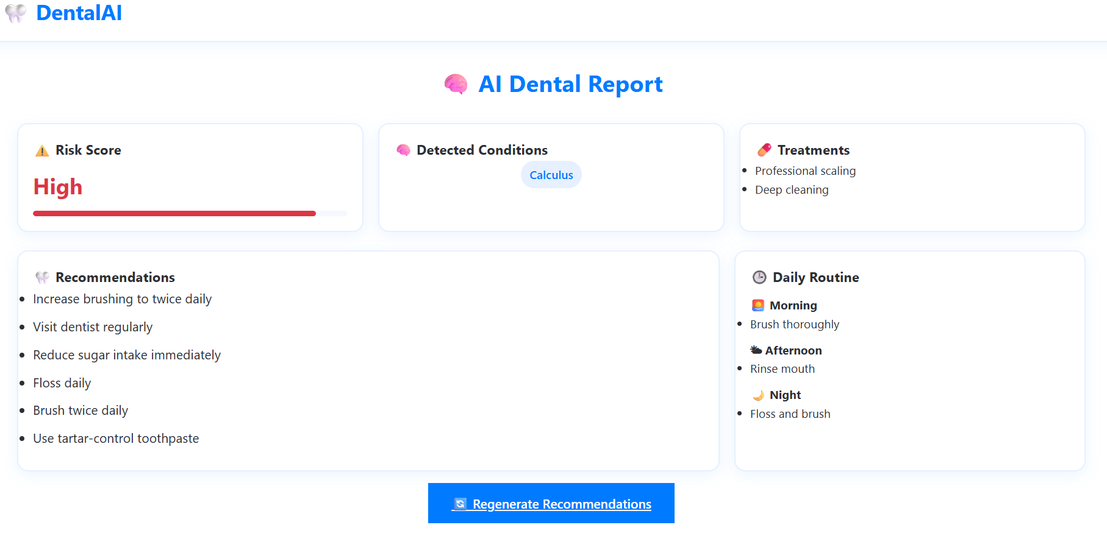
3.Hybrid YOLO + EfficientNet-Based Detection and Disease Progress Tracking
4. RAG-Based Personalized Dental Care Recommendations

Slide 15
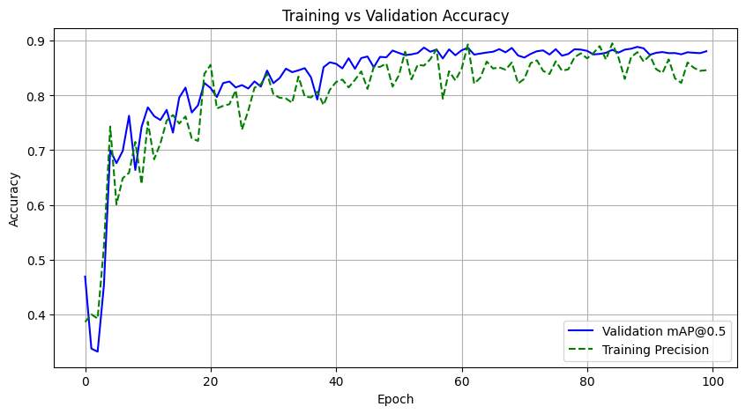
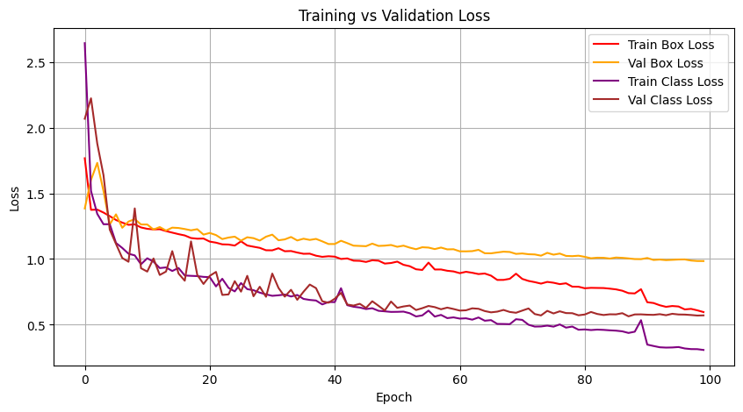
Result Analysis
YoloV8n Training vs Validation Accuracy
YoloV8n Training vs Validation Loss

Slide 16
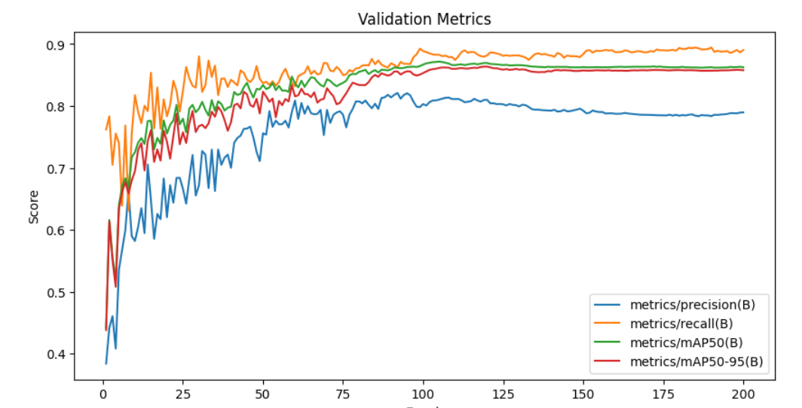
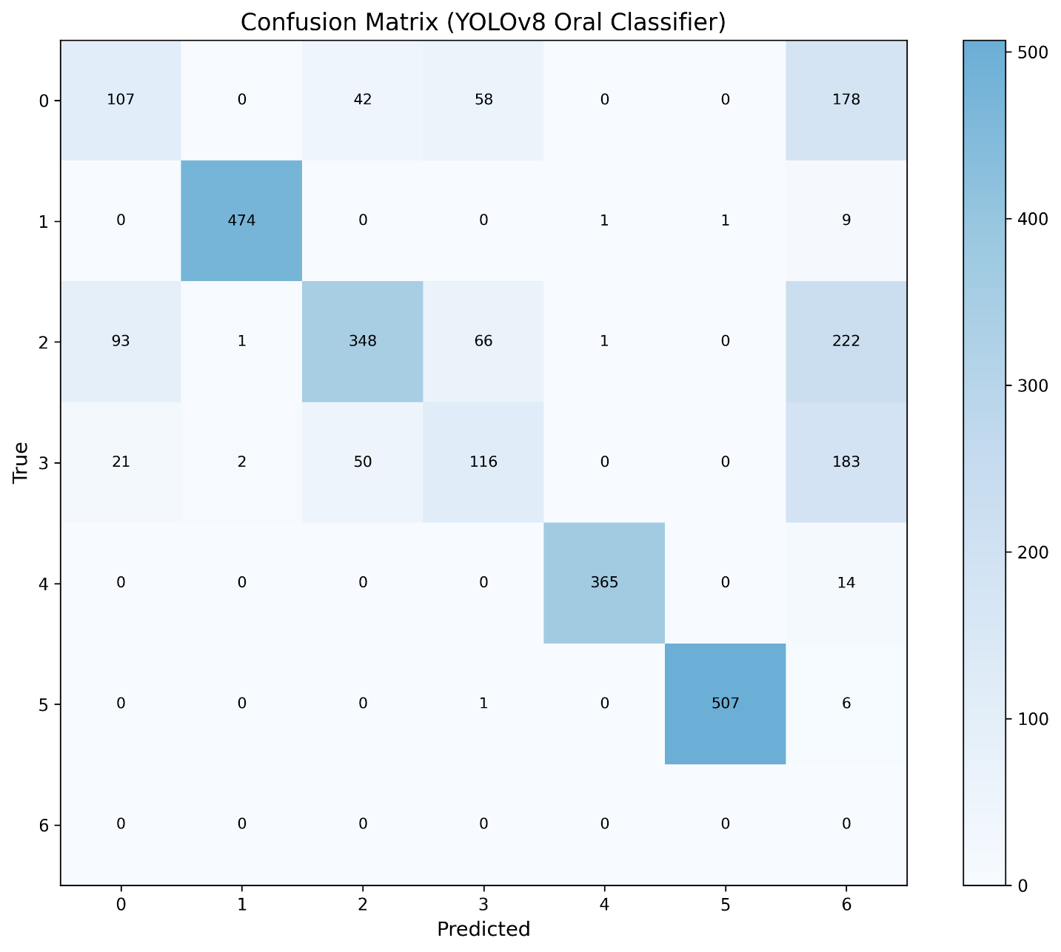
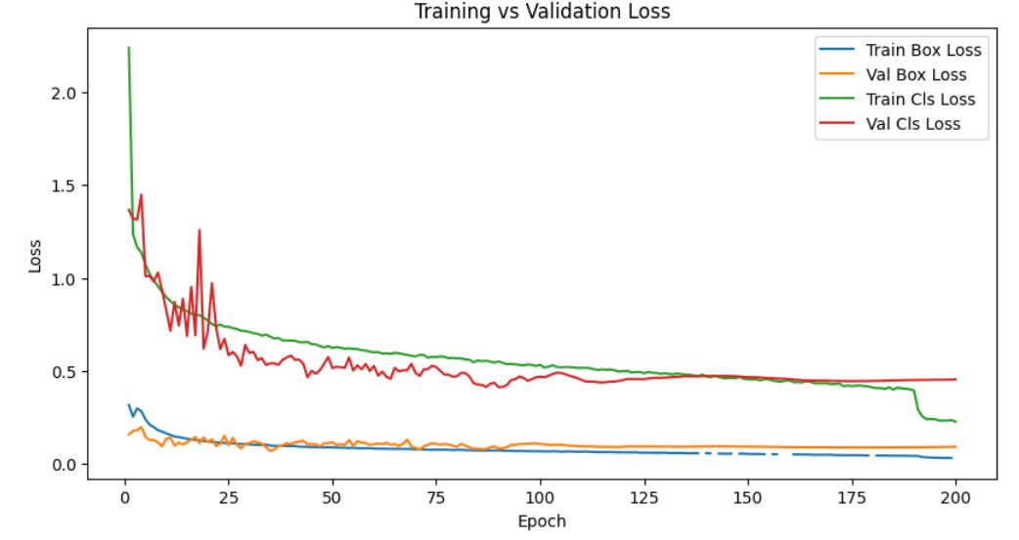
YoloV8m Accuracy & Loss graphs
Confusion Matrix

Slide 17
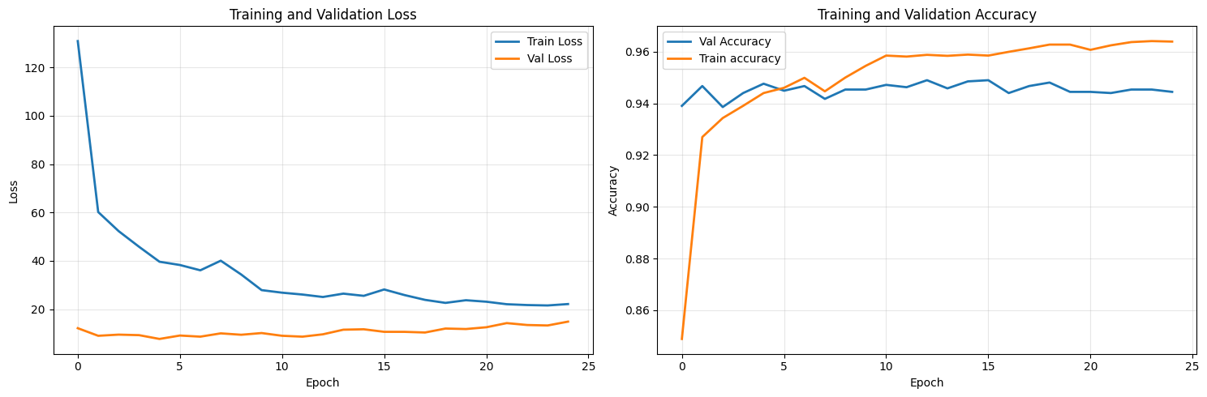
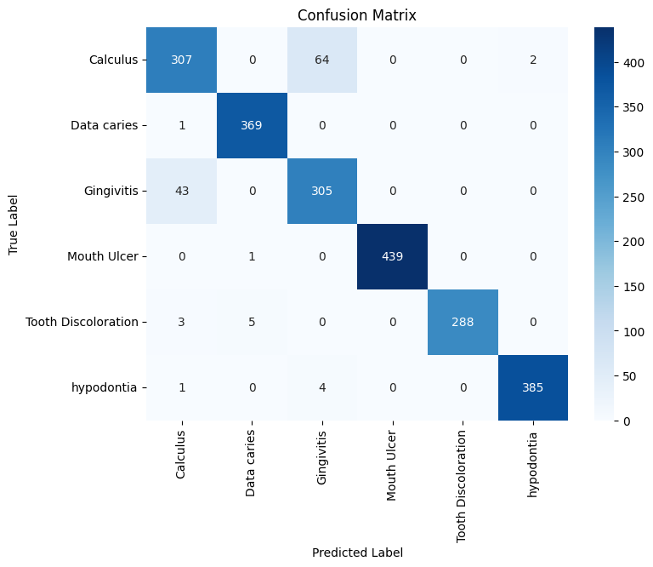
Results and Result Analysis
Yolo+EfficientNet Accuracy & Loss graphs
Confusion Matrix

Slide 18
Model | Accuracy | Precision | Recall | F1-Score | Stability
YOLOv8n | 88.7% | 0.84 | 0.88 | 0.86 | High
YOLOv8m | 90% | 0.85 | 0.90 | 0.87 | High
YOLO + EfficientNet | 94% | 0.95 | 0.94 | 0.94 | Very High
The hybrid YOLO + EfficientNet model outperforms individual YOLO models by providing better feature extraction and classification, resulting in higher accuracy and improved overall performance.

Slide 19
Conclusion and Future Work
Conclusion:
The proposed hybrid model combining YOLO and EfficientNet achieves accurate multi-class detection and classification of dental diseases with improved performance.
Integration of RAG enables personalized recommendations and better analysis, enhancing the overall effectiveness of the diagnostic system.
Future Work:
Integration of temporal dental imaging data and longitudinal datasets can be utilized to improve disease progression analysis, detection accuracy, and overall model robustness in real-world scenarios.
Incorporation of additional disease classes, advanced deep learning architectures, and large language models (LLMs) along with hospital systems can enable automated reporting, intelligent decision support, and practical clinical deployment.

Slide 20
REFERENCES
[1] Naveen S. M. B., R. Krishnaveni, Vidhyaasaravan S., Prakash N., Thamu P., “Enhanced Dental Disease Detection with YOLOv8: A Deep Learning Approach,” Proc. ICAISS 2025, DOI: 10.1109/ICAISS61471.2025.11041768
[2] Radha Wasudeo Wande, Utkarsha Pacharaney, Roshni Rathour, “Dental Disease Detection using EfficientNet,” Proc. IDICAIHEI 2025, DOI: 10.1109/IDICAIHEI65991.2025.11379135
[3] Dr. M. Vijayalakshmi, Sajal Tandon, Sam T. James, Tanay Gupta, “Advancing Oral Disease Diagnosis with Deep Learning and DenseNet Architecture,” Proc. ICECA 2024, DOI: 10.1109/ICECA63461.2024.10801084
[4] A. Sai Sachin, J. Karthikeyan, “A Hybrid-Based Deep Learning Framework for Pill Detection, Multi-Attribute Classification, and Prediction with Metadata Retrieval,” IEEE Access, 2026, DOI: 10.1109/ACCESS.2026.3654582
[5] Emre Atlier Olca, “Professor X: Diagnosis and Treatment of Dermatological Diseases by Integration of Visual Diagnosis and Retrieval-Augmented Generation (RAG) Technologies,” IEEE Access, 2025, DOI: 10.1109/ACCESS.2025.3636437

Slide 21
[6] Agnes Paul Kattukaran, R.Chitra, Ashlin Santhosh et al., “Dental Disease Detection Using Image Classification,” Journal of Medical Imaging and Health Informatics, vol. 13, no. 2, pp. 450–458, 2023, doi: 10.1166/jmihi.2023.
[7] K. Moutselos, E. Berdouses, C. Oulis, “Recognizing Occlusal Caries in Dental Intraoral Images Using Deep Learning,” Computers in Biology and Medicine, vol. 152, pp. 106–115, 2023, doi: 10.1016/j.compbiomed.2023.106115.
[8] Athira Thulaseedharan ,et al.,“Deep Learning-Based Detection of Oral Abnormalities in Clinical Images,” Biomedical Signal Processing and Control, vol. 78, pp. 103–112, 2022, doi: 10.1016/j.bspc.2022.103112.
[9] Dr. M. Vijayalakshmi et al., “CNN-Based Dental Disease Identification for Preventive Healthcare,” Artificial Intelligence in Medicine, vol. 124, pp. 102–110, 2022, doi: 10.1016/j.artmed.2022.102110.
[10] Roshni Rathour et al., “Dental Image Classification Using Deep Convolutional Neural Networks,” IEEE Journal of Biomedical and Health Informatics, vol. 25, no. 6, pp. 2100–2108, 2021, doi: 10.1109/JBHI.2021.3052108.

Slide 22
THANK YOU.

