Slide 1
AI-Based Motor Vibration Fault Detection for Industries
Software prototype · CWRU Bearing Data Center
Detecting bearing fault type and severity from vibration signals using Machine Learning
Real drive-end vibration: inner race fault (0.021")
[Your Name] · [Roll No.] · [Department, College] · [Date]
Notes:
Introduce the project: an AI system that listens to a motor's vibration and identifies bearing faults, both the type of fault and how big it is. The waveform on the right is a real recording from the dataset of a bearing with an inner race crack; the sharp spikes are the impacts every time a ball rolls over the crack. This is a software prototype built on public lab data, not a hardware system.

Slide 2

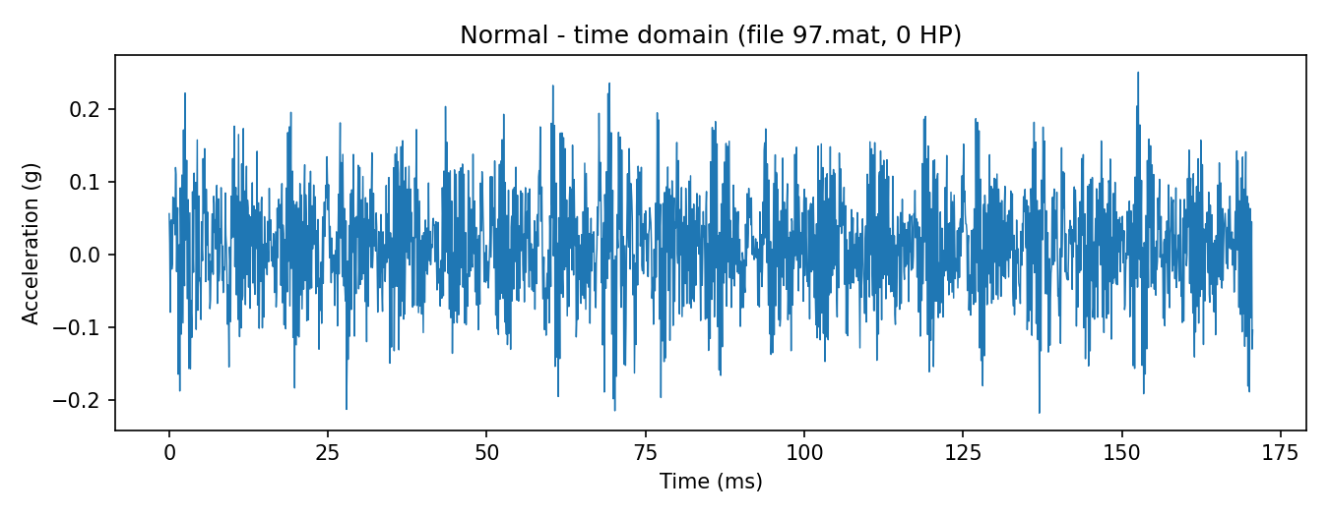

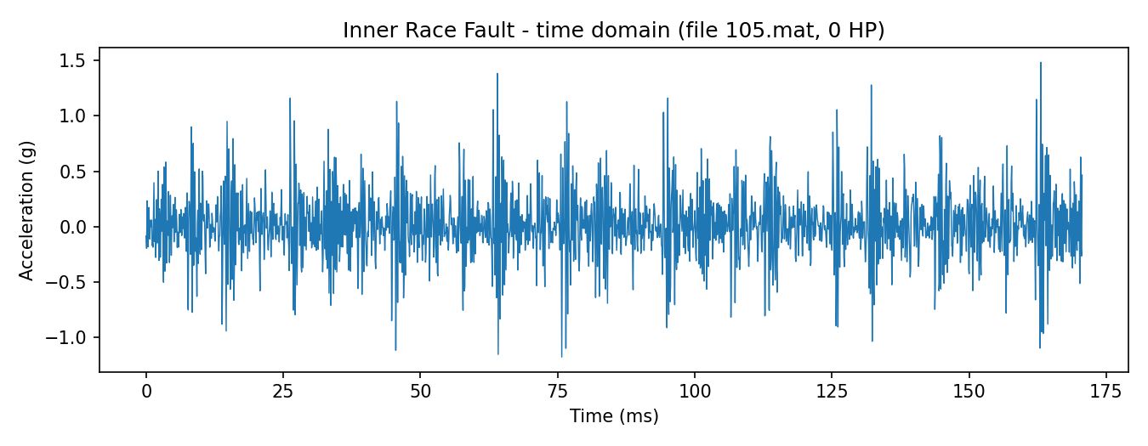

Why bearing health matters
Motors run every industry
Healthy bearing
Pumps, fans, compressors and conveyors all depend on electric motors running without interruption.
Bearings carry the load
Every motor shaft spins on ball bearings. Cracks in the races or balls develop with wear and grow over time.
Inner race fault
Damage changes the vibration
Each time a ball passes a crack it creates an impact. The vibration signal carries a signature of the fault.
Notes:
Motors are everywhere in industry, and bearings are a common point of failure. The key idea of this project: a damaged bearing vibrates differently. On the right, the top plot is a healthy bearing with small, smooth vibration; the bottom plot is a bearing with an inner race crack, showing large repeating spikes. If a human can see the difference, a machine learning model can learn it.

Slide 3



Problem statement
Needs an expert
Faults found too late
"Faulty" isn't enough
Reading vibration spectra by hand requires a trained analyst and takes time for every machine.
Without regular analysis, a small crack can grow until the motor fails unexpectedly.
Maintenance teams need to know which part is damaged and how badly, to plan the repair.
GOAL
Take a vibration signal and automatically report the bearing condition (Normal, Inner Race, Ball or Outer Race fault), the fault size, and a confidence score, with a clear warning when the result is uncertain.
Notes:
Three problems with manual vibration analysis: it needs an expert, faults are often noticed too late, and simply knowing a motor is faulty isn't enough. Our goal is a system that automatically classifies the bearing into one of four conditions, estimates the crack size, gives a confidence score, and warns the user when it isn't sure.

Slide 4

Dataset: CWRU Bearing Data Center
40
2331
12 kHz
0–3 HP
Condition | 0.007" | 0.014" | 0.021" | Windows
Normal | 97–100 |  |  | 206
Inner Race Fault | 105–108 | 169–172 | 209–212 | 709
Ball Fault | 118–121 | 185–188 | 222–225 | 708
Outer Race Fault | 130–133 | 197–200 | 234–237 | 708
recordings
signal windows
sampling rate
motor loads
Case Western Reserve University test rig: a 2 HP motor with an accelerometer on the drive-end bearing. Cracks of three sizes were made in the bearing on purpose and the vibration was recorded at four motor loads.
CWRU file numbers; each group of 4 files = loads 0, 1, 2, 3 HP. Windows = 2048-sample segments (≈0.17 s).
Data check we made
The Normal files were recorded at 48 kHz, not 12 kHz (shaft-speed peaks appeared at ¼ of the true frequency). We downsampled them to 12 kHz so the model learns the bearing condition, not a sampling-rate artefact.
Notes:
We used the public CWRU bearing dataset: 40 recordings covering a healthy bearing and three fault types, each with three crack sizes and four motor loads. Each recording is cut into 2048-sample windows, giving 2331 windows. One important data check: we found the healthy recordings were actually sampled at 48 kHz, not 12 kHz. We confirmed this from the shaft-speed peaks in the spectrum and downsampled them, so the model can't cheat by spotting the sampling-rate difference.

Slide 5




Proposed solution
01
02
03
04
Signal processing
Feature extraction
Two ML models
Web application
Convert to 12 kHz and cut each recording into 2048-sample windows.
14 numbers per window: 9 time-domain and 5 frequency-domain (FFT) features.
Random Forest #1 finds the fault type. Random Forest #2 estimates the crack size.
Upload a CSV and see the waveform, spectrum, prediction, confidence and status.
Built to be robust: trained with extra noisy copies of every signal, accepts any sampling rate, and flags unfamiliar signals as "uncertain" instead of guessing.
Notes:
The solution has four parts: signal processing, feature extraction, two Random Forest models (one for fault type, one for fault size), and a Streamlit web app. We also made it robust: the models are trained on noisy copies of the data, the app converts any sampling rate to 12 kHz, and it warns the user instead of giving a confident wrong answer when a signal looks unfamiliar.

Slide 6







System architecture
Input
Resample
Windowing
Features
Scaling
Vibration CSV
(any sampling rate)
Convert to
12 kHz
2048-sample
windows
14 features
per window
StandardScaler
(mean 0, std 1)
Status
Safety check
Two Random Forests
Motor healthy /
Motor needs inspection
Unfamiliar signal or
confidence < 60% → "uncertain"
#1 Fault type (4 classes)
#2 Fault size (0.007" / 0.014" / 0.021")
The same feature function is used for training and in the app, so the model always sees identical features.
Notes:
This is the full pipeline. A vibration CSV comes in at any sampling rate and is converted to 12 kHz, cut into 2048-sample windows, turned into 14 features, and scaled. Two Random Forest models then predict the fault type and the fault size. A safety check flags unfamiliar or low-confidence results, and the app shows the final status: motor healthy or needs inspection.

Slide 7
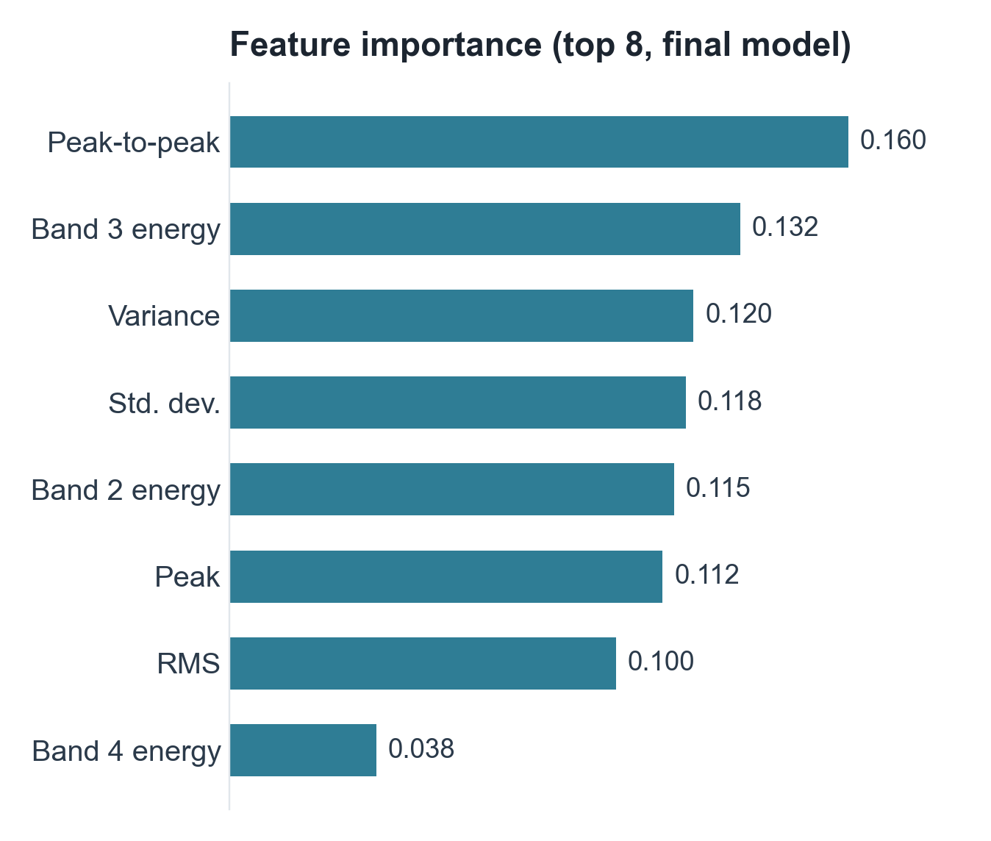
Features and algorithm
Time domain (9)
Mean
RMS
Variance
Std. dev.
Peak
Peak-to-peak
Crest factor
Kurtosis
Skewness
Frequency domain (5)
Dominant freq.
Band 1 energy
Band 2 energy
Band 3 energy
Band 4 energy
Model: Random Forest, 100 trees, balanced class weights, random_state = 42. Trained on clean windows + one noisy copy each (SNR 0–20 dB).
Notes:
Each 2048-sample window becomes 14 numbers. Time-domain features describe the strength and shape of the vibration: RMS is overall energy, kurtosis is high when there are sharp impacts. Frequency-domain features come from the FFT: the dominant frequency and the energy in four frequency bands. The chart shows which features the Random Forest relied on most: peak-to-peak, band 3 energy and variance.

Slide 8
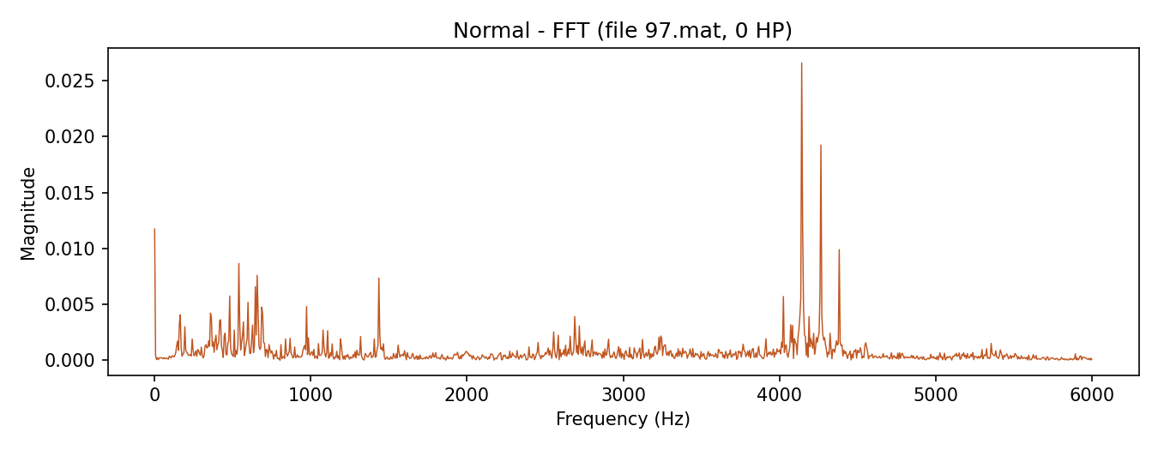
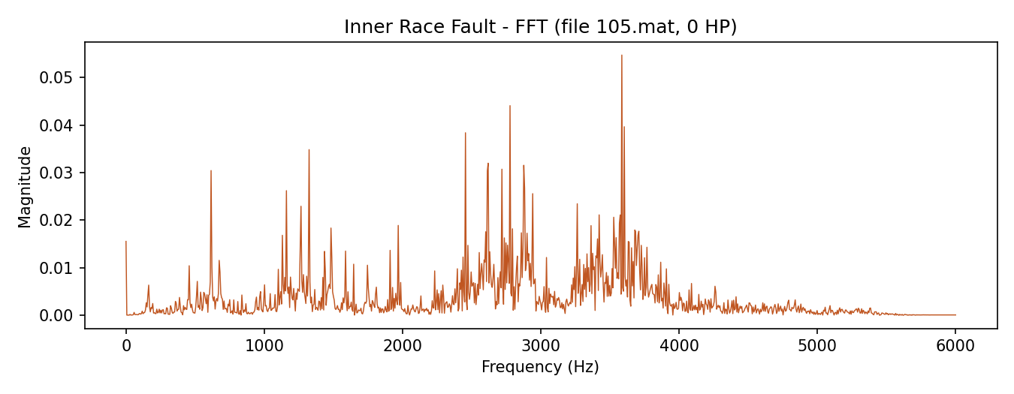
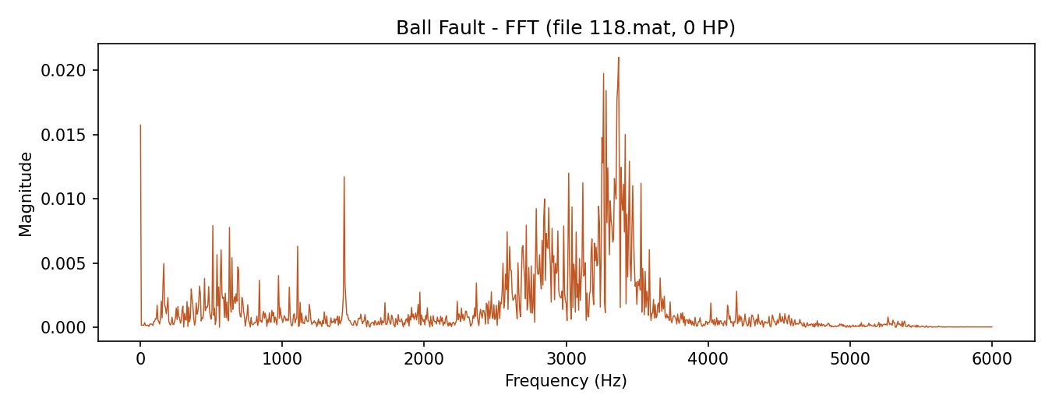
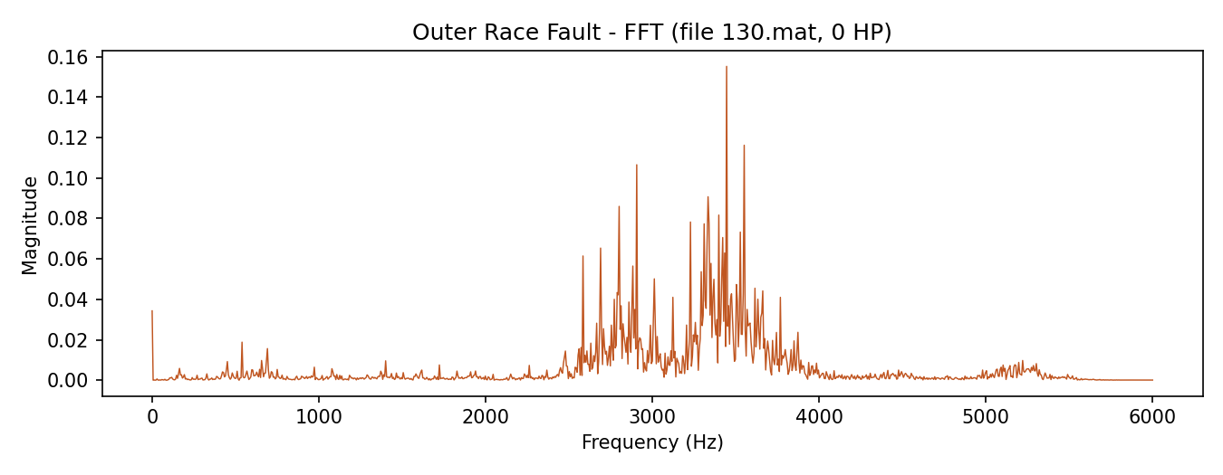
Each fault has its own frequency signature
Normal
Inner race fault
Ball fault
Outer race fault
FFT spectra of the first 2048 samples of each 0 HP recording (0.007" faults). Faults move the vibration energy into different frequency bands.
Notes:
These are the frequency spectra (FFT) for the four conditions. The healthy bearing shows small, scattered peaks. The fault spectra show strong clusters of energy, mostly between about 2.5 and 4 kHz, and each fault has a different shape and strength. That is why the band-energy features are so useful to the model.

Slide 9
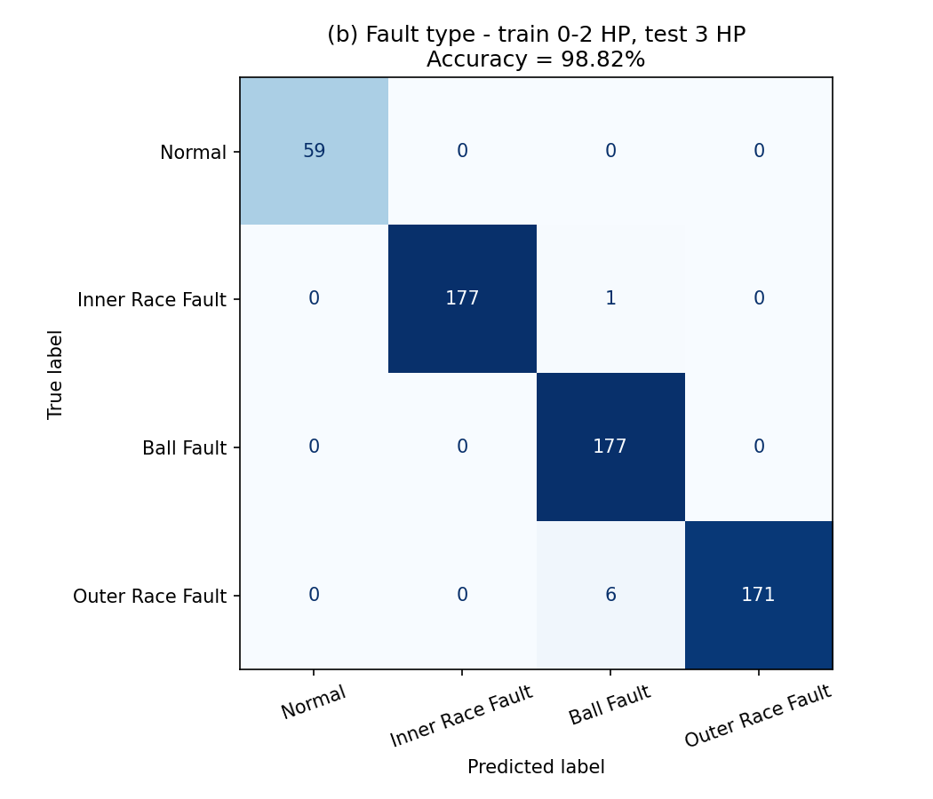
Results: accuracy on unseen data
FAULT TYPE
FAULT TYPE
99.57%
98.82%
Random 80/20 split · 467 test windows
Train 0–2 HP, test unseen 3 HP · 591 windows
FAULT SIZE
FAULT SIZE
99.76%
99.25%
Normal detected perfectly (59/59) at the unseen load.
Random 80/20 split · 425 test windows
Train 0–2 HP, test unseen 3 HP · 532 windows
Notes:
Main results, all on windows the model did not train on. Fault type: 99.57% on a random split, and 98.82% when we train on loads 0 to 2 HP and test on 3 HP, a load the model never saw. Fault size: 99.76% and 99.25%. The confusion matrix shows the unseen-load test: almost everything is on the diagonal, and healthy bearings are never mistaken for faulty ones.

Slide 10
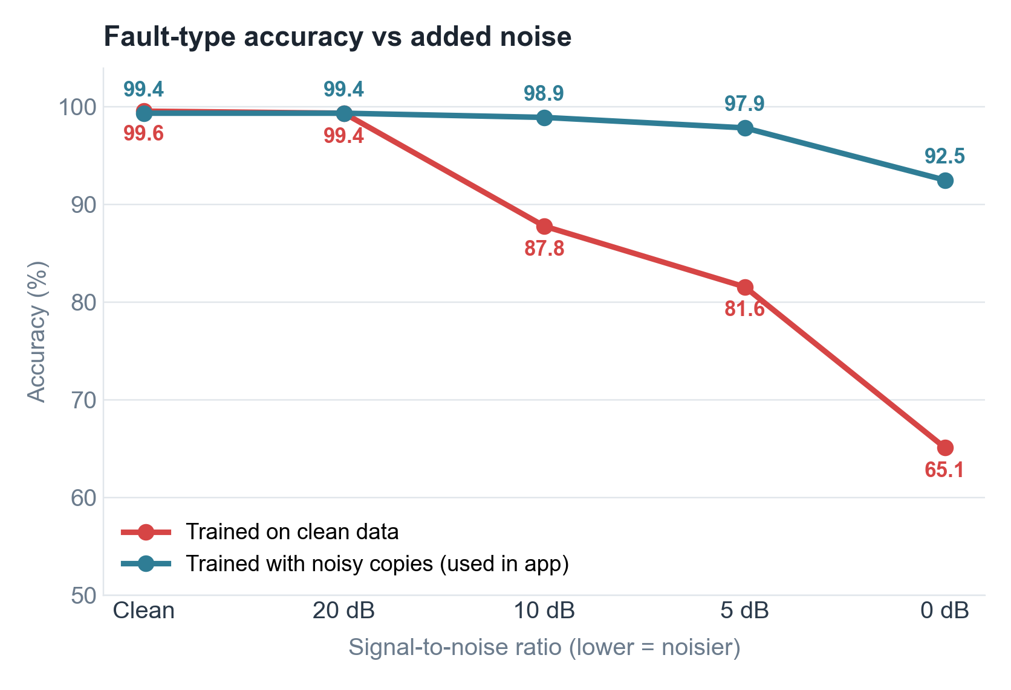
Robust to noisy signals
AT 0 dB (NOISE = SIGNAL)
Before: 65.1%
92.5%
accuracy after training with noisy copies
How we tested: random noise added to the 467 test windows at decreasing signal-to-noise ratios.
Trade-off: only 0.21 points lower on clean data, so the noise-trained model is used in the app.
Notes:
Real factories are noisy, so we tested by adding random noise to the test signals. The model trained only on clean data drops to 65.1% when the noise is as strong as the signal. By training with extra noisy copies of each signal, a technique called data augmentation, accuracy stays at 92.5% at that noise level, and it costs almost nothing on clean data.

Slide 11
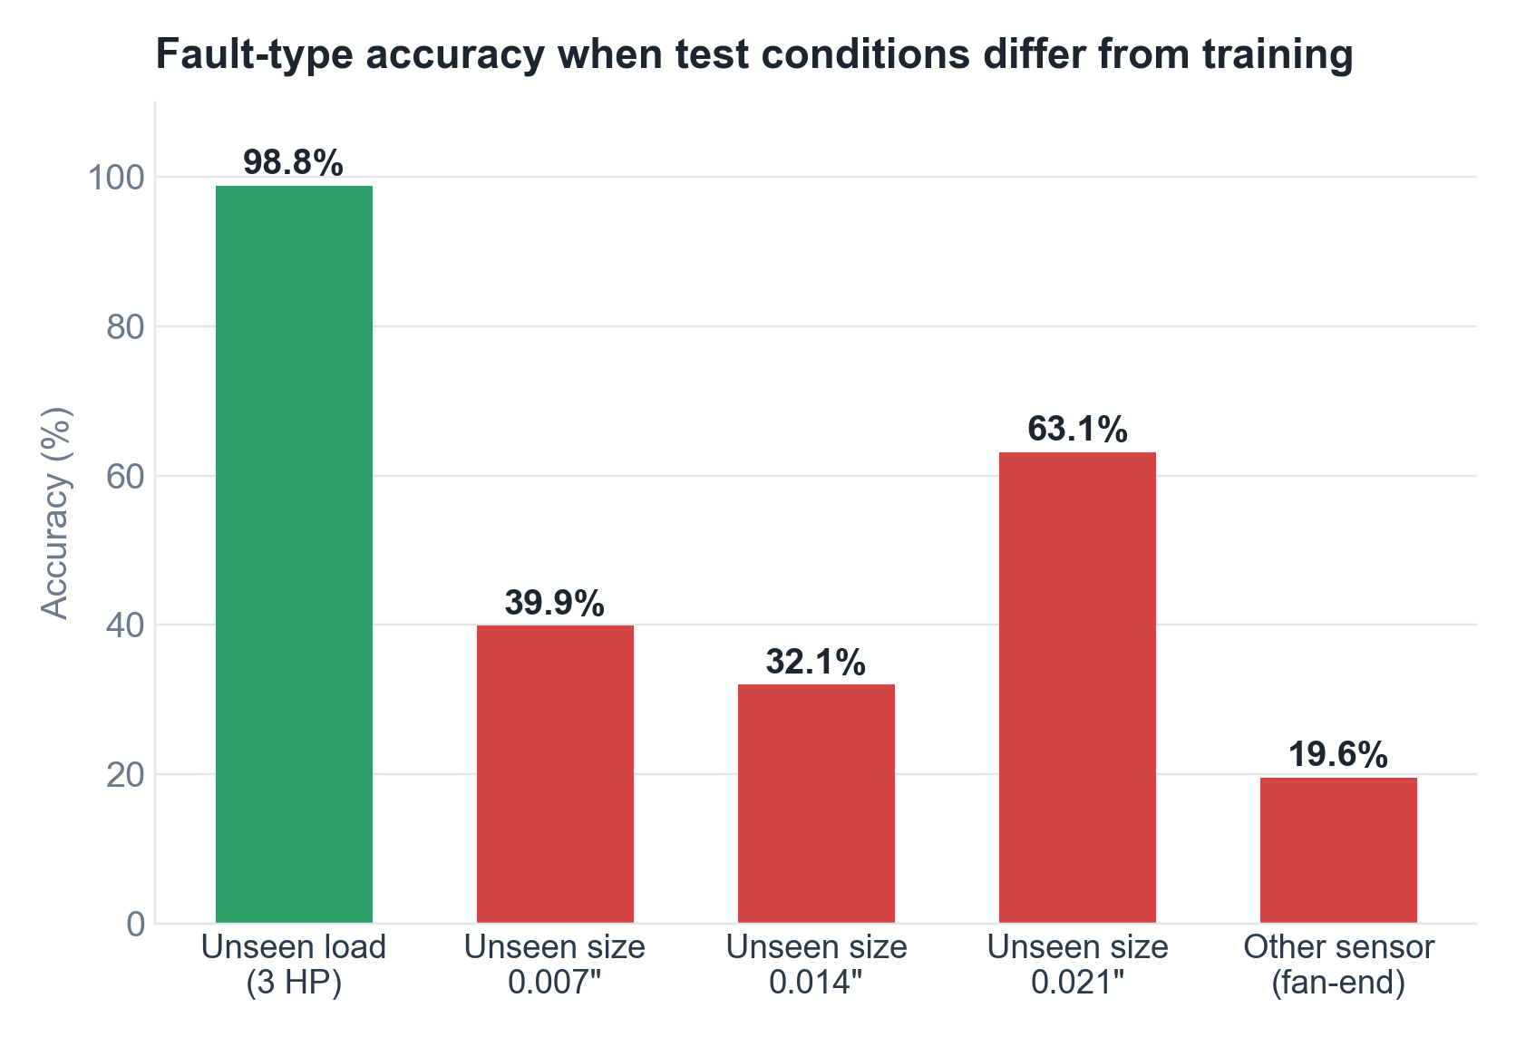


Where the model struggles
Generalises across load
Trained on 0–2 HP, still 98.8% at 3 HP.
Not to new crack sizes
Leaving one size out of training drops accuracy to 32.1–63.1%.
Not to a new sensor position
Drive-end model on fan-end data: 19.6%.
Lesson: train on data from the same fault sizes and sensor position the system will be used on.
Notes:
We also tested the model's limits honestly. It generalises well to an unseen motor load. But if a crack size is completely missing from training, accuracy falls to between 32 and 63 percent, and a model trained on the drive-end sensor doesn't work on the fan-end sensor. The lesson: a real deployment needs training data from the same sensor position and fault range. This is part of our future work.

Slide 12
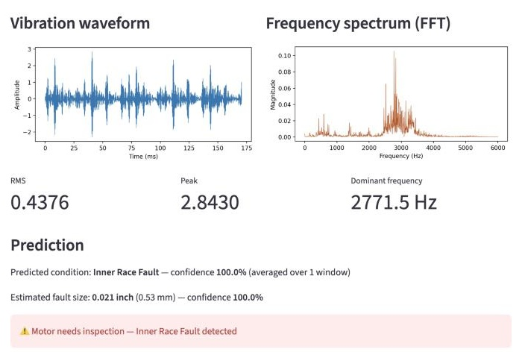
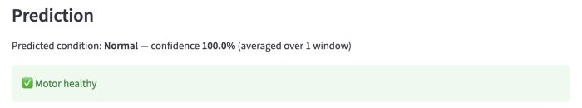
Live demo: Streamlit web app
Upload: sample_normal.csv
Run: python3 -m streamlit run app.py
Demo files in data/samples/ were left out of training (unseen 3 HP data).
All 6 demo samples: correct fault type and fault size.
48 kHz sample: set rate to 48000 → converted, Normal 100%.
Unfamiliar input (e.g. 100× louder signal) → "Result uncertain".
Upload: sample_inner_race_fault_0_021in.csv
Notes:
Live demo. Run python3 -m streamlit run app.py, then upload a sample from data/samples. Show the inner race fault sample first: the app shows the waveform, spectrum, RMS, peak and dominant frequency, then predicts Inner Race Fault with the 0.021 inch size and says the motor needs inspection. Then upload sample_normal.csv to show Motor healthy. If time allows, set the sampling rate to 48000 and upload the 48 kHz sample.

Slide 13




Advantages
Type and severity
Noise robust
Knows when it's unsure
Names the damaged part and estimates the crack size, not just "faulty".
Keeps 92.5% accuracy even when noise is as strong as the signal.
Flags unfamiliar or low-confidence signals instead of guessing.
Any sampling rate
Lightweight
Explainable
Signals recorded at other rates are converted to 12 kHz automatically.
Random Forest on 14 features: trains in about 20 s on a laptop, no GPU.
Each feature (RMS, kurtosis, band energy) has a physical meaning.
Notes:
Six advantages: it identifies both the fault type and size; it stays accurate on noisy signals; it warns when it isn't sure; it accepts any sampling rate; it is lightweight enough to run on a laptop; and it is explainable, because every feature has a physical meaning.

Slide 14




Limitations and future scope
CURRENT LIMITATIONS
FUTURE SCOPE
Software prototype on recorded lab data from one test rig; no hardware or real-time monitoring yet
Does not generalise to unseen crack sizes or a different sensor position
Only bearing faults; misalignment, unbalance and looseness are not classified
User must enter the correct sampling rate
Accelerometer + ESP32
Capture vibration from a real motor for real-time monitoring.
IoT / cloud dashboard
Remote monitoring, alerts and trend history for many motors.
Envelope analysis
Physics-based features at bearing defect frequencies to generalise to new sizes and sensors.
Real industrial data
Train on factory data and more fault types.
Notes:
Limitations: this is a software prototype on lab data; it doesn't yet connect to hardware, it doesn't generalise to unseen crack sizes or sensor positions, and it only covers bearing faults. Future work: add an accelerometer with an ESP32 for real-time monitoring, send data to a cloud dashboard, use physics-based envelope analysis to generalise better, and train on real industrial data.

Slide 15
Thank you
98.82%
fault type at an unseen load
99.25%
fault size at an unseen load
Questions?
92.5%
accuracy with heavy noise
Code, results and demo: motor-fault-detection/ · Data: CWRU Bearing Data Center
Notes:
Summarise: the system detects the bearing fault type with 98.82 percent accuracy at an unseen load, estimates the fault size with 99.25 percent, and stays above 92 percent even with heavy noise. Then invite questions.

