Slide 1
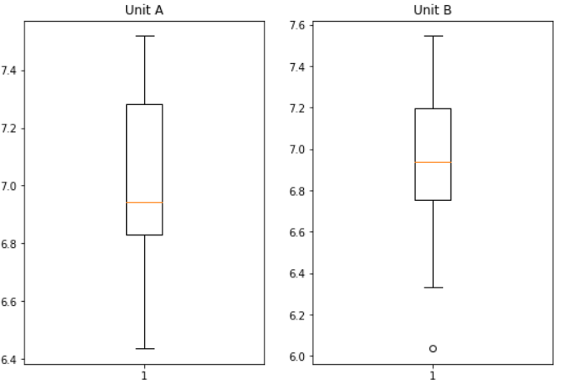
Hypothesis Testing Exercise
A F&B manager wants to determine whether there is any significant difference in the diameter of the cutlet between two units. A randomly selected sample of cutlets was collected from both units and measured? Analyze the data and draw inferences at 5% significance level. Please state the assumptions and tests that you carried out to check validity of the assumptions.
Minitab File : Cutlets.mtw
Ans: H0: unit A = unit B
H1: unit A ≠ unit B
We have to perform two sample 2 tai test,
Significance = 0.025, p value = 0.472
As the p value is greater than 0.05,
H1 is rejected and H0 is accepted,
which is unit A = unit B

Slide 2
Hypothesis Testing Exercise
A hospital wants to determine whether there is any difference in the average Turn Around Time (TAT) of reports of the laboratories on their preferred list. They collected a random sample and recorded TAT for reports of 4 laboratories. TAT is defined as sample collected to report dispatch.
Analyze the data and determine whether there is any difference in average TAT among the different laboratories at 5% significance level.
Minitab File: LabTAT.mtw
Ans: Here, H0: = L1 = L2 = L3 = L4
H1: = Atleast one of them is different
Here are are going to perform an ANOVA Test.
P value = 0.00 , Significance = 0.05
AS we can see that pvalue is less than 0.05,SO we reject Null hypothesis.
So we can say that there is a difference in average TAT among the different laboratories.

Slide 3
Hypothesis Testing Exercise
Sales of products in four different regions is tabulated for males and females. Find if male-female buyer rations are similar across regions.
 | East | West | North | South
Males | 50 | 142 | 131 | 70
Females | 550 | 351 | 480 | 350
Check p-value
If p-Value < alpha, we reject Null Hypothesis
H0
All proportions are equal
Ha
Not all Proportions are equal
Buyer Ratio.mtw

Slide 4
Ans: As the given data is in categorical form and then converted into tabular format, then we willperform the chi-square test.
here, h0: = all proportions are equal
h1: = all proportions are not equal
By applying chi-square contigency table,
p value = 0.809
As we can say that p value is greater than 0.05
we will reject the h1, that means all the proportions are not equal.
Therefore, there is no dependency between male-female buyers rations and are similar across regions.

Slide 5
Hypothesis Testing Exercise
TeleCall uses 4 centers around the globe to process customer order forms. They audit a certain % of the customer order forms. Any error in order form renders it defective and has to be reworked before processing. The manager wants to check whether the defective % varies by centre. Please analyze the data at 5% significance level and help the manager draw appropriate inferences
Minitab File: CustomerOrderForm.mtw
Ans: We are going to conduct a Test of Independence using chi-square test with Contigency table.
Here, H0: = µ1 = µ2 = µ3
H1: = Atleast one of them is different
p value = 0.425 , Significance = 0.05
Hence we reject H1 whereas p value is greater than 0.05.

