Slide 1
KYC Using Hyperledger Fabric Technology
Team :
CV Charan Raj
Honneshkumar
Yeshwanth Rao KN
Bharatkumar
Project Mentor:
Dayal Mukati

Slide 2
Abstract
The know-your-customer (KYC) due diligence process. Our Project is based on distributed ledger technology (Hyperledger fabric), for reducing the costs of the core KYC verification process for financial institutions and for improving the customer experience. In the proposed system, the core KYC verification process is only conducted once for each customer, regardless of the number of financial institutions with which the customer intends to work. The result of the core KYC verification can be securely shared by the customers with all the financial institutions that they intend to work with.

Slide 3
Objective
This system allows for efficiency gains, cost reduction, improved customer experience, customer data ownership, and transparency throughout the process of onboarding a customer.

Slide 4
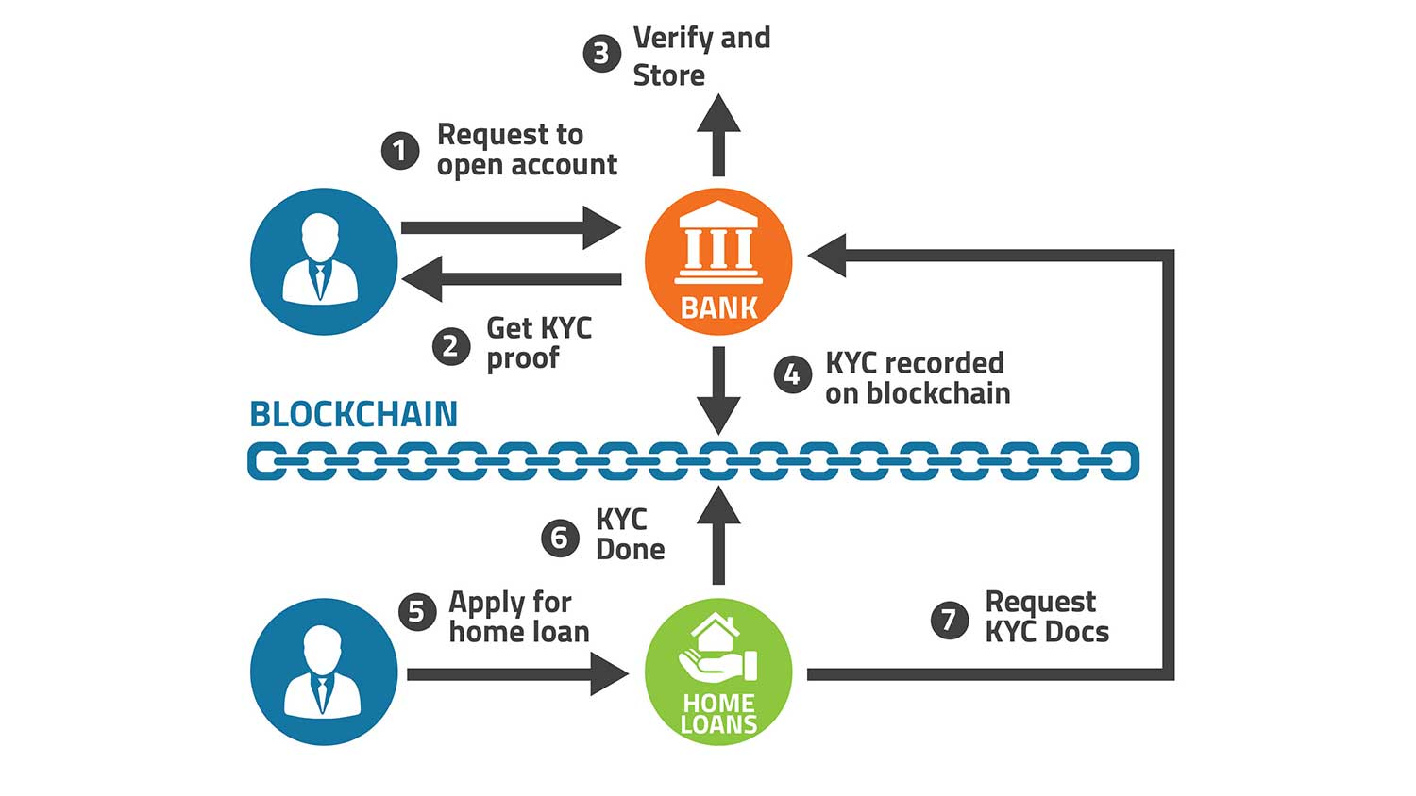
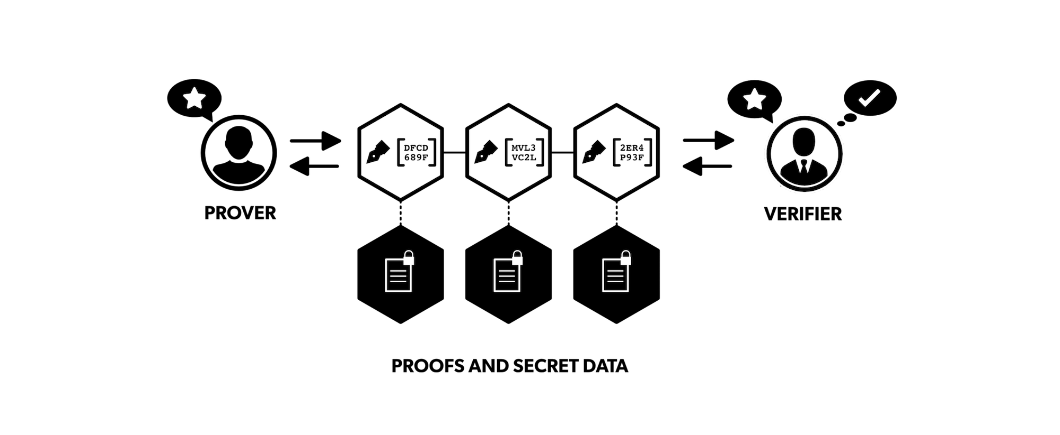
SBI Bank
Citi Bank
Request customer Data
Proves with KYC ID / Aadhar number
Ledger
Raise Permission Or Pay incentive to view Data

Slide 5
Code Demo

Slide 6
Q and A

Slide 7
Thank you

