Slide 1
OPTIMIZING TRAVEL MANAGEMENT
PIP2001 Capstone Project
Review-4
Batch Number: CCS-G18
Under the Supervision of,
Dr. Shanthi S
Associate Professor, School of Computer Science and Engineering
Ms. Sterlin Minish T N
Assistant Professor, Computer Science and Engineering
Presidency University
Roll Number | Student Name
20211CCS0042 | Charan Varma Kalidindi
20211CCS0050 | Mahesh Mallikarjuna
20211CCS0085 | Vishnu Sathvik Reddy
Name of the Program: CCS
Name of the HoD: Dr. Anand Raj Sir
Name of the Program Project Coordinator:
Name of the School Project Coordinators: Dr. Sampath A K / Dr. Abdul Khadar A / Mr. Md Ziaur Rahman

Slide 2
Introduction
Welcome to 2Rism, your one-stop solution for all your travel needs! Whether you're planning a relaxing vacation, a business trip, or a weekend getaway, we make it easy to book everything in one place. From finding the perfect hotel to reserving a cab for your local travel, and even securing tickets for flights, trains, or buses – we've got you covered. Our user-friendly platform provides a seamless experience, offering a wide range of options to suit every budget and preference. With 2Rism, you can travel stress-free knowing that all your bookings are just a click away! Not stopping there, 2Rism makes ticket bookings a breeze. Whether you're looking for flights, trains, or buses, our platform provides a streamlined booking experience, helping you find the best routes and prices in real-time. We understand that travel planning can be overwhelming, which is why we've created an intuitive, user-friendly interface that simplifies the entire process. Our comprehensive travel portal ensures that all your bookings – hotels, cabs, and tickets – are managed in one place, saving you time and effort. So, wherever your next adventure takes you, start your journey with [Travel Site] for a smooth, hassle-free travel experience!

Slide 3
Literature Review
The rise of online travel platforms has revolutionized the way people plan and book their trips. These platforms serve as a digital marketplace where users can access and compare various travel-related services, such as hotels, transportation (including cab services), and ticket bookings for flights, trains, or buses. The literature on travel booking websites is rich and diverse, covering aspects such as usability, customer preferences, the role of technology, and market dynamics.
Online travel booking platforms have transformed how travelers plan and organize their trips by offering integrated services for booking hotels, transportation, and tickets. Research by Law, Leung, and Buhalis (2009) highlights how these platforms, such as Expedia and Booking.com, provide convenience by allowing users to compare prices, check availability, and read reviews, making travel planning more accessible and efficient.
Consumer behavior in using these platforms is influenced by ease of use, price comparison, and the ability to read customer reviews (Tanford, Raab, & Kim, 2012). The integration of artificial intelligence and machine learning has further enhanced the user experience by offering personalized recommendations and automated booking options (Xiang et al., 2015). Multi-service platforms, as noted by Buhalis and Law (2008), allow users to handle multiple travel arrangements in one place, streamlining the process.

Slide 4
Existing method Drawback
Despite the success and widespread use of online travel booking platforms, several drawbacks have been identified in the existing methods:
Information Overload: Users face too many options, leading to decision fatigue and confusion.
Lack of Personalization: Recommendations are often irrelevant or not tailored to individual preferences.
Inconsistent Pricing: Prices fluctuate frequently, with hidden fees and dynamic pricing frustrating users.
Limited Customer Support: Slow or inadequate customer service, especially for cancellations or booking issues.
Data Privacy Concerns: User data is at risk due to security breaches, creating trust issues with platforms.
Dependence on Reviews: Fake or biased reviews can mislead users and affect decision-making.
Accessibility Issues: Non-tech-savvy users struggle with complex interfaces and booking steps.
Fragmented Booking Systems: Users often need to visit multiple platforms to complete their travel plans.

Slide 5
Proposed Method
Simplified User Interface: Design a more intuitive and user-friendly interface with simplified filters and options to reduce decision fatigue and improve ease of use.
Transparent Pricing Models: Adopt clear pricing structures that show all fees upfront, along with price guarantees to reduce inconsistencies and prevent unexpected costs.
Improved Customer Support Systems: Integrate 24/7 live chat support, human agents, and faster response times, ensuring that issues like cancellations or refunds are resolved promptly.
Data Privacy Enhancements: Strengthen encryption, use decentralized blockchain for secure transactions, and be more transparent about data usage to boost user trust and security.
Verified and Authentic Reviews: Introduce AI-powered verification for reviews to filter out fake or biased feedback, ensuring that only authentic user experiences are shared.
Inclusive Accessibility Features: Implement features like voice-activated search, easier navigation for older users, and a simplified booking process for better accessibility.
Unified Booking Systems: Create comprehensive, multi-service platforms that seamlessly integrate hotels, cabs, flights, and other services into one consolidated system for easy management.

Slide 6
Objectives
Simplify Travel Planning: Provide a user-friendly platform that consolidates all aspects of travel—hotels, transportation, and ticket bookings—in one place.
Enhance User Experience: Improve platform usability with intuitive design, personalized recommendations, and streamlined booking processes.
Ensure Price Transparency: Offer clear and consistent pricing with no hidden fees, enabling users to make informed decisions without surprises.
Increase Accessibility: Make travel booking platforms accessible to all users, including those with limited technical skills or disabilities, through simplified interfaces and features.
Improve Personalization: Utilize AI and machine learning to offer tailored travel options based on user preferences, behavior, and real-time data.
Strengthen Customer Trust: Build trust by ensuring secure transactions, safeguarding user data, and being transparent about data usage and privacy policies.
Provide Reliable Customer Support: Ensure timely and effective customer support to handle issues like cancellations, refunds, or booking changes.
Facilitate Seamless Bookings: Offer integrated, multi-service booking options to manage flights, accommodations, and transportation in one place for a hassle-free experience.
Promote Authentic Reviews: Enable users to make informed choices by providing verified, trustworthy reviews and ratings from genuine customers.
Support Sustainable Travel: Incorporate eco-friendly travel options and raise awareness of sustainable practices to cater to environmentally conscious travelers.

Slide 7
Methodology/Modules
User-Centered Design (UCD):Focus on understanding user needs and behaviors through research (e.g., surveys, interviews) to create an intuitive and user-friendly interface. Conduct usability testing and iterative prototyping to refine the platform's design based on real user feedback.
Agile Development: Use agile methodologies to develop the platform in incremental phases (sprints), allowing flexibility, continuous feedback, and iterative improvements. Regularly integrate user input and feedback to adjust features and functionalities dynamically.
Responsive Web and Mobile App Development: Design a responsive website and mobile app that adapt to various devices and screen sizes, ensuring seamless user experience across desktops, tablets, and smartphones. Employ frameworks like React or Flutter for a consistent cross-platform experience.
Secure Payment Gateway Integration: Integrate reliable and secure payment gateways (e.g., Stripe, PayPal) to ensure safe transactions for users booking hotels, cabs, or tickets. Implement encryption and security protocols like SSL and tokenization to protect sensitive data.
API Integration: Use APIs to integrate services such as hotel databases, airline ticketing systems, car rental services, and cab bookings (e.g., Google Maps API for location-based services).Incorporate third-party travel service providers for real-time data on availability, pricing, and bookings.
Cloud Infrastructure and Scalability: Host the platform on cloud services (e.g., AWS, Google Cloud) to ensure scalability, reliability, and performance. Use microservices architecture for modular, scalable services that can be updated independently without affecting the entire system.
Review and Feedback Systems: Develop a reliable, AI-verified review system to ensure authenticity and relevance of customer feedback.
Regularly monitor user reviews to improve platform services and optimize recommendations.

Slide 8
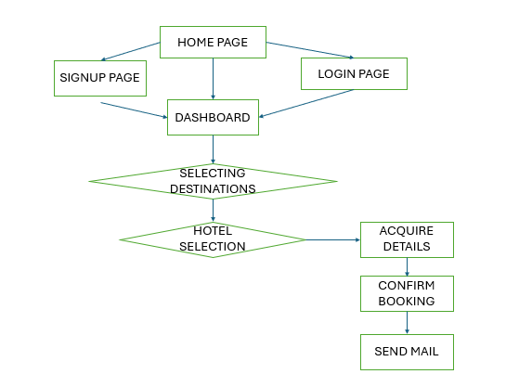
Architecture

Slide 9
Architecture
User Interface Layer (Frontend): Web & Mobile Interface: Intuitive and responsive design for seamless navigation across devices, including features for registration, training access, job discovery, and application. User Profiles: Personalized dashboards displaying progress, recommendations, and job applications
Application Logic Layer (Backend): Training Management System: Handles course delivery, progress tracking, and certification. Job Matching Engine: Centralized job board integrated with various insurance companies to post opportunities and manage applications. AI Recommendation System: AI algorithms to provide personalized training, job recommendations, and automated support based on user data and preferences

Slide 10
Architecture
Data Layer (Database & Storage): User Data & Profiles: Secure storage of user information, preferences, training progress, and certifications. Training Content Repository: Organized storage of educational content, resources, and modules. Job Listings Database: Real-time database of available job opportunities and employer details.
Integration Layer: Third-Party Services: Integration with third-party tools for payment gateways (for premium content), email notifications, and external job boards. Insurance Company APIs: Secure connections to insurance providers for real-time job posting and application status updates.

Slide 11
Hardware/software components
Hardware: Server infrastructure, user devices, and networking equipment.
Software:
Frontend Development :
HTML
CSS
Backend Development :
JavaScript
NodeJs
Database Management :
MySQL

Slide 12
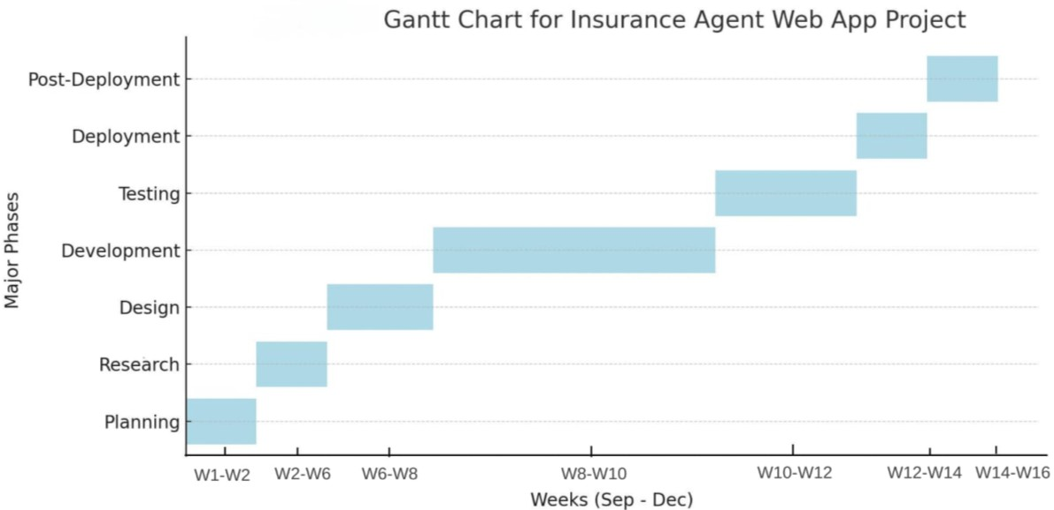
Timeline of Project

Slide 13
Expected Outcomes
Increased Awareness: Enhanced understanding of the insurance industry and the role of agents.
Talent Acquisition: Substantial rise in applications to become insurance agents.
User Engagement: Interactive platform fostering exploration and connection with professionals.
Skill Development: Resources and training materials for aspiring agents.
Data Insights with AI Integration: Valuable user behavior data for platform improvement and Personalized experiences and recommendations using AI tools.
Career Opportunities: Improved visibility of job openings in the insurance sector.

Slide 14
Conclusion
The development of this web app aims to bridge the gap in insurance agent talent by educating and engaging potential candidates. By providing a user-friendly platform that highlights the benefits of becoming an insurance agent, we anticipate increased awareness and interest in the profession.
Furthermore, integrating AI technology will enhance user experiences and tailor resources to individual needs, ultimately contributing to the growth of the insurance sector in India.
Through our efforts, we aspire to create a sustainable pipeline of skilled insurance agents, benefiting both individuals and the industry as a whole

Slide 15
Github Link
The Github link provided should have public access permission.
Github Link
https://github.com/charan6616/PIP235.git

Slide 16
References
Law, R., Leung, R., & Buhalis, D. (2009). Information technology applications in hospitality and tourism: A review of publications from 2005 to 2007. Journal of Travel & Tourism Marketing, 26(5-6), 599-623.
Tanford, S., Raab, C., & Kim, Y. (2012). The influence of reward program membership and commitment on hotel loyalty. Journal of Hospitality & Tourism Research, 35(3), 279-307.
Xiang, Z., Magnini, V. P., & Fesenmaier, D. R. (2015). Information technology and consumer behavior in travel and tourism: Insights from travel planning using the internet. Journal of Retailing and Consumer Services, 22, 244-249.
Buhalis, D., & Law, R. (2008). Progress in information technology and tourism management: 20 years on and 10 years after the Internet—The state of eTourism research. Tourism Management, 29(4), 609-623.
Lee, W., & Gretzel, U. (2012). Designing persuasive destination websites: A mental imagery processing perspective. Journal of Travel Research, 51(3), 315-330.

Slide 17
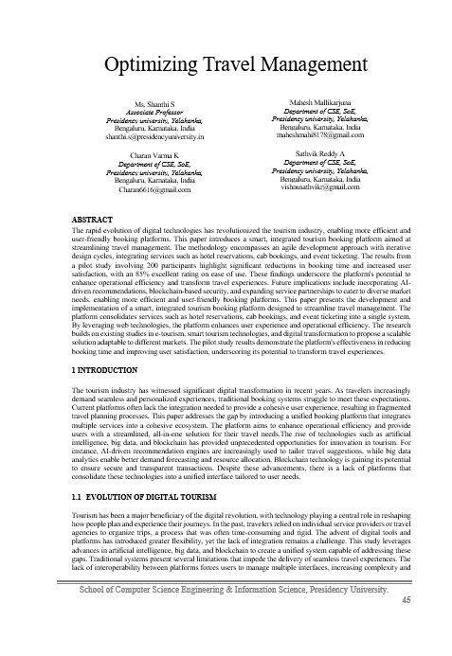
Publication details
Event Name: IJSREM
(International Journal of Scientific Research in Engineering
and Management)
Conducted on: January 2025
Paper Title: Optimizing Travel Management

Slide 18
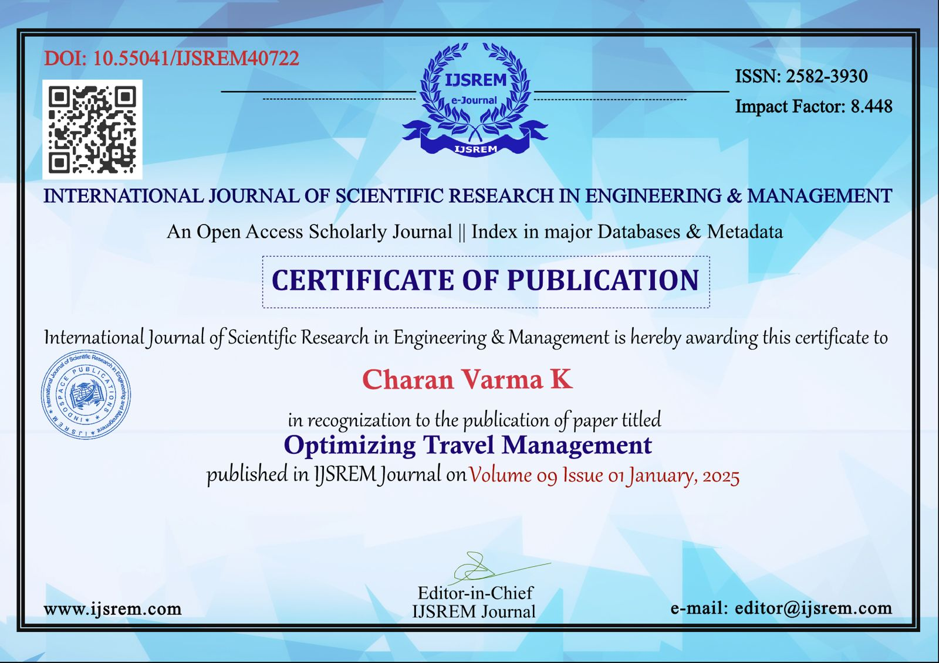
Publication Certification

Slide 19
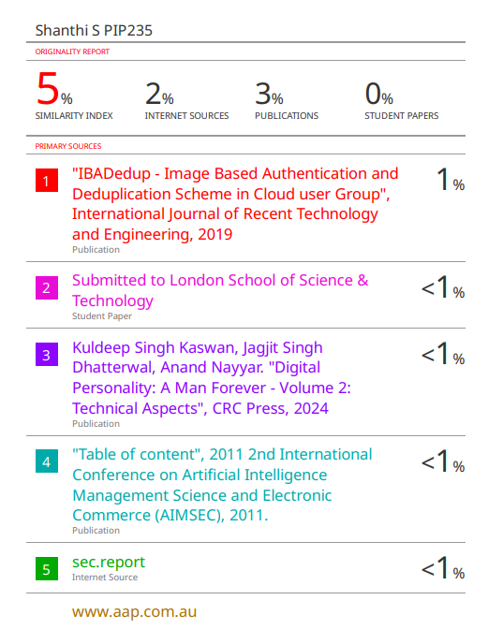
Plagiarism Report

Slide 20

Project work mapping with SDG

Slide 21
Thank You

