Slide 1
6th Minor Irrigation Census
Medium Tube Wells in Telangana

Slide 2
Overview of 6th Minor Irrigation Census
- Conducted to assess groundwater irrigation sources
- Covers different irrigation schemes including Tube Wells
- Telangana has significant groundwater irrigation dependency

Slide 3
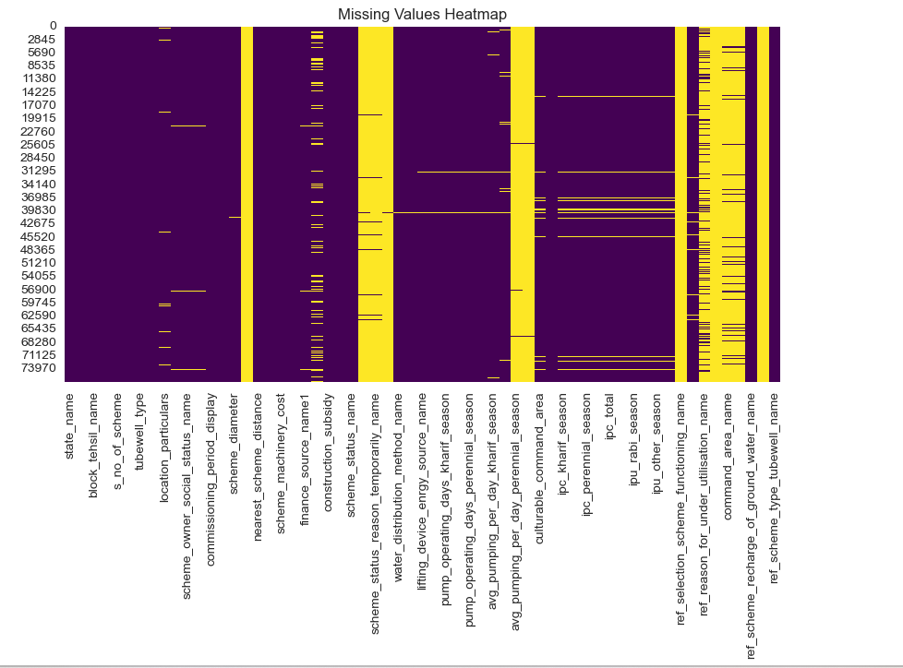

Slide 4
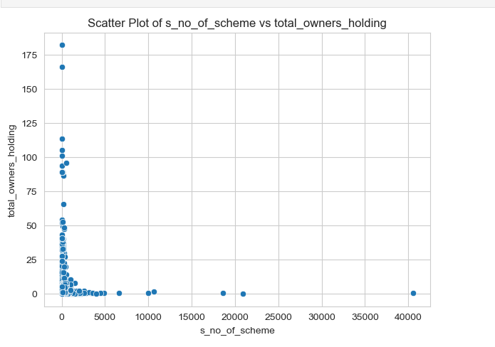

Slide 5
Medium Tube Wells in Telangana – Overview
- Total Medium Tube Wells: 10
- Used for agricultural and drinking water purposes
- Spread across multiple districts

Slide 6
Distribution of Medium Tube Wells by District
Number of Wells by District:
RANGAREDDY 10

Slide 7
Ownership of Medium Tube Wells
Ownership Breakdown:
Owned by individual farmer 10

Slide 8
Utilization of Medium Tube Wells
Utilization Status:
No 9
Yes 1

Slide 9
Challenges and Key Observations
- Some wells are underutilized due to low water availability
- Ownership concentrated among individual farmers
- Need for better groundwater recharge schemes

Slide 10
Conclusion and Recommendations
- Ensure sustainable groundwater management
- Improve recharge infrastructure
- Promote efficient irrigation techniques

