Slide 1
Mutual Fund Analytics Project
Bluestock Capstone Project
Prepared By: Charan

Slide 2
Project Overview
• Analyze mutual fund performance
• Build ETL pipeline
• Calculate performance metrics
• Create Power BI dashboard
• Generate fund recommendations

Slide 3
Data Sources
• Fund Master Data
• NAV History
• AUM Data
• SIP Inflows
• Category Inflows
• Scheme Performance Data
• Portfolio Holdings
• Benchmark Indices

Slide 4
ETL Pipeline
Raw Data
↓
Data Validation
↓
Data Cleaning
↓
Transformation
↓
Processed Data
↓
Analytics & Dashboard

Slide 5
Exploratory Data Analysis (EDA)
• Fund Category Analysis
• Return Distribution Analysis
• AUM Trend Analysis
• SIP Inflow Analysis
• Benchmark Comparison
• Performance Insights

Slide 6
Performance Analytics
• Alpha
• Beta
• Sharpe Ratio
• Sortino Ratio
• Maximum Drawdown
• Annualized Volatility These metrics help evaluate risk-adjusted mutual fund performance.

Slide 7
Power BI Dashboard
• Interactive Fund Analysis Dashboard
• Alpha vs Beta Comparison
• Sharpe Ratio Analysis
• Maximum Drawdown Analysis
• Fund Performance Overview

Slide 8
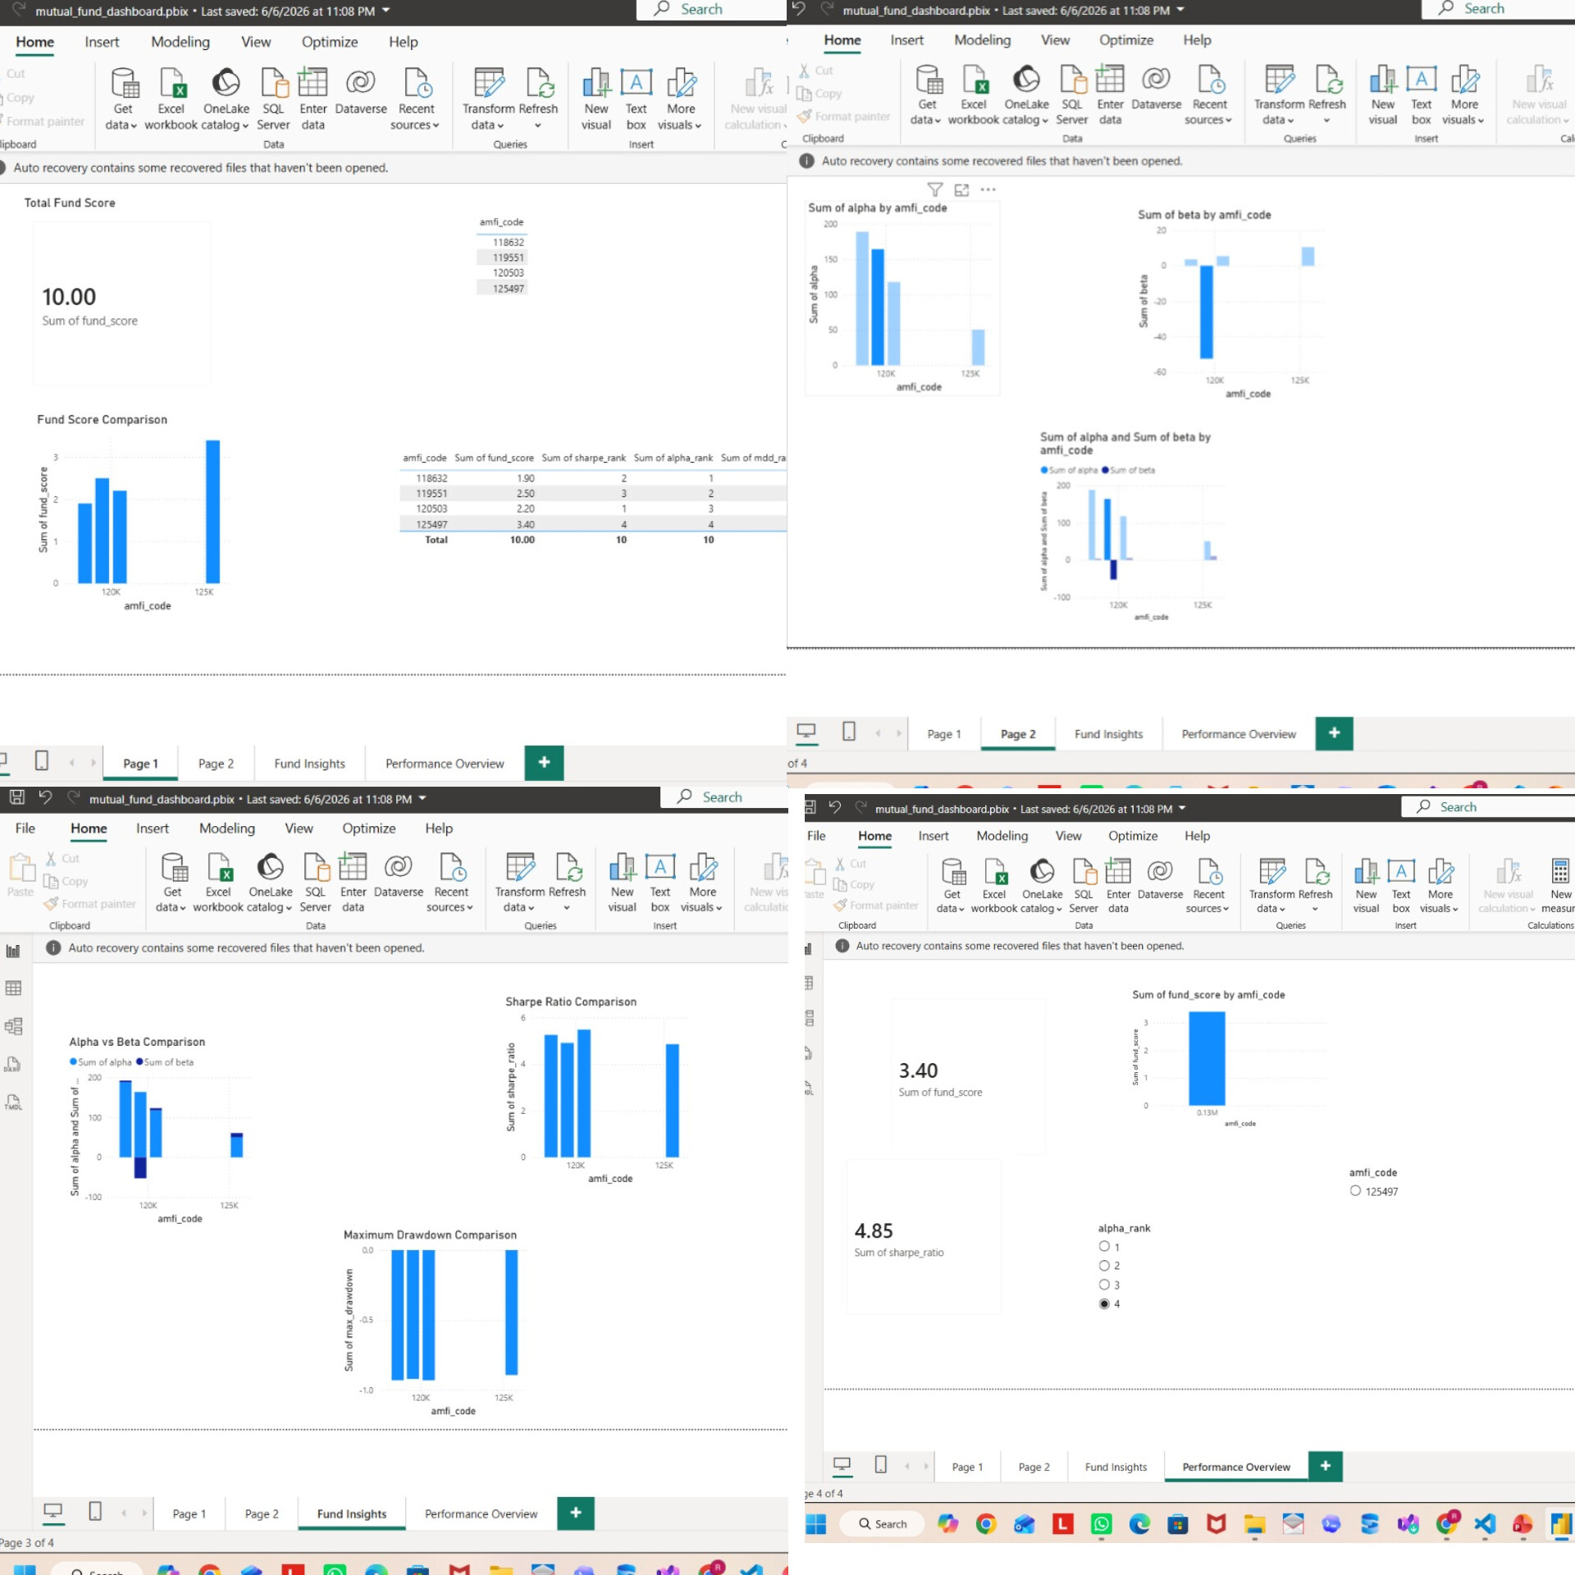
Dashboard Visualizations

Slide 9
Key Findings
• High Sharpe Ratio funds ranked consistently higher.
• Lower expense ratios improved recommendation scores.
• Category performance varies significantly.
• Risk-adjusted metrics provide better evaluation than absolute returns.
• Top-ranked funds demonstrated strong long-term performance.

Slide 10
Conclusion
• Successfully built an end-to-end Mutual Fund Analytics Platform.
• Developed ETL pipeline and data cleaning process.
• Calculated performance analytics metrics.
• Created interactive Power BI dashboards.
• Implemented advanced analytics and fund recommendation engine.
• Enabled data-driven investment decision making.

Slide 11
Thank You

