Slide 1
Fault-Tolerant Quantum Portfolio Optimizer
Step-by-step code walkthrough, with figures generated from the project's own code
Numbers: SYNTHETIC DATA | illustrative 12-qubit instance | 16 steps

Slide 2
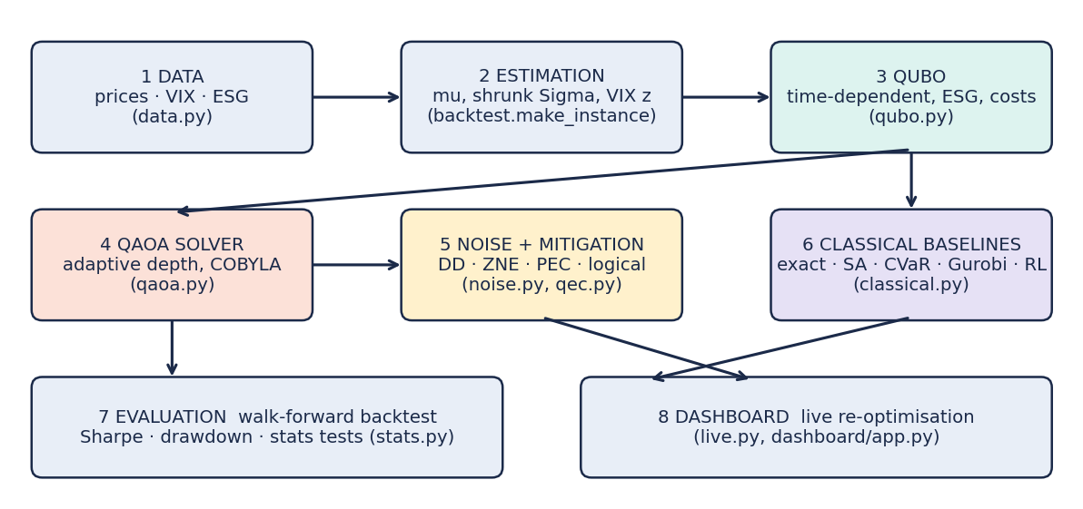
1
The big picture
Where: How the whole code runs, end to end
Data comes in: prices, VIX, ESG scores.
Every month we estimate returns (mu) and risk (Sigma).
We turn 'choose the best weights' into a QUBO: a yes/no puzzle over bits.
QAOA (a quantum circuit) tries to find the lowest-energy bit pattern.
Noise is added, then error mitigation or logical qubits are applied.
Classical solvers (exact, SA, MIQP, CVaR, RL) solve the same problem; a walk-forward backtest compares all of them.
run_all.py calls each box in this order, one command per stage.
Takeaway: Each box is one file in qpo/. Numbers in this deck: SYNTHETIC DATA.
Notes:
Data comes in: prices, VIX, ESG scores. Every month we estimate returns (mu) and risk (Sigma). We turn 'choose the best weights' into a QUBO: a yes/no puzzle over bits. QAOA (a quantum circuit) tries to find the lowest-energy bit pattern. Noise is added, then error mitigation or logical qubits are applied. Classical solvers (exact, SA, MIQP, CVaR, RL) solve the same problem; a walk-forward backtest compares all of them.

Slide 3
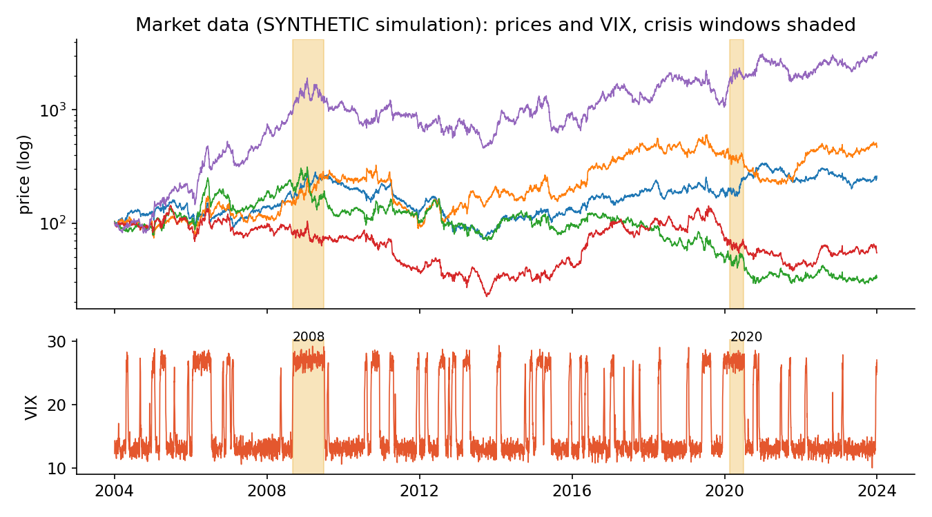
2
Step 1 - Data
Where: qpo/data.py, scripts/fetch_data.py, scripts/build_esg.py
Real mode: fetch_data.py freezes Yahoo prices and FRED series to csv; every later stage runs offline from that snapshot.
ESG: build_esg.py converts Sustainalytics risk scores (lower = better) into a percentile score where higher = better.
Safeguards: macro series are never back-filled, truncated FRED series are dropped, pseudo-ESG is refused.
Offline mode: a synthetic market with calm and stress regimes and forced 2008-like and 2020-like crises (figure).
This deck was built from: SYNTHETIC DATA (meta.json data_source = synthetic).
Figure is the synthetic market used for tests and demos.
Takeaway: Real runs must report survivorship bias and static-ESG look-ahead.
Notes:
Real mode: fetch_data.py freezes Yahoo prices and FRED series to csv; every later stage runs offline from that snapshot. ESG: build_esg.py converts Sustainalytics risk scores (lower = better) into a percentile score where higher = better. Safeguards: macro series are never back-filled, truncated FRED series are dropped, pseudo-ESG is refused. Offline mode: a synthetic market with calm and stress regimes and forced 2008-like and 2020-like crises (figure). This deck was built from: SYNTHETIC DATA (meta.json data_source = synthetic).

Slide 4
3
Step 2 - Estimate return and risk
Where: qpo/backtest.py make_instance()
Use the last 252 trading days only (no look-ahead).
Expected return mu = half the asset's own mean + half the universe mean (shrinkage).
Covariance Sigma is shrunk 20% toward its diagonal.
ESG hard filter: assets with ESG < 40 are removed first.
Greedy pick of 3-4 assets (best Sharpe, low correlation) to fit on qubits.
VIX z-score sets risk aversion lambda_t and the weight cap (50% calm, 33% stress).
lambda_t = 6 x (1 + 0.5 x VIX_z). Stress: cap drops from 3/6 to 2/6.
Takeaway: Time-varying constraints come from this one step.
Notes:
Use the last 252 trading days only (no look-ahead). Expected return mu = half the asset's own mean + half the universe mean (shrinkage). Covariance Sigma is shrunk 20% toward its diagonal. ESG hard filter: assets with ESG < 40 are removed first. Greedy pick of 3-4 assets (best Sharpe, low correlation) to fit on qubits. VIX z-score sets risk aversion lambda_t and the weight cap (50% calm, 33% stress).

Slide 5
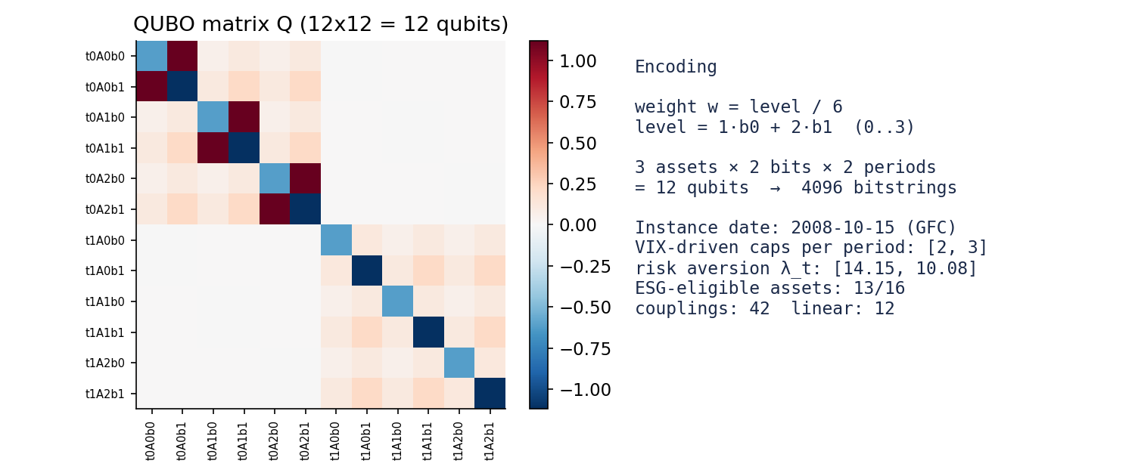
4
Step 3 - Build the QUBO
Where: qpo/qubo.py build_qubo()
A QUBO is: minimise x^T Q x with every x a bit.
Each weight = level/6, level = b0 + 2*b1: two bits per asset per period.
3 assets x 2 bits x 2 periods = 12 qubits (4096 candidate answers).
Q mixes: -return, +risk, +transaction cost, +budget penalty, +cap penalty, -ESG tilt.
Tests: Q matches the direct objective, and its optimum equals the hard-budget MIQP optimum.
Heatmap of Q for the 2008-10-15 instance (synthetic market).
Takeaway: Red/blue cells are the couplings the circuit must encode.
Notes:
A QUBO is: minimise x^T Q x with every x a bit. Each weight = level/6, level = b0 + 2*b1: two bits per asset per period. 3 assets x 2 bits x 2 periods = 12 qubits (4096 candidate answers). Q mixes: -return, +risk, +transaction cost, +budget penalty, +cap penalty, -ESG tilt. Tests: Q matches the direct objective, and its optimum equals the hard-budget MIQP optimum.

Slide 6
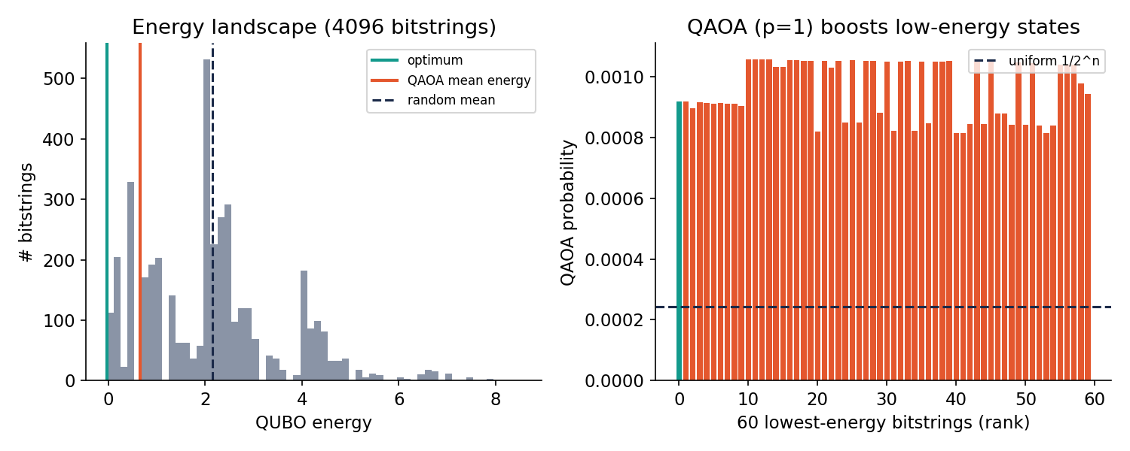
5
Step 4 - QAOA (the quantum part)
Where: qpo/qaoa.py
Start in an equal superposition of all bitstrings.
Repeat p times: a cost phase then an RX mixer.
Two angles per layer are tuned by COBYLA.
Adaptive depth: add layers (up to 3) only while the improvement exceeds 1%.
Sample bitstrings, evaluate their true energy classically, keep the best.
Optimum energy -0.031, random mean 2.149, QAOA (p=1) mean 0.663.
Takeaway: P(optimum) = 0.0009 vs uniform 0.00024: boosted, but the optimum stays unlikely.
Notes:
Start in an equal superposition of all bitstrings. Repeat p times: a cost phase then an RX mixer. Two angles per layer are tuned by COBYLA. Adaptive depth: add layers (up to 3) only while the improvement exceeds 1%. Sample bitstrings, evaluate their true energy classically, keep the best.

Slide 7
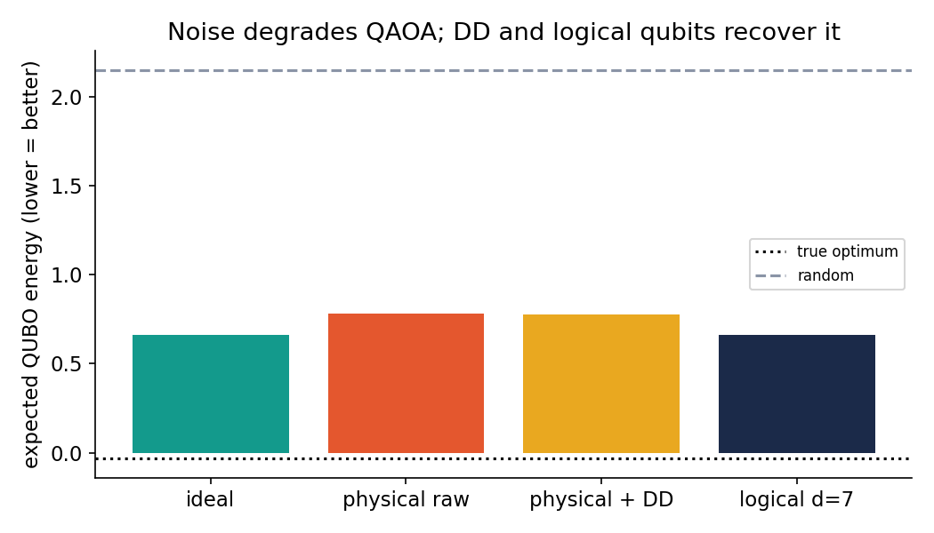
6
Step 5 - Noise (NISQ+ model)
Where: qpo/noise.py
Gate, idle and readout errors are turned into an independent bit-flip probability q per qubit on the output string.
On this instance q is 0.026 (raw), 0.025 (with DD) and 1.0e-06 (logical).
Phenomenological model, not hardware truth.
Energy 0.663 (ideal) -> 0.780 (raw).
Takeaway: Dynamical decoupling only trims idle error, so it helps a little.
Notes:
Gate, idle and readout errors are turned into an independent bit-flip probability q per qubit on the output string. On this instance q is 0.026 (raw), 0.025 (with DD) and 1.0e-06 (logical). Phenomenological model, not hardware truth.

Slide 8
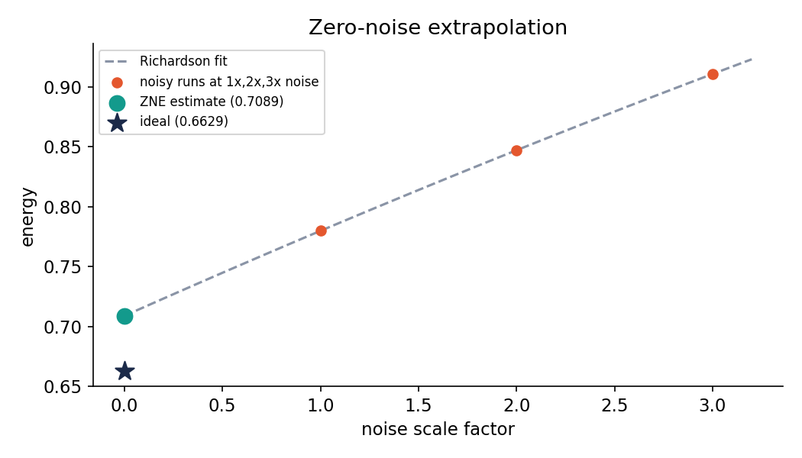
7
Step 6a - Zero-noise extrapolation (ZNE)
Where: qpo/qaoa.py estimate_energy(method='zne')
Run at 1x, 2x and 3x noise.
Fit a curve and read it at 0x.
Cost: more runs and variance inflated by 19x (Richardson weights 3, -3, 1).
Raw 0.7798 -> ZNE 0.7089 (ideal 0.6629).
Takeaway: ZNE reduces the bias but not completely.
Notes:
Run at 1x, 2x and 3x noise. Fit a curve and read it at 0x. Cost: more runs and variance inflated by 19x (Richardson weights 3, -3, 1).

Slide 9
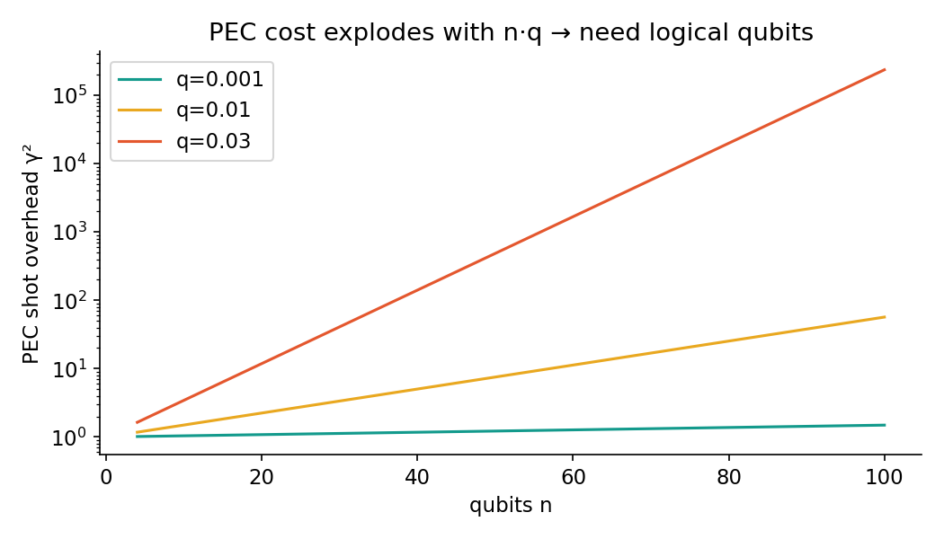
8
Step 6b - Probabilistic error cancellation (PEC)
Where: qpo/qaoa.py + qpo/theory.py
The channel is known, so we apply its inverse with signed random samples.
On this instance PEC gives 0.6629 (ideal 0.6629): unbiased.
Price: gamma = (1-2q)^(-n); shots grow as gamma^2.
n=12 at this q: gamma^2 = 3.6. n=100, q=0.03: gamma^2 = 2.37e+05.
Takeaway: This is why logical qubits are needed at scale.
Notes:
The channel is known, so we apply its inverse with signed random samples. On this instance PEC gives 0.6629 (ideal 0.6629): unbiased. Price: gamma = (1-2q)^(-n); shots grow as gamma^2.

Slide 10
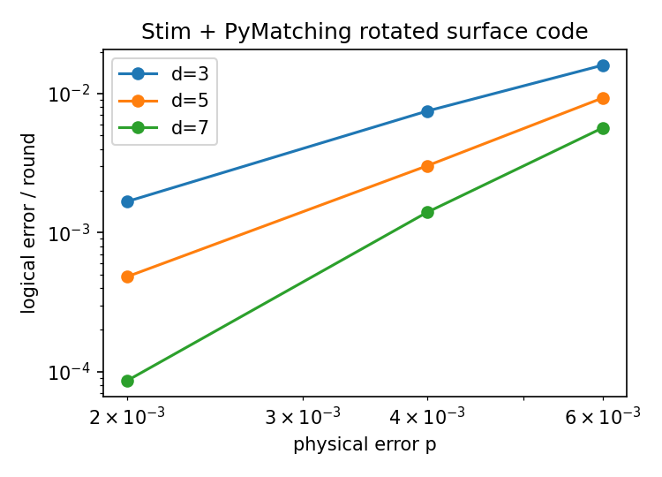
9
Step 7 - Logical qubits with Stim
Where: qpo/qec.py
Stim simulates the rotated surface code memory experiment, PyMatching decodes (d = 3, 5, 7).
Fit: p_L/round = A (p/p_th)^((d+1)/2) with A = 0.044, p_th = 0.0099 (9 points).
Logical mode injects the fitted logical flip rate into the small QAOA simulation.
Stim covers memory only; QAOA's non-Clifford gates are not simulated at code level.
Data exist for p = 2e-3..6e-3 only; lower p is an extrapolation.
Takeaway: Say this clearly in the report.
Notes:
Stim simulates the rotated surface code memory experiment, PyMatching decodes (d = 3, 5, 7). Fit: p_L/round = A (p/p_th)^((d+1)/2) with A = 0.044, p_th = 0.0099 (9 points). Logical mode injects the fitted logical flip rate into the small QAOA simulation. Stim covers memory only; QAOA's non-Clifford gates are not simulated at code level.

Slide 11
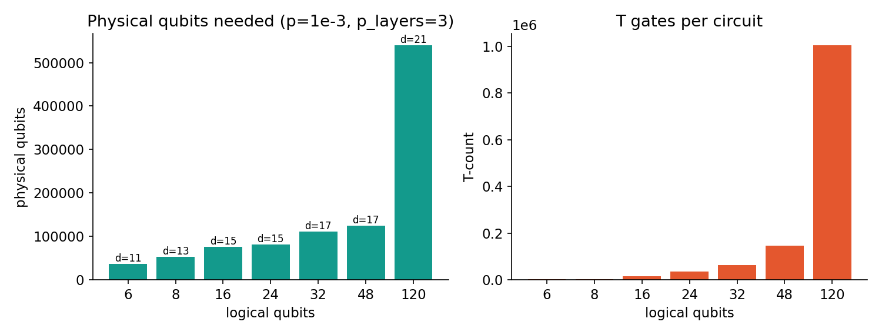
10
Step 8 - Resource estimation
Where: qpo/qec.py estimate_resources(), scripts/resource_sweep.py
Count rotations -> T gates, choose distance d, add T-factory area; failure budget split three ways (logical, synthesis, magic states).
n=16, p=1e-3: 75,576 physical qubits (range 49,232 - 88,758).
n=120, p=1e-3: 539,604 (range 183,480 - 1,180,620); needs 2-level distillation.
All constants are swept (assumptions table, tornado plot). Runtime is T-supply bound.
Report item (a).
Takeaway: Better hardware (p=1e-4) cuts the qubit count several-fold.
Notes:
Count rotations -> T gates, choose distance d, add T-factory area; failure budget split three ways (logical, synthesis, magic states). n=16, p=1e-3: 75,576 physical qubits (range 49,232 - 88,758). n=120, p=1e-3: 539,604 (range 183,480 - 1,180,620); needs 2-level distillation. All constants are swept (assumptions table, tornado plot). Runtime is T-supply bound.

Slide 12
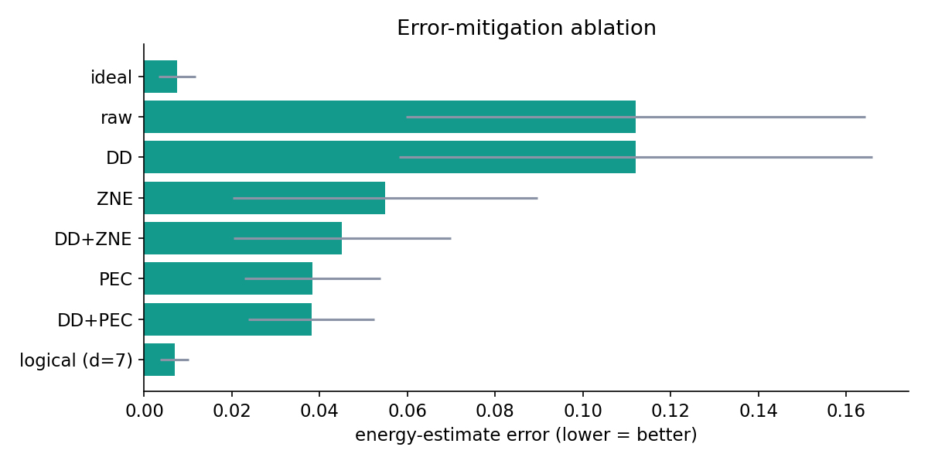
11
Step 9 - Error-mitigation ablation
Where: scripts/ablation.py
Each mitigation is switched on separately and in combination (9 configurations).
Raw error 0.112; ZNE 0.055; PEC 0.038.
DD+ZNE 0.045; DD+PEC 0.038; logical (d=7) 0.007.
Sampling overhead: ZNE 57x, PEC 12x.
Report item (b).
Takeaway: Mitigation helps estimation; logical qubits help most.
Notes:
Each mitigation is switched on separately and in combination (9 configurations). Raw error 0.112; ZNE 0.055; PEC 0.038. DD+ZNE 0.045; DD+PEC 0.038; logical (d=7) 0.007. Sampling overhead: ZNE 57x, PEC 12x.

Slide 13
12
Step 10 - Classical baselines
Where: qpo/classical.py, qpo/miqp.py, qpo/rl_torch.py
exact_qubo: brute force = true QUBO optimum (ceiling for QUBO solvers). sa_qubo: simulated annealing.
miqp_sub: hard-budget discrete problem, Gurobi MIQP if installed, else an exact DP (same optimum, cross-tested).
CVaR stochastic programs in HiGHS (and Gurobi when installed); equal weight.
RL: NumPy evolution-strategy agent; PyTorch REINFORCE agent written but NOT run in this build.
CVaR minimises average loss in the worst 10% of scenarios.
Takeaway: The exact optimum lets us measure how far QAOA is from perfect.
Notes:
exact_qubo: brute force = true QUBO optimum (ceiling for QUBO solvers). sa_qubo: simulated annealing. miqp_sub: hard-budget discrete problem, Gurobi MIQP if installed, else an exact DP (same optimum, cross-tested). CVaR stochastic programs in HiGHS (and Gurobi when installed); equal weight. RL: NumPy evolution-strategy agent; PyTorch REINFORCE agent written but NOT run in this build.

Slide 14
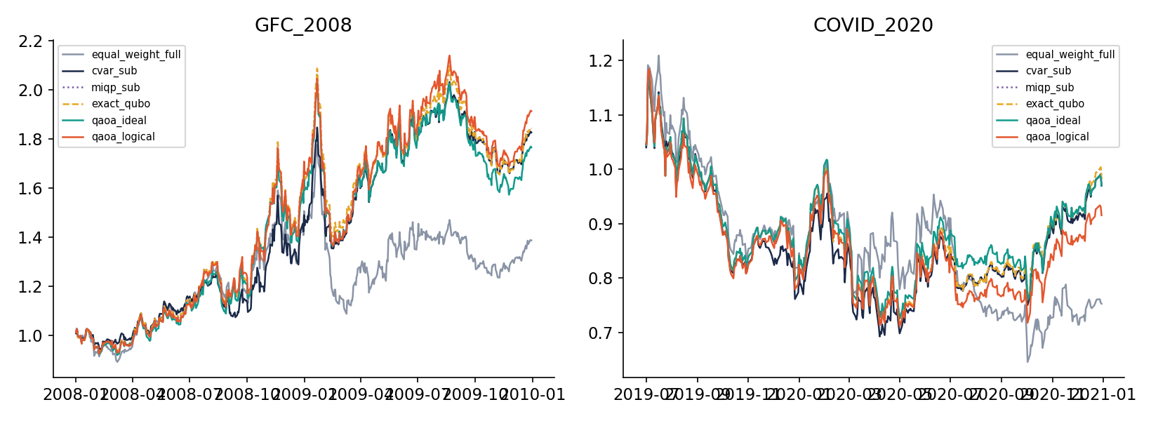
13
Step 11 - Walk-forward backtest
Where: qpo/backtest.py run_backtest()
Every rebalance: build the QUBO from past data only, solve, trade, pay costs, hold.
Methods: 11.
GFC_2008: best classical cvar_sub Sharpe 1.17; QAOA logical 1.16; equal weight 0.67.
COVID_2020: best classical cvar_full Sharpe 0.37; QAOA logical -0.01; equal weight -0.34.
QUBO solvers differ little: the problem is tiny and the exact optimum is the ceiling.
SYNTHETIC DATA. These numbers say nothing about real markets.
Takeaway: Tests confirm there is no look-ahead.
Notes:
Every rebalance: build the QUBO from past data only, solve, trade, pay costs, hold. Methods: 11. GFC_2008: best classical cvar_sub Sharpe 1.17; QAOA logical 1.16; equal weight 0.67. COVID_2020: best classical cvar_full Sharpe 0.37; QAOA logical -0.01; equal weight -0.34. QUBO solvers differ little: the problem is tiny and the exact optimum is the ceiling.

Slide 15
14
Step 12 - Statistical significance
Where: qpo/stats.py
Paired stationary bootstrap on the Sharpe difference; Wilcoxon on per-period returns; Holm correction.
Result: 0 of 28 (GFC) and 0 of 28 (COVID) differences are significant.
Example: qaoa_ideal vs cvar_sub in 2008: diff -0.13, 95% CI [-0.48, +0.32].
Wide intervals mean low power: not significant is not the same as equal.
Report item (c).
Takeaway: No claim of quantum outperformance is supported by this table.
Notes:
Paired stationary bootstrap on the Sharpe difference; Wilcoxon on per-period returns; Holm correction. Result: 0 of 28 (GFC) and 0 of 28 (COVID) differences are significant. Example: qaoa_ideal vs cvar_sub in 2008: diff -0.13, 95% CI [-0.48, +0.32]. Wide intervals mean low power: not significant is not the same as equal.

Slide 16
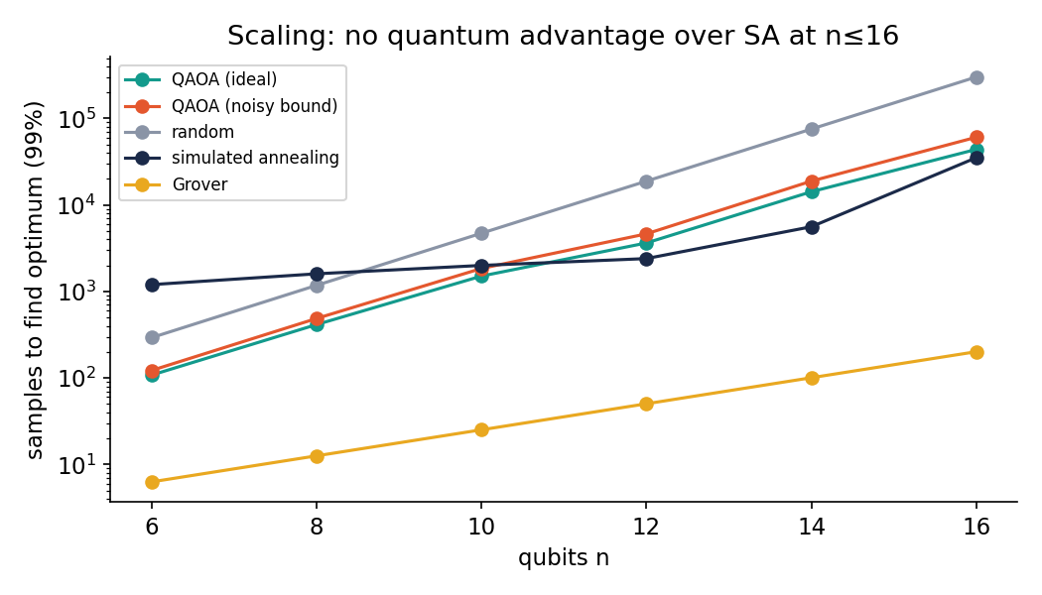
15
Step 13 - Scaling and theory bounds
Where: qpo/theory.py, docs/THEORY.md, scripts/scaling.py
P1 noisy success >= ideal x (1-q)^n. P2 Hoeffding shots. P3 PEC cost gamma^2 (n=100, q=0.03: 2.4e5). P4 ZNE variance x19. P5 random baseline 2^n. P6 noise budget shrinks like 1/n.
Empirical exponents (cost ~ 2^(s n)): QAOA 0.86, SA 0.43, random 1.00, Grover 0.50.
Six sizes, n <= 16: trend evidence only.
Honest result: the bounds are rigorous; an advantage is not shown.
Takeaway: Grover's sqrt(2^n) curve is a reference line only.
Notes:
P1 noisy success >= ideal x (1-q)^n. P2 Hoeffding shots. P3 PEC cost gamma^2 (n=100, q=0.03: 2.4e5). P4 ZNE variance x19. P5 random baseline 2^n. P6 noise budget shrinks like 1/n. Empirical exponents (cost ~ 2^(s n)): QAOA 0.86, SA 0.43, random 1.00, Grover 0.50. Six sizes, n <= 16: trend evidence only.

Slide 17
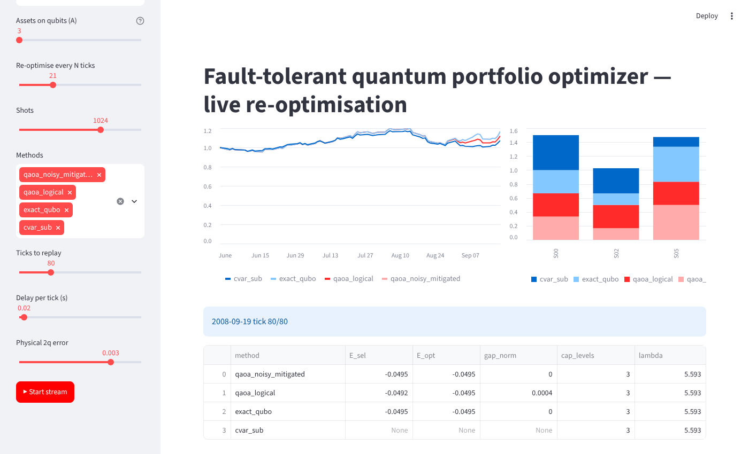
16
Step 14 - Live dashboard
Where: dashboard/app.py, qpo/live.py, scripts/screenshots.py
Streamlit app replays market data tick by tick (synthetic or the real snapshot, with a banner saying which).
Every N ticks it rebuilds the QUBO from data seen so far and re-solves with each chosen method.
Shows P&L lines, weight bars and a table of solver gaps.
Screenshots below are from an EARLIER build on synthetic data; regenerate with scripts/screenshots.py.
Screenshot: 2008 replay, synthetic data, earlier build.
Takeaway: Report item (d).
Notes:
Streamlit app replays market data tick by tick (synthetic or the real snapshot, with a banner saying which). Every N ticks it rebuilds the QUBO from data seen so far and re-solves with each chosen method. Shows P&L lines, weight bars and a table of solver gaps. Screenshots below are from an EARLIER build on synthetic data; regenerate with scripts/screenshots.py.

Slide 18
Where the project stands
Built and tested offline: QUBO, QAOA, noise, DD/ZNE/PEC, resource estimator + sweeps, MIQP (exact DP), stats, theory, data-loader safeguards (mocked)
Needs your machine: real Yahoo/FRED/ESG data, Stim re-run, PyTorch agent test, Gurobi MIQP test, dashboard screenshots
Honest claim: rigorous bounds plus an empirical test; no quantum advantage shown at n up to 16

