Slide 1



Introduction to Hadoop Distributed File System (HDFS) Commands
Introducing the Big Data Computation Laboratory Experiments module, which provides a comprehensive overview of Hadoop Distributed File System (HDFS) and its essential commands.
by charan adapa

Slide 2
Overview of Week 1 Big Data Computation Laboratory Experiments
Hands-On Learning
Focus on Computation
Real-World Applications
Prepare for an immersive experience in handling and processing large-scale data sets using Hadoop in a structured laboratory environment.
Explore the core principles of big data computation, covering basic to advanced techniques and methodologies throughout the week.
Understand how big data concepts are applied to solve practical challenges faced by industries and organizations today.

Slide 3
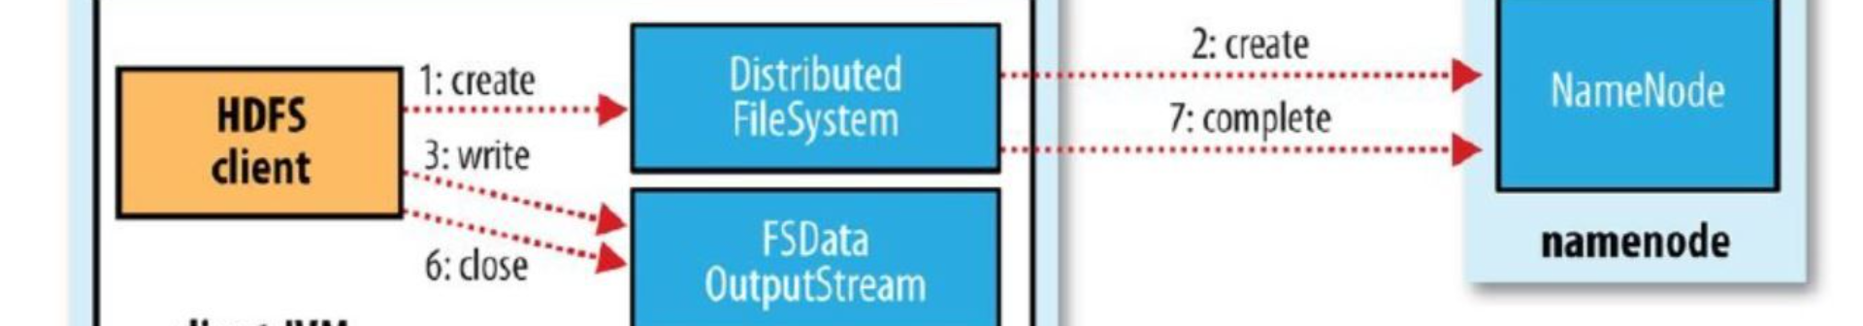
What is Hadoop and why is it important?
1
Data Processing Advancements
2
Scalability & Flexibility
3
Strategic Business Insights
Hadoop is a powerful, open-source framework for distributed storage and processing of large datasets at scale.
Examining Hadoop's impact on handling ever-increasing data volumes and diverse data types efficiently and cost-effectively.
Discover how Hadoop's capabilities have transformed the way organizations derive insights and make data-driven decisions.

Slide 4

Understanding the Hadoop Distributed File System (HDFS)
Data Storage Mechanism
Data Replication & Fault Tolerance
Investigate the core principles behind how HDFS stores and manages data across a distributed cluster of machines.
Explore the key features that ensure redundancy and fault tolerance within the Hadoop Distributed File System.
Namespace & Metadata Management
Understand how HDFS handles file metadata, namespace management, and interaction with other Hadoop components.

Slide 5
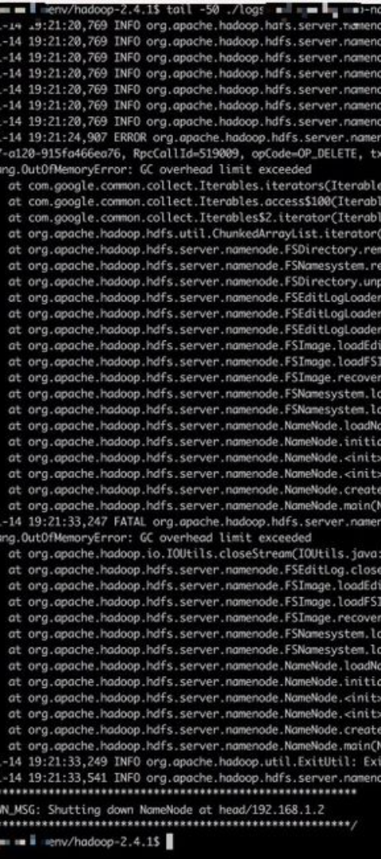
Key features and benefits of HDFS
1
Distributed Storage
2
Streamlined Scalability
Learn about the advantages of distributing data across multiple nodes for improved scalability and availability.
Discover how HDFS's horizontal scalability ensures seamless support for increasing amounts of data.
3
Reliability & Fault Tolerance
Understand how HDFS offers data redundancy and automatic failover, bolstering the reliability of the overall system.

Slide 6



Common HDFS commands and their functionalities
List & Display Commands
Modification Commands
File System Navigation
Learn about commands such as mkdir, mv, and rm used for creating, moving, and deleting files and directories.
Understand commands like cd, pwd, and cp to navigate, fetch, and copy files and directories within the Hadoop file system.
Explore commands like ls, du, and find for navigating and displaying information within HDFS.

Slide 7



Examples of using HDFS commands for file manipulation
File Upload
Learn how to use the put command for uploading files from the local file system to HDFS.
File Download
Explore the get command for downloading files from HDFS to the local file system.
File Deletion
Understand how to use the delete command to remove files from the Hadoop Distributed File System.

Slide 8
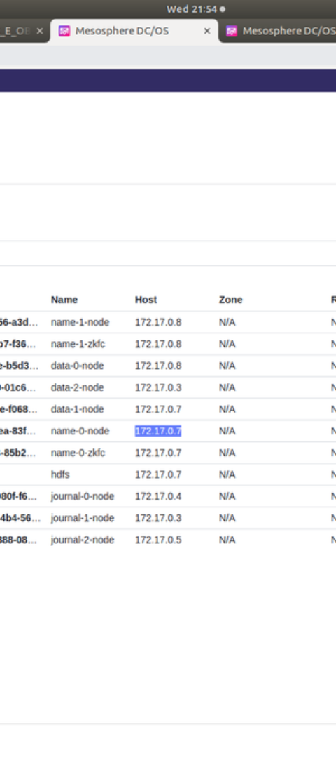
Conclusion and key takeaways
1
Application in Real-World Projects
Emphasize the significance of applying HDFS commands in practical big data projects and scenarios.
2
Continuous Learning & Exploration
Highlight the importance of continual exploration and hands-on experimentation with Hadoop based file manipulations.
3
Community support and Knowledge Sharing
Encourage leveraging the community for support and sharing insights related to HDFS commands and best practices.

