Slide 1











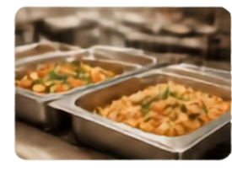











PlateForward
Rescue Food. Share Hope.
Food Waste Redistribution Platform
Hackathon Frontend Prototype
PLATEFORWARD
DONOR
Match Found
COMMUNITY
Restaurants
Delivering hope, not waste.
Hostels & Shelters
Surplus ready to share
Nourishing those in need
Pickup
Donor
Drop-off
Community
Food Saved
Impact in Progress
Lives Nourished
Turning surplus into smiles.
Together.

Slide 2















The Problem
Surplus food goes to waste.
Many surplus food sources exist but lack an efficient way to connect with those in need, leading to food waste.
THE CURRENT GAP
THE PLATEFORWARD SOLUTION
Surplus
Food
No
Receiver
Waste
Surplus
Food
PlateForward
Community
Food is lost.
Needs go unmet.
Food is rescued.
Communities are nourished.

Slide 3















The Solution
PlateForward makes food rescue simple by connecting
those with surplus to those who need it most.
01
02
03
04
05
Post Food
Discover
Claim
Coordinate Pickup
Redistribute
Food providers post surplus details in seconds.
Nearby receivers discover available food in real time.
Interested receivers claim what they can use.
Both sides confirm pickup time and location.
Food reaches those
in need and nourishes the community.
One platform. Five simple steps. Countless lives nourished.

Slide 4















Frontend Architecture
A lightweight, responsive frontend built for clarity today — ready to connect to real services tomorrow.
</>
{}
JS
LocalStorage / Application Data
Authentication + Backend (Next Step)
HTML
CSS
JavaScript
Structure and content
Reusable styles and layout
Interactions and dynamic behavior
Client-side state and data simulation
Real SMS OTP and backend integration planned
RESPONSIVE BY DESIGN
CONSISTENT & MODULAR
DYNAMIC & ENGAGING
CLIENT-SIDE STATE
BUILT FOR WHAT’S NEXT
The UI adapts seamlessly across devices for every user.
Reusable CSS components ensure a clean, consistent experience.
JavaScript enables smooth interactions and real-time updates.
LocalStorage keeps data on this device to simulate real usage.
Backend services and SMS OTP authentication are the next milestone.

Slide 5

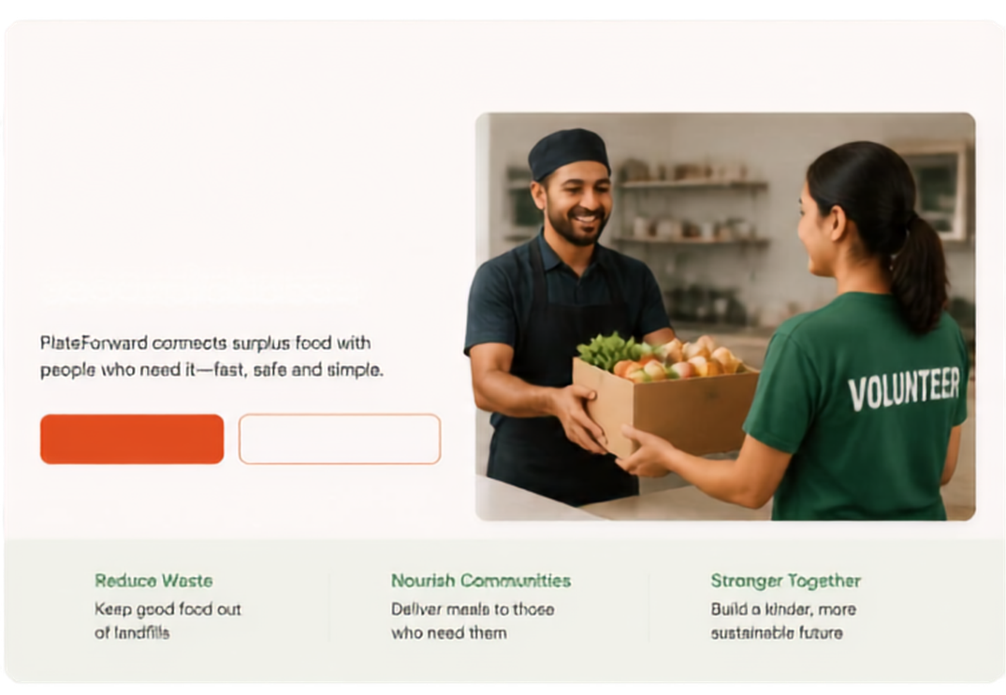








PlateForward
PlateForward
How It Works
Impact
For Donors
For NGOs
About Us
Log In
Sign Up
Rescue Food. Share Hope.
Good food
deserves a
second chance.
Connecting restaurants, hostels,
NGOs and communities to reduce waste
and fight hunger together.
PlateForward connects surplus food with
people who need it—fast, safe and simple.
Find Food Nearby
Donate Surplus Food
Find Food Nearby
Donate Surplus Food
Our Impact So Far
25K+
120+
15K+
30+
Reduce Waste
Nourish Communities
Stronger Together
Partners
People Served
Keep good food out
of landfills
Deliver meals to those
who need them
Build a kinder, more sustainable future
Meals Rescued
Cities
How It Works
1
Share Surplus
2
Match Instantly
3
Safe Pick-up
4
Feed & Empower
Restaurants and hostels
list extra food in minutes
PlateForward connects
donors with NGOs
nearby
NGOs pick up food
quickly and safely
Nutritious meals reach people and strengthen communities

Slide 6






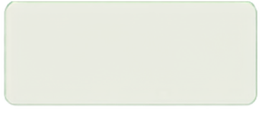





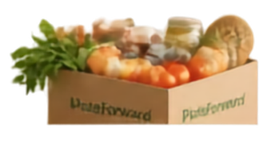









Authentication UI
A simple, trusted start for every user.
From landing to dashboard in four clear steps. One account. Two roles. More impact.
PlateForward
Welcome back, Ananya
A
Rescue Food, Share Hope.
Create your account
Choose your role
Sign up or log in to continue.
How do you want to use PlateForward?
Impact this week
24
6
Good food deserves a second life.
Sign Up
Log In
Meals Rescued
Connections Made
Donor
Quick actions
Join a community that resurves surplus food and nourishes more lives.
Full Name
I have surplus food to share.
List surplus food
Email
→
Phone number
Receiver
Recent activity
I represent an organization that receives food.
Surplus listed
PlateForward
Password
12 kg — Today, 10:30 AM
PlateForward
By continuing, you agree to our terms.
Food delivered
8 kg — Yesterday, 5:20 PM
Create an account
Continue
Continue
Request matched
Log in
Already have an account? Log in
1
Landing
2
Sign up or log in
3
Choose donor or receiver
4
Platform dashboard
Real SMS OTP integration is the next implementation step.

Slide 7

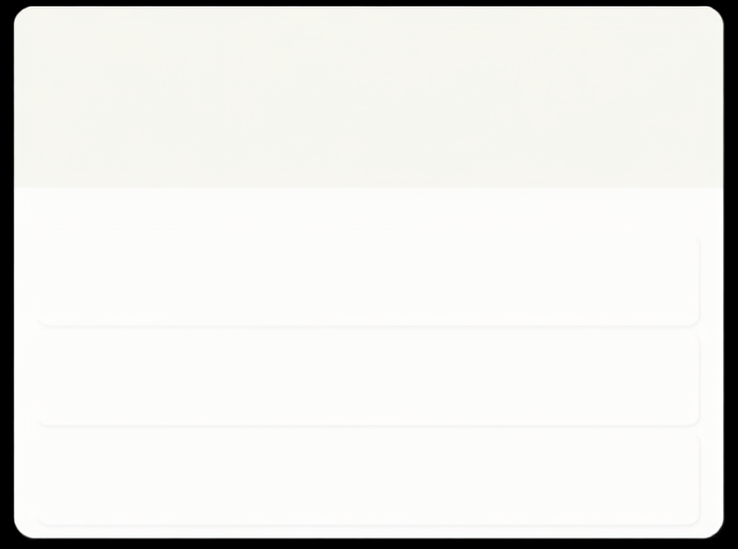




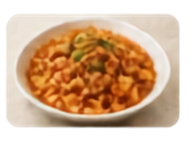

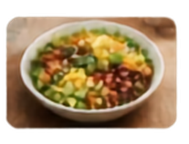

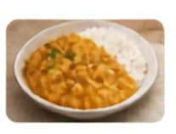

Donor Experience
Donate Food
Post surplus food in minutes.
Track your impact with ease.
Description
What are you donating?
My Dashboard
Quantity
Category
My Listings
Meals Offered
Communities Helped
Total Impact
7
126
4
18
e.g., 20 meals
Select category
active
meals
connected
kg rescued
Pickup Window
My Listings
Select date
Select time range
Pasta with Tomato Sauce
Active
Location
20 meals ⋅ Italian
Today, 4:00 PM - 6:00 PM
Downtown
Edit
Delete
Enter pickup location
Mixed Vegetable Salad
Active
Notes (optional)
15 meals ⋅ Healthy
Tomorrow, 12:00 PM - 2:00 PM
Riverside
Edit
Delete
Any additional details
Veg Biryani
Active
25 meals ⋅ Indian
May 25, 5:00 PM - 7:00 PM
Uptown
Submit Listing
Edit
Delete

Slide 8












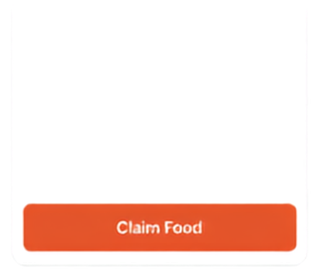

Receiver Experience
Find food near you
Search food, cuisine, or kitchen
Category
Within
Pickup Window
Find nearby surplus food and claim it with ease.
All Categories
10 km
Today
Reset
Available Now
Browse fresh surplus food near you
Filter by category, location and pickup window
See quantity, location and pickup details upfront
Claim what you can use and make an impact
Vegetable Fried Rice
Dal Parthas
Pasta in Tomato Sauce
Community Kitchen
Green Leaf Cafe
Urban Bites
Quantity
6 kg
Quantity
20 pieces
Quantity
5 kg
Location
Indiranag, Bengaluru
Location
Koramangaia, Bengaluru
Location
HSR Layout, Bengaluru
Pickup Window
4:00 PM – 5:00 PM
Pickup Window
3:00 PM – 5:00 PM
Pickup Window
5:00 PM – 7:00 PM
Claim Food
Claim Food
Claim Food

Slide 9





Impact Dashboard
Real-time metrics that capture the change we create together.
0
0
0
0
Meals Shared
Active Donors
Food Saved
People Helped
These metrics will dynamically update after backend integration and successful claims.

Slide 10









Status & Next Steps
COMPLETED IN PROTOTYPE
NEXT STEPS
Responsive frontend
Real SMS OTP integration
Landing page
Firebase/backend setup
Authentication UI
Donor interface
Cloud database implementation
Receiver interface
Real-time listings and updates
Food listing and browse/claim flow
My Listings
Notifications system
Dynamic statistics structure
Production deployment
Role-based UI
PlateForward turns surplus food into community impact.
From frontend prototype to real-world food redistribution.

