Slide 1

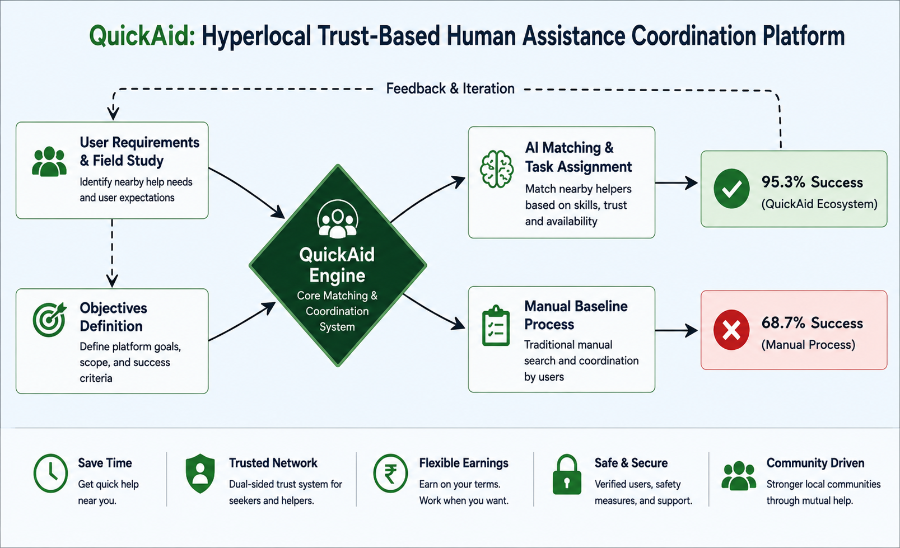
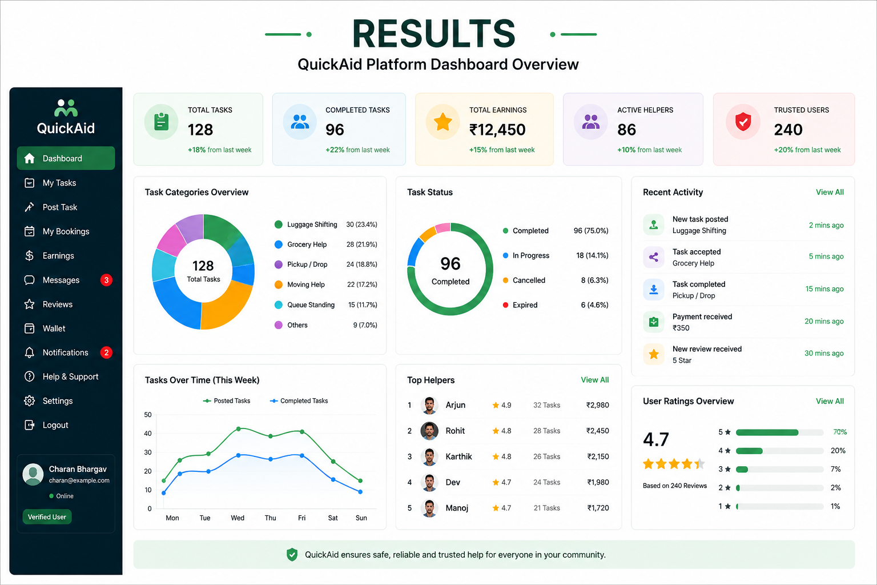
.
Student Name: G Charan Bhargav
Project Guide: Dr S Saraswathi Reg. No: 192365028
QuickAid: Hyperlocal Trust-Based Human Assistance Coordination Platform
INTRODUCTION
QuickAid is a hyperlocal mobile application designed to connect nearby people for short-duration physical assistance tasks.
The platform helps users quickly find trusted nearby helpers for activities such as luggage shifting, grocery assistance, pickup/drop support, and temporary moving help.
The application is mainly focused on environments like college hostels, apartments, and local communities where urgent nearby help is frequently needed.
QuickAid provides flexible earning opportunities for students and local workers without requiring fixed jobs or long-term commitments.
The platform uses a dual-sided trust system where both helpers and task seekers are verified and evaluated using trust metrics and completion history
Figure 1 – QuickAid System Workflow
`
MATERIALS AND METHODS
User Registration /Login
Task Creation / Helper Availability
Hyperlocal Matching Engine
Trust & Safety Processing
Feedback Update
Task Completion & Payment
Communication & Coordination
Notification & Task Acceptance
RESULTS
The QuickAid platform successfully enables nearby users to coordinate physical assistance tasks in real time.
The system improves rapid helper discovery for urgent nearby requirements.
The trust system increases transparency and accountability between users.
Controlled location-sharing improves user privacy and safety.
The platform supports flexible earning opportunities for students and local workers.
DISCUSSION AND CONCLUSION
QuickAid successfully demonstrates the use of hyperlocal technology for nearby human assistance and flexible earning opportunities.
The dual-sided trust and verification system improves safety, transparency, and accountability for both seekers and helpers.
The platform reduces dependency on personal social networks by providing a low-social-pressure environment for requesting temporary help.
The real-time nearby matching system enables faster task coordination and improves response efficiency in hostels and apartment communities.
QuickAid provides a scalable and user-friendly solution for trusted short-duration physical assistance .
The platform creates independent part-time earning opportunities for students and local workers without requiring fixed employment or long-term commitments.
BIBLIOGRAPHY
A. Sharma and R. Verma, “Hyperlocal Service Platforms and Community-Based Assistance Systems,” International Journal of Mobile Computing and Applications, vol. 12, no. 3, pp. 45–58, 2024.
P. Kumar and S. Reddy, “Trust and Reputation Mechanisms in Mobile Service Applications,” Journal of Smart Computing Systems, vol. 9, no. 2, pp. 101–115, 2025.
M. Gupta et al., “Location-Aware Real-Time Coordination Systems for Urban Assistance Applications,” International Conference on Intelligent Mobile Systems, pp. 210–218, 2023.
S. Narayan and V. Rao, “Human-Centered Trust Design in Digital Marketplace Platforms,” International Journal of Human-Computer Interaction, vol. 18, no. 4, pp. 88–99, 2025.
IEEE Xplore Digital Library, “Research Articles on Hyperlocal Mobile Coordination Systems,” 2024. Available: https://ieeexplore.ieee.org

