Slide 1
VARDHAMAN COLLEGE OF ENGINEERING DEPARTMENT OF CSE
Mini Project Review - I
Title: AI-Driven Polypharmacy Risk Prediction Using Graph Neural Networks
Team No: 23MPCS-H18
Guide Details
MR. Rajkumar B Patil
Associate Professor
S.No | Roll No | Student Name
1 | 23881A05FE | G Charan Chandra
2 | 23881A05FL | G. Nagadeepika
3 | 23881A05GR | V Praveen Dheeraj

Slide 2
Table of Contents
1. Title
2. Background Research
3. Project Planning (Include Gantt Chart)
4. Literature Survey
5. Objectives
6. Project Milestone Tracker
7. Q&A

Slide 3
TITLE
Project Title: AI-Driven Polypharmacy Risk Prediction Using Graph Neural Networks
Domain/Area: Artificial Intelligence, Machine Learning, Healthcare Analytics, Deep Learning.
Type: Research + Application Development
Keywords: Polypharmacy , Drug-Drug Interaction(DDI),Graph Neutral Network(GNN).

Slide 4
PROJECT PLANNING
Include a Gantt Chart covering:
- Research Phase
- Design Phase
- Implementation
- Testing
Recommended Tools: Excel / Canva / MS Project

Slide 5
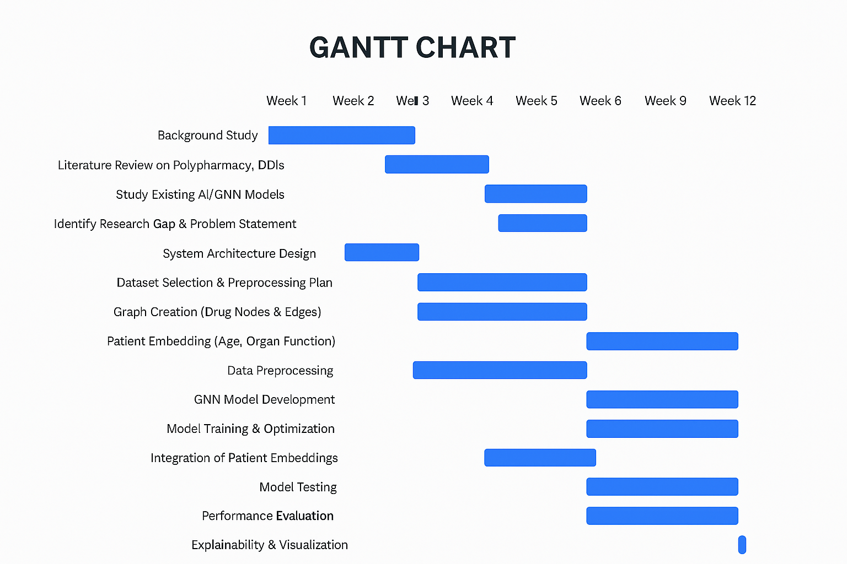
PROJECT PLANNING
Gantt Chart

Slide 6
Research Phase
Through my research phase, I thoroughly studied the critical problem of polypharmacy and how it leads to adverse drug reactions in patients taking multiple medications. I explored existing drug interaction prediction systems like Micromedex, Lexicomp, and DrugBank, and quickly realized they rely on rule-based approaches that cannot predict novel drug combinations or personalize risk for individual patients.
I then reviewed multiple research papers on Machine Learning and Deep Learning approaches for DDI prediction. Traditional ML methods like Random Forest and SVM showed decent accuracy but required heavy manual feature engineering and couldn't capture the complex network relationships between drugs. This led me to explore Graph Neural Networks—a breakthrough approach that naturally represents drugs as nodes and interactions as edges.

Slide 7
Research Phase
This comprehensive research helped me define a clear problem statement: developing an interpretable, multi-modal GNN framework that predicts drug-drug interactions with severity classification while providing explainable insights for clinical decision-making.

Slide 8
Design Phase
Requirements Analysis:
Functional Requirements
User Authentication & Management.
Patient Data Management.
Medication/Drug Input.
Risk Prediction Engine.
Explainability & Interpretation.
Alternative Drug Recommendations.
Prediction History & Tracking.
Dashboard & Analytics.
Drug Database Management (Admin).
User Management (Admin).

Slide 9
Design Phase
Non-functional requirements :
Performance Requirements.
Scalability Requirements.
Availability & Reliability.
Security Requirements.
Usability Requirements.
Maintainability Requirements

Slide 10
Design Phase
System Requirement’s:
Hardware:
Development: 8GB RAM, i5 processor, optional GPU
Cloud: AWS/Azure/GCP options included.
Software:
Languages: Python 3.10+, JavaScript ES6+, SQL, Cypher
Backend: Flask/FastAPI, PyTorch, PyTorch Geometric
Frontend: React 18+, Bootstrap/MUI, Chart.js
Databases: PostgreSQL 15, Neo4j 5, Redis 7
Tools: VS Code, Docker, Git, Postman, Canva

Slide 11
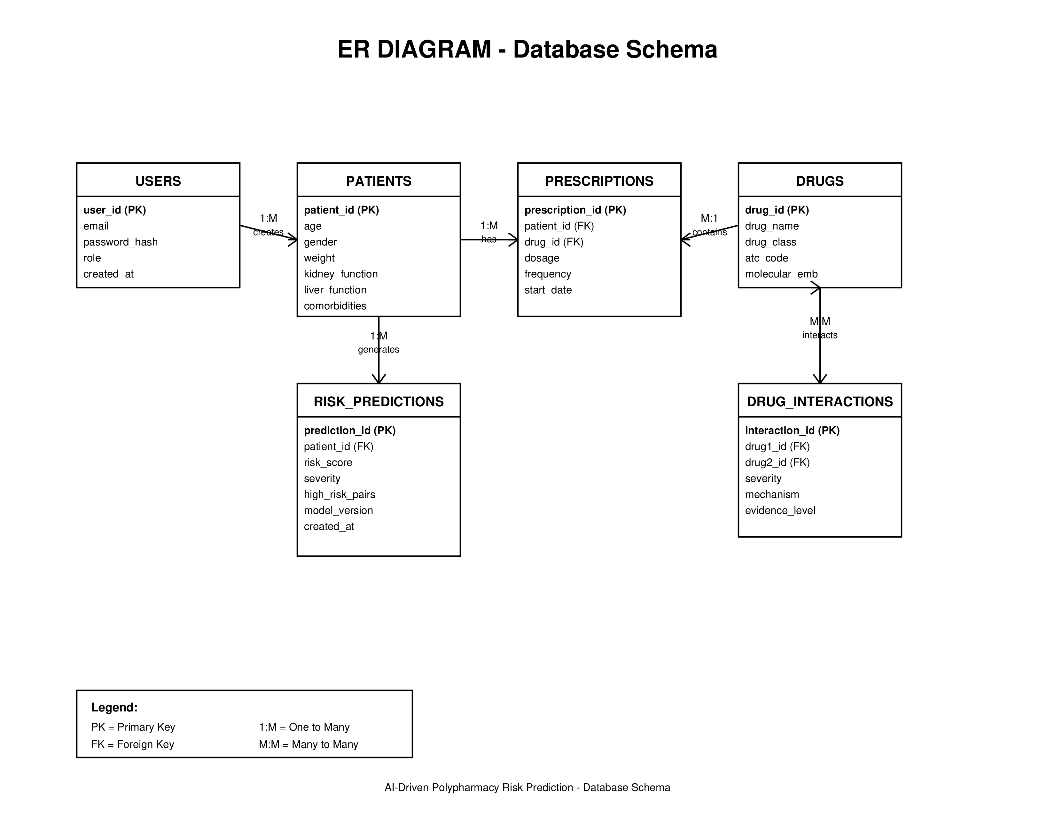
Design Phase

Slide 12
BACKGROUND RESEARCH
Existing Solutions
Micromedex Drug Interaction Checker– Rule-based clinical decision support system– Widely used in hospitals.
Lexicomp Drug Interactions– Provides interaction severity and recommendations
mainly pairwise drug interaction analysis.
IBM Watson for Drug Discovery– Uses AI for drug discovery and safety analysis not personalized for individual patient condition.

Slide 13
BACKGROUND RESEARCH
Challenges
Complex drug interaction networks
Multiple drugs interact simultaneously– Effects are non-linear and cumulative.
Lack of patient personalization
Same drug combination behaves differently– Age, organ function, and comorbidities ignored.
Data heterogeneity
Drug data, clinical data, lab reports in different formats.
Rare but dangerous interactions
Insufficient data for rare drug combinations.

Slide 14

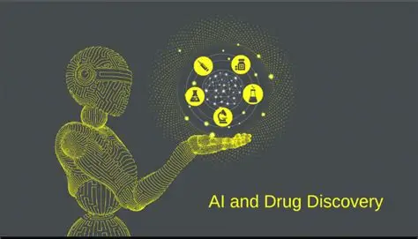
BACKGROUND RESEARCH
Motivation
Existing drug interaction systems mainly use rule-based methods to detect known drug–drug interactions but struggle with complex polypharmacy cases and lack patient-specific personalization. Polypharmacy involves non-linear interactions influenced by age, organ function, and comorbidities, making accurate prediction challenging. These limitations motivate the use of Graph Neural Networks to model complex drug relationships and generate personalized, explainable risk predictions for improved medication safety.

Slide 15
LITERATURE SURVEY
Paper Title | Approach/Algorithm | Dataset Used | Key Findings | Gaps Identified
SmileGNN: Drug–Drug Interaction Prediction Based on SMILES & GNN | Graph Convolutional Network (GCN) Multirelational graph modeling Drugs as nodes, side effects as edge types Message passing to learn drug–drug interaction patterns | Knowledge graph built from multiple drug interaction sources (e.g., Deep DDI). | Achieved better DDI prediction performance compared to existing models. | Focused on structure-based DDI; lacks patient-specific context for personalized risk.

Slide 16
LITERATURE SURVEY
Paper Title | Approach/Algorithm | Dataset Used | Key Findings | Gaps Identified
SimVec: Predicting Polypharmacy Side Effects for New Drugs | Graph Neural Network (GNN) Drug interaction graph construction Node embedding learning via neighborhood aggregation | DrugBank DDI dataset | GNN models outperform traditional machine learning methods in DDI prediction Graph-based learning captures complex drug relationship patterns | The model predicts drug–drug interactions without incorporating patient-specific clinical factors.

Slide 17
OBJECTIVES
To design a graph-based framework for modeling complex drug–drug interactions in polypharmacy scenarios.
To develop a Graph Neural Network model that predicts patient-specific risk of adverse drug reactions.To integrate clinical parameters such as age, comorbidities, and organ function into the risk prediction process.

Slide 18
OBJECTIVES
To generate interpretable outputs by identifying high-risk drug combinations contributing to the predicted risk.
To support clinical decision-making by providing early warnings for unsafe medication combinations.

Slide 19
PROJECT MILESTONE TRACKER
Paste Scanned Copy of Handbook Page No:3(Signed)

Slide 20
Q&A
Thank you
Open for the Questions

