Slide 1
Title: Bank Customer Churn Prediction
UMBC Data Science Master Degree Capstone
Dr. Chaojie (Jay) Wang
Author Name: Charan Ganemaneni
WW88694
GitHub Profile: https://github.com/charangani
LinkedIn Profile: https://www.linkedin.com/in/charan-ganemaneni-9779a6158/

Slide 2
Introduction
As the banking industry faces increased competition and higher customer expectations, banks' ability to accurately predict customer churn has become critical in their efforts to retain customers and improve overall customer satisfaction. Understanding the underlying causes of customer churn can provide valuable insights for banks in developing targeted retention strategies, optimizing the customer experience, and improving overall customer relationship management practices. Banks can better address customer attrition by gaining a deeper understanding of customer behavior and preferences through the use of advanced analytics and data-driven approaches.
As the banking industry faces increasing competition and higher customer expectations, accurately predicting customer churn has become a critical factor for banks in their efforts to retain customers and enhance overall customer satisfaction. Understanding the underlying factors that contribute to customer churn can provide valuable insights that help banks develop targeted retention strategies, optimize the customer experience, and improve overall customer relationship management practices. By leveraging advanced analytics and data-driven approaches, banks can gain a deeper understanding of customer behavior and preferences, enabling them to address customer churn more effectively.

Slide 3
Dataset Overview
The dataset is about customer churn in the banking sector. It contains various features like credit score, age, tenure, balance, number of products, credit card status, active membership status, estimated salary, and churn status. Predicting customer churn is critical for businesses, especially in the banking sector. Retaining existing customers is often more cost-effective than acquiring new ones. By predicting which customers are likely to churn, banks can proactively address their concerns and improve customer retention.

Slide 4
About the data
Data Sources: https://www.kaggle.com/datasets/cybersimar08/binary-classification-of-bank-churn-synthetic-data/data
Data Size:
The file size is 36.27 MB .
The dataset consists of 25 columns and 175028 rows.

Slide 5
Data Dictionary
Column Name | Data Type | Definition | Potential Values
Surname | Categorical | Label Encoded Surnames | Various encoded surnames
CreditScore | Numerical | Customer's credit score | Any numerical value
Age | Numerical | Customer's age | Any numerical value
Tenure | Numerical | Number of years customer has been with the bank | Any numerical value
Balance | Numerical | Customer's account balance | Any numerical value
NumOfProducts | Numerical | Number of bank products customer uses | Any numerical value
HasCrCard | Binary | Whether the customer has a credit card | 1 = yes, 0 = no
IsActiveMember | Binary | Whether the customer is an active member | 1 = yes, 0 = no
EstimatedSalary | Numerical | Estimated salary of the customer | Any numerical value
Exited | Binary | Whether the customer has churned | 1 = yes, 0 = no

Slide 6
Preprocessing
Data Preprocessing is a vital phase in machine learning that ensures the data fits the models used.
Standardization is used to normalize numerical data, while encoding is employed to convert categorical data into a format suitable for machine learning models.
This phase guarantees that the data is formatted appropriately for the training of the model.

Slide 7
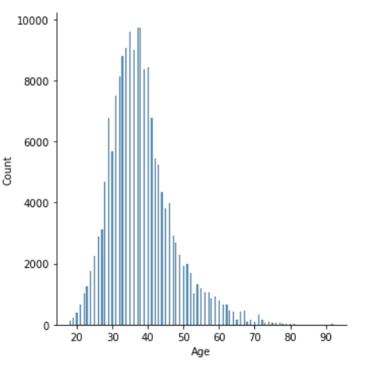
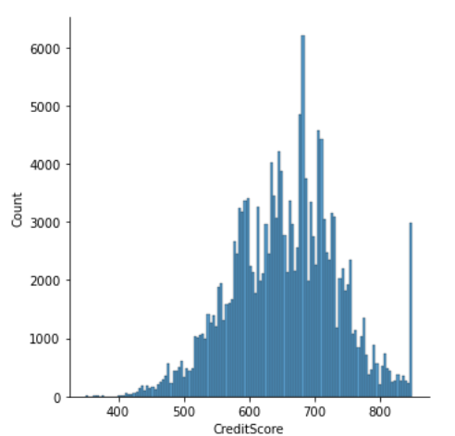
Exploratory Data Analysis

Slide 8
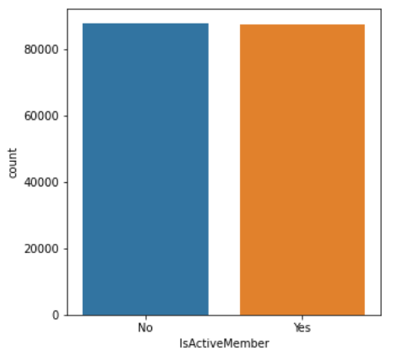
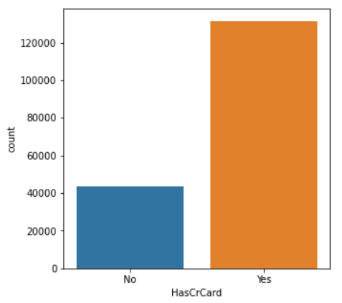

Slide 9
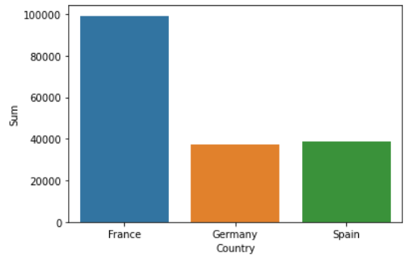
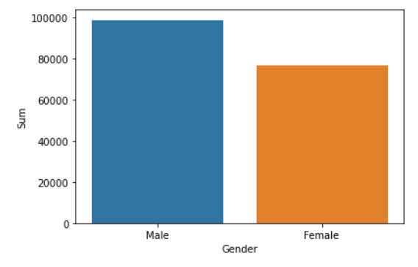

Slide 10
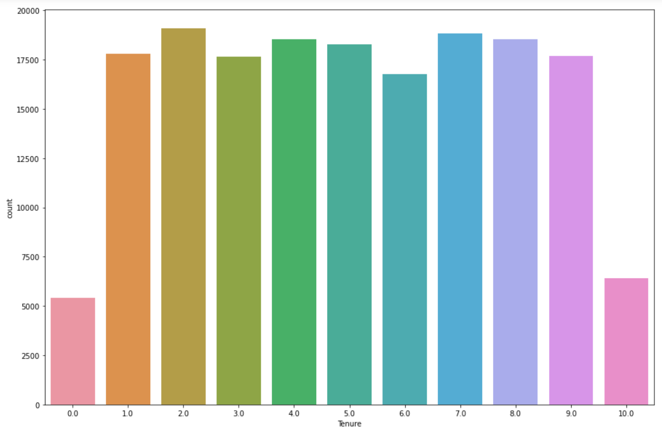

Slide 11
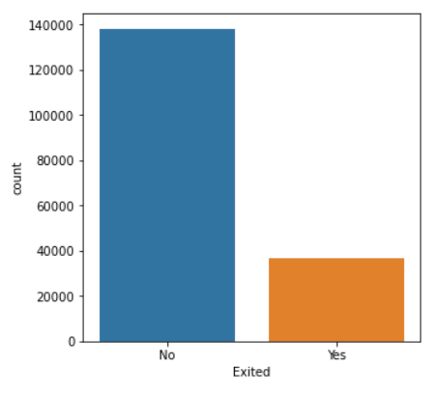
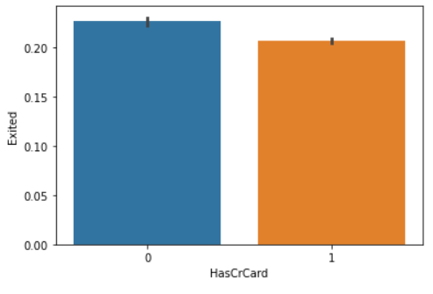

Slide 12
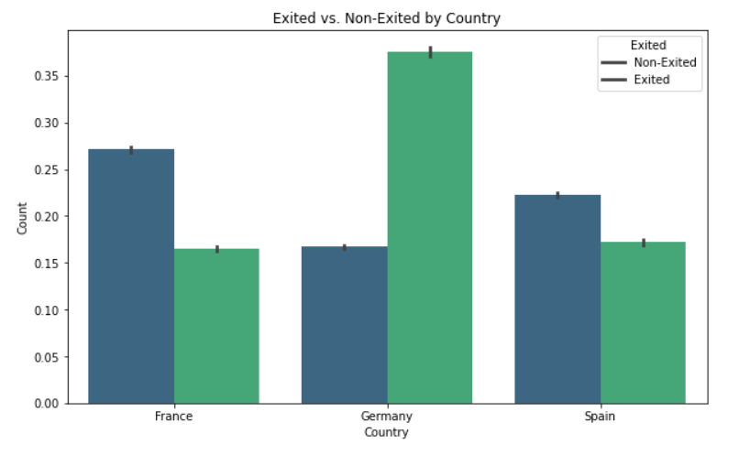

Slide 13
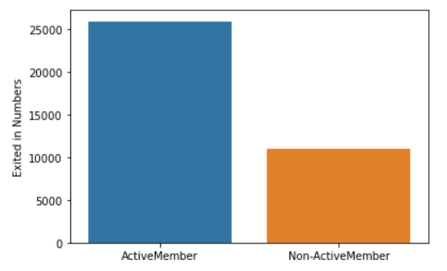

Slide 14
Machine learning predictions
I split the data into 70% training data and 30% test data and the model was trained using the packages and libraries such as pandas, scikit-learn, seaborn.
Multiple models were trained to predict customer churn: After training the models, we evaluated their performance on the test set. The evaluation metrics are crucial for understanding the effectiveness of the models in predicting customer churn.

Slide 15
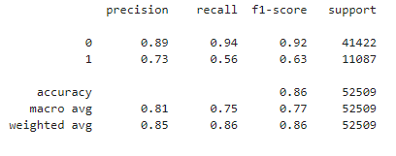
Logisti
Regression models used in this project are:
Decision Tree Regression
Random Forest Regression
Logistic Regression
1. Decision Tree Regression

Slide 16
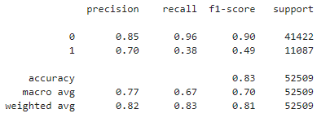
Random Forest Regression

Slide 17
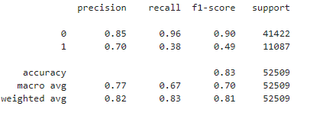
Logistic Regression

Slide 18
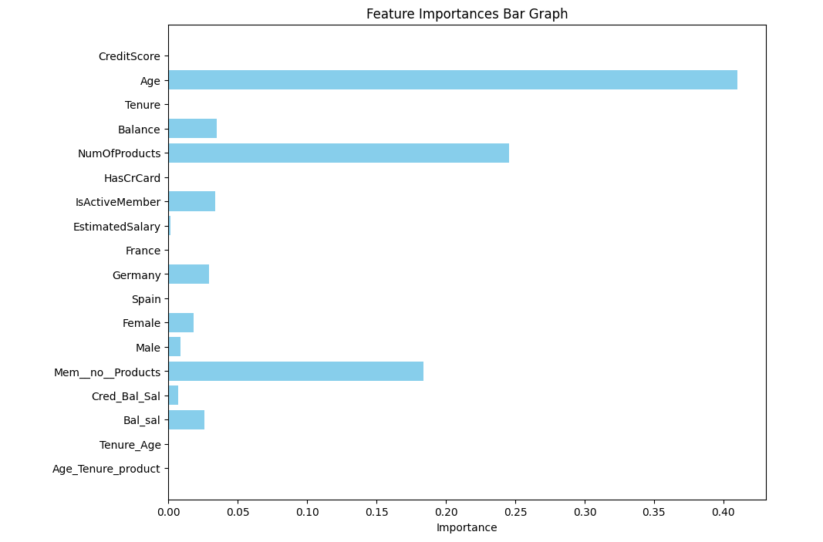

Slide 19
Web Application
Steamlit web application utilizes a pre-trained machine learning model to predict Customer churn based on user input.
Users input the credit score, age, tenure, balance, num_of_products, has_cr_card, is_active_member, estimated salary, France, Germany, Spain, Female, Male, mem_no_products, cred_bal_sal, balance, tenure_age, age_tenure_product. Predict and display the result. By integrating machine learning with web technology, the model predicts customer churn based on the user input.

Slide 20
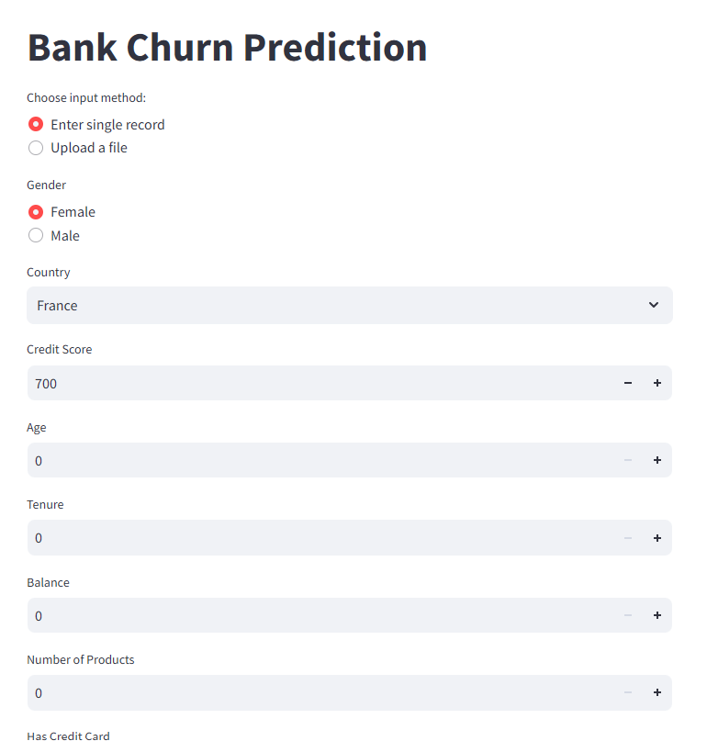
Web Application

Slide 21
Conclusion
The ultimate objective is to develop a predictive tool that aids in early identification of at-risk customers, enabling proactive retention strategies and reducing churn for better business outcomes.
Decision Tree and Random Forest models reached about 86% accuracy.
Random Forest had higher precision for predicting churned customers.
Both models need better recall and F1-scores for churned customers.
Logistic Regression model was slightly less accurate at 83%.

Slide 22
Thank you

