Slide 1
Alfresco webscripts

Slide 2

Agenda
RESTful services – Introduction
Spring Dependency Injection
Freemarker Overview
Java Backed web scripts
Webscript architecture
Java Backed webscripts - Demo
Types of Webscripts
JS Webscripts-Demo
Alfresco API -Overview

Slide 3


Recap
Alfresco Developer
ADF
Alfresco process services
Further Extension points
Web scripts
Share application & Basic Customization
Why Share?
Architecture
What is Alfresco CMS
Java Developer

Slide 4
RESTful Services

Slide 5
A RESTful service - Introduction
REST - REpresentational State Transfer
------------------------------------------------------
It’s not a Standard ! It’s an Architectural Style
Resource based –
Talks about Noun or things instead of Verb or action
Identify by URI Eg: cts/user/{John}
Representations
Talks about how a resource is getting manipulated
Typically JSON or XML
Example :
Resource : John
Service : GET
Representation :
Address, name, phone number
JSON or XML format
5

Slide 6
The fundamental constraints are
Uniform Interface
Stateless
Cacheable
Client-Server
Layered System
Code on Demand (optional)
Decouples architecture by separating Client and Server communication via request and response
This means :
Uses HTTP Vebs ( GET, PUT, POST, DELETE)
URI as resources
Get status and representation in HTTP response body
Request
Client
Server
Response
6

Slide 7
Violating any constraint other than Code on Demand is strictly not RESTful
Compliance with REST allows
Scalability
Maintanability
Visibility
Portability etc…
It is used to build Web services that are lightweight, maintainable, and scalable
A service based on REST is called a RESTful service
7

Slide 8
HTTP Methods
GET : Retrieve data from specific resource
POST : Submit data to be processed to a specific resource
PUT : Update a specified resource
DELETE : Delete a specified resource

Slide 9
HTTP Response Code
HTTP Verb | CRUD | Entire Collection (e.g. /customers) | Specific Item (e.g. /customers/{id})
POST | Create | 201 (Created), 'Location' header with link to /customers/{id} containing new ID. | 404 (Not Found), 409 (Conflict) if resource already exists..
GET | Read | 200 (OK), list of customers. Use pagination, sorting and filtering to navigate big lists. | 200 (OK), single customer. 404 (Not Found), if ID not found or invalid.
PUT | Update/Replace | 405 (Method Not Allowed), unless you want to update/replace every resource in the entire collection. | 200 (OK) or 204 (No Content). 404 (Not Found), if ID not found or invalid.
DELETE | Delete | 405 (Method Not Allowed), unless you want to delete the whole collection—not often desirable. | 200 (OK). 404 (Not Found), if ID not found or invalid.

Slide 10
Freemarker Overview

Slide 11
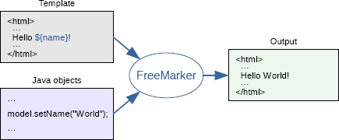
Apache Freemarker
FreeMarker is a template engine for java applications
A Java library to generate text output
Freemarker is used in Alfresco application for
Email templates
UI form field rendering
View engine for Webscripts
Ref : http://freemarker.org/docs/dgui_quickstart_basics.html

Slide 12
Powerful template language:
Conditional blocks, iterations, assignments, string and arithmetic operations and formatting, macros and functions, including other templates, escaping by default (optional), and many more
Multipurpose and lightweight:
Zero dependencies, any output format, can load templates from any place (pluggable), many configuration options
Internationalization/localization-aware:
Locale sensitive number and date/time formatting, localized template variations.
XML processing capabilities:
Drop XML DOM-s into the data-model and traverse them, or even process them declaratively
Versatile data-model:
Java objects are exposed to the template as a tree of variables through pluggable adapters, which decides how the template sees them.

Slide 13
Freemarker - Examples
Built-ins for strings
cap_first ${“green mouse"?cap_first} ----> GREEN mouse
index_of "abcabc"?index_of("bc") ----> 1
Replace ${"aaaaa"?replace("aaa", "X")} - --- Xaa
Trim (${" green mouse "?trim}) -- (green mouse)
Ref : http://freemarker.org/docs/ref_builtins_string.html
Built-ins for sequences
<#assign colors = ["red", "green", "blue"]> ${colors?join(", ")}
<#assign ls = ["whale", "Barbara", "zeppelin", "aardvark", "beetroot"]?sort>
<#list ls as i>${i} </#list>
Ref: http://freemarker.org/docs/ref_builtins_sequence.html

Slide 14
Loop variable built-ins
<#-- Note: x is a loop variable -->
<#list ['a', 'b', 'c'] as x> ${x?index} </#list>
<#list ['a', 'b', 'c'] as i>
${i?counter}: ${i}
</#list>
<#list ['a', 'b', 'c'] as i>
${i?has_next?c}
</#list>
Built-ins for hashes
<#assign myHash = { "name": "mouse", "price": 50 }>
<#list myHash?keys as k> ${k} </#list>
<#assign myHash = { "name": "mouse", "price": 50 }>
<#list myHash?values as v> ${v} </#list>
<#include "/common/copyright.ftl">

Slide 15
Freemarker Demo

Slide 16
Webscripts – Architecture

Slide 17
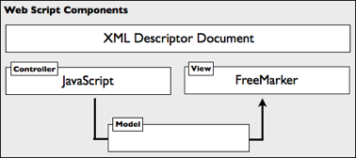
Webscripts - Introduction
Webscript is a RESTful service
Helps to implement our own REST API to communicate with Alfresco share or repository
The Web Script Framework is designed according to the Model View Controller (MVC) pattern

Slide 18
Webscripts Types
There are two kinds of web scripts
Data web scripts
Presentation web scripts
Data web scripts provide a server interface for client applications to query, retrieve, update, and perform processes, typically using request and response formats such as XML and JSON.
Presentation web scripts let you customize and extend the web UI. They typically render HTML and can include browser-hosted JavaScript.

Slide 19
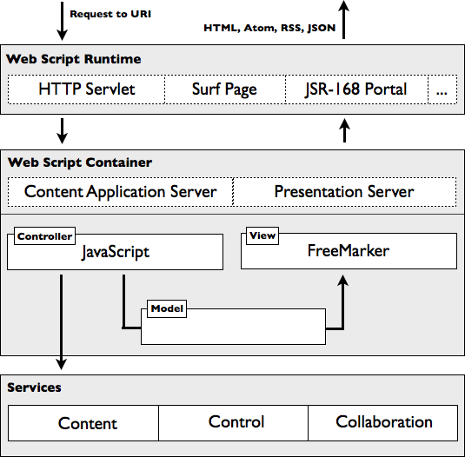
Webscript Framework

Slide 20
Webscript Components
Each web script comprises only the following components:
A description document
An optional controller script
One or more FreeMarker response templates

Slide 21
Webscript – Descriptor file
A web script description document is an XML file that describes the URI and HTTP method that initiates the web script
helloworld.get.desc.xml [<web script id>.<http method>.desc.xml]
<webscript>
<shortname>Hello World Sample Webscript</shortname>
<description>Hands back a greeting</description>
<url>/sample/helloworld</url>
<format default="html"></format>
</webscript>
Advanced Topic Ref : http://docs.alfresco.com/5.2/references/api-wsdl-webscript-descriptor-language-reference.html

Slide 22
Webscript – Controller
A web script controller script is a JavaScript/ Java file that contains the actual logic of a web script.
helloworld.get.js [ <web script id>.<http method>.js ]
model["fromJS"] = "Hello from JS!";
Webscript – Response template
web script response templates render output in the correct format for specific needs, such as HTML, Atom, XML, RSS, JSON, CSV, or any combination of these.
helloworld.get.html.ftl [<web script id>.<httpMethod>.<format>.ftl]
Message: '${fromJS}'
<web script id>.<http method>.<format>.<status code>.ftl

Slide 23
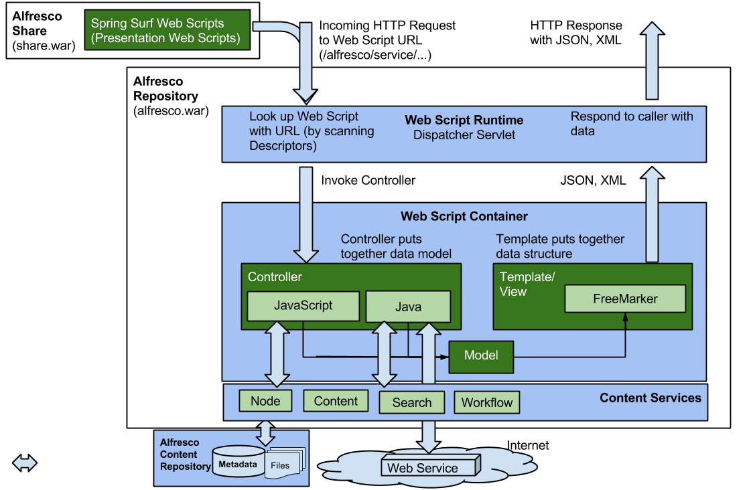
Web script components

Slide 24
File Locations
Navigate to following path Via Share application
Repository > Data Dictionary > Web Scripts Extensions
Repository > Data Dictionary > Scripts
In the file system under Alfresco installation directory
alfresco.war
In the classpath under the folder /alfresco/extension/templates/webscripts
In the classpath under the folder /alfresco/templates/webscripts
share.war
Under classpath /alfresco/site-webscripts
Under classpath /alfresco/web-extension/site-webscripts

Slide 25
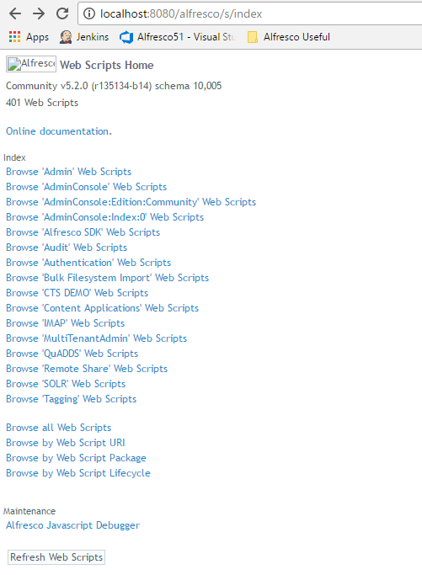
Alfresco Webscript Home
http://localhost:8080/alfresco/s/index

Slide 26
Root scope Objects
JavaScript root objects are available when you are implementing a controller for a Web Script
Ref : http://docs.alfresco.com/5.2/references/api-ws-root.html
https://community.alfresco.com/docs/DOC-5367-javascript-api-cookbook

Slide 27
Javascript Web script - Demo

Slide 28
Java Backed Webscripts

Slide 29
Alfresco API
Repository Java API
Ref : http://docs.alfresco.com/5.2/concepts/dev-services.html
https://community.alfresco.com/docs/DOC-5367-javascript-api-cookbook

Slide 30
Thank you

