Slide 1
National Apartment Association Education Institute
Rental Policies and Procedures
December 2013

Slide 2
Objectives
Effectively complete a rental application
Apply correct procedures in verifying a rental application
Describe the key elements in apartment home contracts
December 2013

Slide 3
Program Objectives
Successfully complete a lease agreement.
Identify tools and activities that help orient a new resident to the apartment community on move-in day.
Recognize the fair housing implications related to the processing of rental paperwork and policies.
December 2013

Slide 4


Leasing
Administration
December 2013

Slide 5
“The Rental Policy”
Statement of Rental Policy
or
Resident Qualifications Criteria
December 2013

Slide 6
Rental Policies
Be consistent with the lease documents.
Do not put the apartment community at risk for liabilities.
Be reasonable, rational, and not unlawfully discriminatory.
Do not lead to fraudulent misrepresentations.
December 2013

Slide 7
The Rental Policy Activity
  Availability
  Monthly rent ratio
  Fees and charges
  Application
  Credit Check
  Residence
  Employment
  Credit Bureau
  Criminal Check
  Identity documents
December 2013

Slide 8
The Rental Policy Activity
  Application Fee
  Age
  Roommates
  Occupants
  Vehicles
  Water Furniture/
  Aquariums
  Rental Payment
  Renters Insurance
  Miscellaneous
December 2013

Slide 9

Completing the Application
  Patience
  Attention to Detail
  Accuracy
December 2013

Slide 10
“What does this mean?”
OCCUPATION
Number of children, Name(s), Age(s)
Name of others that live in the apartment)
PETS
Animals and description (only one animal per apartment)
Animals weighing more than 25 lbs. are prohibited
December 2013

Slide 11
“What does this mean?”
EMPLOYMENT HISTORY
(Applicant) (Employer’s name, address, telephone)
(Position) (Supervisor’s name)
(Gross monthly income) (Length of employment)
(Former employment) (Position) (Length of employment)
(Other means of income)
December 2013

Slide 12
“What does this mean?”
EMPLOYMENT HISTORY
(Co-Applicant) (Employer’s name, address, telephone)
(Position) (Supervisor’s name)
(Gross monthly income) (Length of employment)
(Former employment) (Position) (Length of employment)
(Other means of income)
December 2013

Slide 13
“What does this mean?”
BANKING INFORMATION
(Savings account number) (Bank)
(Bank Branch)
(Checking account number) (Bank) (Bank Branch)
December 2013

Slide 14

“What does this mean?”
CARS / OTHER VECHILCES
(Account number) (Financed by)
(Account number) (Financed by)
(Driver’s license number) (Make) (Model) (Registered to)
(Driver’s license number) (Make) (Model) (Registered to)
If you have a motorcycle, a camper, a boat that you intend to keep here, please identify them by indicating information and numbers.)
December 2013

Slide 15
“What does this mean?”
REFERENCES
(Local credit reference) (Address) (Account number)
(Local credit reference) (Address) (Account number)
(Personal reference) (Address) (Telephone number)
(Personal reference) (Address) (Telephone number)
December 2013

Slide 16
Completing the Application
While the Leasing Professional should review the information, the prospect has the ultimate responsibility for the accuracy of the information.
December 2013

Slide 17

Application Verification
Rental history
Employment history
Credit history
Banking and personal references
Criminal background
Identification Documents and verification
December 2013

Slide 18
Rejecting an Application
NOT
APPROVED
December 2013

Slide 19
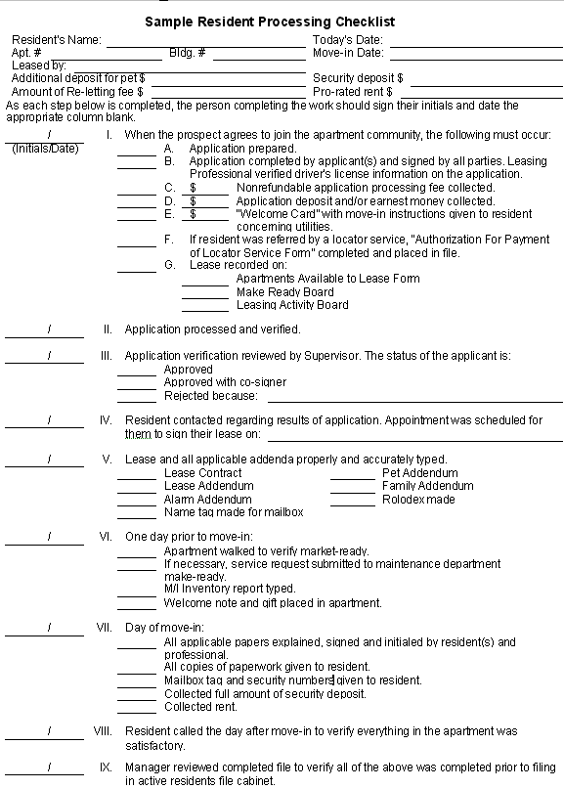
December 2013

Slide 20
The Law of Contracts
contract
A contract is an agreement that the law recognizes as being legally binding on the signature parties.
December 2013

Slide 21
4 Basic Elements of a Contract
The Offer
The Acceptance
Consideration
Capacity
Once these four requirements have been satisfied, a contract will generally be deemed to be enforceable.
December 2013

Slide 22

Elements of Lease Agreements
Contact law
Property law
A lease is a contract whereby the owner of a property permits another person (the resident) to use that property for a period of time in return for rental payment.
December 2013

Slide 23
Elements of Lease Agreements
Offer is made when the application is complete
The parties to a lease reach agreement on the major terms of the lease
There is consideration
The parties are competent and have the capacity to contract
December 2013

Slide 24
Major Terms of the Lease
The address of the apartment to be leased
The apartment number
The amount of rent
How often the rent is to be paid
The term of the lease
December 2013

Slide 25

Lease Duration
Fixed Term
Month-to-Month
Lease at Will
Lease Termination
December 2013

Slide 26
Avoiding Potential Lease Problems
December 2013

Slide 27

Rental Lease
Agreements
December 2013

Slide 28

The Move-In Process
Personal Welcome
Welcome Letter
Move-in Packet
Move-in Gift
Resident Handbook
December 2013

Slide 29



Resident Relations
BE AVAILABLE ON MOVE-IN DAY
T
U
R
N
O
V
E
R
P
R
O
F
I
T
S
December 2013

Slide 30

ACTIVITY
“Market Trust”
December 2013

Slide 31

Fair Housing Implications
Be consistent
Treat everyone the same
Do not deny housing when it is available
Use the same qualification criteria for everyone
Do not steer
Do not overemphasize drawbacks
Offer the same assistance to all new residents
Use the same process in verifying and reviewing all
applications
December 2013

Slide 32
Fair Housing
2 Golden Rules
Treat everyone the same
Be consistent
December 2013

Slide 33
Summary
Effectively complete a rental application.
Apply correct procedures in verifying a rental application.
Describe the key elements in apartment home contracts.
December 2013

Slide 34
Summary
Successfully complete a leasing agreement.
Identify tools and activities that help orient a new resident to their apartment community on move-in day.
Recognize the fair housing implications related to the processing of rental paperwork and policies.
December 2013

Slide 35
Rental Policies and Procedures
December 2013

