Slide 1


Restricted Area Monitoring System
Students:
Charan Chowdary Thota (1RV25CY015),
Advik Kamath (1RV25CY005),
Bhuvan G (1RV25CY013),
Kushagra Tater (1RV25CY028),
Mentor: Dr. Jinka Ranganayakalu
RV College of Engineering

Slide 2
Background / Introduction
This project is a hardware-based security system for restricted areas.
Motion detection starts the authentication sequence immediately.
RFID verification allows only authorized personnel.
A 10-second non-blocking timer prevents bypass and tailgating.

Slide 3
Objectives
Prevent unauthorized entry after physical detection.
Enforce a strict 10-second authentication window.
Trigger an alarm for invalid cards or timeouts.
Provide visual and audio feedback.

Slide 4
Methodology
PIR sensor detects movement.
MFRC522 scans the card and validates the UID.
OLED and buzzer show status and alarms.
Non-blocking millis() tracks the countdown.
State logic handles monitoring, access, and breach modes.

Slide 5
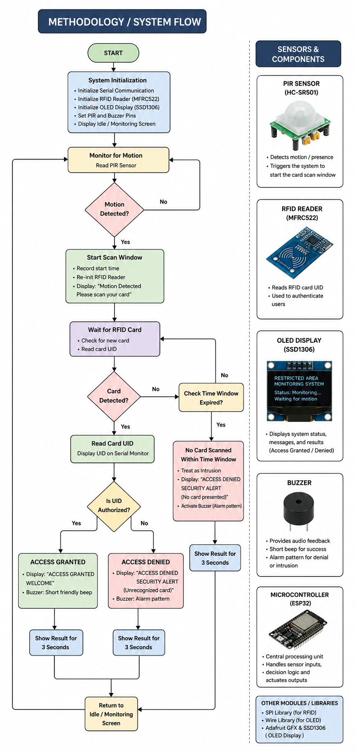
Methodology

Slide 6
Experiment / Circuit Diagram
PIR, RFID, OLED, buzzer, and controller form the setup.
The pin diagram maps the RFID, OLED, PIR, and buzzer wiring.
Workflow: motion → card scan → allow or alarm.
The prototype keeps monitoring and verification active together.

Slide 7
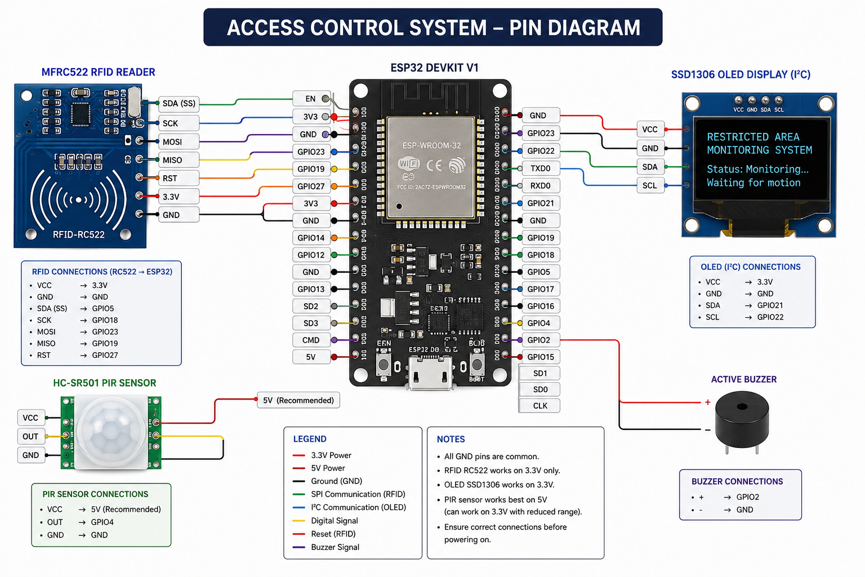
Experiment / Circuit Diagram

Slide 8
Results & Discussion
Valid cards give a welcome message and a short beep.
Invalid cards or timeouts trigger a 6-pulse alarm.
OLED and buzzer give immediate feedback with no lag.
The system forces identity verification at the moment of motion.

Slide 9
Conclusion
Validated across all operational scenarios.
Authorized cards granted access; invalid and timeout cases triggered alarms.
Non-blocking millis() removed processing lag.
Future upgrades: Wi-Fi alerts and cloud logging.

Slide 10
References
A. C. Jose and R. Malekian, “Improving Smart Home Security: Integrating Logical Sensing Into Smart Home,” IEEE Sensors Journal, vol. 17, no. 13, pp. 4269–4286, 2017.
Datasheets and manuals for PIR sensor, MFRC522 RFID reader, SSD1306 OLED, buzzer, and microcontroller.

