Slide 1
Kubernetes

Slide 2
Agenda
Kubernetes Overview
Docker Swarm Vs Kubernetes
Kubernetes Components
Kubernetes Architecture
Kubernetes Pod, Networking, Storage, Volume,
Kubernetes Deployment
Kubernetes in DevOps

Slide 3
What is Kubernetes?
Kubernetes(K8s) is an open-source container-orchestration system for automating application deployment, scaling, and management.
The name Kubernetes originates from Greek, meaning helmsman or pilot. It was founded by Joe Beda, Brendan Burns and Craig McLuckie who were quickly joined by other Google engineers including Brian Grant and Tim Hockin, and was first announced by Google in mid-2014.
Kubernetes development and design are heavily influenced by Google's Borg system Kubernetes system is implemented in Go.
It was originally designed by Google, and is now maintained by the Cloud Native Computing Foundation

Slide 4
Why Containers?
Containers on the same OS kernel are lighter and smaller.
It takes less time to start container.
Better resource utilization compared to VMs
Boot-up process is short and takes few seconds
Deployment Speed/Agility – Docker containers house the minimal requirements for running the application, enabling quick and lightweight deployment.
Portability – Because containers are essentially independent self-sufficient application bundles, they can be run across machines without compatibility issues.
Reuse – Containers can be versioned, archived, shared, and used for rolling back previous versions of an application. Platform configurations can essentially be managed as code.

Slide 5
Kubernetes Alternatives and Competitors
Amazon ECS
Docker Platform(Docker Swarm)
Apache Mesos
Helios
Marathon
Centurion
Cloudify

Slide 6
Difference between Docker Swarm and Kubernetes
Kubernetes
Docker Swarm
An application can be deployed using a combination of pods, deployments, and services (or micro-services).
Complex installation as compared to docker swarm
Kubernetes supports multiple versions of logging and monitoring when the services are deployed within the cluster.
It is a complex system as it offers a unified set of APIs and strong guarantees about the cluster state, which slows down container deployment and scaling.
Kubernetes network is flat, as it enables all pods to communicate with one another.
Applications can be deployed as services (or micro-services)
Simple to install
Docker Swarm is supported for only monitoring with the third party applications.
Docker Swarm can deploy containers fast
In a Docker Swarm, a node joining a cluster creates an overlay network of services that span all of the hosts in the Swarm

Slide 7
Benefits of Kubernetes
Kubernetes is backed by the Cloud Native Computing Foundation (CNCF).
Service discovery and load balancing
Storage orchestration
Automated rollouts and rollbacks
Automatic bin packing
Self-healing
Secret and configuration management

Slide 8
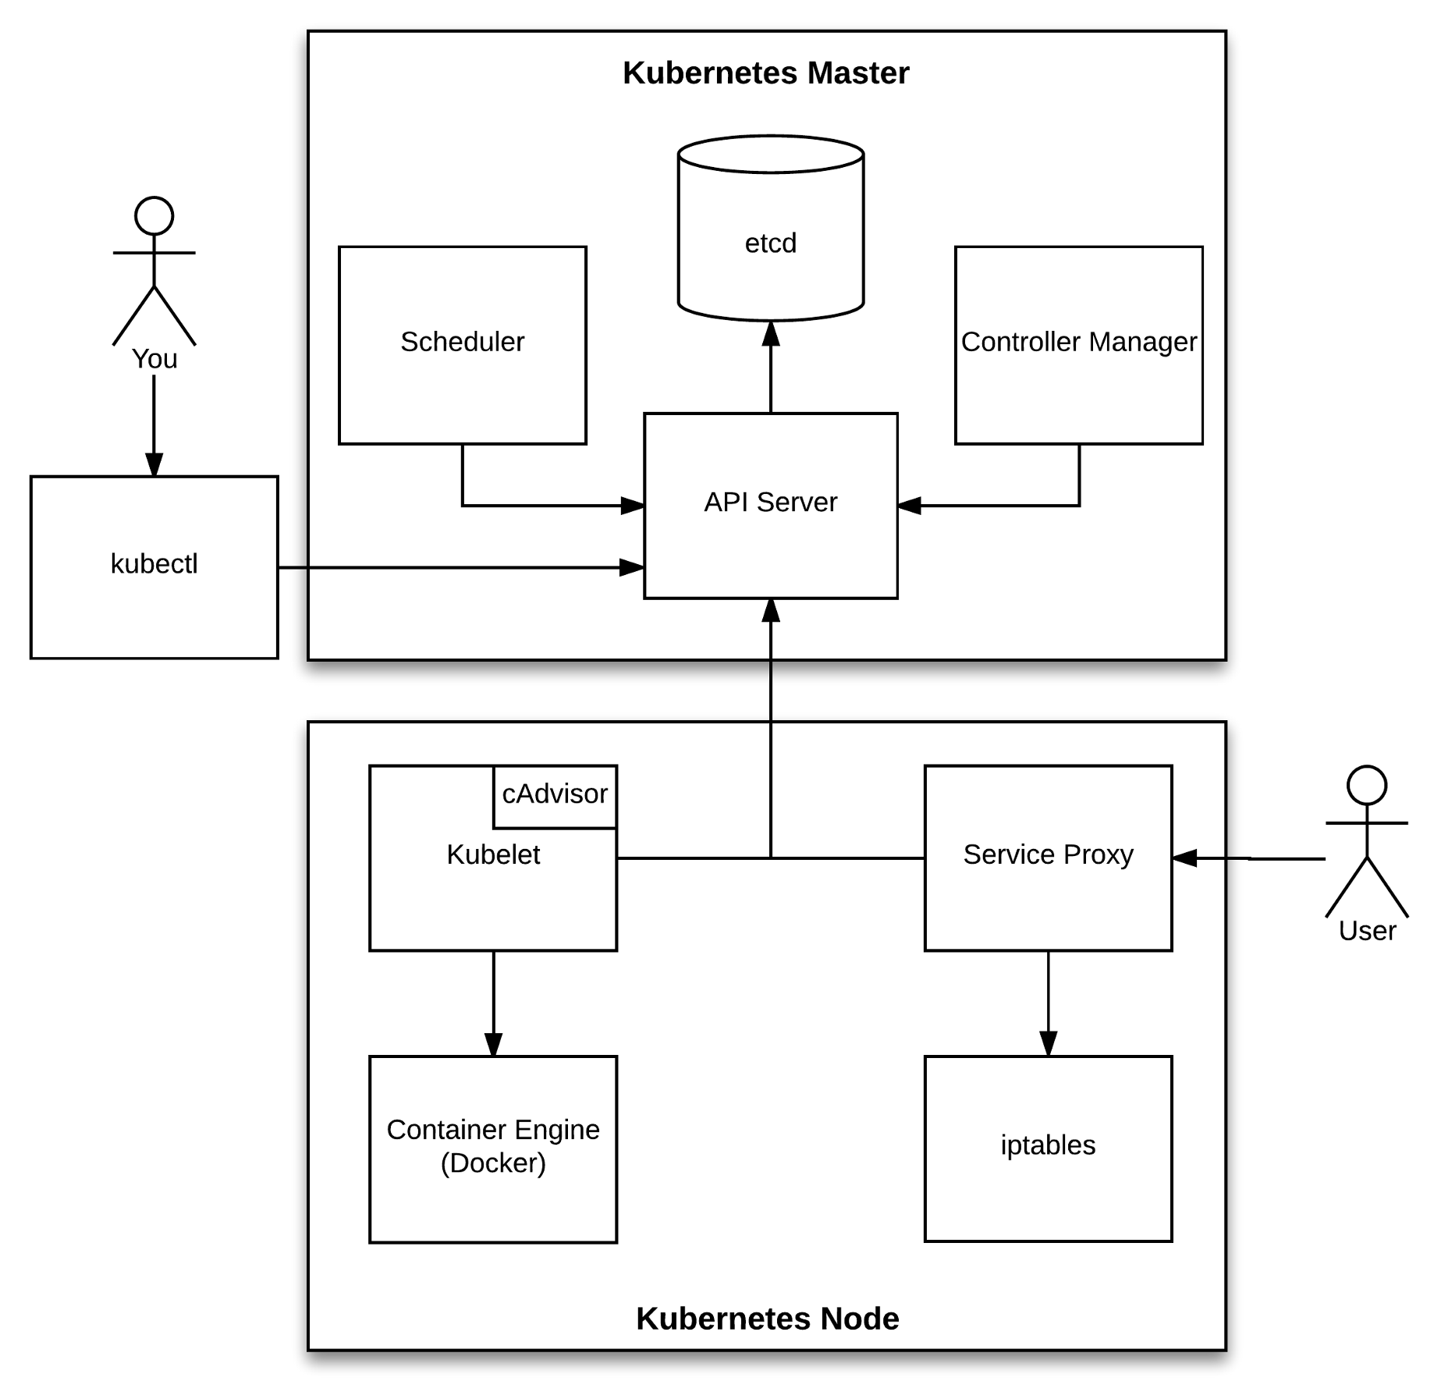
Kubernetes Architecture

Slide 9
Components of Kubernetes
Master Components:
Kube-apiserver: Component on the master that exposes the Kubernetes API. It is the front-end for the Kubernetes control plane.
Etcd: Consistent and highly-available key value store used as Kubernetes’ backing store for all cluster data. Kubernetes cluster uses etcd as its backing store
Kube-scheduler: Component on the master that watches newly created pods that have no node assigned, and selects a node for them to run on.
Kube Controller Manager: It is a separate process, but to reduce complexity, they are all compiled into a single binary and run in a single process.
Node Components:
Kubelet: An agent that runs on each node in the cluster. It makes sure that containers are running in a pod.
Kube-proxy: It is a network proxy that runs on each node in your cluster, implementing part of the Kubernetes service concept.
Container Runtime: The container runtime is the software that is responsible for running containers.

Slide 10
PODs
A Pod is the basic execution unit of a Kubernetes application–the smallest and simplest unit in the Kubernetes object model that you create or deploy
Pods that run a single container. The “one-container-per-Pod” model is the most common Kubernetes use case; in this case, you can think of a Pod as a wrapper around a single container, and Kubernetes manages the Pods rather than the containers directly.
Pods that run multiple containers that need to work together. A Pod might encapsulate an application composed of multiple co-located containers that are tightly coupled and need to share resources.
Pods are managed by a replication controller, which creates and destroys replicas of pods as needed. Individual pods can also be created outside of a replication controller.
Pods have labels for the application name, role, environment, version, etc. Each of these can be combined in order to select all pods with a certain role, a certain application, or a more complex query

Slide 11
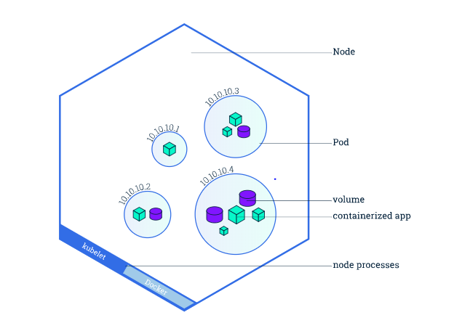

Slide 12
Networking
Each Pod is assigned a unique IP address.
Every container in a Pod shares the network namespace, including the IP address and network ports.
Containers inside a Pod can communicate with one another using localhost.
When containers in a Pod communicate with entities outside the Pod, they must coordinate how they use the shared network resources (such as ports).
Kubernetes does not provide any default network implementation, rather it only defines
the model and leaves to other tools to implement it.

Slide 13
Storage
In Kubernetes, a volume can be thought of as a directory which is accessible to the containers in a pod.
Types of volumes supported by Kubernetes:
awsElasticBlockStorage azureDisk
azureFile emptydir
hostpath gcePersistantDisk
cinder NFS
ISCSI Vsphere Volume
All containers in the Pod can access the shared volumes, allowing those containers to share data.
A key advantage of Kubernetes volume is, it supports different kind of storage wherein the pod can use multiple of them at the same time.
Persistent Volume(PV) and Persistent Volume Claim(PVC) are supported by Kubernetes.

Slide 14
Deployment
A deployment is an object in Kubernetes that lets you manage a set of identical pods.
Without a deployment, you’d need to create, update, and delete a bunch of pods manually.
With a deployment, you declare a single object in a YAML file. This object is responsible for creating the pods, making sure they stay up to date, and ensuring there are enough of them running
We can also easily auto scale our applications using a Kubernetes deployment.

Slide 15
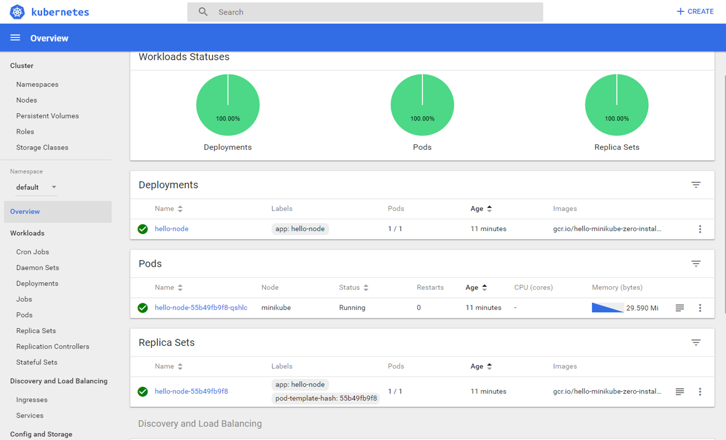
Kubernetes Dashboard

Slide 16
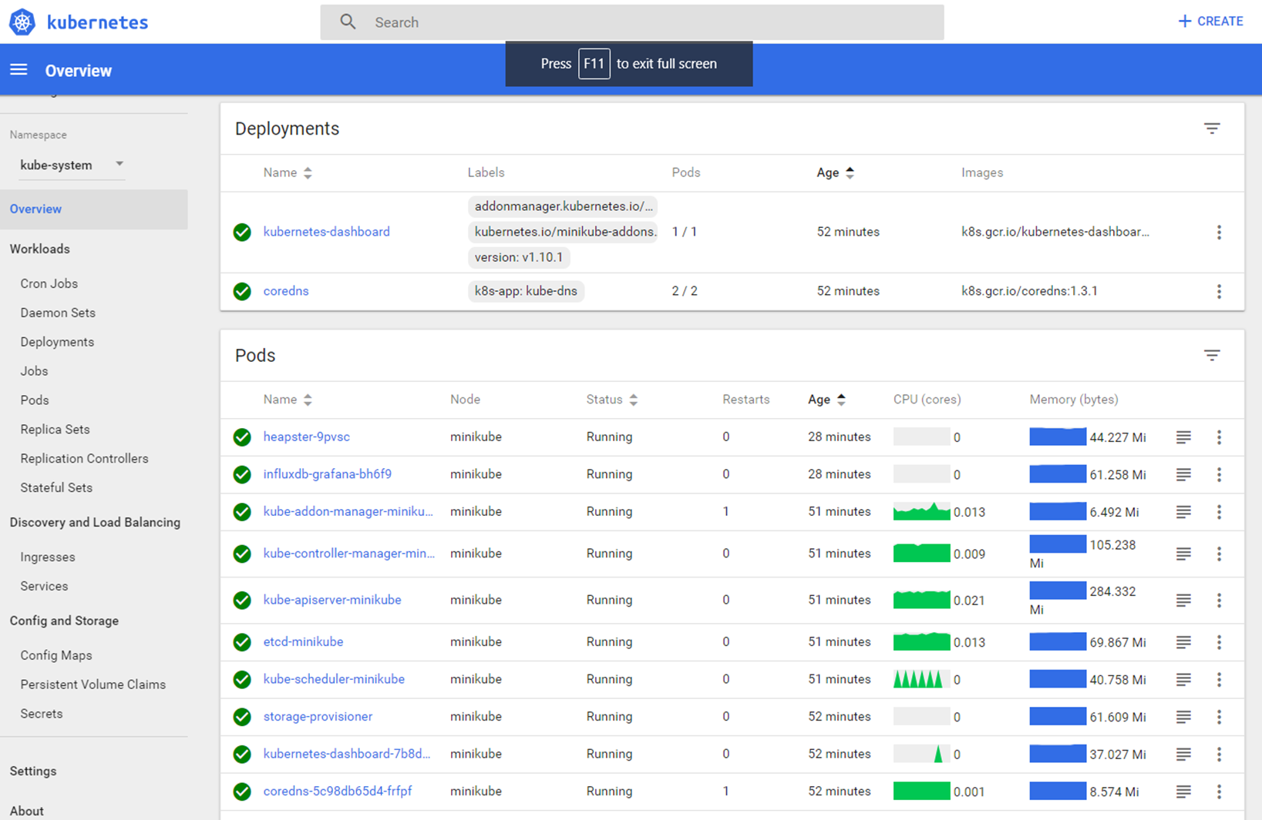

Slide 17
Kubernetes strength for DevOps
Kubernetes within the container ecosystem has impacted the CI/CD process. Instead of shifting code between different virtual machines in different environments, the same code can be moved across container clusters with Kubernetes
Hassle-free solution for making development, testing and production environment consistent
Provides simple updates
Support for multiple frameworks
Offers Scalability
Less time is taken to the onboard new application
Increase in developer’s productivity
Solving Infrastructure problems
Server usage efficiency

Slide 18
THANK YOU

