Slide 1


10/03/2025
LiveDocs: A Peer-to-Peer Real-Time Collaborative Document Editor Using WebRTC and CRDTs
Team Members:
Charankumar E G D [921321205029]
Arunprasad S [921321205015]
Dharani Dharan R [921321205032]
Mentor:
Mrs. A. Sangeetha, M.E., Ph.D.,
Assistant Professor - Information Technology

Slide 2
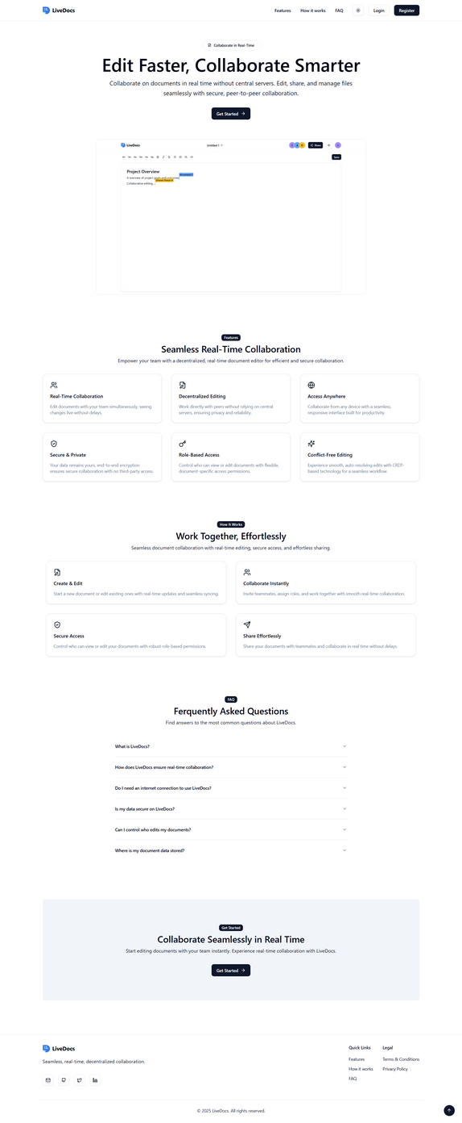
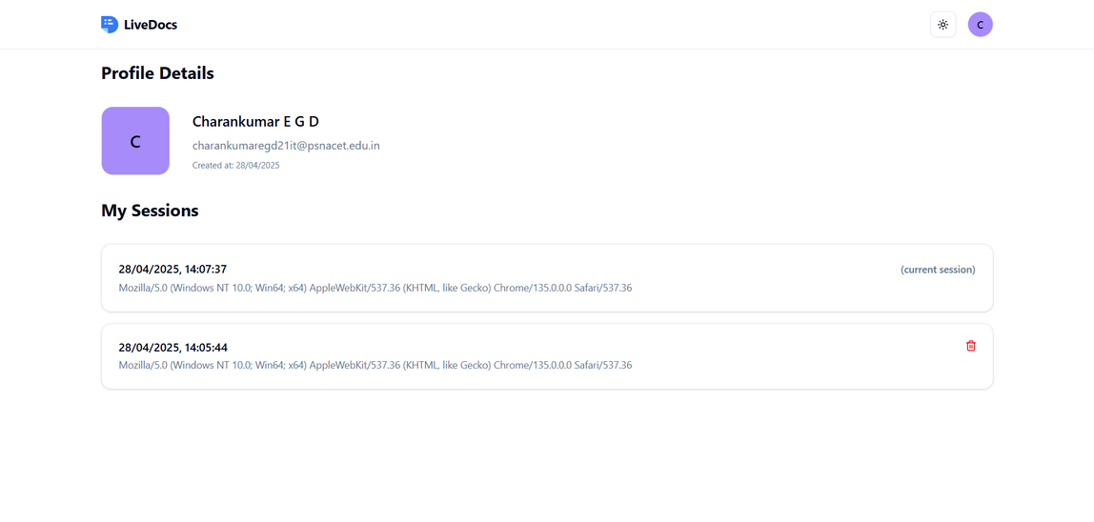
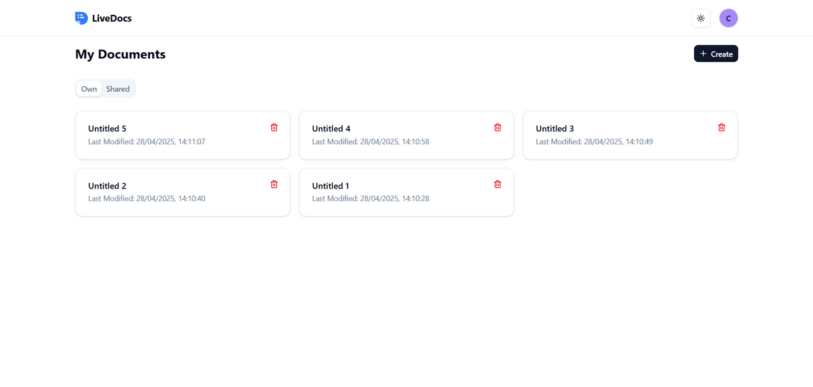
Prototype

Slide 3
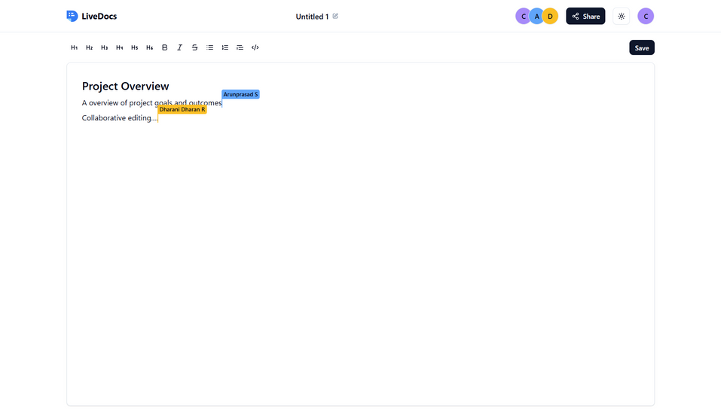
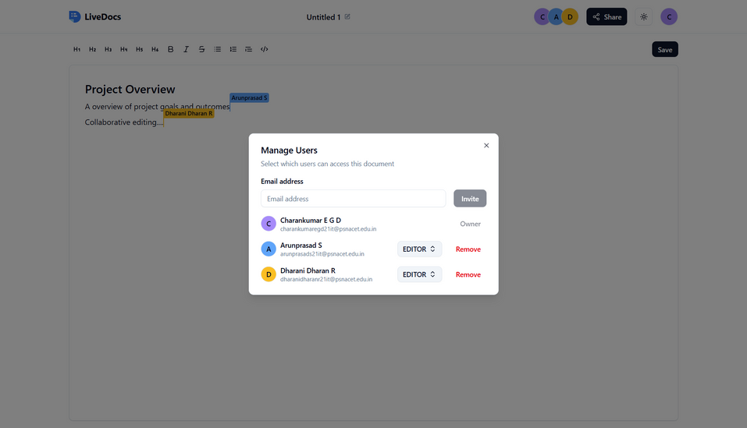
Prototype

Slide 4
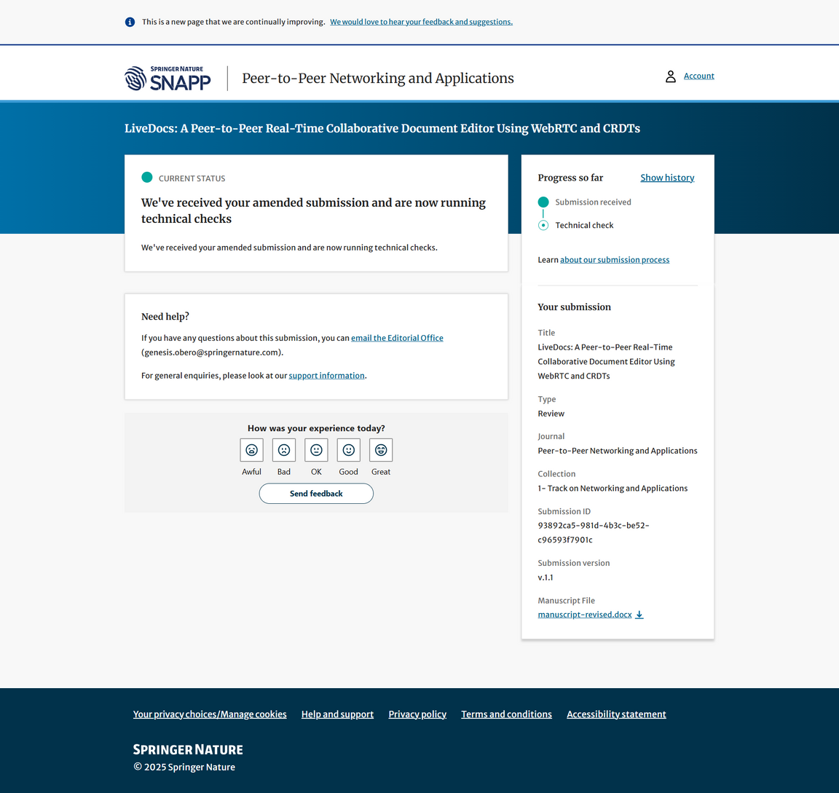
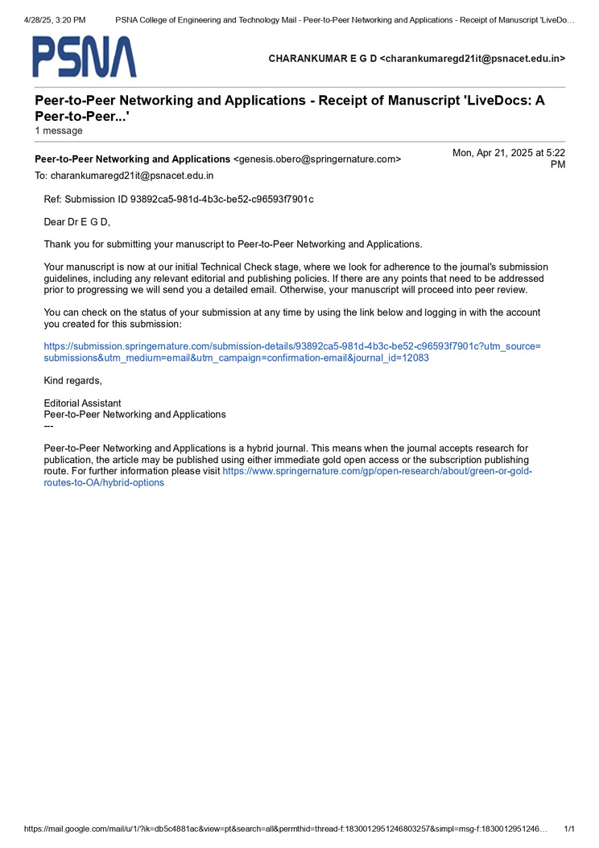
Progress in Journal

Slide 5
Thank you

