Slide 1
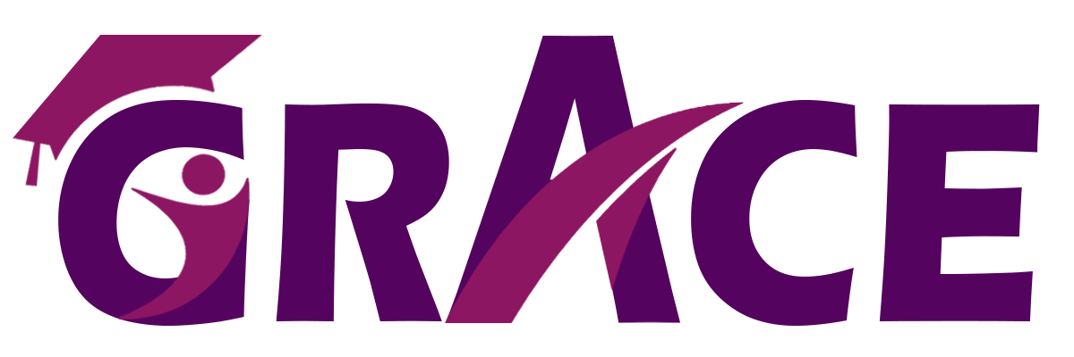
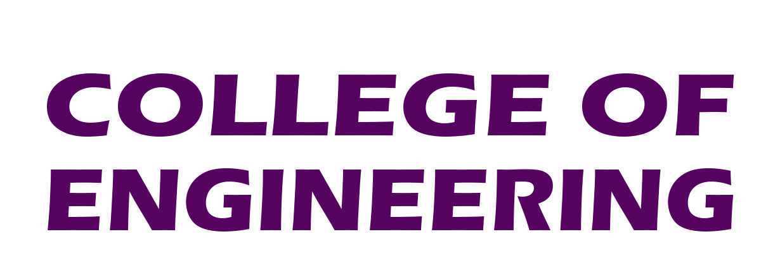

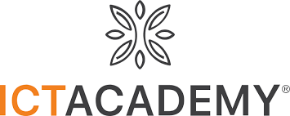
Thoothukudi - 05
International Conference on Recent Innovation in Technologies (ICRIT’25) during 14th & 15th May 2025
Paper ID : ICRIT211
LIVEDOCS: A PEER-TO-PEER REAL-TIME COLLABORATIVE DOCUMENT EDITOR USING WEBRTC AND CRDTS
Charankumar E G D
Arunprasad S
Dharani Dharan R
PSNA College of Engineering and Technology

Slide 2
PRESENTATION CONTENT
Introduction
Literature Review
Challenges
Objective
Implementation of Proposed Work
Results & Impact
Summary

Slide 3
INTRODUCTION
LiveDocs is a decentralized, real-time collaborative document editor that enables seamless collaboration without centralized servers. It leverages WebRTC for peer-to-peer (P2P) communication and Yjs (CRDTs) for distributed synchronization, ensuring low-latency collaboration, fault tolerance, and scalability. Key features include real-time editing, role-based permissions, and JWT-based authentication for secure access. By eliminating centralized infrastructure, LiveDocs reduces server costs, enhances scalability, and improves fault tolerance, making it a powerful alternative for teams and enterprises needing real-time collaboration.

Slide 4
LITERATURE REVIEW
S.NO | PAPER TITLE | AUTHOR | CONCEPT | LIMITATIONS
1 | Performance of real-time collaborative editors at large scale: User perspective | Quang-Vinh Dang, Claudia-Lavinia Ignat – 2016 | Evaluates large-scale collaborative editors using user interaction data and system logs to assess responsiveness and consistency. | Performance degradation observed under high concurrency, limited consideration for network partition scenarios.
2 | A Personal Distributed Real-time Collaborative System | Michalis Konstantopoulos, Nikos Chondros, Mema Roussopoulos – 2020 | A distributed peer-to-peer (P2P) collaborative editing system with decentralized storage, reducing reliance on central servers. | Consistency management becomes complex when multiple users edit simultaneously; relies heavily on stable peer connectivity.
3 | Collaborative Code Editors - Enabling Real-Time Multi-User Coding and Knowledge Sharing | Khushwant Virdi, Anup Lal Yadav, Azhar Ashraf Gadoo, Navjot Singh Talwandi – 2023 | Examines collaborative code editors, focusing on WebSocket communication, OT algorithms, and conflict resolution, with a prototype evaluation and comparison to existing platforms. | Persistent issues like latency, synchronization, and conflict resolution remain, requiring further innovation for larger-scale effectiveness.
4 | SecureC2Edit: A Framework for Secure Collaborative and Concurrent Document Editing | Shashank Arora, Pradeep K. Atrey – 2023 | Proposes a secure framework for concurrent collaborative editing, integrating cryptographic controls to ensure content integrity. | Increased processing overhead due to encryption; real-time performance is affected in low-bandwidth environments.

Slide 5
CHALLENGES
Traditional real-time document editors face significant challenges due to high latency and dependence on centralized servers for synchronization and storage. This reliance introduces scalability limitations, single point of failure, and potential privacy risks. As user demand increases, latency issues degrade the collaborative experience, making real-time editing less efficient. To address these challenges, a decentralized approach is required to ensure low-latency, fault-tolerant, and scalable real-time document collaboration without reliance on a central server.

Slide 6
OBJECTIVE
Network Dependencies: WebRTC requires a stable network connection for efficient P2P communication.
Leverage WebRTC-based P2P communication for low-latency and efficient real-time collaboration.
Integrate Yjs (CRDTs) to enable seamless, conflict-free data synchronization across users.
Provide an intuitive UI with modern design for a smooth and responsive editing experience.
Ensure security with JWT authentication and role-based access.

Slide 7
IMPLEMENTATION OF PROPOSED WORK
Use Next.js for the frontend with a custom collaborative editor.
Apply Yjs (CRDTs) for real-time updates and conflict resolution.
Leverage WebRTC for direct peer-to-peer communication and low latency.
Implement JWT authentication for secure access control.
Store documents in PostgreSQL for reliable backups and fast access.
Enable collaboration features like presence and roles
Optimize WebRTC and CRDTs for low latency, scalability, and efficient sync.

Slide 8
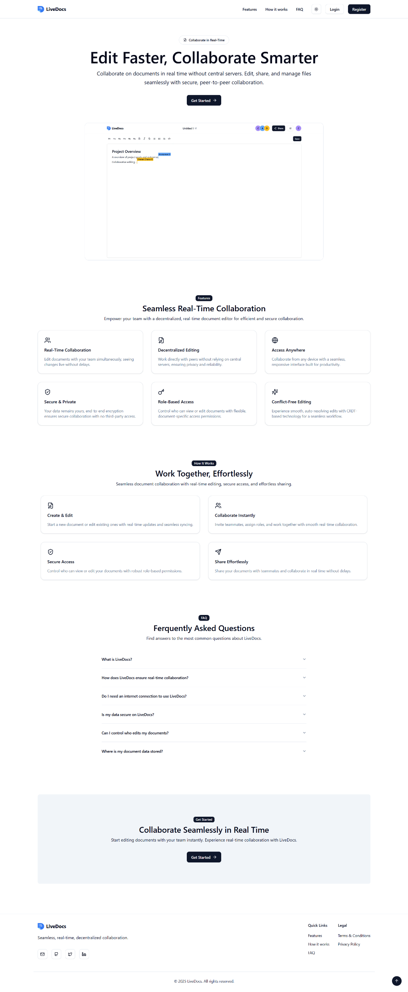
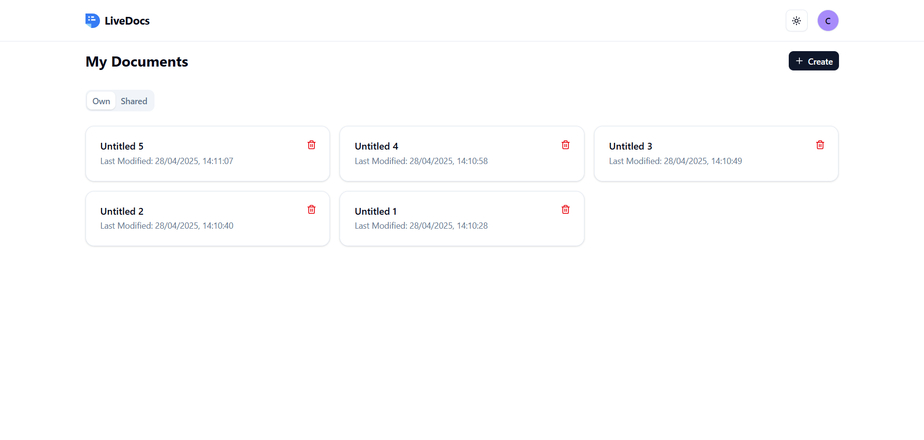
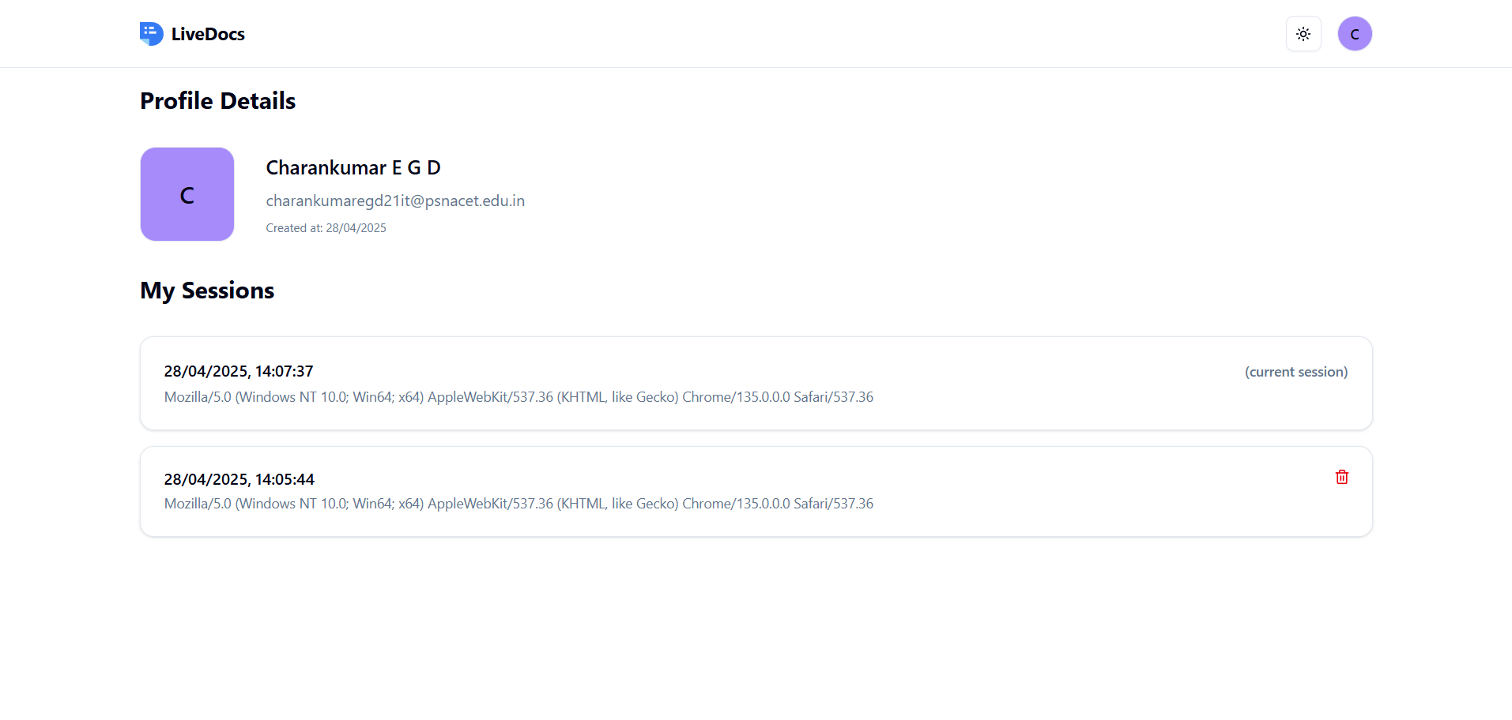
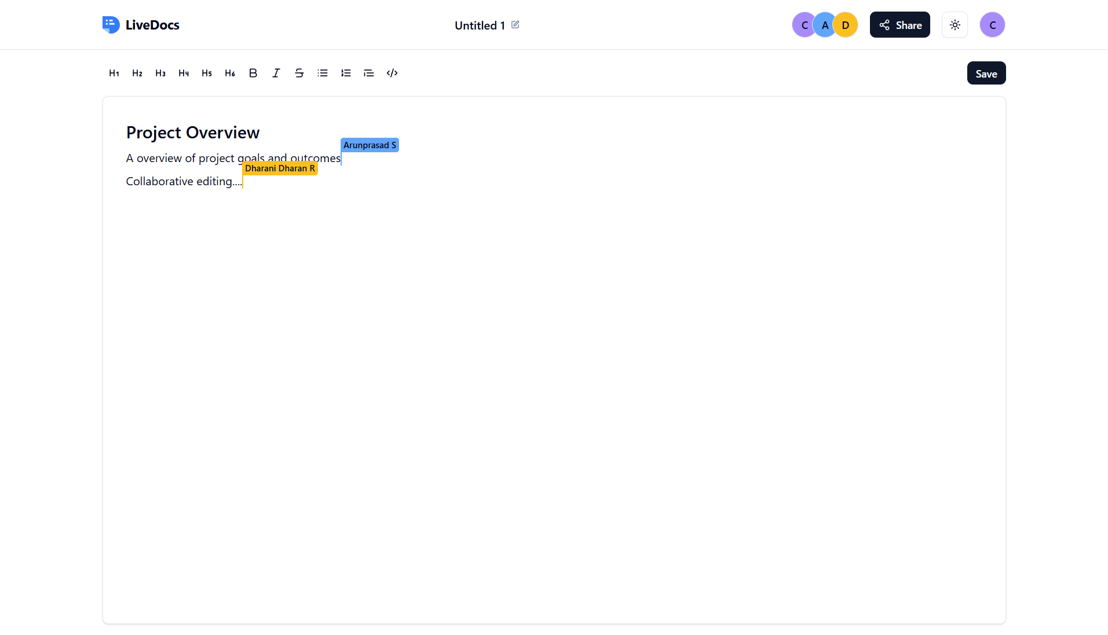
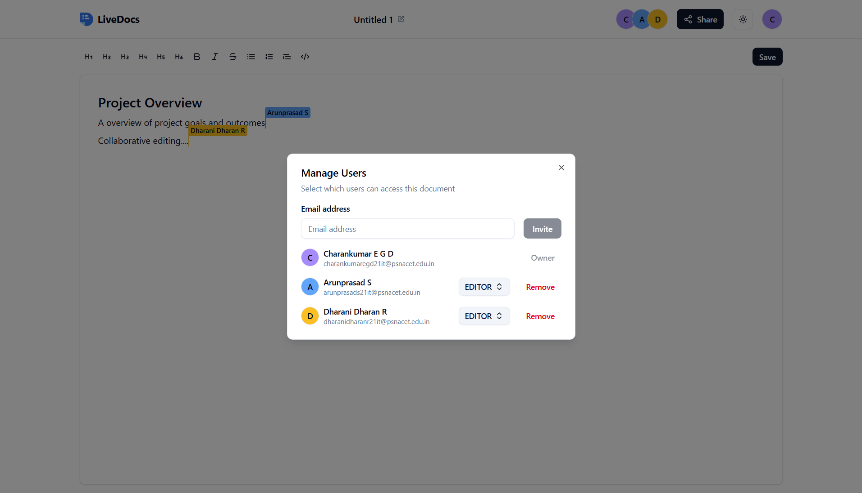
RESULTS & IMPACT

Slide 9
SUMMARY
LiveDocs is a decentralized, peer-to-peer document editor using WebRTC and Yjs for real-time collaboration.
It improves privacy, scalability, and fault tolerance by eliminating centralized servers.
JWT-based authentication ensures secure document access, though challenges remain with persistence and resource usage.
Future upgrades like hybrid storage, mobile support, and AI tools aim to enhance performance and usability.

Slide 10
THANK YOU

