Slide 1


Slide 2
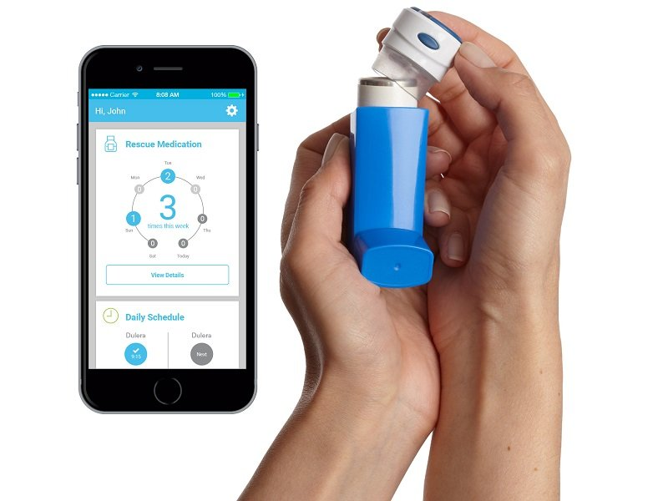
ASTHMA MANAGING DEVICE
Team: The Variants
Team Members:
Ch Sai Charan T Sai Gopi
G Sri Krishna Kireeti G Hemanth Sai

Slide 3
ABSTRACT
Asthma is increasing around the world – and no one really knows why.
For many patients, managing their asthma can be difficult – for some symptoms may be hard to control, and attacks may appear unpredictable.
Doctors also struggle to unpick what might be triggering attacks and have little idea if their patients are taking their medication properly, if at all.
Also, patients are struggling to detect asthma before it’s attack.
With almost 235 million people living with asthma in India, new 'smart inhalers' may provide better ways of treating the disease and help scientists understand what is driving this growing global epidemic.

Slide 4
SOLUTION
This project that has combined an asthma inhaler with a range of sensors and mobile technology promises to change this.
This inhaler gathers information about the environment, such as the temperature and humidity. It even collects information about how the patient is using the device, such as shaking the inhaler before pressing the button to receive a dose of their medicine.
This data is connected to the patient on their mobile phone to help them understand and better manage their own symptoms.

Slide 5
PROBLEM
People forget to carry inhaler with them.
People tend to forget to take medication on time.
Proper shaking is not done which is a main factor for efficient usage.
People tend to forget to restock when the medicine inside the inhaler is about to complete.

Slide 6
WORKFLOW REPRESENTATION:

Slide 7
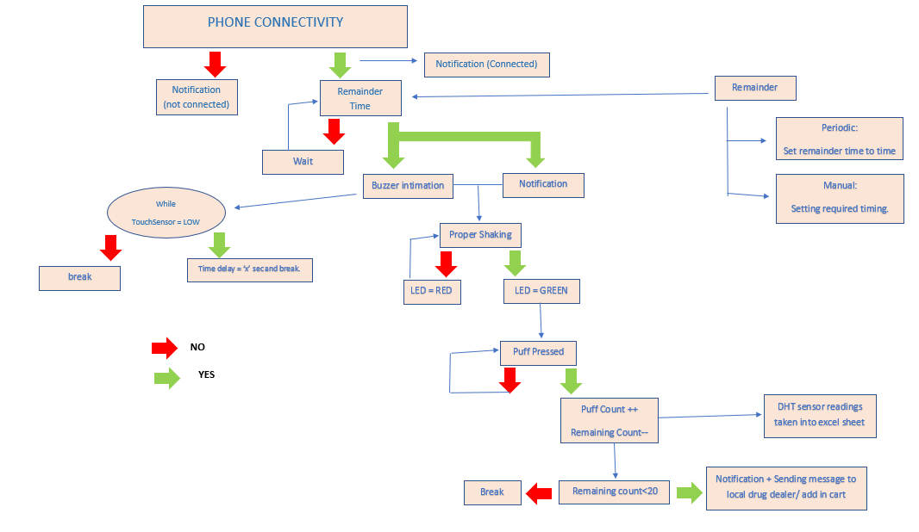

Slide 8
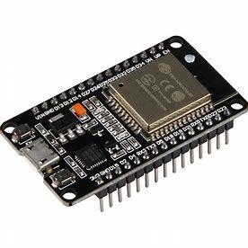
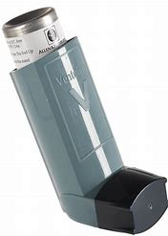
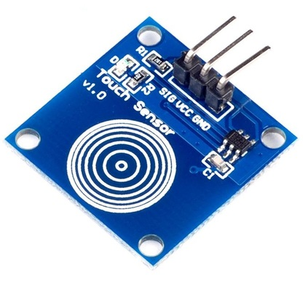
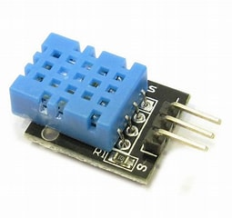
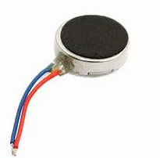
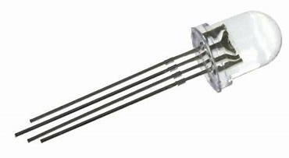
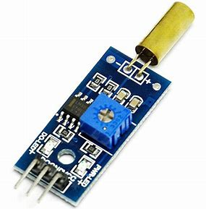
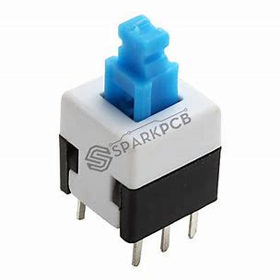
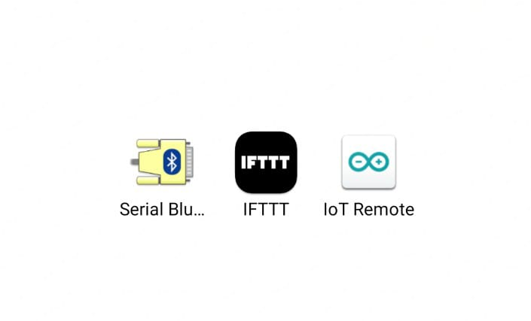
COMPONENTS AND SOFTWARES USED:
Components :
Inhaler
Esp32
Touch sensor
DHT sensor
Tilt sensor
Vibration motor
push button
RGB led
Softwares:
Arduino Iot Cloud
IFTTT trigger
Serial bluetooth terminal

Slide 9
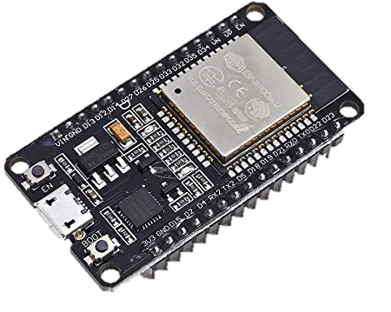
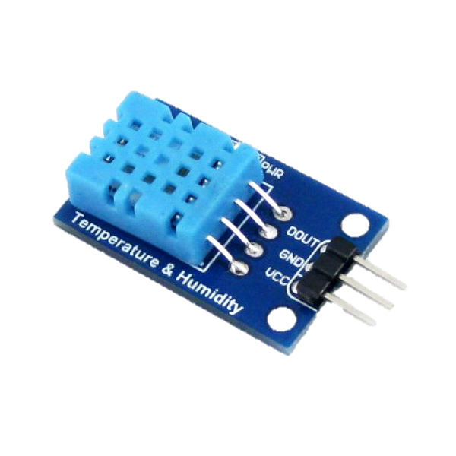
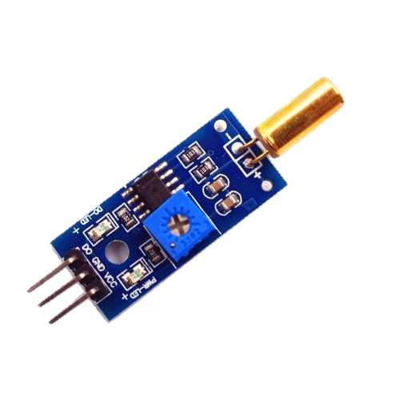
ESP 32 : ESP32 is a series of low-cost, low-power system on a chip microcontrollers with integrated Wi-Fi and dual-mode Bluetooth. ESP 32 acts as an intermediate between the sensors used and the user. We connect ESP 32 to IOT cloud to share data between sensors and the user interface (application).
 | DHT SENSOR: DHT11 is a commonly used Temperature and humidity sensor for prototypes monitoring the ambient temperature and humidity of a given area. DHT sensor is used to calculate surrounding conditions and send alert if these conditions are not suitable to store the inhaler.
TILT SENSOR: A tilt sensor, or tilt switch, is a device used for measuring the tilt of an object in multiple axes with reference to an absolute level plane. Tilt sensors work by detecting changes in angle from a pre-set “zero” state. We use this sensor to count number of shakes since correct shaking an inhaler is a mandatory thing.

Slide 10
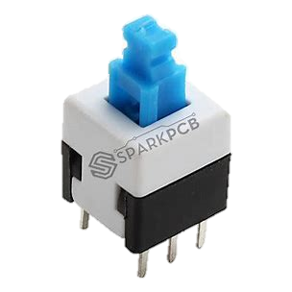
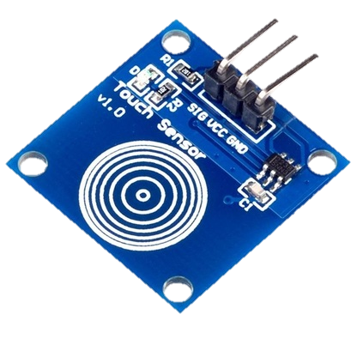
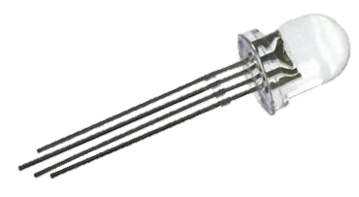
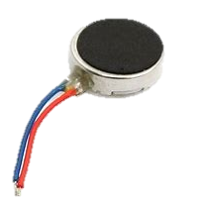
 | PUSH BUTTON and TOUCH SENSOR: Push button is used as counter. i.e. to count number of puffs taken. Touch sensor is used to stop vibration which will be generated to notify the user.
 | RGB and VIBRATION MOTOR: RGB LED acts as an indicator to tilt sensor. i.e. It indicates weather the user has shaken the inhaler properly or not. Vibration motor acts as a remainder to the user. It vibrates at specific time which will be set by the user.
 | IFTTT and IOT CLOUD: These software are used as an intermediate between sensors and end-users.

Slide 11
Business Aspects:
Whom do you need to work with to produce and deliver solution..
Ans :Partnerships between healthcare companies and medtech vendors
Both healthcare companies and medtech vendors can benefit from partnerships around IoT-powered devices and solutions. Together they can develop specific treatment solutions that can have a good traction among patients. Healthcare companies can provide valuable feedback to manufacturers while the latter would implement solutions that are easily integrated into their partner’s hospital ecosystems. In this way, new devices and services can be introduced much faster and function as expected.
Ex: Johnson and Johnson, Wipro GE Healthcare, Medtronics PLC, Novartis etc...
What do u need to have to produce, market and deliver your solution?
Ans :
1. Physical resources, such as raw material, buildings, vehicles, transportation, storage facility, machines and factory.
2. Human resources, or staff, such as a talented engineer or marketing experts. These resources are more important in companies in the knowledge-intensive and creative sectors.
3. Intellectual resources, such as your brand, patents, copyrights, partnerships, and customer databases. This can include recipes for those who deals with food. Or it can include a particular way of doing things (that maybe only you know).
4. Financial resources, such as cash, credit etc.

Slide 12
Customer Relationships:
How do u deliver your solution to customers?
Hospitals, Retail pharmacies, e-commerce websites and general pharmacies.
Who needs your solution?
People suffering with asthma and having smartphones can use our solution.
How many people needs your solution right now?
Around 292 million people are being effected with asthma every year. And nearly 63.7% (186 million) people are having smartphones with good connectivity. Hence, they can use our solution

Slide 13
Customer Segment:
1. Who needs your solution?
Around 292 million people are being effected with asthma every year.
Even if we consider 10% of them buying it, we can easily get our investment within a year.

Slide 14
Revenue Structure:
The global smart inhalers market size was valued at $34 million in 2019 and is estimated to reach $1,406 million by 2026, growing at a CAGR of 58.4% from 2019 to 2026.

Slide 15
REFERENCES:
https://docs.arduino.cc/cloud/iot-cloud
https://platform.ifttt.com/docs
https://www.alliedmarketresearch.com/smart-inhalers-market

Slide 16

BY:
Team Variants

