Slide 1
WELCOME!

Slide 2



unveiling the heroes
A Data-Driven Exploration of Comic Book Characters

Slide 3
marvel dc

Slide 4
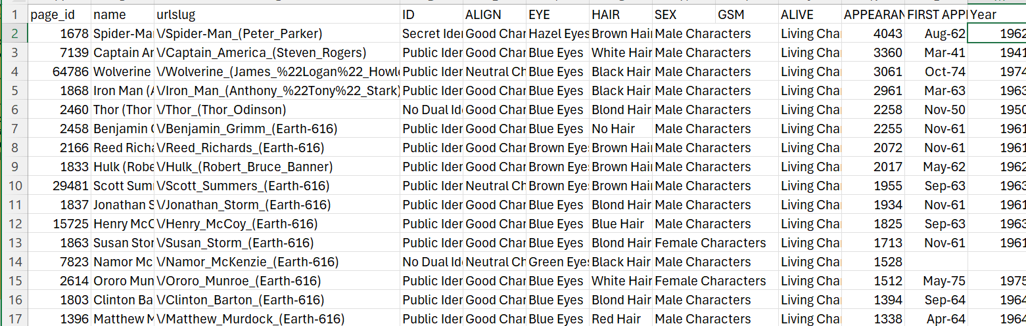
The FiveThirtyEight Comic Characters Dataset

Slide 5
characterstics
01
Character names
04
Debut date
02
Good/evil
05
details
03
gender
Character names and aliases
Debut date
Alignment (good/evil)
Biographical details (origins, powers, occupations)
Gender, eye/hair color, publisher

Slide 6
Unmasking the Trends: Key Research Questions
We're investigating some key questions with this data:

Slide 7
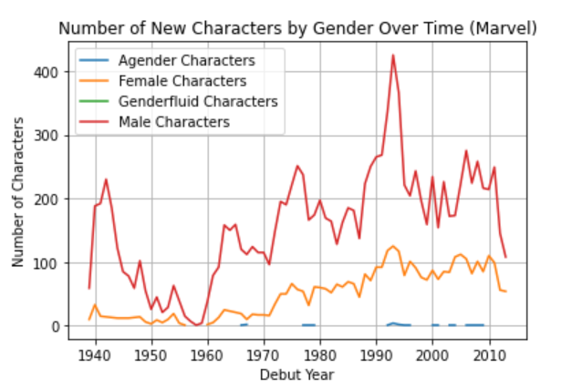
01
Changes in Demographics and Representation Over Time ---

Slide 8
Gender Representation Over Time (Marvel): The line chart visualizes the number of new Marvel characters introduced each year, broken down by gender. We can observe a few notable trends:
For most of the early decades (1940s to 1970s), there was a clear dominance of male characters being introduced compared to female characters.
Starting around the late 1980s and 1990s, there has been a steady increase in the introduction of new female characters, narrowing the gap with male characters.
In more recent years (late 2000s and beyond), the number of new female and male character introductions appears more balanced, suggesting greater gender diversity in modern Marvel comics.

Slide 9
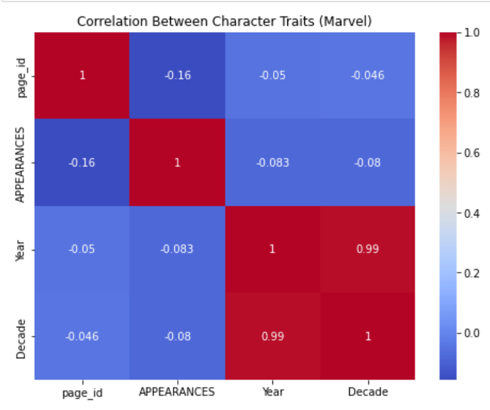
02
Character Demographics and Biographical Details ---

Slide 10
—correlation
The correlation between 'APPEARANCES' (which may be related to a character's popularity or significance) and 'Year' or 'Decade' is negative but relatively small (-0.08 and -0.08 respectively). This suggests that the number of appearances is not strongly correlated with the character's introduction year or decade.
'Year' and 'Decade' have a very high positive correlation of 0.99, which is expected since they essentially represent the same information (decade is derived from the year).
The correlation values between 'page_id', 'APPEARANCES', 'Year', and 'Decade' are all relatively small, indicating weak linear relationships between these variables.

Slide 11
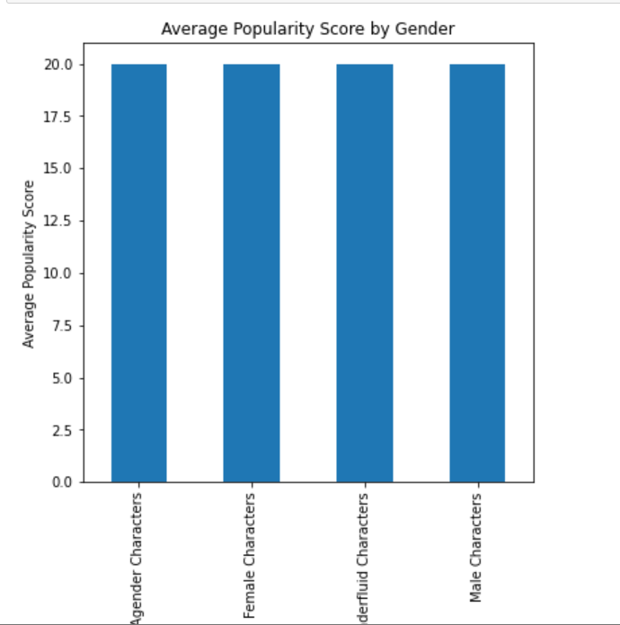
03
Character Attributes and Popularity/Impact (Exploratory Analysis)

Slide 12
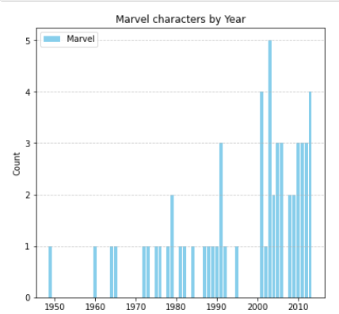
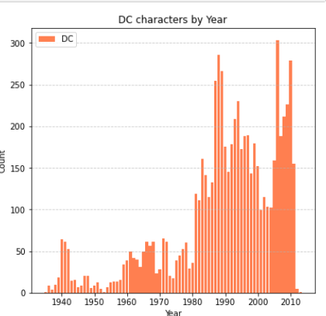
04
Quantifying Diversity

Slide 13
IN DEPTH
By placing the two bar charts side-by-side, we can directly compare the distribution of character introductions between Marvel and DC. This comparison can reveal periods where DC was more active in creating new characters, potentially indicating a higher rate of diversification during those times.

Slide 14
citations
https://fivethirtyeight.com/features/women-in-comic-books/

Slide 15
Thank you

