Slide 1
Additional Slides One

Slide 2
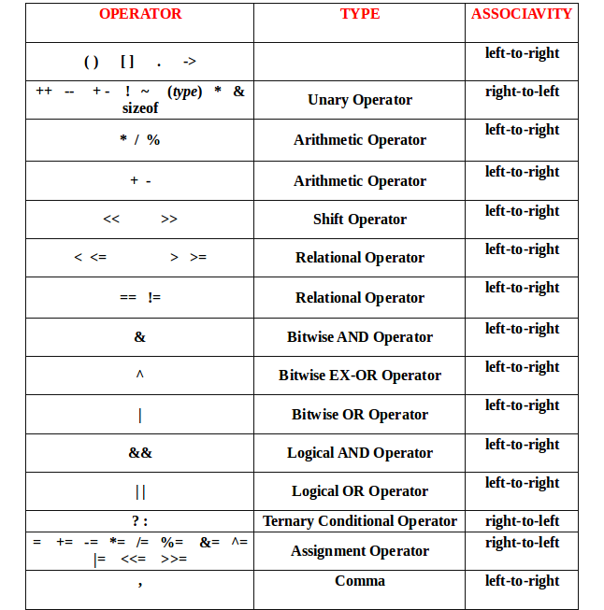

Slide 3
