Slide 1
Introduction to C Programming

Slide 2
Benefits of C Programming
Efficient language
Powerful if used for the right purposes
Portable language. ...
Built-in functions. ...
Well suited for Systems Programming
Open-source. ...
Structured programming language. ...
The language for Implementation of core algorithms and data structures
Provides good interoperability with other languages
Provides good interoperability with databases

Slide 3
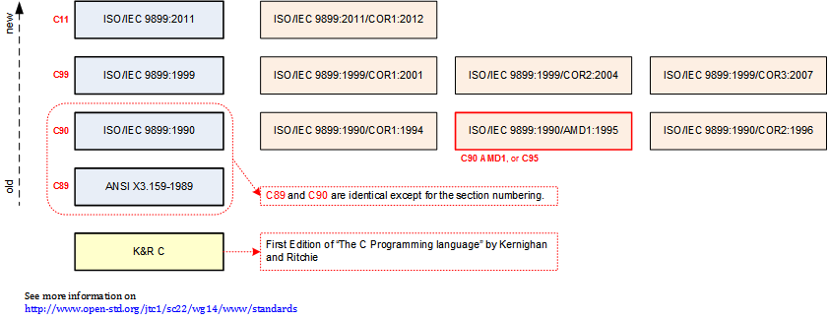

Slide 4
Timeline of language development
Year | C Standard^{[9]}
1972 | Birth
1978 | K&R C
1989/1990 | ANSI C and ISO C
1999 | C99
2011 | C11
2017 | C17
TBD | C2x

Slide 5
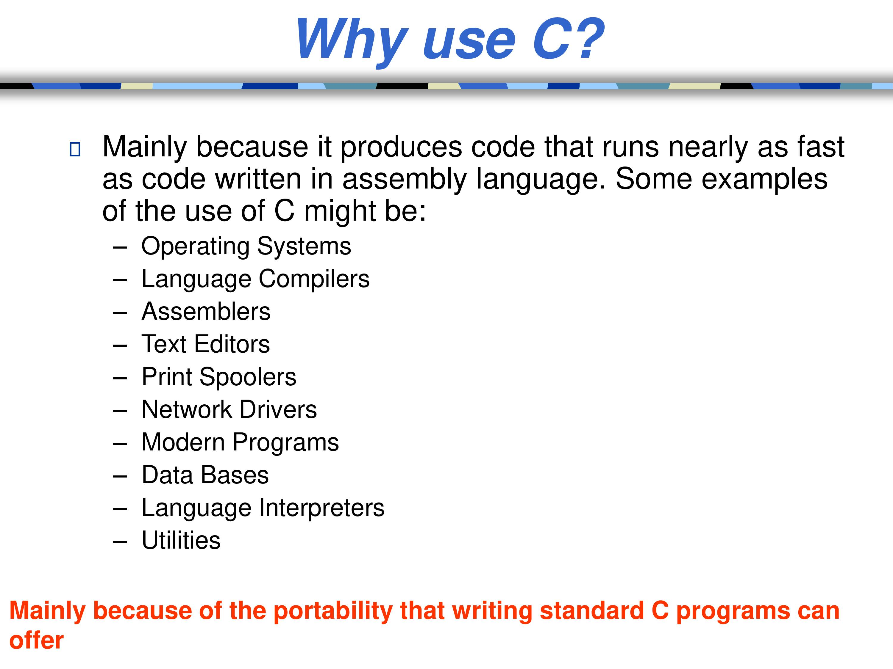

Slide 6
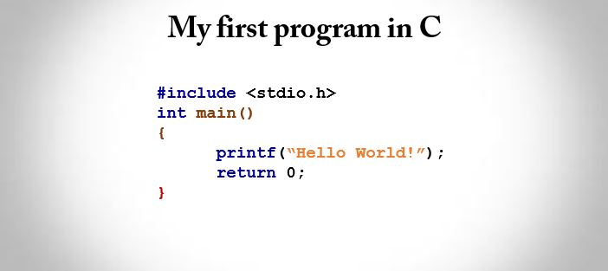

Slide 7
Compiler to use
MinGW compiler
https://sourceforge.net/projects/mingw-w64/
https://www.mingw-w64.org/

Slide 8
Compiler to use
if you want to compile on ISO C then give the command
gcc -std=c99 -pedantic-errors yourfile.c
or
gcc -std=c17 -pedantic-errors yourfile.c
Or just give - gcc yourfile.c

Slide 9
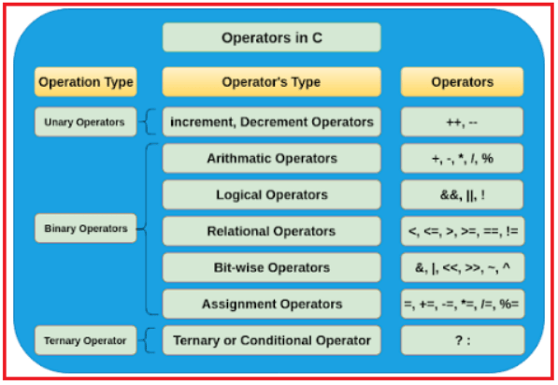

Slide 10
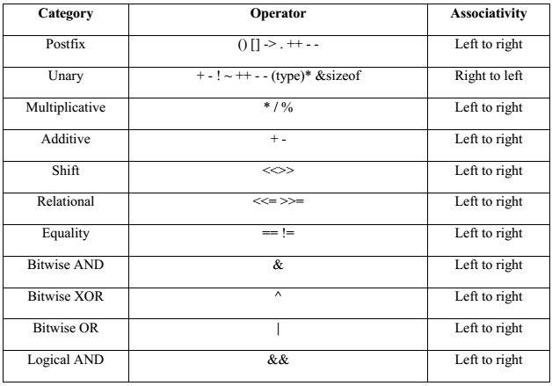

Slide 11
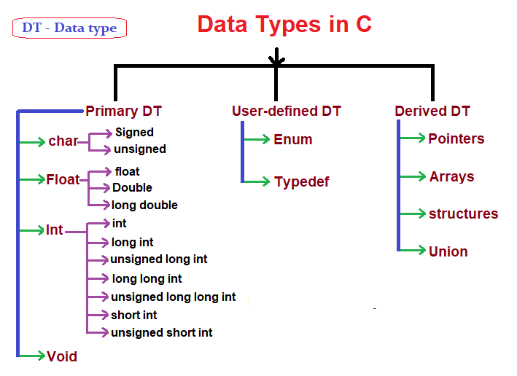

Slide 12
void
char
signed char
unsigned char
short, signed short, short int, or signed short int
unsigned short, or unsigned short int
int, signed, or signed int
unsigned, or unsigned int
long, signed long, long int, or signed long int
unsigned long, or unsigned long int
long long, signed long long, long long int, or signed long long int
unsigned long long, or unsigned long long int

Slide 13
float
double
long double
_Bool
float _Complex
double _Complex
long double _Complex
atomic type specifier
struct or union specifier
enum specifier
typedef name

Slide 14
float
double
long double
_Bool
float _Complex
double _Complex
long double _Complex
atomic type specifier
struct or union specifier
enum specifier
typedef name

Slide 15
Format Specifier | Type
%c | Character
%d | Signed integer
%e or %E | Scientific notation of floats
%f | Float values
%g or %G | Similar as %e or %E
%hi | Signed integer (short)
%hu | Unsigned Integer (short)
%i | integer
%l or %ld or %li | Long
%lf | Double
%Lf | Long double
%lu | Unsigned int or unsigned long
%lli or %lld | Long long
Format Specifier | Type
%llu | Unsigned long long
%o | Octal representation
%p | Pointer
%s | String
%u | Unsigned int
%x or %X | Hexadecimal representation
%n | Prints nothing
%% | Prints % character

Slide 16
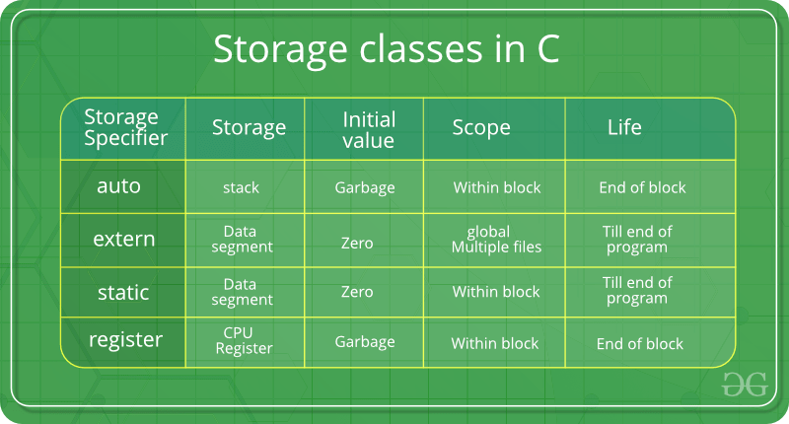

Slide 17
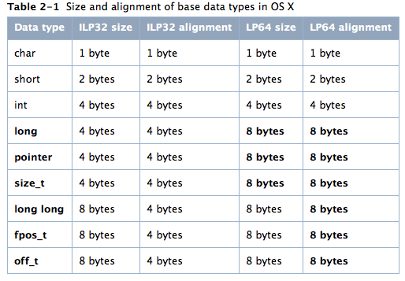

Slide 18
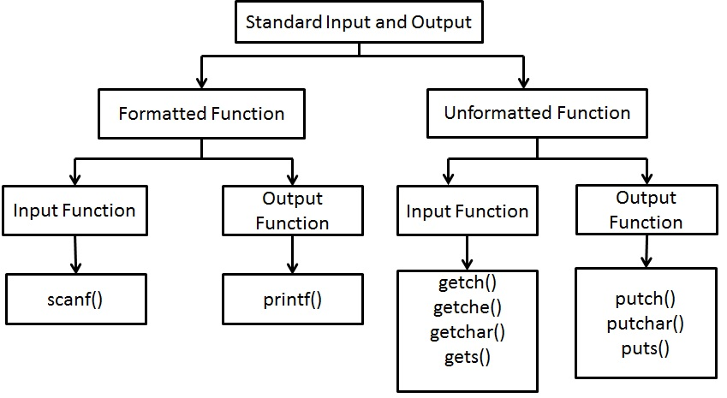

Slide 19
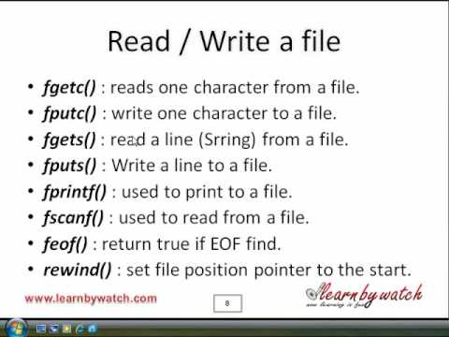

Slide 20
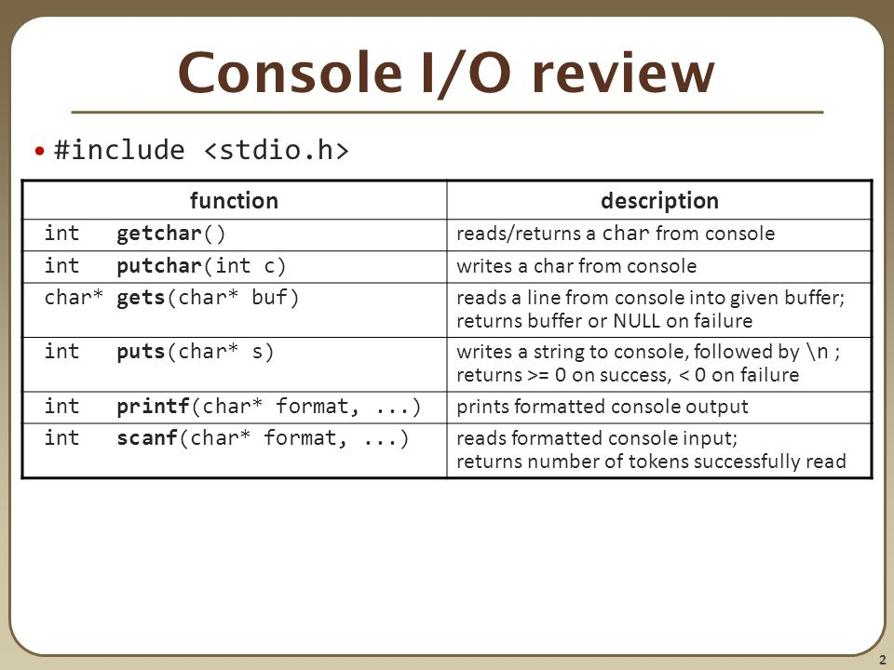

Slide 21
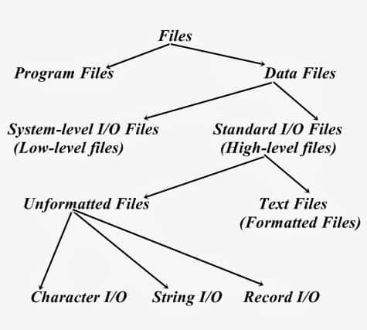

Slide 22
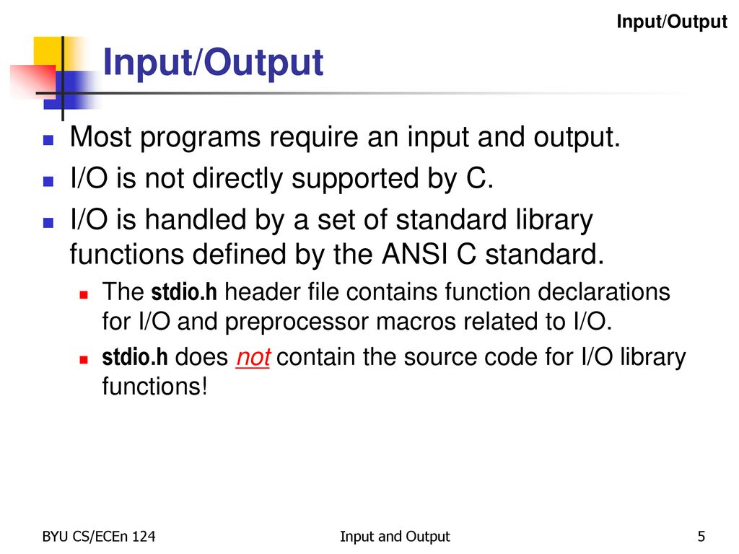

Slide 23
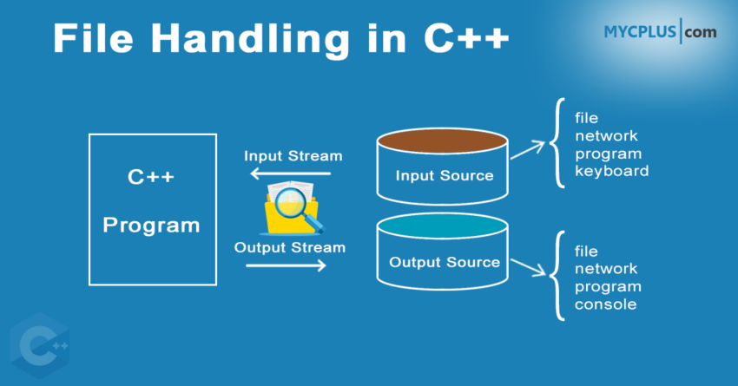

Slide 24
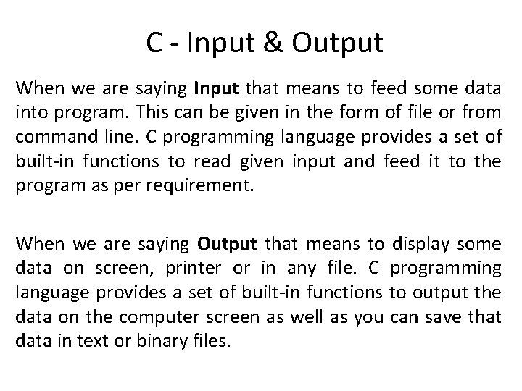
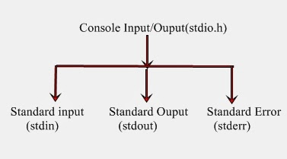

Slide 25
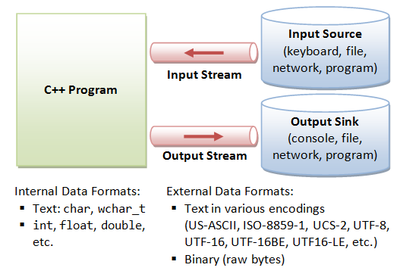

Slide 26
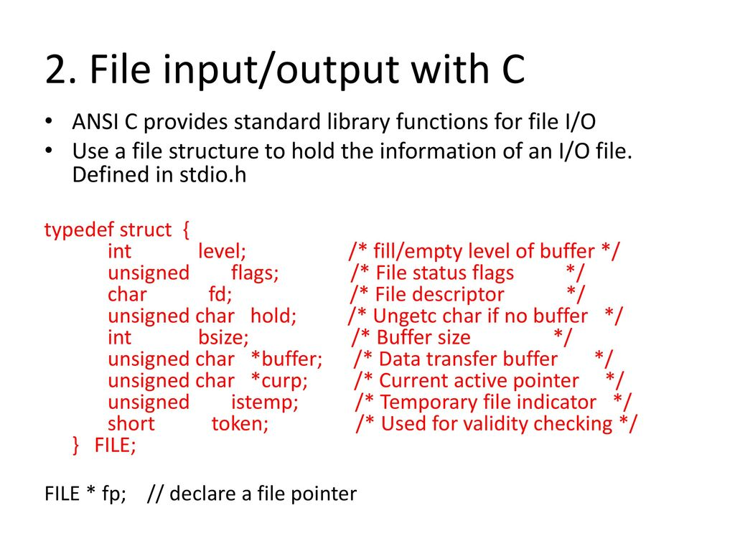

Slide 27
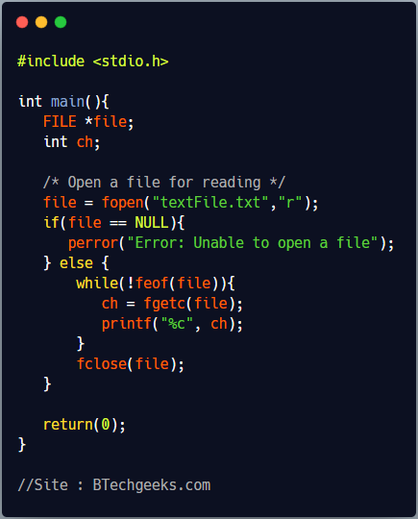

Slide 28
