Slide 1
Module 1
Introduction to node.js
Notes:
Keep to agenda
Know your students
Check retention periodically
Employ visual aids
Use various teaching techniques
Use real-life scenarios
Use positive reinforcement

Slide 2
Outline
An overview of Node.js
Installing Node.js
Preparing development environment
Quick peek into Node’s event loop
Writing asynchronous code with callbacks
Debug first node app

Slide 3
What is nodejs - Official website says
Node.js® is a JavaScript runtime built on Chrome's V8 JavaScript engine.
Node.js uses an event-driven, non-blocking I/O model that makes it lightweight and efficient.

Slide 4
Where is node used
Server side development
Desktop and IoT development

Slide 5
Core components
Node.js
LIBUV
V8
C++

Slide 6
Setup Node
Download binary of targeted platform and install
https://nodejs.org/en/download/
Test your installation
Open terminal run node -v
Open terminal run npm -v

Slide 7
Preparing development environment
Any editor of choice ( ST3, NP++, WS, VSCode, Atom)
Command line

Slide 8
Welcome to node
node -v
npm -v

Slide 9
Node REPL
ctrl + c − terminate the current command.
ctrl + c twice − terminate the Node REPL.
ctrl + d − terminate the Node REPL.
Up/Down Keys − see command history and modify previous commands.
tab Keys − list of current commands.
.help − list of all commands.
.break − exit from multiline expression.
.clear − exit from multiline expression.
.save filename − save the current Node REPL session to a file.
.load filename − load file content in current Node REPL session.
Read Evaluate Print Loop
Command line tool to quickly evaluate / experiment your work
Notes:
Code file : 0-repl.js

Slide 10
Helloworld Node
Filename : helloworld.js
let greeting = 'Helloworld Node';
console.log(greeting);
run code : node helloworld.js

Slide 11
Execution model
Non-blocking
Non-blocking I/O, asynchronous I/O, or "Non-sequential I/O" is a form of input/output processing that permits other processing to continue before the transmission has finished.
Event Driven
A programming paradigm in which the flow of the program is determined by events such as user actions or messages from other programs/threads
Notes:
Code file: 2-async.js

Slide 12
Why so much fuss about sync vs async
Javascript is single threaded, so nodejs runtime. Which means JS can do ONE AND ONLY THING AT A TIME.

Slide 13

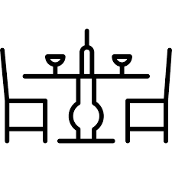

Restaurant Example
3 tables (users)
1 waiter (node)
2 chefs (db, fs)

Slide 14
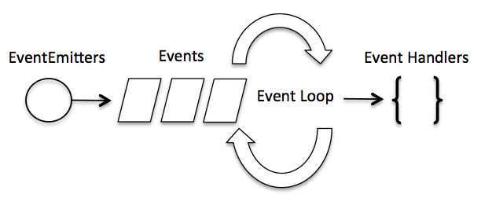
Event loop - The HEART & SOUL
The event loop got its name because of how it's usually implemented
Responsible for scheduling asynchronous operations
while (queue.waitForMessage()) { queue.processNextMessage(); }
Notes:
Code file : 3-async-with-callback.js

Slide 15
Debug node application
node –-inspect-brk helloworld.js
chrome://inspect

Slide 16

Summary
What is nodejs
Setting up development environment
Non blocking I/O
Eventloop
Debugging node apps

Slide 17
Check your knowledge
What is Server side runtime for javascript?
Which Javascript vm is used by node?
Name 2 important design decisions of node runtime
Which command is used to run code in node?
Expand REPL
Descramble - vneotpeol

