Slide 1
ERP Modular Architecture
Discussion Summary

Slide 2
Technology Stack
Platform: .NET 9
IDE: Visual Studio 2022
Database: SQL Server
ORM: Entity Framework - Database First and Code first
Architecture Goal: Modular Plug-and-Play ERP (SaaS Ready)

Slide 3
ERP Modular Architecture Design
Use Modular Monolith Architecture. (A modular monolith is an architectural pattern that structures the application into independent modules or components with well-defined boundaries.)
Design a Modular ERP Platform:
Multiple business modules exist
Tenants subscribe only to required modules
Modules work independently but can share data
System supports multi-tenant SaaS architecture
Benefits:
Plug-and-play modules
Independent development
Easy future migration to microservices

Slide 4
ERP Request Processing Flow
User Request Domain/Subdomain Detection Tenant Identification Authentication Module Subscription Check Controller Service Layer DbContext SQL Server

Slide 5
Modules as Projects or MVC Areas
Separate projects - Reason: Areas are only for UI grouping, not business modules.
BrickworkERP.sln
BrickworkERP.Host
BrickworkERP.Identity
BrickworkERP.BuildingBlocks
BrickworkERP.SharedContracts
BrickworkERP.Modules.CRM
BrickworkERP.Modules.HR
BrickworkERP.Modules.Finance
BrickworkERP.Modules.Admin

Slide 6
Core tables required for multi-tenant system:
Table | Purpose
Tenants | ERP customers
Users | login users
Employees | employee records
Modules | list of ERP modules
TenantModules | subscription mapping
TenantDomains | subdomain mapping
Tenants
Users/Identity
EmployeesModules
TenantModules
TenantDomains

Slide 7
Tenant Identification:
Incoming Request
Tenant Middleware
Tenant Identification
Store TenantId in Request Context

Slide 8
Module Communications
Each module contains:
Module
├ Domain
├ Application
├ Infrastructure
└ API/UI
Modules communicate through service contracts or interfaces.
(Modules must not access each other's database directly. Instead use service contracts.)
Module Communication
ModuleContracts IEmployeeProvider
HR Module EmployeeService
SalesCRM Module Uses IEmployeeProvider

Slide 9
Shared Table
Employee is owned by HR module.
Other modules use service contracts.

Slide 10
Identity and Business Context
Use multiple DbContexts. (Use Core + Module DbContexts.)
IdentityDbContext
CoreDbContext
SalesCRMDbContext
HRDbContext
FinanceDbContext
Advantages:
Module isolation
Independent migrations
Clean architecture

Slide 11
Development Roadmap
Create solution structure
Implement Identity system
Create tenant tables
Implement tenant middleware
Build module subscription system
Develop first module (SalesCRM)
Implement module communication
Build dynamic menu system
Add additional modules (HR, Finance)
Deploy SaaS platform

Slide 12
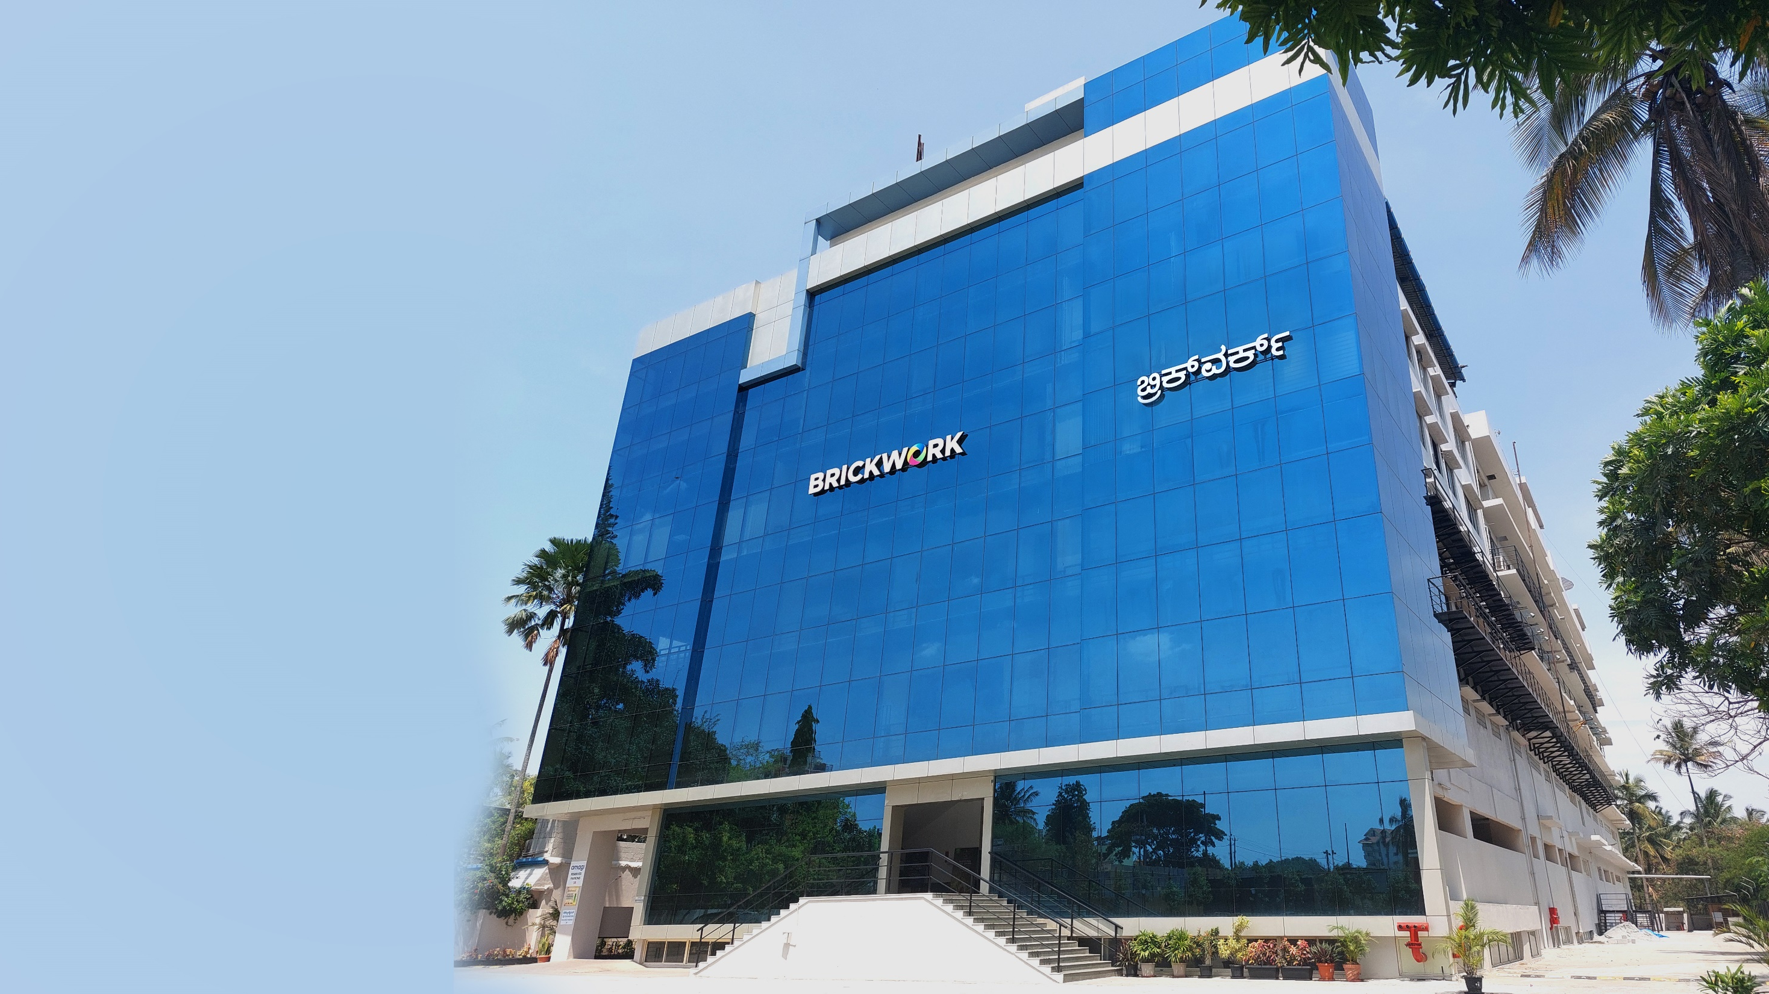
Give us an opportunity to augment your team and add value to your business.
Thank You!
Contact:
info@brickworkindia.com
USA: +1 (617) – 608 – 2427
India: +91 (80) – 6751 – 9999

