Slide 1

Introduction to Ecommerce Product Categorization
Problem Statement: In the rapidly evolving world of eCommerce, accurate product categorization is crucial for ensuring seamless customer experiences, reducing search friction, and increasing product discoverability. However, the sheer volume of diverse products poses a significant challenge. Current classification systems struggle to handle ambiguities, unconventional naming conventions, and multi-language data. This hackathon aims to address these challenges by inviting participants to create innovative solutions that enhance product categorization efficiency, accuracy, and scalability.
Develop a text classification model that categorizes products with maximum accuracy based on description of the product
by CHARAN RAJU

Slide 2
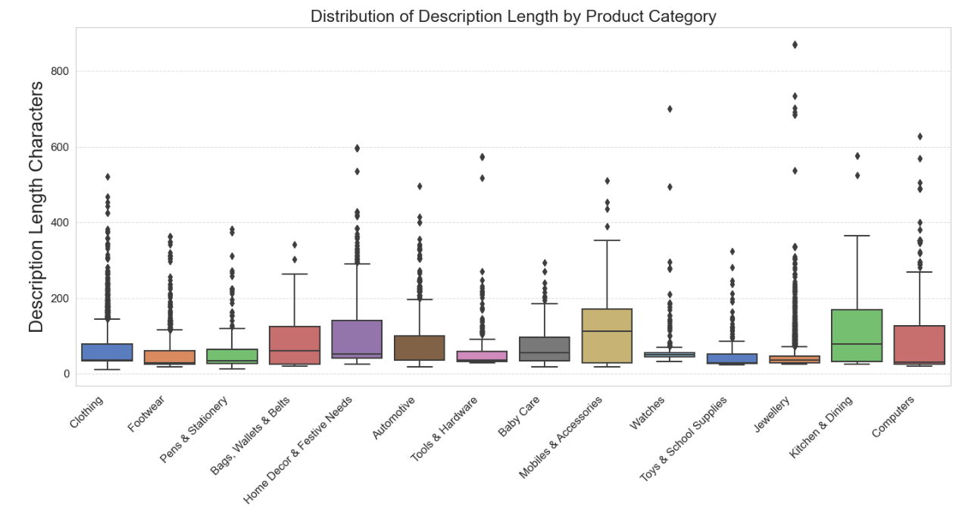
Description Length Distribution by Category
Descriptions for products in the “Mobiles & Accessories” category tend to be the longest, followed by “Kitchens & Dining” and “Computers.”
Descriptions for products in the “Clothing” ,”watches” and “Footwear” categories tend to be on the shorter side.

Slide 3
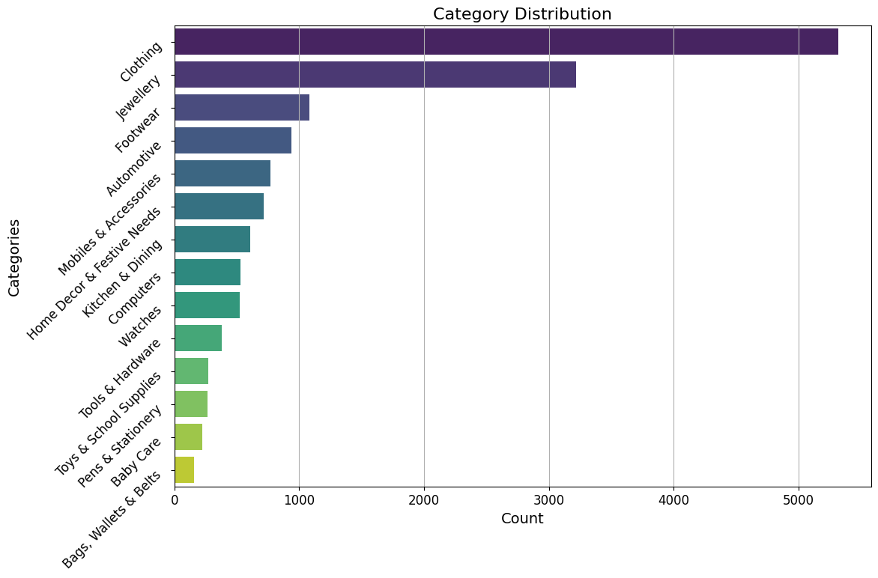
Category Distribution
Dataset contains more categories of “Clothing” followed by “Jewellery” and “Footwear”, this implies that customers are more interested in buying this products probably female customers

Slide 4
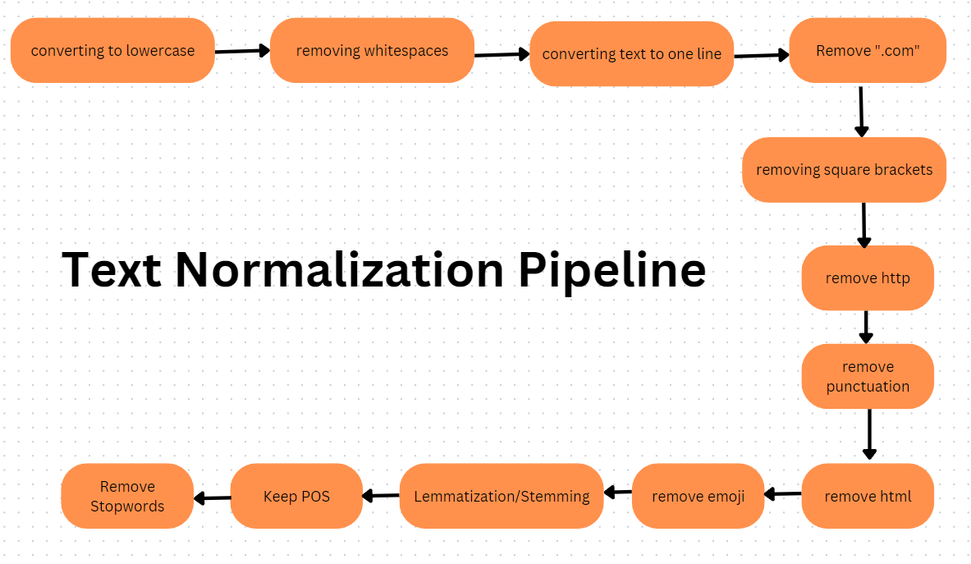
Text Normalization Pipeline

Slide 5
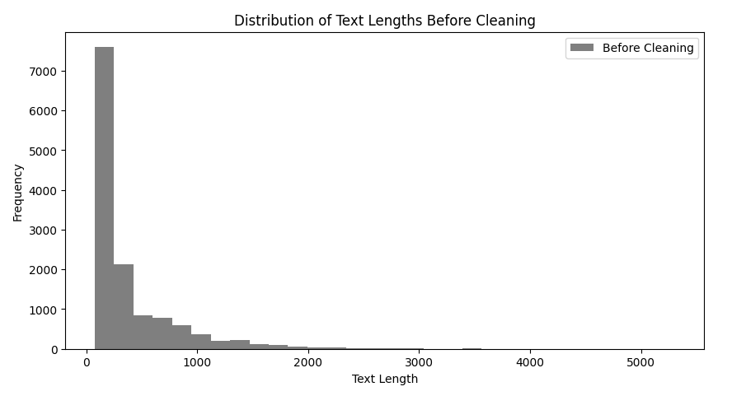
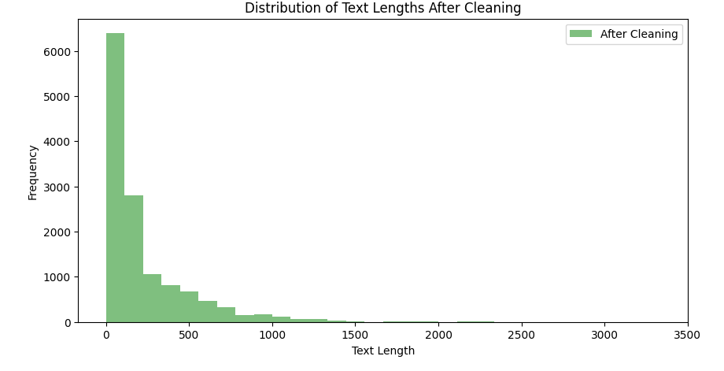
After Applying Normalization

Slide 6
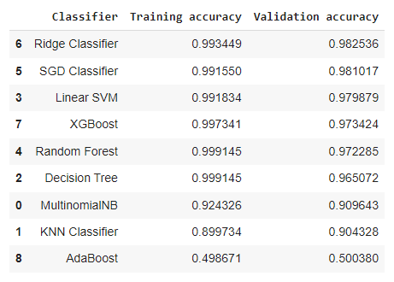
Applying Models on TF-IDF Vectorization

Slide 7
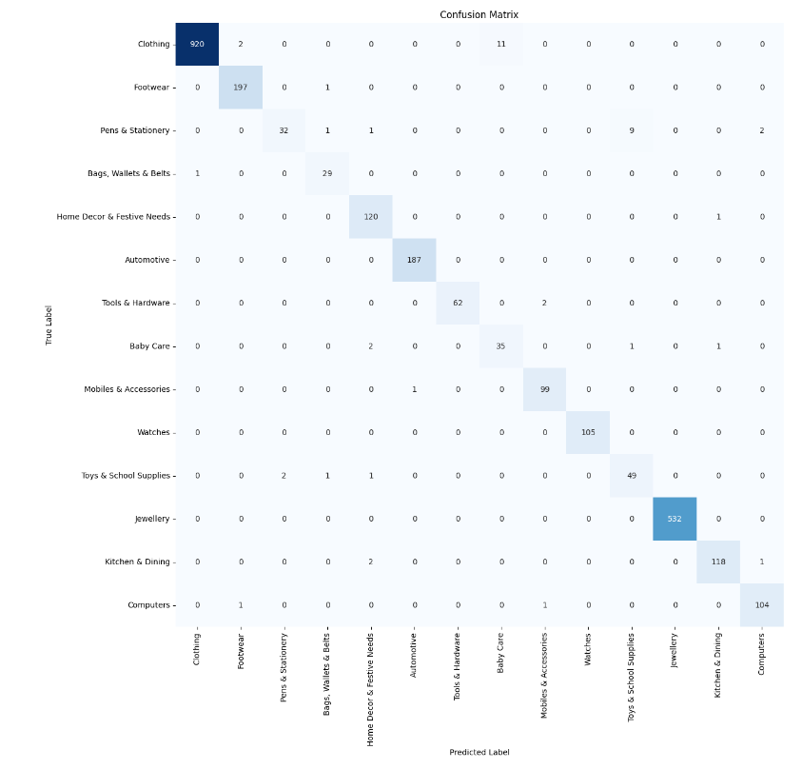
HyperParameter Tuning on Best Perfomed

Slide 8
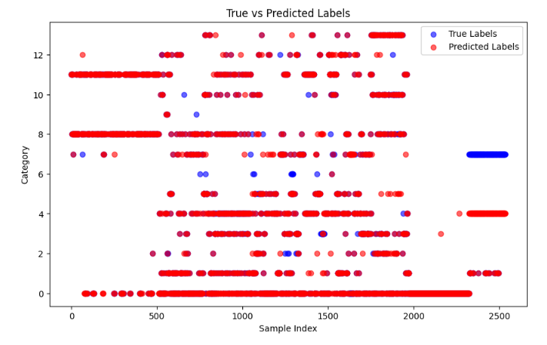
Prediction on Test Data

Slide 9
Machine Learning Techniques
Random Forest
Support Vector Machines (SVMs)
Logistic Regression
k-Nearest Neighbors (k-NN)
Random Forest is an ensemble learning technique that combines multiple decision trees to improve accuracy and reduce overfitting. It excels at handling complex, nonlinear relationships in the data.
Logistic Regression is a popular linear model for binary classification problems. It models the probability of a binary outcome as a function of the input features, providing interpretable results.
k-NN is a simple and effective algorithm that classifies a data point based on the class of its k nearest neighbors. It's well-suited for complex, nonlinear decision boundaries.
SVMs are powerful algorithms for classification and regression tasks. They find the optimal hyperplane that separates different classes with the largest margin, making them robust to outliers and noise.

Slide 10
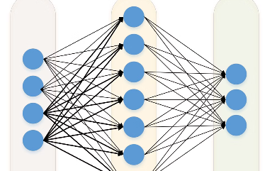
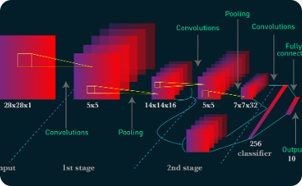
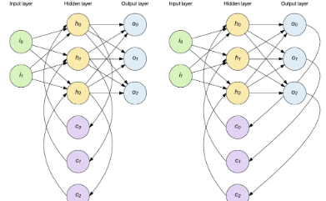
Deep Learning Models
Neural Networks
Convolutional Networks
Recurrent Networks
Leverage the power of artificial neural networks to learn complex patterns and relationships in product data, enabling more accurate categorization.
Leverage the sequential modeling capabilities of recurrent neural networks to account for contextual information in product descriptions, improving text-based categorization.
Utilize convolutional neural networks to effectively process and extract features from product images, boosting the accuracy of visual-based categorization.

Slide 11

Evaluation Metrics
Accuracy
Overall correctness of the model
F1-Score
Harmonic mean of precision and recall
Precision
Fraction of true positives among all positive predictions
Recall
Fraction of true positives identified among all actual positives

Slide 12

Thank you

