Slide 1
Protein Classification Model Using Supervised Machine Learning Algorithms

Slide 2
Abstract
Protein data base helped the life science community to study about different diseases and come with new drugs and solution that help the human survival. The constantly-growing PDB is a reflection of the research that is happening in laboratories across the world. This can make it both exciting and challenging to use the database in research and education. Structures are available for many of the proteins and nucleic acids involved in the central processes of life, so you can go to the PDB archive to find structures for ribosomes, oncogenes, drug targets, and even whole viruses. However, it can be a challenge to find the information that you need, since the PDB archives so many different structures. You will often find multiple structures for a given molecule, or partial structures, or structures that have been modified or inactivated from their native form.

Slide 3
Existing system:
Correct Prediction of protein class is of great importance as it helps the life science community to study about different diseases and come with new drugs and solution that help the human survival. Many methods have been deployed for the same. Artificial Neural Network based method is the first technique to be used for the protein prediction. Machine learning has been used for prediction of protein class. Random Forest is another machine learning model used for predicting the protein class.
Disadvantage :
If the number of class labels are in greater number then accuracy will be decrease.
If we can make use the different features then the accuracy will be improved

Slide 4
Proposed system:
In this paper, protein classification model using supervised machine learning algorithms the usage of multinomialNB algorithm has been proposed. The algorithms have been compared based upon the parameters: Size of the dataset and Number of technical indicators used. Accuracy has been computed for each algorithm. The proposed architecture for the implemented work mainly consist of four steps: feature extraction from the given dataset, supervised classification of the training dataset, supervised classification of the test dataset, and result evaluation.
Advantages:
More labels are used, compared, modified the data set so can get accurate results
Only relevant features are extracted to get better accuracy.
The accuracy for three algorithms are computed and visualized for the same

Slide 5
Modules
Supervised Classification (Training Dataset)
The data has been divided into two parts i.e., training and testing data in the 70:30 ratios. Learning algorithms have been applied on the training data and based on the learning, predictions are made on the test data set.
Supervised Classification (Test Dataset)
The test dataset is 30% of the total data. Supervised learning algorithms have been applied on the test data and the output obtained is compared with the actual output.

Slide 6
Libraries :
Pandas: pandas is an open source, BSD-licensed library providing high-performance, easy-to-use data structures and data analysis tools for the Python programming language.
Numpy: NumPy is a general-purpose array-processing package. It provides a high-performance multidimensional array object, and tools for working with these arrays. It is the fundamental package for scientific computing with Python.
MatPlotLib: matplotlib.pyplot is a plotting library used for 2D graphics in python programming language. It can be used in python scripts, shell, web application servers and other graphical user interface toolkits
Scikit-learn: Scikit-learn is a free machine learning library for Python. It features various algorithms like support vector machine, random forests, and k-neighbors, and it also supports Python numerical and scientific libraries like NumPy and SciPy.

Slide 7
SYSTEM SPECIFICATIONS
Software Requirement Specification
Software Requirements Specification (SRS) – a requirements specification for a software system – is a complete description of the behavior of a system to be developed. It includes a set of use cases that describe all the interactions the users will have with the software. In addition to use cases, the SRS also contains non-functional requirements. Non-functional requirements are requirements which impose constraints on the design or implementation
Functional Requirement
a. Software Requirements
OS : Windows
Python IDE : python 3.x and above
Jupyter Notebook,
Anaconda 3.5
Setup tools and pip to be installed for 3.6.x and above

Slide 8
b. Hardware Requirements
RAM : 4GB and Higher
Processor : Intel i3 and above
Hard Disk : 500GB: Minimum
NON Functional Requirements
Secure access of confidential data (user’s details). SSL can be used.
24 X 7 availability.
Better component design to get better performance at peak time
Flexible service based architecture will be highly desirable for future extension

Slide 9
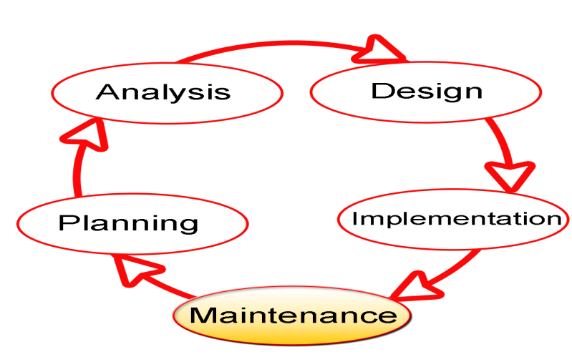
SDLC Methodologies
The Software Development Lifecycle (SDLC) for small to medium database application development efforts.
This project uses iterative development lifecycle, where components of the application are developed through a series of tight iteration. The first iteration focus on very basic functionality, with subsequent iterations adding new functionality to the previous work and or correcting errors identified for the components in production.

Slide 10
The six stages of the SDLC are designed to build on one another, taking outputs from the previous stage, adding additional effort, and producing results that leverage the previous effort and are directly traceable to the previous stages. During each stage, additional information is gathered or developed, combined with the inputs, and used to produce the stage deliverables. It is important to not that the additional information is restricted in scope, new ideas that would take the project in directions not anticipated by the initial set of high-level requirements or features that are out-of-scope are preserved for later consideration.

Slide 11
UML DIAGRAMS

Slide 12
Use Case :

Slide 13
Sequence Diagram

Slide 14
Collaboration Diagram

Slide 15
Activity Diagram

Slide 16
Activity Diagram:

Slide 17
Class Diagram

Slide 18
Component Diagram
dataset
server
modules
algorithms

Slide 19
State Diagram

Slide 20
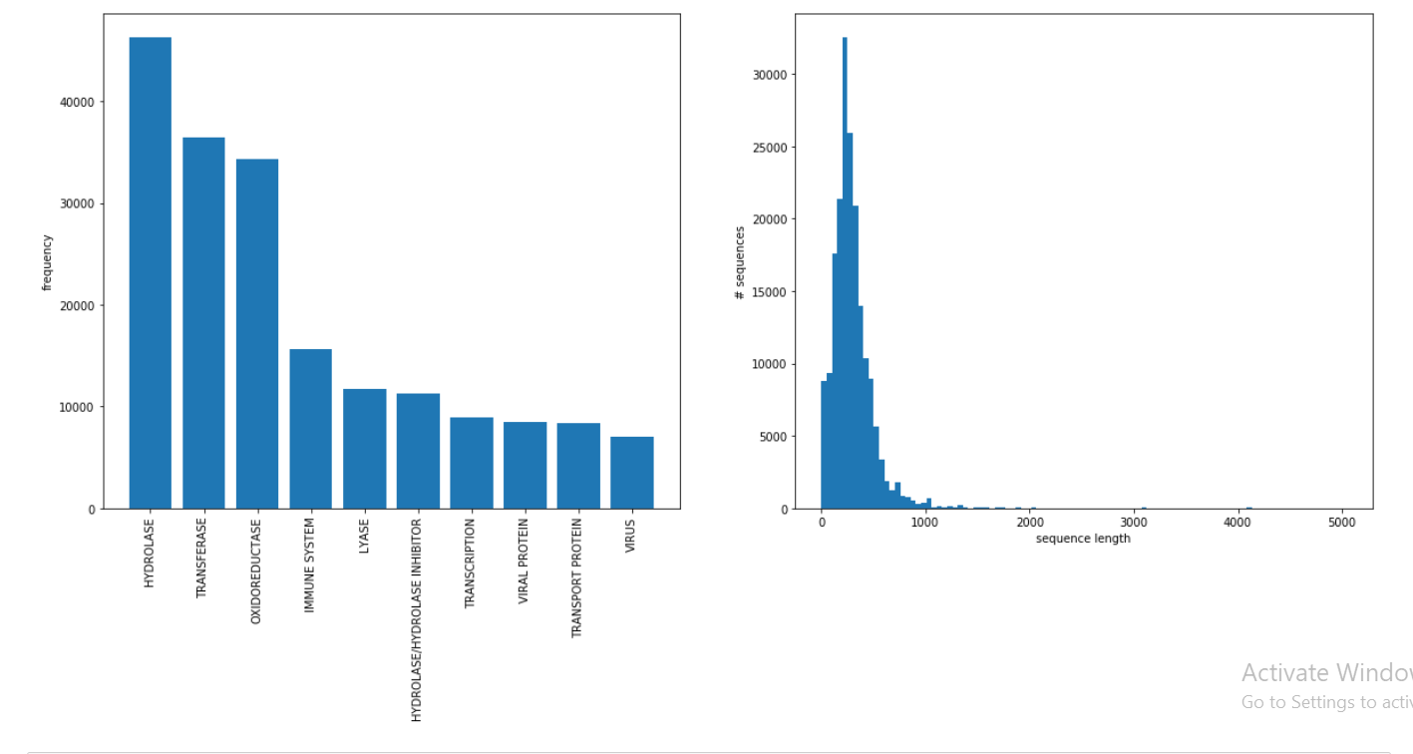
Graph For Class Label Distribution

Slide 21
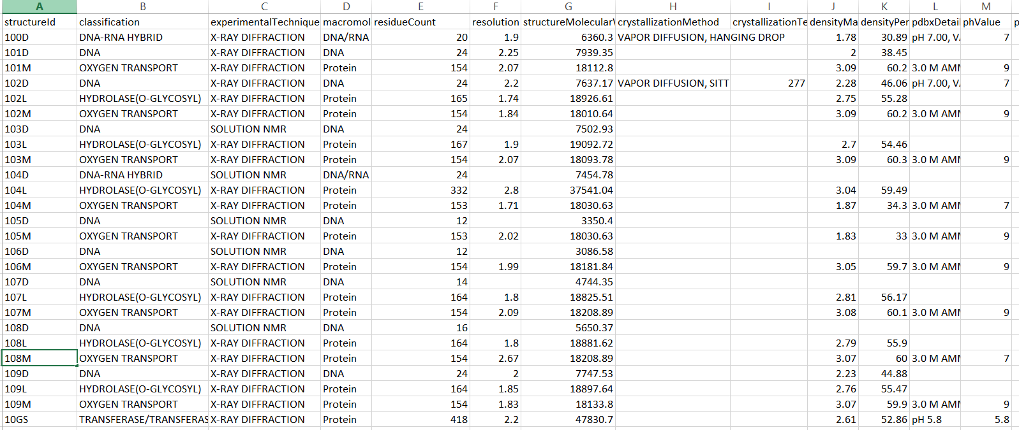
Data Set

Slide 22
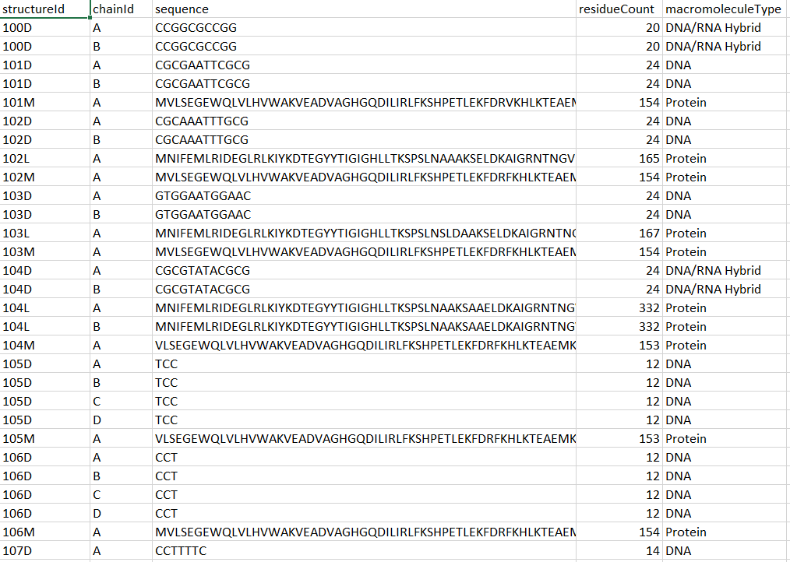

Slide 23
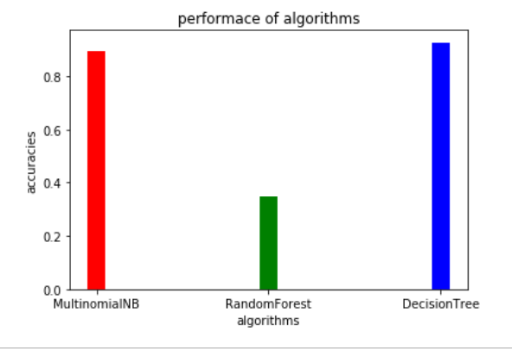
Performance of Different Algorithms

