Slide 1


3D-Chromatin-Aware Genomic Foundation Model
VR SIDDHARTHA ENGINEERING COLLEGE, VIJAYAWADA
Department of Computer Science and Engineering
23CS7552: B. Tech Mini Project (2nd Review)
October 16, 2026
Batch No: __
Batch Members
P. Charan Sai (238W1A5447)
G. Karthik (248W5A5404)
P. Sanath (238W1A5446)
Under the Guidance of
Mrs. K. Divya Kothapali
Assistant Professor

Slide 2
Abstract
Genomic foundation models such as Evo 2 and Caduceus learn powerful representations of DNA, yet they read the genome as a one-dimensional string. Inside the nucleus, chromatin folds into compartments, topologically associating domains (TADs) and loops that physically decide which enhancers can reach which promoters — and recent probing shows that even a 7-billion-parameter sequence-only model fails to capture this higher-order organization. Existing structure-aware methods bolt a graph module onto an already-trained encoder (CHROME) or align embeddings to Hi-C patches by contrastive distillation (Evo2HiC); in no published model does 3D structure shape a self-supervised pretraining objective over nucleotides. This project fills that gap: a bidirectional Mamba DNA language model whose recurrence is modulated by Hi-C-derived structural features, so that structure controls how far information propagates during masked-token pretraining. On a GM12878 chromosome-9 pilot, the model is compared against sequence-only, post-hoc and distillation arms at matched parameters (+0.43%) and compute, with shuffled-structure controls verifying that gains reflect genuine 3D structure rather than genomic distance.
Keywords: genomic foundation model; 3D chromatin structure; Hi-C; topologically associating domains; state space models (Mamba); self-supervised pretraining; variant effect prediction

Slide 3
Presentation Outline
1. Research Domain
2. SDG Categories
3. Aim and Motivation
4. Research Questions
5. Title Justification
6. Objectives
7. Scope
8. Timeline Chart
9. Introduction
9.1. The 3D Genome and Hi-C
9.2. Genomic FMs and SSMs
10. Study on Existing Technologies
11. Gap Analysis
12. SDLC Model (ML Life Cycle)
13. Functional and Non-Functional Requirements
14. Data Collection
15. Data Preparation
16. Proposed Methodology
16.1. Proposed System Architecture
16.2. Different Modules
16.3. Proposed Model and Algorithm
17. Results and Discussion
17.1. Experimental Setup
17.2. Results and Analysis
17.3. Comparison with Previous Work
18. Project Outcomes
19. Conclusion and Future Work
References

Slide 4
1. Research Domain
Primary Domain: Artificial Intelligence and Machine Learning — Foundation Models and Self-Supervised Learning
Sub-Domain: Computational Genomics and Long-Range DNA Sequence Modeling with State Space Models (Mamba/SSM)
Application Area: Regulatory genomics — enhancer–promoter interaction, regulatory element association — and clinical variant-effect interpretation (ClinVar)
Interdisciplinary basis: 3D genome biology (Hi-C, TADs, chromatin loops) supplies the structural signal that the machine-learning contribution conditions on.

Slide 5

2. SDG Categories
Mapped SDGs
SDG 3 — Good Health and Well-Being: improved interpretation of non-coding and pathogenic variants (ClinVar evaluation) supports precision-medicine and disease-mechanism research.
SDG 9 — Industry, Innovation and Infrastructure: open, reproducible AI research infrastructure — released pipeline, data card and matched-compute benchmark protocol.
Only SDGs directly aligned with the project objectives and outcomes are claimed.

Slide 6
3. Aim and Motivation
Aim
To build and evaluate a genomic foundation model whose self-supervised pretraining is conditioned on 3D chromatin structure (Hi-C), so that structural information shapes the learned sequence representation itself — not merely a layer added after training.
Motivation
The genome operates in 3D: TADs and loops physically decide which enhancers reach which promoters.
Current genomic FMs read DNA as a 1D string — and Evo 2-7B provably misses TAD/loop-scale organization despite 9.3T training tokens.
Existing fixes are post-hoc (CHROME) or embedding alignment (Evo2HiC) — the pretraining objective itself has never seen structure.

Slide 7
4. Research Questions
Does conditioning self-supervised masked-token pretraining on Hi-C-derived structural features improve a DNA language model over a sequence-only baseline at matched parameters and compute?
Does structure entering the SSM recurrence during pretraining outperform post-hoc integration (CHROME-style) and contrastive distillation (Evo2HiC-style) on regulatory and variant-effect transfer tasks?
Are the observed gains attributable to genuine locus-specific 3D structure rather than to genomic distance decay — i.e., do shuffled-structure and distance-matched controls (S0–S3) degrade performance?

Slide 8
5. Title Justification
"3D-Chromatin-Aware" — the model consumes measured Hi-C contact structure (insulation, directionality, contact density, A/B compartments), not just the linear sequence.
"Genomic" — it operates on nucleotide-resolution DNA, where CTCF motif orientation — the actual loop grammar — is representable (impossible at CHROME’s 5 kb bins).
"Foundation Model" — general-purpose self-supervised pretraining evaluated by transfer, unlike supervised single-task predictors (Akita, Orca, CHROME).
The title states the mechanism precisely: awareness of 3D chromatin during pretraining is what no alternative title in this space already covers.

Slide 9
6. Objectives
To construct a paired sequence + Hi-C pilot dataset (GM12878, chr9, GRCh38) with an 8-feature per-bin structural vector validated against independent 4D Nucleome tracks (target r > 0.95).
To design and implement a structural-bias mechanism inside a bidirectional Mamba recurrence, matching the sequence-only baseline’s parameter count within 5% (achieved: +0.43%).
To pretrain and compare four matched arms — sequence-only, CHROME-style post-hoc, Evo2HiC-style distillation, and the proposed model — with at least 3 seeds per configuration.
To verify via shuffled-structure controls (S0–S3) that any gain derives from genuine 3D structure, and to evaluate transfer on DNALongBench-style regulatory and variant tasks.

Slide 10
7. Scope
The pilot is restricted to one chromosome of one cell line of one species — human GM12878, chr9, 5 kb Hi-C resolution; every claim inherits this limitation and is stated accordingly.
Model scale is bounded by the available compute (2× NVIDIA L40S, 96 GB total): a ~7.7 M-parameter backbone on 32,768-bp windows — the small-model regime, not a 7B-scale reproduction.
Evaluation covers masked-token loss plus selected regulatory/variant transfer tasks; cross-species modeling (DNA Zoo) and genome-wide scaling are explicitly out of scope for this phase.

Slide 11
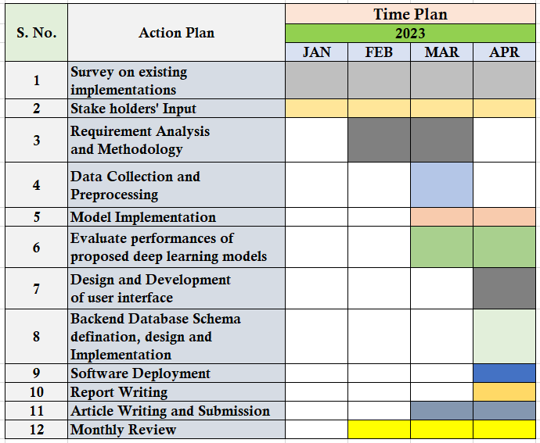
8. Timeline Chart
Table 1. Timeline chart for the Mini Project work (August – November 2026)
S. No. | Action Plan | AUG | SEP | OCT | NOV
1 | Literature survey and gap analysis
2 | Pilot data acquisition (Hi-C + genome + GTF)
3 | Structural features (φ) and validation
4 | Mechanism design and architecture spec
5 | Model implementation and unit tests
6 | Baseline and comparison-arm training
7 | Ablations (S0–S3) and downstream evaluation
8 | Results analysis and comparison
9 | Report writing and paper draft
10 | Project reviews (0th / 1st / 2nd / End Sem.)

Slide 12
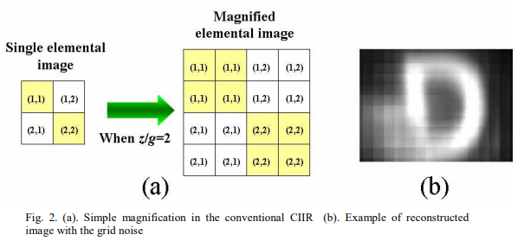
9.1. Introduction — The 3D Genome and Hi-C
Two metres of DNA fold into a ~10 μm nucleus — the genome is a 3D object read as 1D text.
Hi-C (Lieberman-Aiden et al., 2009) [1] crosslinks spatially close loci and sequences the ligation junctions, producing a genome-wide contact matrix.
Contact maps reveal a hierarchy: A/B compartments; TADs — megabase-scale self-interacting domains, largely cell-type invariant (Dixon et al., 2012) [2]; and loops joining promoter–enhancer pairs (Rao et al., 2014) [3].
Loop anchors bind CTCF in convergent orientation — a sequence-level grammar of 3D folding, visible only at nucleotide resolution.
TAD invariance across cell types is what makes a pretraining-time structural prior defensible: it is genome-intrinsic signal, not a cell-line artifact.

Slide 13
9.2. Introduction — Genomic FMs and SSMs
Genomic foundation models learn from raw DNA by self-supervision — masked-token (Caduceus) or next-token (Evo 2) objectives — and are judged by transfer to regulatory and variant tasks.
Transformers cost O(L²) in sequence length; state space models (Mamba) run in linear time, making 100 kb–1 Mb genomic contexts practical.
Caduceus [4]: bidirectional, reverse-complement-aware Mamba DNA LM — our baseline architecture class (~7.7 M parameters, trainable on 2× L40S).
Evo 2 [5]: 7B/40B StripedHyena-2, 1M-token context, 9.3T tokens — the sequence-only state of the art.
Yet Evo 2 penalises TAD-boundary deletions less than matched random controls (Lee, 2026) [13] — sequence-only pretraining does not discover higher-order 3D structure on its own.

Slide 14
10. Study on Existing Technologies
Title: A 3D Map of the Human Genome at Kilobase Resolution Reveals Principles of Chromatin Looping [3]
Journal Details: Cell, Vol. 159, Issue 7, Elsevier, 2014
Dataset: In situ Hi-C, 9 human cell types; GM12878 map with ~4.9B contacts at 1 kb resolution
Description:
Introduced in situ Hi-C at kilobase resolution; identified ~10,000 chromatin loops, contact domains (median ~185 kb) and six subcompartments. Loop anchors bind CTCF in convergent orientation — the sequence-level mechanism of loop formation. The GM12878 map is the densest public human Hi-C dataset and is this project’s pilot data source.
Gaps Addressed:
First kilobase-resolution genome-wide map of 3D genome folding.
Established loops and CTCF convergence as reproducible structural units.
Limitations:
Bulk, population-averaged contacts — no single-cell heterogeneity.
Descriptive assay only: no predictive model linking sequence to structure.

Slide 15
10. Study on Existing Technologies
Title: Caduceus: Bi-Directional Equivariant Long-Range DNA Sequence Modeling [4]
Journal Details: Proc. ICML 2024, PMLR Vol. 235, 2024 (arXiv:2403.03234)
Dataset: Human reference genome hg38; GenomicBenchmarks, Nucleotide-Transformer tasks, Long Range Benchmark
Description:
Extends the Mamba SSM block to BiMamba (bidirectional) and MambaDNA (reverse-complement equivariant) — the first RC-equivariant bidirectional long-range DNA language model, pretrained by masked-token prediction (15%) at up to 131 kb context. Beats models ~10× larger on long-range eQTL variant-effect prediction.
Gaps Addressed:
Linear-time long-context DNA modeling beyond transformer O(L²).
Principled reverse-complement handling (PH augmentation / PS equivariance).
Limitations:
Sequence-only — no chromatin-structure signal at any stage.
Evaluated in the small-model regime only; our baseline inherits this scale.

Slide 16
10. Study on Existing Technologies
Title: Genome Modelling and Design Across All Domains of Life with Evo 2 [5]
Journal Details: Nature, Springer Nature, 2026 (preprint bioRxiv 10.1101/2025.02.18.638918)
Dataset: OpenGenome2 — 8.8–9.3T tokens from >128,000 genomes across all domains of life
Description:
Autoregressive StripedHyena 2 models at 7B and 40B parameters with context up to 1M tokens at single-nucleotide resolution; demonstrates chromosome-scale generation and >90% accuracy on BRCA1 benign-vs-pathogenic classification — the strongest sequence-only genomic FM.
Gaps Addressed:
Long-context nucleotide modeling at unprecedented scale.
Cross-domain-of-life generalization from a single model.
Limitations:
No 3D structure anywhere — probing (Lee, 2026 [13]) shows it misses TAD/loop-scale organization.
7B/40B scale is not reproducible on academic compute (enters this project only as a frozen-embedding reference).

Slide 17
10. Study on Existing Technologies
Title: A Generalizable Hi-C Foundation Model for Chromatin Architecture, Single-Cell and Multi-Omics Analysis Across Species [6]
Journal Details: Nature Methods, Springer Nature, 2026 (preprint bioRxiv 10.1101/2024.12.16.628821)
Dataset: Hundreds of Hi-C assays: 81 human cell lines/tissues, ~118M contact submatrices; validated on 316 species
Description:
Self-supervised pretraining on Hi-C submatrix patches; produces embeddings at chromosome, loci and locus levels; fine-tuned decoders handle reproducibility scoring, resolution enhancement, loop detection, single-cell Hi-C and epigenomic-activity prediction from Hi-C alone.
Gaps Addressed:
First generalizable foundation model over Hi-C contact maps.
Cross-species structural transfer at scale.
Limitations:
No DNA sequence channel — a point mutation does not change its input, so variants cannot be scored.
Requires Hi-C at inference; inapplicable to cell types without Hi-C.

Slide 18
10. Study on Existing Technologies
Title: Hi-Cformer Enables Multi-Scale Chromatin Contact Map Modeling for Single-Cell Hi-C Data Analysis [7]
Journal Details: bioRxiv 10.1101/2025.08.04.668453, 2025
Dataset: Single-cell Hi-C: Ramani2017, Lee2019, Tan2021, Wu2024 (1 Mb resolution)
Description:
Transformer with multi-scale block attention over single-cell contact maps, pretrained with an MLM objective over contact-map block embeddings (20% masking, three-scale reconstruction loss); yields per-cell embeddings for clustering, cell-type annotation and imputation.
Gaps Addressed:
Multi-scale modeling of extremely sparse scHi-C data.
Self-supervised structural representation at single-cell level.
Limitations:
No sequence channel — "general-purpose" scope is cells, not loci or variants.
1 Mb resolution is far above regulatory-element scale.

Slide 19
10. Study on Existing Technologies
Title: Chromatin Interaction–Aware Gene Regulatory Modeling with Graph Attention Networks [8]
Journal Details: Genome Research, Vol. 32, Issue 5, CSHL Press, 2022
Dataset: HiChIP/Hi-C interaction graphs + 1D epigenomic tracks (CAGE, ChIP-seq)
Description:
Graph attention networks over chromatin-interaction graphs predict gene expression; attention weights provide interpretable enhancer→gene attribution. Established the GAT-over-contact-graph pattern that CHROME later refined.
Gaps Addressed:
Long-range enhancer attribution beyond fixed 1D windows.
Interpretable structure-aware regulatory prediction.
Limitations:
Structure used only in supervised downstream training — never in pretraining.
Interaction graph required at inference.

Slide 20
10. Study on Existing Technologies
Title: A Chromatin-Structure-Guided Framework for Predictive and Interpretable Regulatory Genomics (CHROME) [9]
Journal Details: Briefings in Bioinformatics, Vol. 27, Issue 4, Oxford University Press, 2026
Dataset: 4DN Hi-C at 5 kb (GM12878, K562, IMR-90); 751 ENCODE ChIP-seq assays; GTEx eQTL; ClinVar
Description:
Filters Hi-C to physically non-random contacts via a polymer null model (~2–6% kept); builds signal-centered subgraphs (≤4 Mb) over 5 kb loci; two GAT layers propagate neighbor information. Encoders are trained structure-free to convergence in stage 1; structure enters only in stage-2 fine-tuning. Improves ChIP-seq, eQTL and ClinVar performance.
Gaps Addressed:
Physically-grounded filtering separates specific contacts from polymer noise.
Structure-aware variant interpretation evaluated on ClinVar and eQTL.
Limitations:
Structure is strictly post-hoc — the sequence representation is fixed before structure exists; supervised only, no self-supervised pretraining.
Needs the contact graph at inference; 5 kb bins cannot represent CTCF motif orientation.

Slide 21
10. Study on Existing Technologies
Title: Evo2HiC: A Multimodal Foundation Model for Integrative Analysis of Genome Sequence and Architecture [10]
Journal Details: bioRxiv 10.1101/2025.11.18.689171, 2025 (Noble Lab, Univ. of Washington)
Dataset: 1.2M × 2 kb human genomic bins; Hi-C contact maps; 177 DNA Zoo species (resolution enhancement)
Description:
Distills frozen Evo 2 (7B) into a 3.6M-parameter CNN via two SigLIP-style contrastive objectives: student ↔ Evo 2 embeddings, then student ↔ Hi-C patch embeddings — transferring TAD/loop knowledge into a DNA encoder. +10.9% Spearman over Orca on contact prediction at ~500× cheaper inference than Evo 2.
Gaps Addressed:
First work where Hi-C shapes a sequence encoder during representation learning.
Compute-efficient alternative to running a 7B genomic FM.
Limitations:
Contrastive alignment to a frozen teacher — no self-supervised objective over nucleotides (keyword count in paper: MLM = 0); the student’s ceiling is the teacher.
No variant-level evaluation at all (ClinVar/eQTL/variant = 0 occurrences); CNN only — no SSM.

Slide 22
10. Study on Existing Technologies — Summary
Table 2. Summary of existing implementations
No. | Article / Model | Venue, Year | Data structure | Gap addressed | Limitation
1 | Rao et al. (in situ Hi-C) [3] | Cell, 2014 | Hi-C, 9 cell types, 1 kb | Kilobase 3D map; loops + CTCF convergence | Bulk averages; descriptive only
2 | Caduceus (BiMamba) [4] | ICML, 2024 | Sequence only (hg38) | Linear-time bidirectional RC-aware DNA LM | No structure at any stage
3 | Evo 2 (StripedHyena 2) [5] | Nature, 2026 | Sequence only, 9.3T tokens | 1M-token context; strongest sequence-only FM | Misses TAD/loop organization [13]
4 | HiCFoundation [6] | Nat. Methods, 2026 | Hi-C only, 81 cell lines | Generalizable Hi-C foundation model | No sequence; cannot score variants
5 | Hi-Cformer [7] | bioRxiv, 2025 | scHi-C only, 1 Mb | Multi-scale scHi-C representation (MLM) | No sequence; cell-level scope
6 | GraphReg (GAT) [8] | Genome Res., 2022 | Seq. features + graph | Enhancer→gene attribution via attention | Supervised downstream only
7 | CHROME (GAT) [9] | Brief. Bioinf., 2026 | Sequence + Hi-C graph | Non-random contact filtering; ClinVar/eQTL gains | Structure post-hoc; graph needed at inference
8 | Evo2HiC (distillation) [10] | bioRxiv, 2025 | Sequence + Hi-C patches | Hi-C shapes a sequence encoder (contrastive) | No nucleotide objective; no variant eval
9 | Akita [11] / Orca [12] | Nat. Meth. 2020 / Nat. Genet. 2022 | Sequence → contact map | Hi-C as supervised training target | Single-task; representations never transferred
10 | Evo2 3D probing (Lee) [13] | arXiv, 2026 | Evo 2 likelihoods vs Micro-C | Shows Evo 2 fails higher-order 3D tests | Preprint; 7B only, CTCF structures only

Slide 23
11. Gap Analysis
Sequence-only FMs (Evo 2, Caduceus) never see structure — and Evo 2-7B demonstrably fails TAD/loop-scale probes, so scale alone has not closed the gap.
Hi-C-only FMs (HiCFoundation, Hi-Cformer) have no sequence channel, so a point mutation cannot change their input — variant scoring is impossible in principle.
CHROME integrates structure only post-hoc: its encoder converges with no structure present, and the contact graph is required again at inference.
Evo2HiC aligns a distilled encoder to Hi-C patches contrastively — no self-supervised nucleotide objective, no variant evaluation, and a frozen teacher as its ceiling.
Akita/Orca use Hi-C as a supervised target, but a forward-citation sweep over 318 citing papers finds their representations have never been transferred to any non-folding task.
The empty cell: no published model combines an SSM sequence backbone with 3D structure inside a self-supervised pretraining objective — the cell this project occupies.

Slide 24
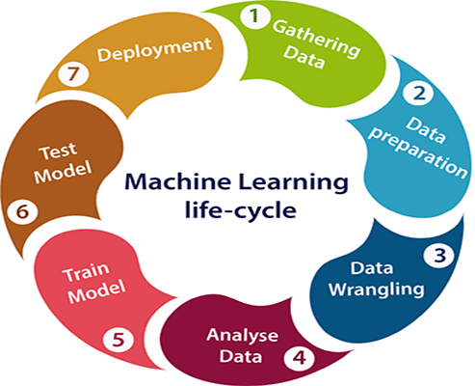
12. SDLC Model
Iterative ML life-cycle model — chosen because pretraining research loops through data–model–evaluation cycles gated by diagnostics, not a linear waterfall. Stages instantiated for this project:
Problem definition — structure-conditioned pretraining hypothesis (Phase 0 literature gap).
Data collection — 4DN Hi-C + Ensembl GRCh38 + GENCODE v47 (chr9 pilot).
Data preparation — band extraction, O/E correction, φ features, tokenization, leakage-free splits.
Modeling — BiMamba backbone + structural bias at matched parameters.
Evaluation — masked-token loss, ablation ladder S0–S3, DNALongBench transfer, ≥3 seeds.
Deployment — reproducible pipeline, released code/weights and paper draft as research artifacts.
Monitoring — training-time diagnostics D1–D4 catch a silently-inert mechanism within hours.

Slide 25
13. Functional and Non-Functional Requirements
Table 3. Functional and non-functional requirements
ID | Requirement | Category
FR1 | Acquire and align Hi-C, reference sequence and annotation on GRCh38 (chr9 pilot), with md5-verified provenance manifest | Functional
FR2 | Compute the 8-feature per-bin structural vector φ with O/E correction and validate it against independent 4DN tracks | Functional
FR3 | Tokenize 32,768-bp windows with an explicit N policy and leakage-free buffered train/val/test splits | Functional
FR4 | Train baseline and structural arms at matched parameters (≤5%) and matched compute | Functional
FR5 | Run shuffled-structure controls S0–S3 and mechanistic diagnostics D1–D4 | Functional
FR6 | Log every hyperparameter, seed and metric to results/ before any number is reported | Functional
NFR1 | Reproducibility — fixed seeds, versioned configs, fully scripted pipeline | Non-Functional
NFR2 | Compute budget — all runs fit 2× NVIDIA L40S (96 GB total) | Non-Functional
NFR3 | Numerical safety — no NaN may reach the recurrence; invalid φ masked with validity flags | Non-Functional
NFR4 | Fairness — identical data, N policy and scan kernel across all comparison arms | Non-Functional
NFR5 | Honesty — no unlogged number may appear in any report, slide or draft | Non-Functional

Slide 26
14. Data Collection
Name of the Dataset: 4D Nucleome experiment set 4DNES3JX38V5 — in situ Hi-C, GM12878 lymphoblastoid cell line (Rao et al., 2014) [3], assembly GRCh38
Selected because it is the densest public human Hi-C map, and GM12878 is one of CHROME’s training cell lines — keeping our pilot directly comparable.
Hi-C: 4DNFIXP4QG5B multiresolution .mcool (27.4 GB) — never downloaded; read remotely via HTTP range requests; ICE-balanced; 5 kb default (1–2 kb available for ablation).
Sequence: GRCh38 chr9 (Ensembl release 113). Annotation: GENCODE v47 — 169,668 chr9 rows; 3,190 genes.
Validation-only tracks (never model inputs): 4DN TAD boundaries, insulation score, A/B compartments; CTCF ChIA-PET loops as an independent assay.
Scale: chr9 = 138,394,717 bp (cooler and FASTA agree exactly); 27,679 bins @ 5 kb; ±2 Mb band = 7,108,483 retained entries (occupancy 0.645).
Known holes, recorded up front: 19.31% of bins carry no balancing weight — dominated by a 17.25 Mb centromeric gap; 12.0% of chr9 sequence is N.
Windows (32,768 bp): train 5,422 / validation 273 / test 242 — disjoint genomic intervals with 1 Mb buffers; verified zero leakage.

Slide 27
15. Data Preparation
Band extraction: ±2 Mb around the diagonal at 5 kb, tiled in 10 Mb windows with 2 Mb overlap (no seam loss), deduplicated; separate 250 kb whole-chromosome matrix for compartments.
Distance-decay (O/E) correction before any feature is built — raw contact frequency is dominated by 1D distance, and uncorrected "structure" would be a positional prior in disguise (control S3 exists to catch exactly this).
φ per bin (8 features): insulation @ 100/250/500 kb, directionality index, log contact density, upstream mass fraction, short/long-range ratio, compartment PC1 — each tagged symmetric or antisymmetric under reverse complement.
Genome-wide standardization (failure-mode F1 mitigation); coverage: 21,519 / 27,679 bins (77.7%) have complete φ.
Validation against 4DN’s independently derived tracks: insulation r = +0.9969; compartments r = +0.9759.
Tokenization A/C/G/T/N with N ≤ 10% per window; φ linearly interpolated bin→token (7 → 32,757 distinct values per window — F4 mitigation); invalid positions get the standardized mean + validity flag, so no NaN can reach the recurrence.
Reverse-complement augmentation reverses tokens and φ and negates the two antisymmetric coordinates (F7 safeguard) — verified against independently computed expectations.

Slide 28
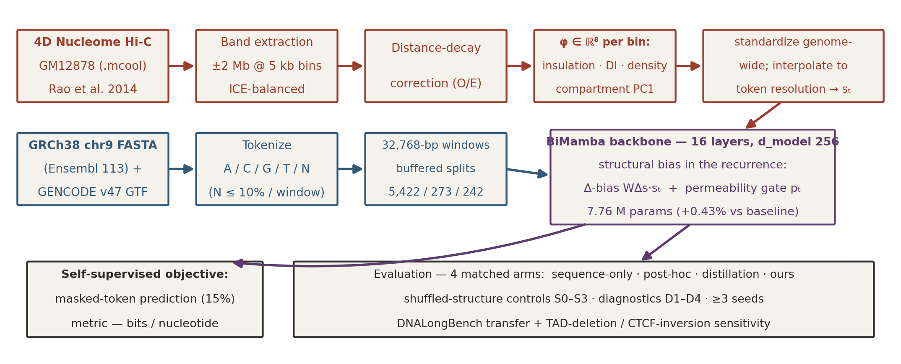
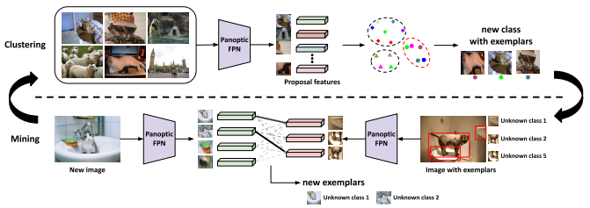
16.1. Proposed System Architecture
Two input pathways — sequence tokens and Hi-C-derived structural context sₜ — merge inside the BiMamba recurrence, not by input concatenation.
Structure is a training-time signal; inference needs sequence only (CHROME, by contrast, needs the contact graph at inference).
All four comparison arms share data, N policy, splits and scan kernel — differences isolate the mechanism.
Figure 1. Proposed system architecture: structure-conditioned self-supervised pretraining pipeline.

Slide 29
16.2. Different Modules
Module 1 — Data Acquisition (scripts/phase1_acquire.py):
Resolves 4DN accessions via the public API; extracts the contact band remotely from the 27.4 GB .mcool; mirrors FASTA/GTF; writes an md5-verified provenance manifest.
Module 2 — Structural Features (scripts/phase1_features.py):
Builds and standardizes the 8-feature φ vector with O/E correction; validates against 4DN’s independent tracks (r = 0.997 insulation, r = 0.976 compartments).
Module 3 — Dataset Builder (scripts/phase1_dataset.py):
Tokenizes windows, enforces the N policy, builds buffered leakage-free splits, interpolates φ to token resolution, applies RC augmentation with antisymmetric sign flips.
Module 4 — Model and Verification (src/chromfm/model.py, scripts/test_model.py):
BiMamba backbone with structural Δ-bias and permeability gate; parameter accounting by instantiation; 16/16 unit tests including exact baseline equivalence at initialization.

Slide 30
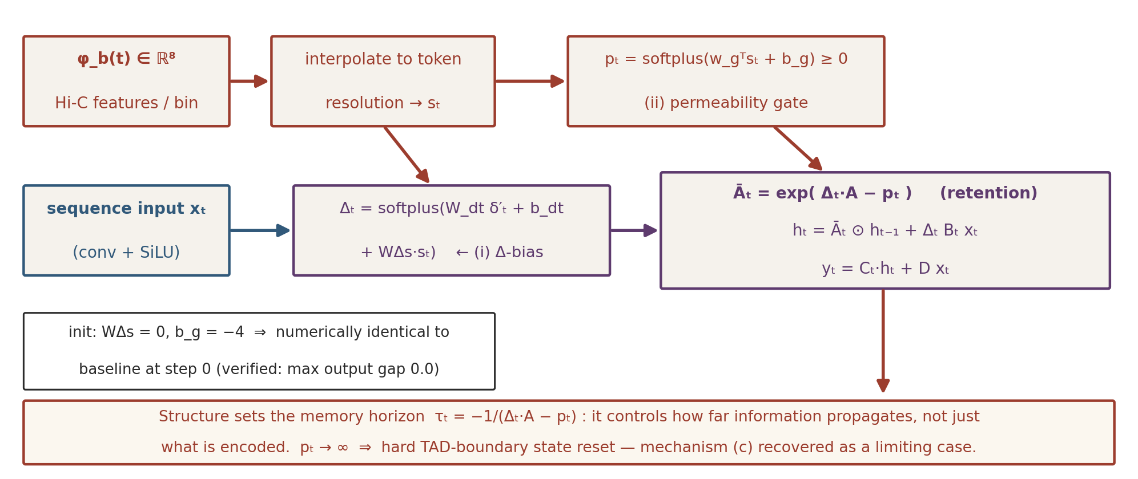
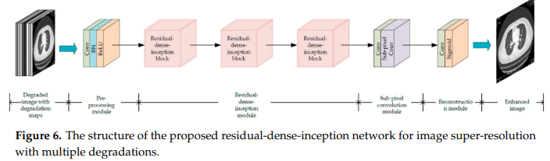
16.3. Proposed Model
(i) Δ-bias: WΔs·sₜ shifts each channel’s timescale — structural context changes how quickly state decays.
(ii) Permeability gate: pₜ ≥ 0 adds uniform extra decay — boundary/low-contact regions damp information flow across them.
Init WΔs = 0, b_g = −4 → exactly the baseline at step 0 — any divergence is learned structural signal.
Figure 2. Structural bias in the SSM recurrence — mechanism (a) of docs/architecture_spec.md.

Slide 31
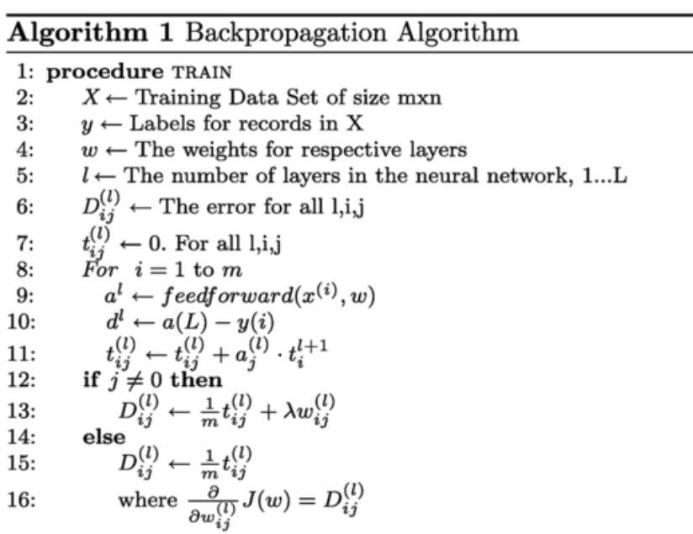
16.3. Algorithm / Pseudocode
Algorithm 1: one training step of structure-conditioned masked-token pretraining
Input: tokens x[1..L]; structural features φ (per 5 kb bin); mask ratio m = 0.15
Output: updated parameters θ
1: s <- interpolate(standardize(φ)) # token resolution; invalid bins -> 0 + flag
2: (x_masked, M) <- mask(x, m) # BERT-style masking
3: for layer l = 1..16, direction d in {fwd, rev}:
4: Δ <- softplus(W_dt δ′ + b_dt + W_Δs s) # (i) structural Δ-bias
5: p <- softplus(w_gᵀ s + b_g) # (ii) permeability gate
6: A_bar <- exp(Δ·A − p) # structure modulates retention
7: h_t <- A_bar * h_(t−1) + Δ·B_t x_t ; y_t <- C_t·h_t + D·x_t
8: loss <- CrossEntropy(logits[M], x[M]) # loss only on masked positions
9: θ <- AdamW(θ, ∇loss); log Δ/τ distributions + diagnostics D1–D4
RC augmentation flips the antisymmetric φ coordinates (F7 safeguard). Structural pathway adds 33,042 parameters (+0.43%).

Slide 32
17.1. Experimental Setup
Hardware: 2× NVIDIA L40S (48 GB each, 96 GB total); mixed-precision training.
Software: Python 3.10, PyTorch, mamba-ssm, cooler, pyBigWig, NumPy/SciPy, Matplotlib.
Data: chr9 GM12878 pilot — 5,422 train / 273 val / 242 test windows of 32,768 bp; N policy and splits fixed in the dataset layer so no arm can diverge.
Model config: d_model 256, 16 BiMamba layers, d_state 16, vocab 16; baseline 7,725,312 vs structural 7,758,354 parameters (+0.43%, within the 5% budget).
Objective / metric: masked-token prediction (15%); bits per nucleotide on held-out regions.
Comparison arms: sequence-only; CHROME-style post-hoc; Evo2HiC-style distillation; proposed structure-in-pretraining.
Ablation controls: S0 zeroed φ, S1 global permutation, S2 circular shift (≥10 Mb), S3 distance-matched rewire; diagnostics D1–D4; ≥3 seeds per configuration.
Downstream: DNALongBench tasks (enhancer–target-gene, eQTL, contact map) [14] + perturbation sensitivity: TAD-boundary deletions and CTCF inversions vs matched controls [13].

Slide 33
17.2. Results and Analysis — Verified to Date
Pipeline validation: our insulation vs 4DN’s independent track r = +0.9969 (100 kb); compartment PC1 r = +0.9759 — the feature pipeline reproduces reference tracks it never saw.
Visual gate: a TAD (chr9:132.59–132.98 Mb) and the NOTCH1 loop (chr9:136.485↔136.625 Mb, O/E = 7.5, supported by 6 CTCF ChIA-PET PETs from an independent assay) confirmed in our processed matrix — next slide.
Coordinate alignment, three ways: exact chr9 length match (138,394,717 bp); centromere gap coincides between FASTA N-content and Hi-C dead zone; landmark genes at expected contact coordinates.
Parameter accounting (by instantiation, not citation): 7,758,354 vs 7,725,312 = +0.43% — matched-parameter constraint passes with ~11× headroom.
Implementation: 16/16 unit tests pass; structural model numerically identical to baseline at init (max gap 0.0); gradients verified to reach WΔs and the gate.
Risk measured (F4): max per-layer memory horizon at init ≈ 994 tokens < one 5 kb bin → φ interpolation now mandatory; trained-τ gate added before Phase-4 compute.
Every number on this slide comes from logged script output (docs/data_card.md, scripts/).

Slide 34
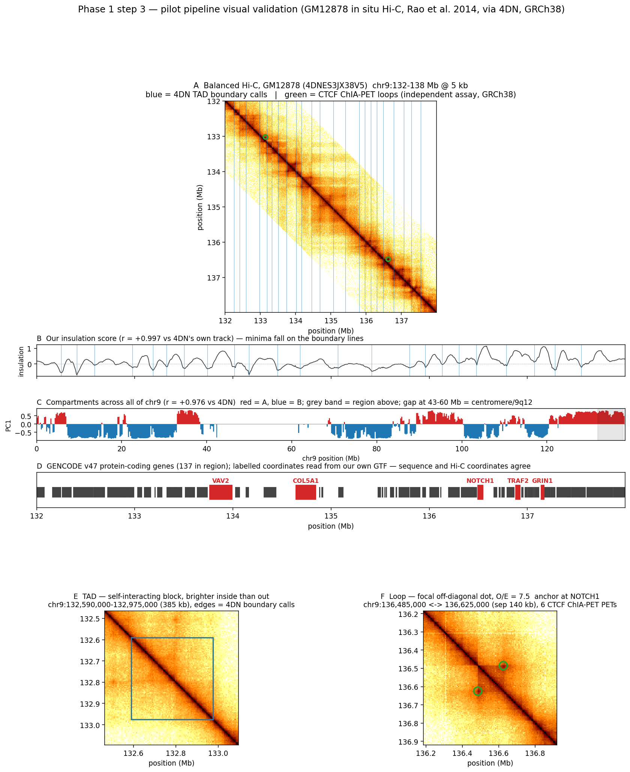
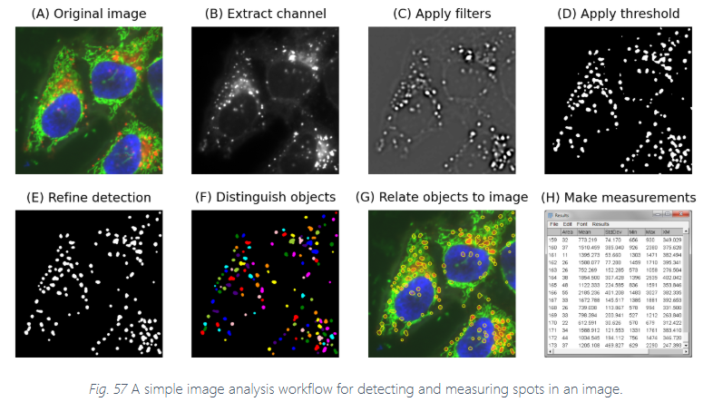
17.2. Results and Analysis (contd.)
Phase-1 visual validation (chr9:132–138 Mb):
Contact matrix with 4DN TAD-boundary calls falling at block edges, not interiors.
TAD panel: chr9:132.59–132.98 Mb — visibly brighter inside the block than outside.
Loop panel: NOTCH1 anchor pair at 140 kb separation, O/E = 7.5, corroborated by 6 CTCF ChIA-PET PETs from an independent assay.
Whole-chromosome A/B compartment alternation; the 43–60 Mb centromeric gap shows as a blank interval — itself a coordinate-alignment check.
Gene landmarks (VAV2, COL5A1, NOTCH1, TRAF2, GRIN1) read from our GTF at runtime and positioned against contact coordinates.
Every annotation is externally sourced — boundaries from 4DN’s caller, loops from ChIA-PET, genes from GENCODE.
Figure 3. Phase-1 validation (real pipeline output: figures/phase1_validation.png).

Slide 35
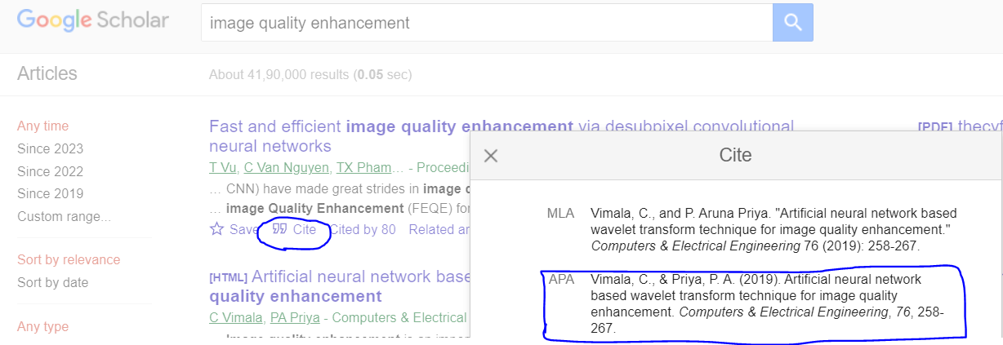
References
[1] Lieberman-Aiden, E., et al. (2009). Comprehensive mapping of long-range interactions reveals folding principles of the human genome. Science, 326(5950), 289–293.
[2] Dixon, J. R., et al. (2012). Topological domains in mammalian genomes identified by analysis of chromatin interactions. Nature, 485, 376–380.
[3] Rao, S. S. P., et al. (2014). A 3D map of the human genome at kilobase resolution reveals principles of chromatin looping. Cell, 159(7), 1665–1680.
[4] Schiff, Y., Kao, C.-H., et al. (2024). Caduceus: Bi-directional equivariant long-range DNA sequence modeling. Proceedings of ICML 2024, PMLR 235. arXiv:2403.03234.
[5] Brixi, G., et al. (2026). Genome modelling and design across all domains of life with Evo 2. Nature. (Preprint: bioRxiv 10.1101/2025.02.18.638918).
[6] Wang, X., et al. (2026). A generalizable Hi-C foundation model for chromatin architecture, single-cell and multi-omics analysis across species. Nature Methods. (Preprint: bioRxiv 10.1101/2024.12.16.628821).
[7] Wu, X., Chen, X., & Jiang, R. (2025). Hi-Cformer enables multi-scale chromatin contact map modeling for single-cell Hi-C data analysis. bioRxiv 10.1101/2025.08.04.668453.
[8] Karbalayghareh, A., et al. (2022). Chromatin interaction–aware gene regulatory modeling with graph attention networks. Genome Research, 32(5), 930–944.
[9] Ye, F., et al. (2026). A chromatin-structure-guided framework for predictive and interpretable regulatory genomics. Briefings in Bioinformatics, 27(4), bbag360.
[10] Fang, T., Wang, X., Xiao, Z., et al. (2025). Evo2HiC: A multimodal foundation model for integrative analysis of genome sequence and architecture. bioRxiv 10.1101/2025.11.18.689171.
[11] Fudenberg, G., Kelley, D. R., & Pollard, K. S. (2020). Predicting 3D genome folding from DNA sequence with Akita. Nature Methods, 17, 1111–1117.
[12] Zhou, J. (2022). Sequence-based modeling of three-dimensional genome architecture from kilobase to chromosome scale. Nature Genetics, 54, 725–734.
[13] Lee, U. (2026). Probing 3D chromatin structure awareness in Evo2 DNA language model. arXiv:2604.07196.
[14] Cheng, W., et al. (2025). DNALongBench: A benchmark suite for long-range DNA prediction tasks. Nature Communications, 16(1), 10108.

