Slide 1


ChromGraphFM: An End-to-End 3D Chromatin-Conditioned Genomic Foundation Model
VR SIDDHARTHA ENGINEERING COLLEGE, VIJAYAWADA
Department of Computer Science and Engineering
23CS7552: B. Tech Mini Project (2nd Review)
October 16, 2026
Batch No: __
Batch Members
P. Charan Sai (238W1A5447)
G. Karthik (248W5A5404)
P. Sanath (238W1A5446)
Under the Guidance of
Mrs. K. Divya Kothapali
Assistant Professor

Slide 2
Abstract
Three-dimensional chromatin organisation lets distal regulatory elements control gene expression, yet most genomic sequence models treat the genome as a one-dimensional string. This project develops ChromGraphFM, a compact 3D chromatin-conditioned genomic representation model trained from scratch on DNA sequence and Hi-C contact maps. Genomic regions become nodes in a sparse contact graph, and measured Hi-C contact strengths bias attention among distant DNA windows throughout self-supervised pretraining, so structure shapes the sequence representation instead of being appended after it. Pretraining combines masked DNA modelling, distance-matched contact-aware contrastive learning, and chromatin contact prediction. The model is evaluated against sequence-only, shuffled-contact, distance-only, random-graph and late-fusion controls trained at matched parameters, data and compute, using chromosome-level and cell-type held-out splits for contact-map prediction, chromatin loop detection, enhancer-promoter linking and Hi-C-free transfer. The central question is whether experimentally measured 3D structure can be internalised into a reusable DNA representation rather than supplied as an extra input at prediction time.

Slide 3
Presentation Outline
1. Research Domain
2. SDG Categories
3. Aim and Motivation
4. Research Questions
5. Title Justification
6. Objectives
7. Scope
8. Timeline Chart
9. Introduction
10. Study on Existing Technologies
11. Gap Analysis
12. SDLC Model
13. UML Diagrams
14. Functional and Non-Functional Requirements
15. Data Collection
16. Data Preparation
17. Proposed System Architecture
18. Experimental Setup and Results
19. Project Outcomes
20. Conclusion and Future Work

Slide 4
1. Research Domain
Primary domain: Computational Genomics / Bioinformatics
  Three-dimensional genome organisation and gene regulation
  Chromosome conformation capture data (Hi-C, Micro-C)
Secondary domain: Machine Learning / Representation Learning
  Self-supervised pretraining and foundation models for biological sequences
  Attention and graph neural networks with a structural inductive bias
Where the two meet
    The genome is read as a 1D string but folds in 3D. Regulatory elements act on genes megabases away in sequence yet nanometres away in space. This project asks whether measured folding can be built into how a model reads the sequence.

Slide 5

2. SDG Categories
SDG 3 - Good Health and Well-being
  Most disease-associated variants from genome-wide association studies fall in non-coding regions whose target genes are unknown
  Better enhancer-gene linking is a direct route to interpreting those variants
SDG 9 - Industry, Innovation and Infrastructure
  A compact, openly released pretrained encoder lowers the compute barrier for labs that cannot train billion-parameter genomic models
  The Hi-C-free setting matters here: most labs have sequence but no Hi-C
SDG 4 - Quality Education
  Fully reproducible pipeline, tracked data manifest and public repository

Slide 6
3. Aim and Motivation
Aim
  Develop and evaluate a genomic representation model trained from scratch in which Hi-C contact information directly biases how a DNA sequence encoder exchanges information across distant genomic regions during self-supervised pretraining.
Motivation
  Sequence-only models must infer long-range regulatory relationships from sequence alone, though those relationships have already been measured experimentally
  Existing 3D-genome models either predict Hi-C from sequence, represent Hi-C maps themselves, or align a frozen encoder to Hi-C embeddings after the fact
  None lets the measured contact map decide which distal windows communicate while the representation is being learned
The bet
    If real contacts carry information a sequence model cannot recover alone, conditioning on them should beat a matched model given shuffled contacts. If it does not, that null is itself a result about the limits of the signal.

Slide 7
4. Research Questions
RQ1 - Does structural conditioning help at all?
  Does biasing attention with measured Hi-C improve held-out chromosome contact prediction over a matched sequence-only encoder?
RQ2 - Is the gain from real biology or from any extra signal?
  Does it beat matched controls given shuffled Hi-C, distance-only edges and a random contact graph?
RQ3 - Is conditioning better than fusion?
  Does contact-biased attention inside the encoder beat late fusion applied after the sequence has been encoded?
RQ4 - Is the structure retained in the sequence representation?
  Does any improvement survive removing the contact graph at inference time?
RQ5 - Does it transfer?
  Does the pretrained encoder beat a from-scratch model on loop detection and enhancer-promoter linking, including on a held-out cell line?

Slide 8
5. Title Justification
"ChromGraphFM"
  Chrom - the object of study is chromatin, not sequence alone
  Graph - a contact is a relation between two loci, not a pixel in an image
  FM - the artefact is a pretrained encoder evaluated across several tasks
"End-to-End"
  Distinguishes this work from Evo2HiC, which distils a frozen Evo 2 backbone; here the sequence encoder trains from scratch under the structural objectives
"3D Chromatin-Conditioned"
  Conditioned, not fused: the contact map alters attention inside the encoder at every block rather than being concatenated to its output
A deliberate restraint on the word "Foundation"
    At 20-40M parameters this is a compact pretrained representation model, and the report will call it that unless multi-task transfer is demonstrated.

Slide 9
6. Objectives
O1 - Reproducible data foundation
  Chromosome-split hg38 and Hi-C dataset at 5 kb, rebuildable from a tracked manifest
O2 - Sparse contact graph construction
  640 kb regions as 128-node graphs, with target edges provably held out from the conditioning edges
O3 - Contact-biased sequence encoder
  Bi-directional Mamba local encoder, contact-biased attention, structure dropout
O4 - Structure-aware pretraining
  Masked DNA modelling, distance-matched contrastive learning, contact prediction
O5 - Controlled evaluation
  B0-B5 controls at matched parameters, data and steps; held-out chromosomes, held-out cell line, Hi-C-free inference
O6 - Biological interpretation
  Test whether high-attention contact anchors are enriched for CTCF motifs and overlap known loop anchors

Slide 10
7. Scope
In scope
  Human genome hg38; bulk Hi-C from 4DN and ENCODE
  5 kb contact resolution; 640 kb context (128 nodes x 5 kb)
  2-3 cell lines, one fully held out; 20-40M parameters; DNA and Hi-C only
  Controlled comparison against our own matched baselines B0-B5
Out of scope
  Billion-parameter pretraining; million-base contexts
  ATAC-seq, DNase-seq or CTCF tracks as model inputs (stretch goal only)
  Single-cell Hi-C, cross-species transfer, variant-effect prediction (stretch)
Claim discipline
    No claim of superiority over a published model unless task, data, split, metric, resolution and input setting all match. Published numbers are reported as context, never as a head-to-head result.

Slide 11
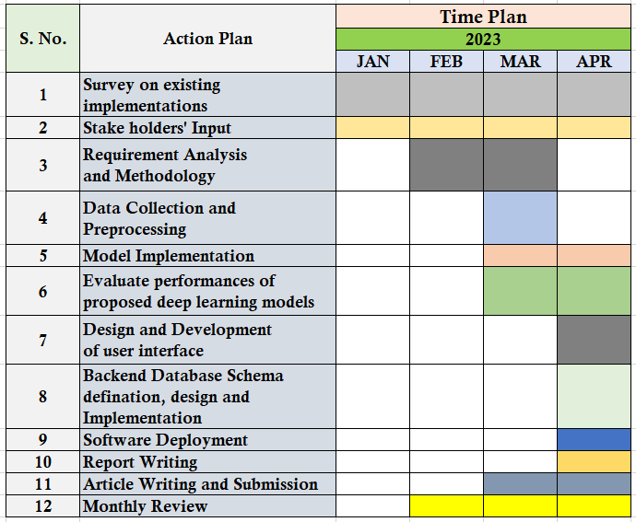
8. Timeline Chart
Table 1: Timeline chart for the mini project. Phases 0-2 need no GPU and run on a laptop; Phases 3-6 require the L40S cluster.
Phase | Weeks | Deliverable | Status
Phase 0 | Wk 1 | Scaffold, config system, split validator | Complete
Phase 1 | Wk 2-5 | hg38 windows, streamed Hi-C, 5 kb bins, QC report | Complete
Phase 2 | Wk 6-8 | Sparse contact graphs, held-out edges, control corruptions | Complete
Phase 3 | Wk 9-11 | Bi-Mamba encoder, B0 baseline, evaluation harness | In progress
Phase 4 | Wk 12-15 | Contact-biased attention, three pretraining losses | Planned
Phase 5 | Wk 16-18 | Matched B0-B5 sweep, held-out chromosome and cell line | Planned
Phase 6 | Wk 19-20 | CTCF interpretation, report, poster, public repository | Planned

Slide 12
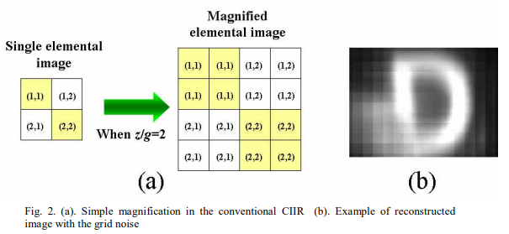
9. Introduction
The biology
  Human DNA is about 2 metres long and folds into a nucleus about 6 micrometres across. The folding is not random: it forms loops, domains and compartments.
  An enhancer can regulate a gene a megabase away because folding brings them into physical proximity. Sequence adjacency and functional adjacency differ.
The measurement
  Hi-C sequences pairs of genomic fragments that were physically close, producing a contact matrix over genomic bins - the experimental readout of that folding.
The modelling gap
  Genomic language models read the genome as text. Attention over sequence position cannot know two distant windows are neighbours in space unless it is told.
This project
    Tell it, during pretraining, and measure whether that changes what the encoder learns - with controls strong enough that a positive result means something.

Slide 13
10. Study on Existing Technologies
Title: Evo2HiC - a multimodal foundation model for integrative analysis of genome sequence and architecture [7]
  Venue: bioRxiv preprint, November 2025
  Method: contrastive distillation of a frozen 7B-parameter Evo 2 into a 3.6M parameter CNN sequence encoder, aligned against Hi-C patch embeddings
  Relevance: the closest precedent, and the reason this project cannot claim to be the first to use Hi-C in genomic representation learning
  Limitation we build on: the backbone stays frozen, and contacts never enter the encoder's own contextualisation
Title: MIX-HIC - Multimodal 3D Genome Pre-training [6]
  Venue: NeurIPS 2025 (arXiv:2504.09060)
  Method: joint pretraining over Hi-C contact maps and epigenomic tracks, more than 1.2 million paired samples, 5 kb resolution, chromosome-level splits
  Limitation we build on: raw DNA sequence is not an input; the authors name sequence integration as future work

Slide 14
10. Study on Existing Technologies
Three families of prior work
  Sequence-to-structure predictors - Akita, C.Origami, EPCOT. Sequence in, contact map out. Hi-C is the prediction target.
  Hi-C representation models - HiCFoundation, MIX-HIC. Hi-C in, Hi-C representation out. DNA sequence absent or secondary.
  Sequence foundation models - Caduceus, HyenaDNA, Evo 2. Long-range sequence modelling with no structural signal.
What the field has already settled
  Hi-C can be predicted from sequence, and Hi-C maps can be pretrained on
  Hi-C can shape a sequence encoder by distillation (Evo2HiC)
What this means for our claim
    "First to use Hi-C in a genomic foundation model" is false and must not be claimed. The defensible contribution is the mechanism and the controls that isolate it.

Slide 15
10. Study on Existing Technologies
Table 2: Summary of existing implementations and the gap each leaves open.
Model | Venue | Core idea | What it does not do
Akita | Nature Methods, 2020 | CNN predicting 3D folding from DNA sequence | Task-specific predictor; no reusable pretrained representation
C.Origami | Nature Biotech., 2023 | Cell-type-specific 3D organisation from sequence, CTCF, ATAC | Hi-C is the target, not a signal shaping an encoder
EPCOT | Nucleic Acids Res., 2023 | Pretrain/fine-tune for epigenome, contacts, transcription | Pretraining centres on epigenomic features
Caduceus | arXiv:2403.03234, 2024 | Bi-directional RC-equivariant long-range DNA model | Strong sequence-only baseline; uses no Hi-C
HiCFoundation | Nature Methods, 2026 | Foundation model pretrained on Hi-C contact maps | Represents contact maps, not DNA sequence
MIX-HIC | NeurIPS 2025 | Multimodal Hi-C and epigenomic pretraining | No raw DNA input; names sequence integration as future work
Evo2HiC | bioRxiv, 2025 | Hi-C-guided contrastive distillation of Evo 2 into a CNN | Closest precedent; frozen backbone, contacts never enter contextualisation

Slide 16
11. Gap Analysis
Established in the literature
  Foundation models pretrained on Hi-C maps exist (HiCFoundation)
  Multimodal Hi-C and epigenomic pretraining exists (MIX-HIC)
  Hi-C-guided distillation into a DNA encoder exists (Evo2HiC)
Still open
  No published model trains a DNA encoder end to end while measured contact graphs control which distal windows exchange information at every layer
  Post-hoc alignment and late fusion have not been separated from in-encoder conditioning under matched parameters, data and compute
  Whether structural knowledge survives removal of Hi-C at inference is asserted more often than it is tested against a shuffled-contact control
Gap statement
    It remains untested whether contact graphs conditioning sequence contextualisation throughout pretraining yield a more transferable DNA representation than the alternatives, measured against distance-matched and shuffled-contact controls.

Slide 17
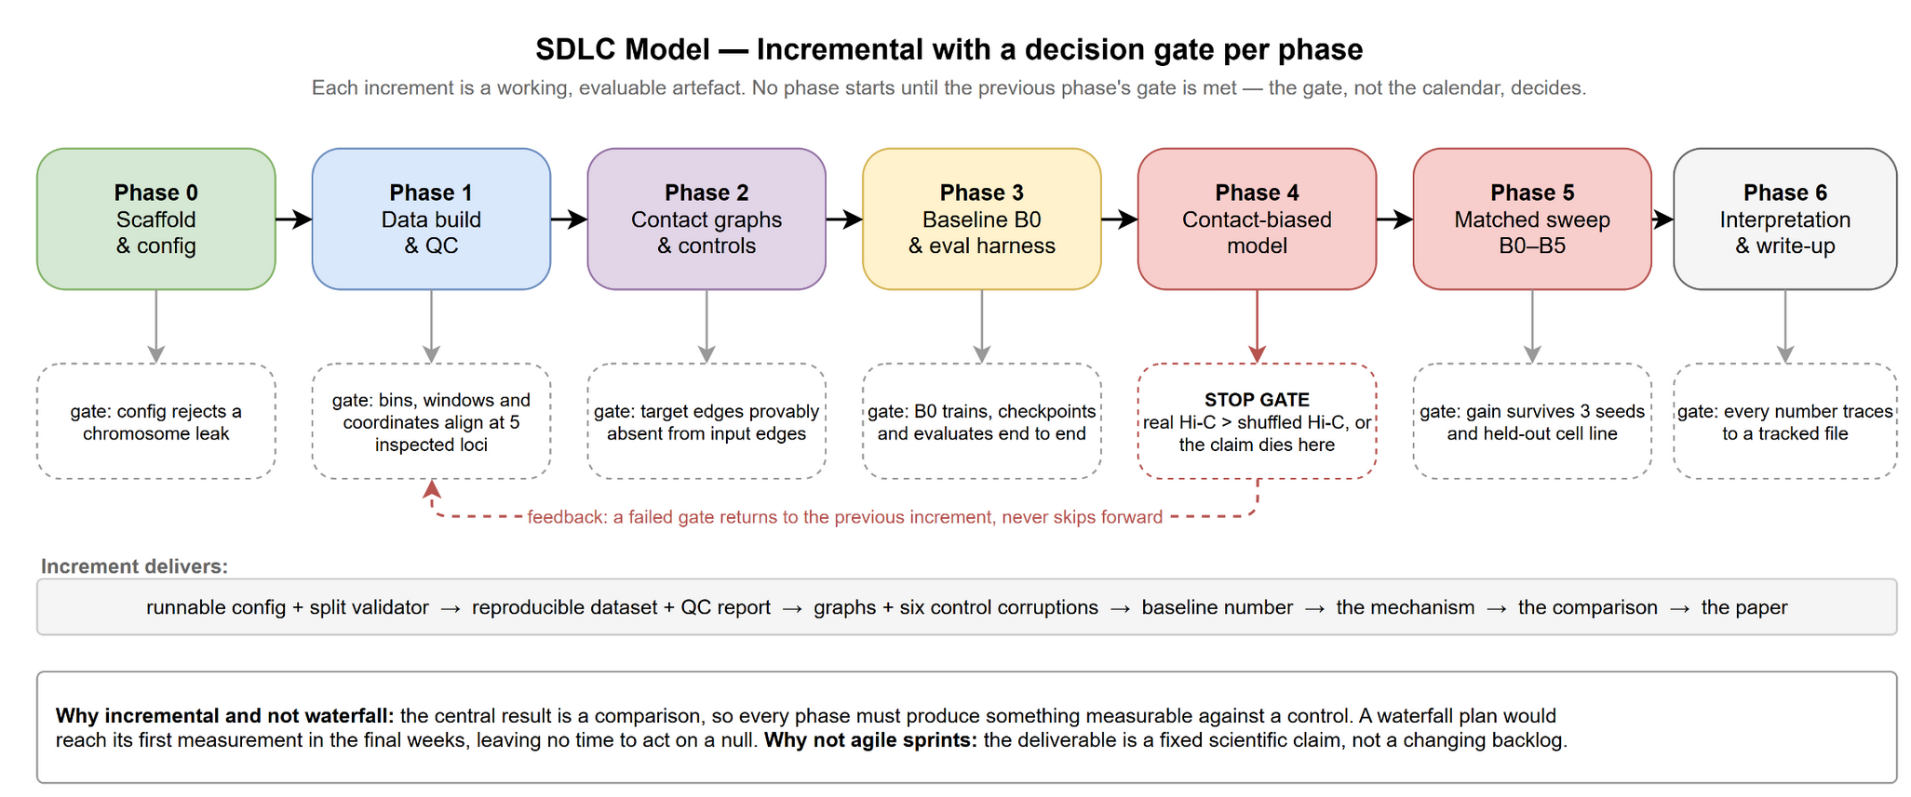
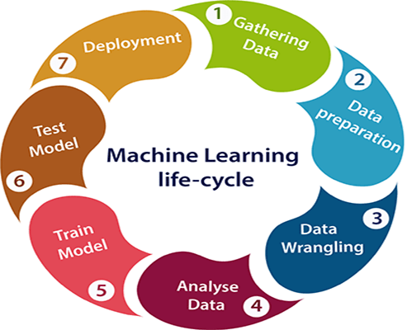
12. SDLC Model
Figure 1: Incremental model with an explicit decision gate per phase.
Notes:
Incremental, not waterfall: the deliverable is a comparison, so every phase must yield something measurable against a control. A waterfall plan reaches its first measurement in the final weeks, leaving no time to respond to a null.
Incremental, not agile sprints: the scientific claim is fixed in advance; the backlog does not change, only the evidence accumulates.
Phase 4 carries a stop gate. If the model given real Hi-C does not beat the same model given shuffled Hi-C, the central claim fails and we report that rather than tuning until the number moves.

Slide 18
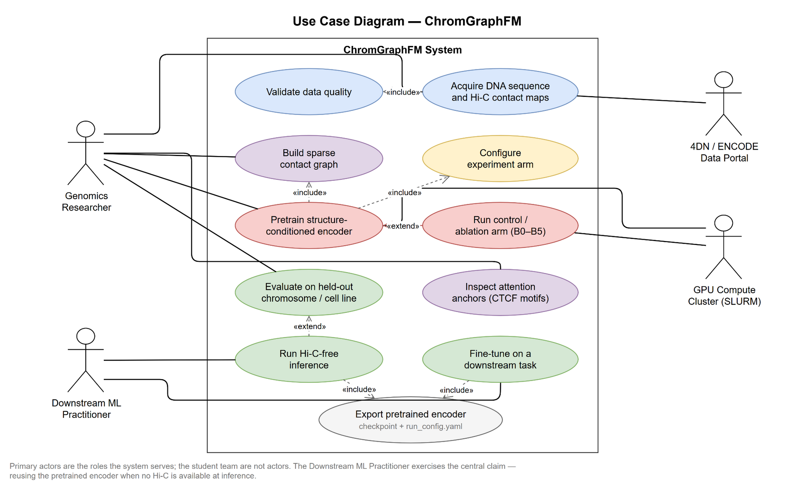
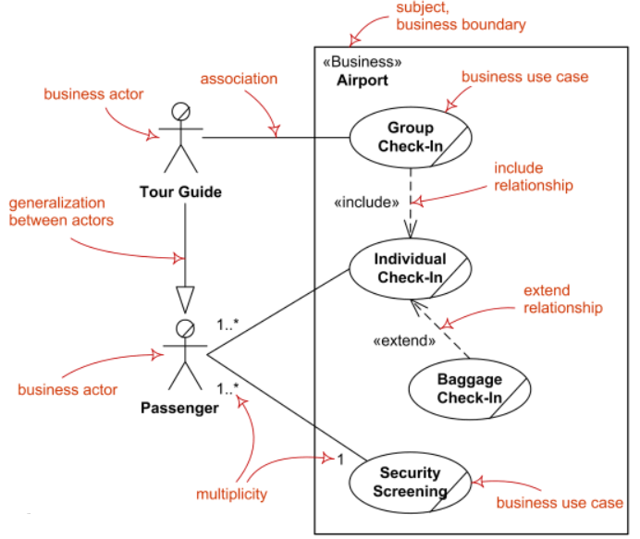
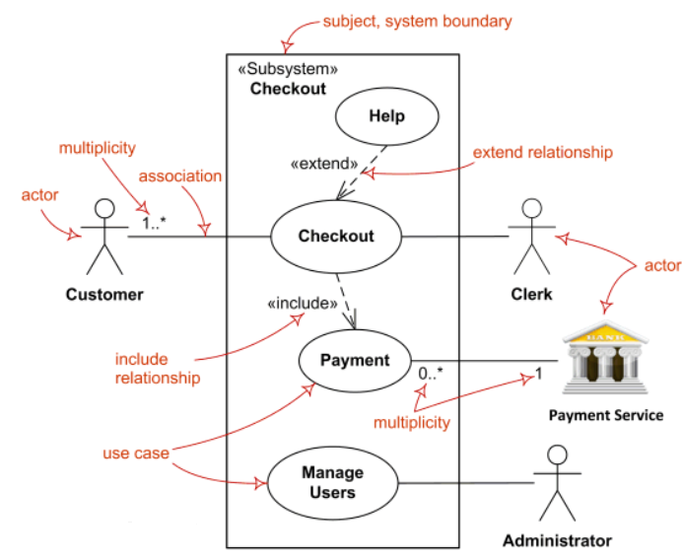
13.1. Use Case Diagram
Figure 2: Actors are the external roles the system serves, plus the two external systems it depends on.
Notes:
The Downstream ML Practitioner is the actor that exercises the central claim: reusing the pretrained encoder when no Hi-C is available at inference.

Slide 19
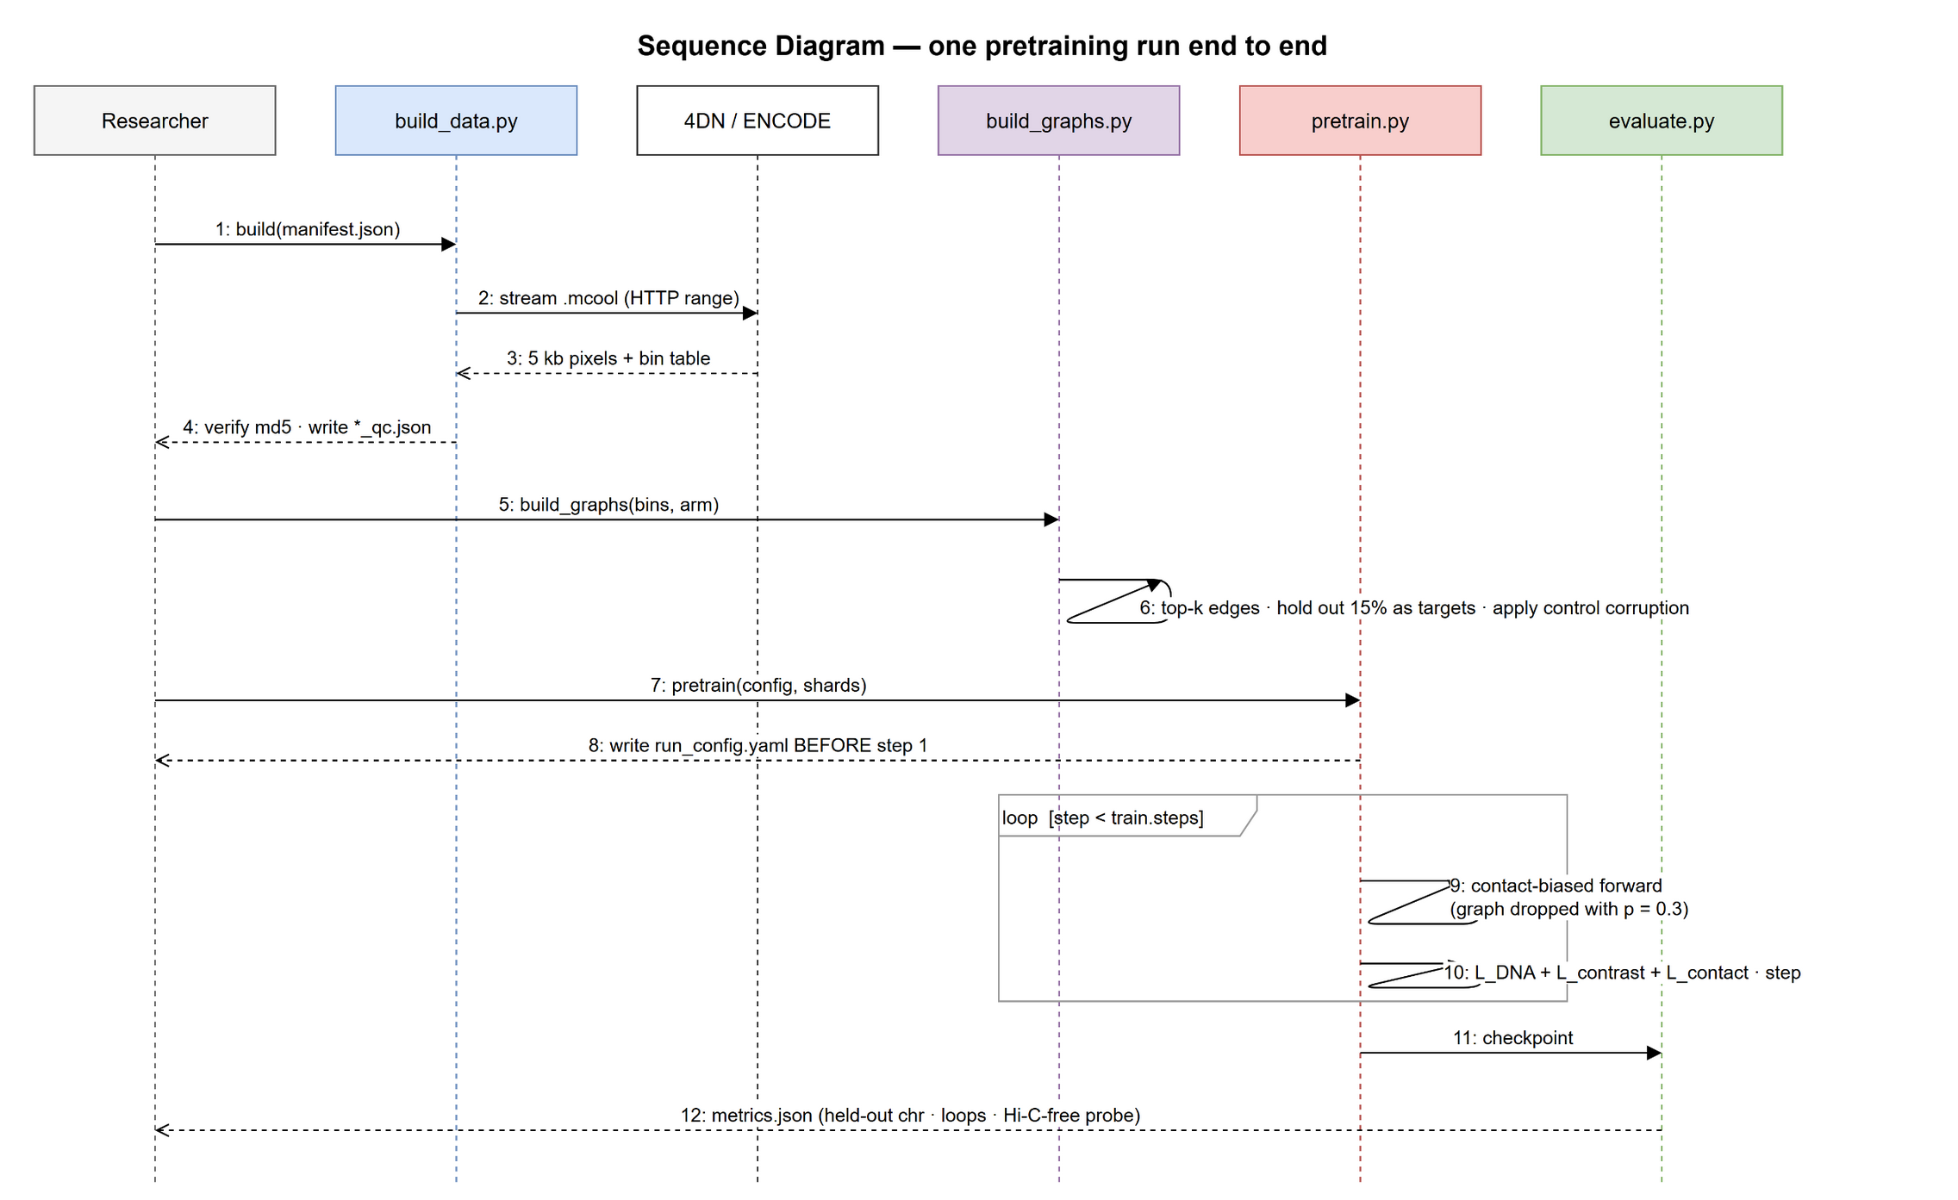
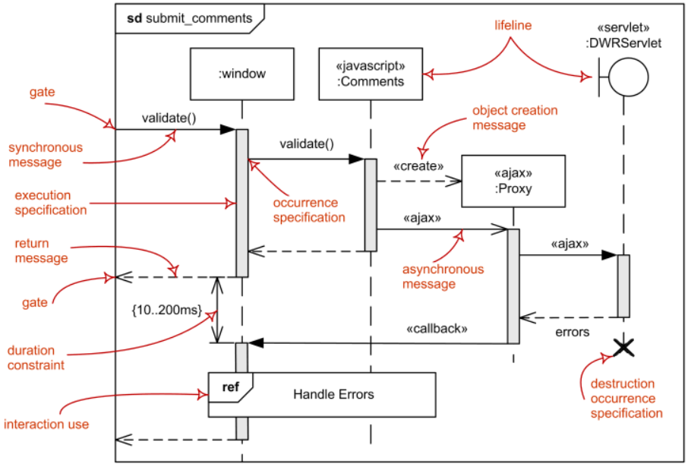
13.2. Sequence Diagram
Figure 3: One pretraining run, from manifest resolution to tracked metrics.
Notes:
Note message 8: run_config.yaml is written BEFORE the first training step, not after the last, so a run that dies mid-way still leaves a complete record of what it was.

Slide 20
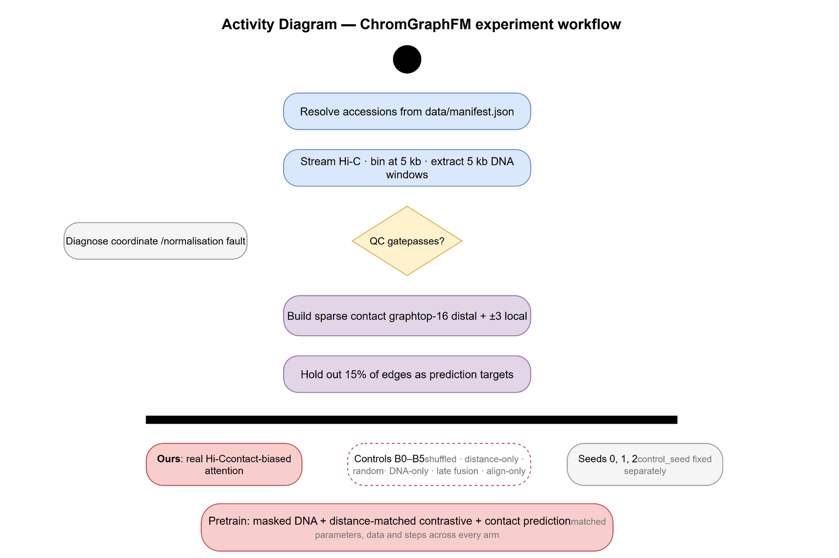
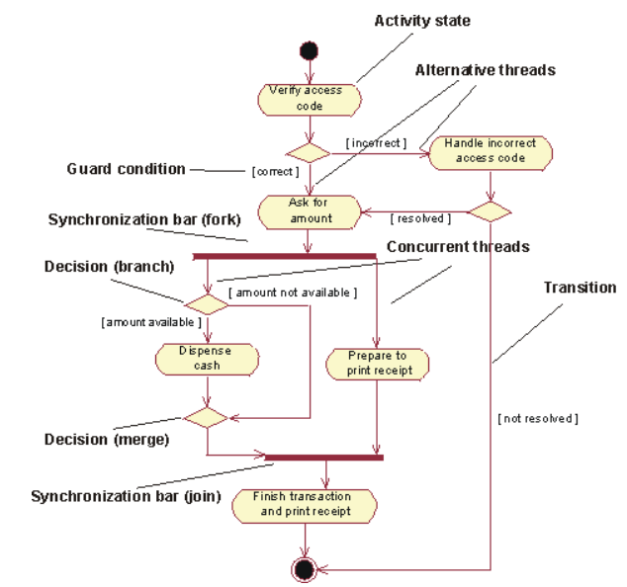
13.3. Activity Diagram
Figure 4: Experiment workflow, including the QC gate and the shuffled-Hi-C decision point.

Slide 21
14. Functional and Non-Functional Requirements
Functional requirements
  FR1: Rebuild the full dataset on any machine from data/manifest.json alone
  FR2: Construct sparse contact graphs with configurable top-k and local radius
  FR3: Hold out a configurable fraction of edges as prediction targets, excluded from the conditioning graph
  FR4: Train any of the seven arms (B0-B5, full) from one configuration field
  FR5: Write run_config.yaml and metrics.json for every run
  FR6: Run inference with the contact graph removed
Non-functional requirements
  NFR1 Reproducibility: seed, commit hash, config and accessions recorded per run
  NFR2 Portability: no hardcoded paths; laptop (CPU) and cluster (CUDA) from one tree
  NFR3 Memory: no dense chromosome-scale contact matrix is ever materialised
  NFR4 Integrity: the config loader rejects chromosome leakage and unknown keys
  NFR5 Auditability: no reported number without a tracked file behind it

Slide 22
15. Data Collection
Table 3: Accessions, URLs and md5 checksums live in data/manifest.json, the only data artefact carried in git. Splits are chromosome-level: train on autosomes, validate on chr10 and chr11, test on chr3, chr13 and chr17.
Data | Source | Format / resolution | Use
Reference genome | UCSC hg38 | FASTA + .fai | 5 kb DNA window per node
Bulk Hi-C | 4DN Data Portal | .mcool, 5 kb, ICE | Contact graph, pretraining
Hi-C, 2nd cell line | ENCODE | .mcool, 5 kb | Held-out cell-type test
Chromatin loops | CTCF ChIA-PET / HiChIP | BEDPE | Loop detection labels
Gene expression | ENCODE CAGE / RNA-seq | bigWig / TSV | Downstream transfer
CTCF motif | JASPAR MA0139 | PWM | Interpretation only
Notes:
Never split genomic windows randomly. Hi-C is autocorrelated over megabases, so a random split puts near-identical regions on both sides of the boundary and inflates every metric.
Two harder evaluations sit on top: a fully held-out cell line, and Hi-C-free inference where the contact graph is removed after pretraining.

Slide 23
16. Data Preparation
Step 1 - Resolve and verify
  Read accessions from the manifest; verify md5 after transfer
Step 2 - Stream, never densify
  Read .mcool pixels chromosome by chromosome with cooler. A dense chr1 matrix at 5 kb is about 49,800 x 49,800 floats, roughly 10 GB, so only sparse pixels are ever held in memory.
Step 3 - Align coordinates
  One node = one 5 kb Hi-C bin = one 5 kb DNA window. Keeping these identical removes a pooling layer and an entire class of off-by-one coordinate bugs.
Step 4 - Filter
  Drop nodes whose DNA is more than 50% N; drop bins with zero coverage
Step 5 - Shard and record
  Write 128-node samples plus a QC report: coordinate spot checks, the P(s) contact decay curve, split disjointness and N-content distribution
Decision gate
    No training starts until DNA window and Hi-C bin coordinates are manually verified to agree at several independent loci.

Slide 24
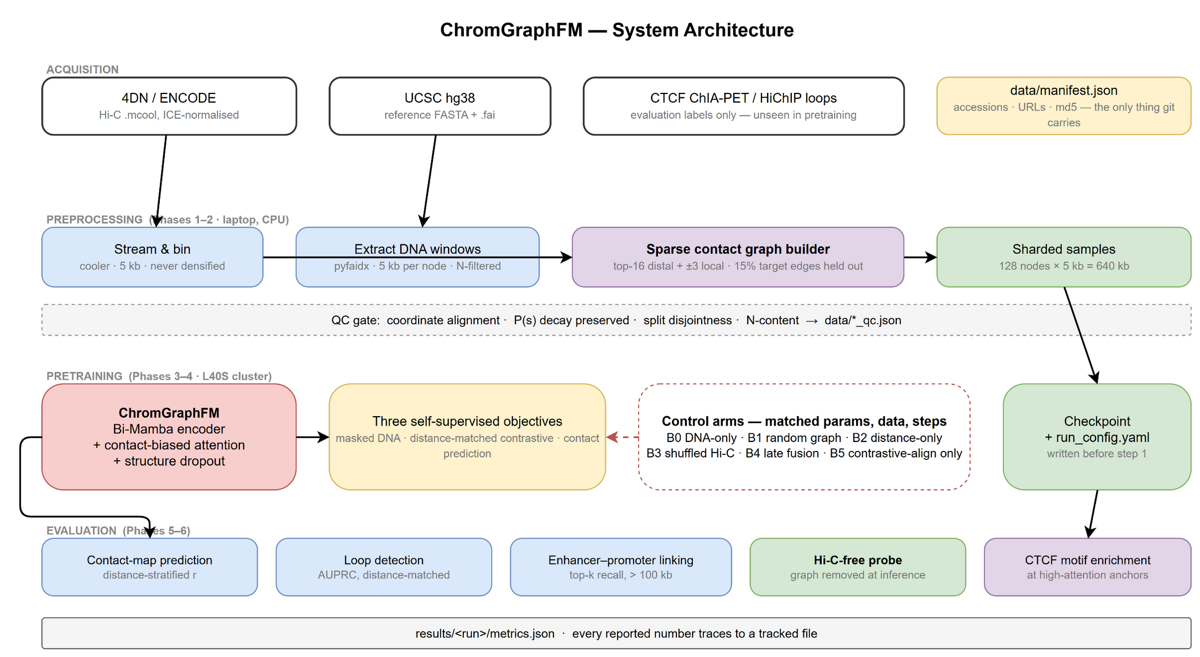
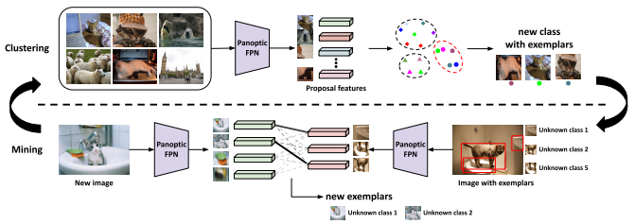
17.1. Proposed System Architecture
Figure 5: End-to-end system, from public data to tracked metrics.

Slide 25
17.2. Different Modules
Module 1 - Data (chromgraph/datasets)
  Manifest resolution, Hi-C streaming and binning, DNA window extraction, QC report
Module 2 - Graph (chromgraph/preprocessing)
  Top-k distal and local edge selection, edge features, target-edge hold-out
  The six control corruptions: random graph, distance-only edges, shuffled contacts
Module 3 - Model (chromgraph/models)
  Bi-Mamba local DNA encoder, contact-biased multi-head attention, learned edge bias, structure dropout, three pretraining heads
Module 4 - Training (chromgraph/training)
  Arm selection, mixed precision, checkpointing, run configuration capture
Module 5 - Evaluation (chromgraph/evaluation)
  Distance-stratified contact metrics, loop AUPRC, enhancer-promoter ranking, Hi-C-free probe, CTCF motif enrichment

Slide 26
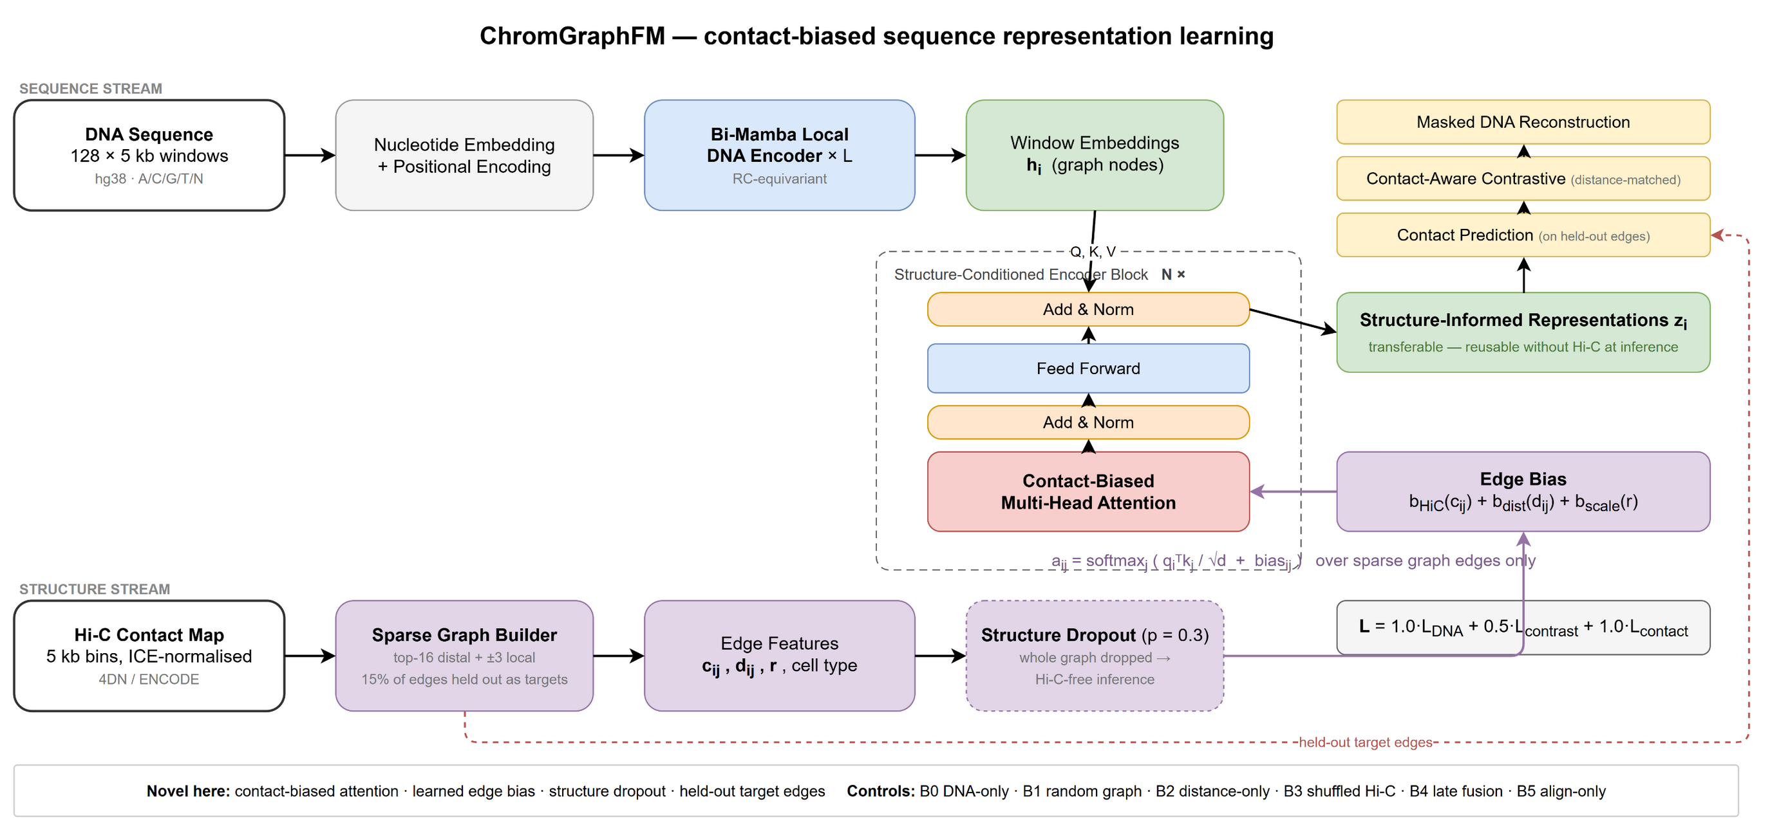
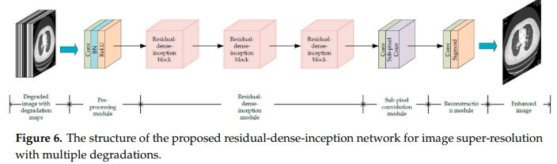
17.3. Proposed Model
Figure 6: ChromGraphFM. The Hi-C-derived edge bias enters the attention score, so the contact map decides which distal windows communicate.
Notes:
Contact-biased attention:
a_ij = softmax_j ( q_i . k_j / sqrt(d) + b_HiC(c_ij) + b_dist(d_ij) + b_scale(r) )
c_ij is normalised contact strength, d_ij linear genomic distance, r the contact resolution. The bias terms are learned. Attention runs over graph edges only, which is what makes 640 kb of context fit on one 48 GB GPU.
Objective: L = 1.0*L_DNA + 0.5*L_contrast + 1.0*L_contact
Two design choices make the claim testable. Structure dropout (p = 0.3) drops the whole graph during pretraining, so Hi-C-free inference is in-distribution rather than an untested hope. Held-out target edges keep the contact head from copying its own input.

Slide 27
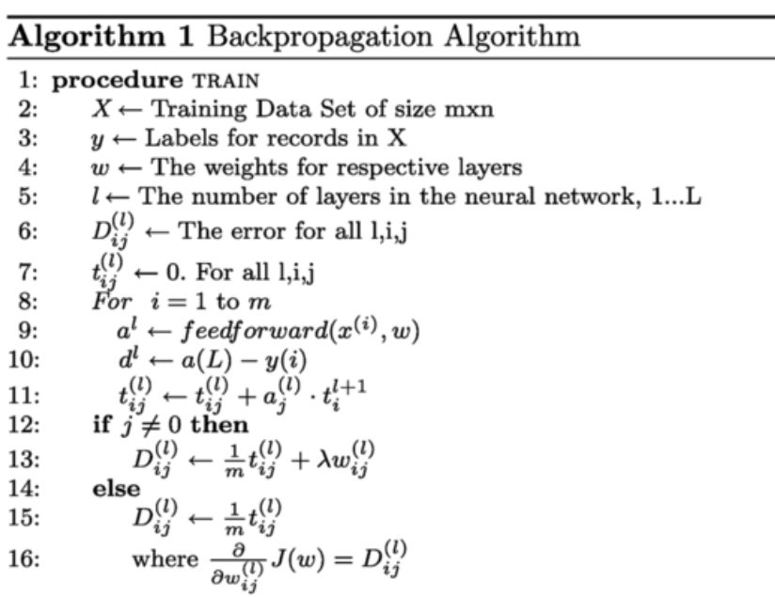
17.3. Algorithms/Pseudo Codes
Algorithm 1: Sparse contact graph construction
  Input: contact pixels C, bin size b, k, local radius m, hold-out fraction f
  Output: conditioning edges E_in, target edges E_tgt
    1. Normalise C by the expected contact at each genomic separation
    2. For each node i, keep the k strongest j with |i - j| >= min_separation
    3. Add local edges (i, j) for all 0 < |i - j| <= m
    4. Sample a fraction f of edges into E_tgt using control_seed
    5. E_in = E \ E_tgt # assert E_in and E_tgt are disjoint
    6. Attach features (c_ij, d_ij, r, cell_type) to every edge
Algorithm 2: One pretraining step
    1. h = BiMambaEncoder(dna) # one embedding per 5 kb node
    2. if uniform() < p_structure_dropout: E_in = local edges only
    3. for layer in 1..N: h = Block(h, E_in) # contact-biased attention
    4. L = L_DNA(h) + 0.5*L_contrast(h) + L_contact(h, E_tgt)
    5. backward, clip gradients to 1.0, optimiser step

Slide 28
18.1. Experimental Setup
Hardware
  Development (Phases 0-2): laptop, Intel i5-12450H, 16 GB RAM, no CUDA
  Training (Phases 3-6): NVIDIA L40S, 48 GB VRAM, university cluster
    Concurrent GPU count, wall-time limit and scratch quota still to be confirmed with the cluster administrator; the plan scales from 1 to 4 GPUs.
Software
  PyTorch with bfloat16 mixed precision and gradient checkpointing
  cooler and pyfaidx for Hi-C and sequence access; NumPy, SciPy, scikit-learn
  YAML configuration, seed and commit hash recorded per run
Experimental discipline
  Every arm shares parameter count, dataset, optimiser, schedule and step budget; only the structural signal differs
  Three training seeds per arm; controls corrupted with a separate fixed seed so seed variance and shuffle variance are never confounded
  Hyperparameters tuned on chr10 and chr11 only; test chromosomes touched once

Slide 29
18.2. Results and Analysis
Table 4: Main comparison on held-out chromosomes (chr3, chr13, chr17), mean over 3 seeds. Entries remain ?? until results/final_comparison.csv exists. The decisive row is Ours against B3.
ID | Arm | Contact r (long-range) | Loop AUPRC | Hi-C-free probe
B0 | DNA-only | ?? | ?? | ??
B1 | Random contact graph | ?? | ?? | ??
B2 | Distance-only edges | ?? | ?? | ??
B3 | Shuffled Hi-C | ?? | ?? | ??
B4 | Late fusion | ?? | ?? | ??
B5 | Contrastive alignment only | ?? | ?? | ??
Ours | Contact-biased attention | ?? | ?? | ??

Slide 30
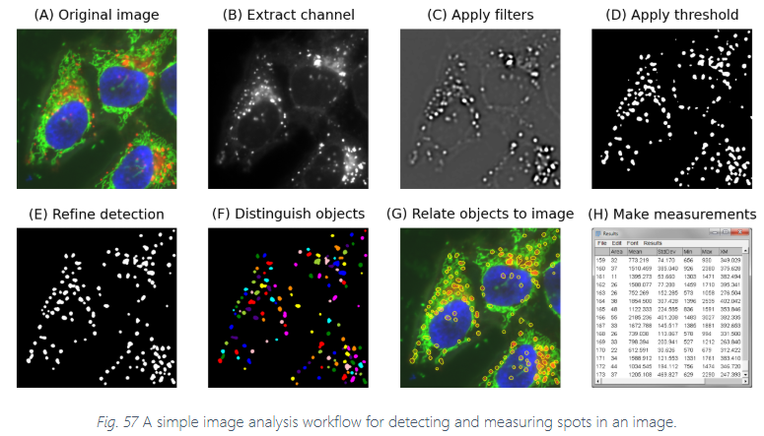
18.2. Results and Analysis
Distance-stratified, never a single correlation
  Hi-C is dominated by short-range contacts. One overall Pearson r can look strong while long-range prediction is at chance.
  Every contact metric is reported separately for short, medium and long separations
Distance-matched negatives everywhere
  Loop and enhancer-promoter negatives are matched on genomic distance, or the model is rewarded for learning only that nearby loci contact more often
What would falsify the hypothesis
  Ours failing to exceed B3 (shuffled Hi-C) on long-range contact prediction
  Ours matching B2 (distance-only), which would mean the model learned separation rather than structure
    Either outcome is reported as measured. A null on a well-controlled experiment is a result about the signal, not a failure of the project.

Slide 31
18.4. Proof of Concept
Proof of concept delivered so far
  A configuration system that refuses a chromosome leak between splits, an unknown configuration key, or a graph whose local and distal edge classes overlap
  A reproducible build: every figure regenerates from its draw.io source and every deck regenerates from one script
  Pilot dataset build on two small chromosomes: ??
  End-to-end smoke run, forward and backward pass: ??
How to verify it
    git clone, pip install -e ., python tests/test_config.py, then python scripts/build_data.py --pilot. No manual step and no downloaded artefact outside the manifest.

Slide 32
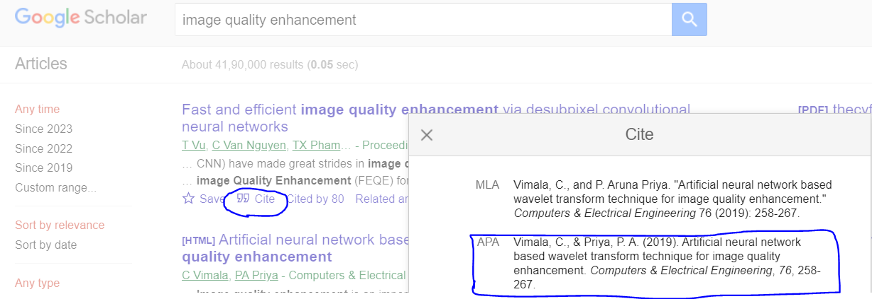
References
[1] Fudenberg, G., Kelley, D. R., & Pollard, K. S. (2020). Predicting 3D genome folding from DNA sequence with Akita. Nature Methods, 17(11), 1111-1117.
[2] Tan, J., et al. (2023). Cell-type-specific prediction of 3D chromatin organization enables high-throughput in silico genetic screening. Nature Biotechnology, 41(8), 1140-1150.
[3] Zhang, Z., et al. (2023). A generalizable framework to comprehensively predict epigenome, chromatin organization, and transcriptome. Nucleic Acids Research, 51(12), 5931-5947.
[4] Schiff, Y., et al. (2024). Caduceus: Bi-directional equivariant long-range DNA sequence modeling. arXiv:2403.03234.
[5] A generalizable Hi-C foundation model for chromatin architecture, single-cell and multi-omics analysis across species (HiCFoundation). Nature Methods (2026).
[6] MIX-HIC: Multimodal 3D Genome Pre-training. arXiv:2504.09060 (2025).
[7] Evo2HiC: a multimodal foundation model for integrative analysis of genome sequence and architecture. bioRxiv 2025.11.18.689171 (2025).
[8] Gu, A., & Dao, T. (2023). Mamba: Linear-time sequence modeling with selective state spaces. arXiv:2312.00752.
[9] Vaswani, A., et al. (2017). Attention is all you need. NeurIPS 2017.
[10] Rao, S. S. P., et al. (2014). A 3D map of the human genome at kilobase resolution reveals principles of chromatin looping. Cell, 159(7), 1665-1680.
[11] Abdennur, N., & Mirny, L. A. (2020). Cooler: scalable storage for Hi-C data and other genomically labeled arrays. Bioinformatics, 36(1), 311-316.
Notes:
Author lists for [5], [6] and [7] are to be completed against the published record before submission. They are cited here by title and identifier so that every entry is verifiable exactly as written.

