Slide 1


ChromGraphFM: An End-to-End 3D Chromatin-Conditioned Genomic Foundation Model
VR SIDDHARTHA ENGINEERING COLLEGE, VIJAYAWADA
Department of Computer Science and Engineering
23CS7552: B. Tech Mini Project (Project Pitch)
2026
Batch No: __
Batch Members
P. Charan Sai (238W1A5447)
G. Karthik (248W5A5404)
P. Sanath (238W1A5446)
Under the Guidance of
Mrs. K. Divya Kothapali
Assistant Professor

Slide 2
Abstract
Three-dimensional chromatin organisation lets distal regulatory elements control gene expression, yet most genomic sequence models treat the genome as a one-dimensional string. This project develops ChromGraphFM, a compact 3D chromatin-conditioned genomic representation model trained from scratch on DNA sequence and Hi-C contact maps. Genomic regions become nodes in a sparse contact graph, and measured Hi-C contact strengths bias attention among distant DNA windows throughout self-supervised pretraining, so structure shapes the sequence representation instead of being appended after it. Pretraining combines masked DNA modelling, distance-matched contact-aware contrastive learning, and chromatin contact prediction. The model is evaluated against sequence-only, shuffled-contact, distance-only, random-graph and late-fusion controls trained at matched parameters, data and compute, using chromosome-level and cell-type held-out splits for contact-map prediction, chromatin loop detection, enhancer-promoter linking and Hi-C-free transfer. The central question is whether experimentally measured 3D structure can be internalised into a reusable DNA representation rather than supplied as an extra input at prediction time.

Slide 3
11. Gap Analysis
Established in the literature
  Foundation models pretrained on Hi-C maps exist (HiCFoundation)
  Multimodal Hi-C and epigenomic pretraining exists (MIX-HIC)
  Hi-C-guided distillation into a DNA encoder exists (Evo2HiC)
Still open
  No published model trains a DNA encoder end to end while measured contact graphs control which distal windows exchange information at every layer
  Post-hoc alignment and late fusion have not been separated from in-encoder conditioning under matched parameters, data and compute
  Whether structural knowledge survives removal of Hi-C at inference is asserted more often than it is tested against a shuffled-contact control
Gap statement
    It remains untested whether contact graphs conditioning sequence contextualisation throughout pretraining yield a more transferable DNA representation than the alternatives, measured against distance-matched and shuffled-contact controls.

Slide 4
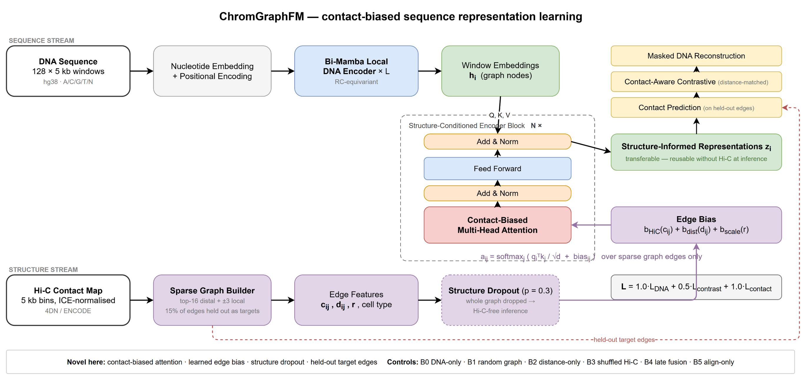
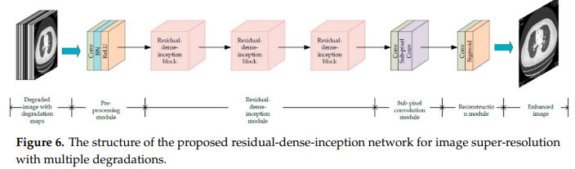
17.3. Proposed Model
Figure 6: ChromGraphFM. The Hi-C-derived edge bias enters the attention score, so the contact map decides which distal windows communicate.
Notes:
Contact-biased attention:
a_ij = softmax_j ( q_i . k_j / sqrt(d) + b_HiC(c_ij) + b_dist(d_ij) + b_scale(r) )
c_ij is normalised contact strength, d_ij linear genomic distance, r the contact resolution. The bias terms are learned. Attention runs over graph edges only, which is what makes 640 kb of context fit on one 48 GB GPU.
Objective: L = 1.0*L_DNA + 0.5*L_contrast + 1.0*L_contact
Two design choices make the claim testable. Structure dropout (p = 0.3) drops the whole graph during pretraining, so Hi-C-free inference is in-distribution rather than an untested hope. Held-out target edges keep the contact head from copying its own input.

Slide 5
20. Conclusion & Future Work
Here, we have discussed
  1. The regulatory problem: enhancers act across megabases, and sequence-only models must infer relationships that have already been measured
  2. A mechanism: measured contact graphs biasing attention inside the encoder throughout pretraining, rather than fusion or post-hoc alignment
  3. A controlled test: matched B0-B5 arms, chromosome and cell-line held-out splits, and a Hi-C-free inference probe
  4. A discipline: no number without a tracked file, no superiority claim without a matched setting
Future work
  Multi-scale contacts (5 kb plus 25-50 kb) for domains and compartments
  More cell lines; epigenomic tracks as additional node or edge features
  Variant-effect prediction on non-coding GWAS variants
  Cross-species transfer to mouse; single-cell Hi-C with sparse contacts
  A stronger backbone via parameter-efficient adaptation of Caduceus

