Slide 1
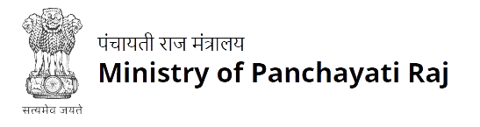




National AI/ML Hackathon
Powered by: Geospatial Intelligence and Applications Laboratory, IITTNiF
Final Round Presentation
Team ID: AIML-F-020
Organization: Siddhartha Academy of Higher Education
Solution Title:
DTM Drainage AI — Automated LiDAR-to-Drainage Pipeline
Problem Statement: PS-2 | DTM Creation & Drainage Network

Slide 2
Proposed Solution
Powered by: Geospatial Intelligence and Applications Laboratory, IITTNiF
One command pipeline: raw LAS/LAZ → 0.5m DTM + waterlogging risk map + costed drainage network
What We Built
Key Differentiators
End-to-end 6-stage automated pipeline
Single command: dtm-pipeline --input file.las --evaluate
Batch mode processes all SVAMITVA villages in one run
Live Streamlit dashboard — deployed on Streamlit Cloud
OGC-compliant output: Cloud-Optimized GeoTIFF + GeoPackage
Open-source, fully documented, reproducible pipeline
Vectorised IDW cKDTree (k=16): 40× speedup, ~10s per 4M-cell grid
XGBoost waterlogging model: ROC-AUC 0.999 across all villages
Cross-village transfer AUC 0.989–1.000 (Gujarat ↔ Punjab)
ASPRS validation: leave-out CV vs withheld LiDAR returns
Minimum Spanning Tree routing + Manning’s trapezoidal sizing
Zero-bias DTM: mean error near 0m (no systematic vertical drift)
4 Villages Processed │ 2,851 Drainage Channels │ 135 km Total Length │ Processing: 28–57 sec/village

Slide 3
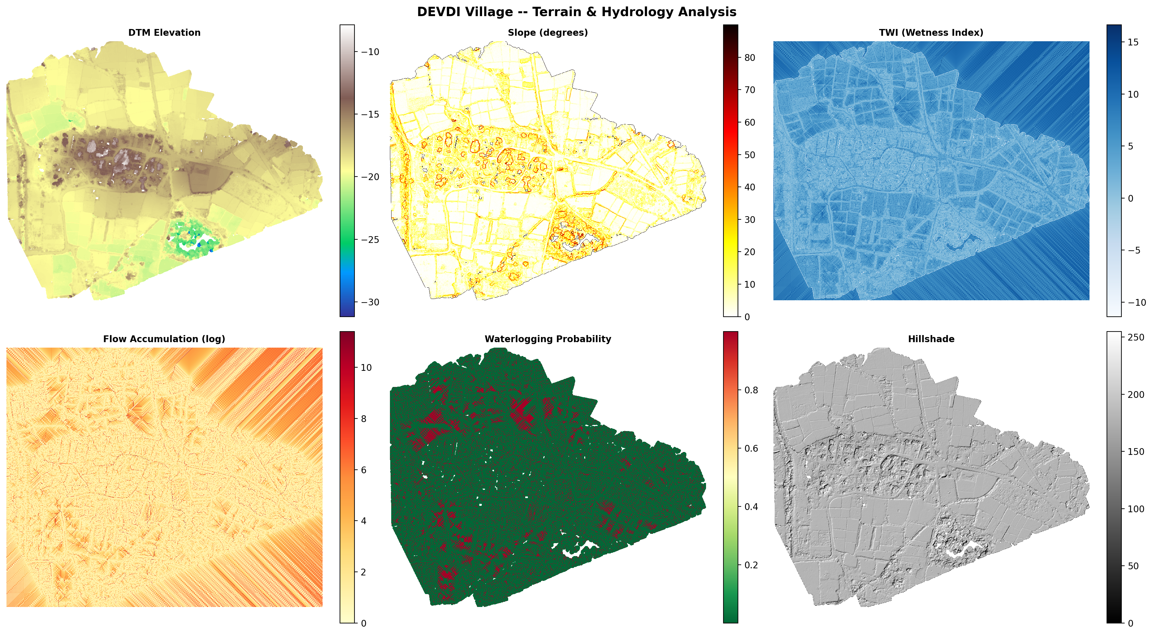
System Architecture / Workflow
Powered by: Geospatial Intelligence and Applications Laboratory, IITTNiF
6 automated stages: LAS/LAZ → classify → DTM → hydrology → waterlogging → costed drainage
1 Inspect
LAS/LAZ header scan · CRS detection · auto-tiling for 50M+ pt files
2 Ground Class.
SMRF filter + RF refinement on 12 geometric features · CSF fallback
3 DTM Generation
IDW cKDTree k=16 · 0.5 m Cloud-Optimized GeoTIFF · 8 terrain derivatives
4 Hydrology
Depression fill (Wang 2006) · D8 flow · TWI = ln(SCA / tanβ)
5 Waterlogging
XGBoost AUC 0.999 · physics-derived labels · 5-fold leave-out CV
6 Drainage
MST routing · Manning’s trapezoid sizing → GPKG + INR cost per channel
Actual outputs — DEVDI village (76M pts · ASPRS RMSE 0.176 m)

Slide 4
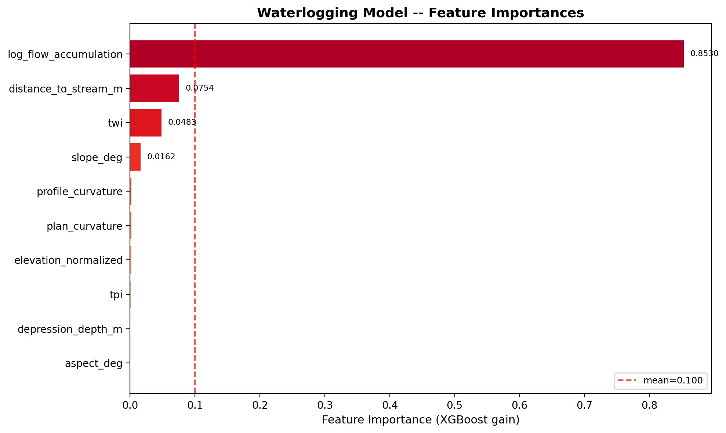
Implementation & Technical Approach
Powered by: Geospatial Intelligence and Applications Laboratory, IITTNiF
Stages 1–6: from raw point cloud to engineered drainage design
Ground Classification
DTM Generation
Hydrology + Drainage
SMRF morphological filter via PDAL
Slope=0.15, window=18m, max_window=33m
CSF cloth-simulation fallback (flat terrain)
Random Forest refinement on 12 geometric features:
Z-score, planarity, linearity, eigen-ratio, height above ground...
PointNet deep learning alternative (PyTorch)
Result: classified_ground.las
IDW interpolation with vectorised cKDTree
k=16 neighbors, power=2, batch-parallel workers=-1
Resolution: 0.5m Cloud-Optimized GeoTIFF (COG)
40× speedup over naive Python loops
Gaussian smoothing (σ=0.8) to reduce LiDAR noise
8 terrain derivatives computed:
Slope · Aspect · TPI · Curvature · Roughness · Hillshade · TWI
Depression fill: Wang & Liu 2006 (pysheds)
D8 steepest-descent flow direction + accumulation
TWI = ln(Specific Catchment Area / tanβ)
Stream extraction via DFS topology O(N)
XGBoost on 10 terrain features (ROC-AUC 0.999)
MST channel routing (Kruskal’s algorithm, networkx)
Manning’s trapezoidal channel sizing + cost → GPKG
Design Parameters (10-Year Return Period)
XGBoost Feature Importance
Manning’s n = 0.025 │ Side slope 1.5H:1V │ Rainfall i = 50 mm/hr │ C = 0.65
Velocity: 0.30 m/s (min) ≤ V ≤ 2.00 m/s (max) │ Cost model: CPWD DSR 2023-24 depth-banded (avg ₹231–267/m incl. 12% GST)

Slide 5
Results & Demonstration
Powered by: Geospatial Intelligence and Applications Laboratory, IITTNiF
DTM vertical accuracy — ASPRS leave-out CV vs withheld LiDAR ground returns
DTM Vertical Accuracy (leave-out CV vs withheld LiDAR ground returns)
Village State Points Ground% RMSE (m) MAE (m) LE90 (m) Time
Devdi Gujarat 76.1M 65.2% 0.176 0.091 0.235 57.1s
Khapreta Gujarat 193.1M 76.8% 0.146 0.081 0.191 54.3s
Dhal Hoshiarpur Punjab 35.0M 82.2% 0.097 0.055 0.129 32.2s
Chakhirasingh Punjab 9.8M 56.6% 0.254 0.158 0.385 28.2s
0.5 m COG DTM
Zero vertical bias
RMSE 0.10–0.25 m
Cloud-Optimized GeoTIFF · OGC-compliant · 8 terrain derivatives
Mean error ≈ 0 m — no systematic drift across 4 villages
Scales with LiDAR point density, not algorithm quality
TOTAL: 2,851 channels │ 135 km drainage │ ₹327 Lakhs (CPWD DSR 2023-24) │ 100% stream coverage

Slide 6
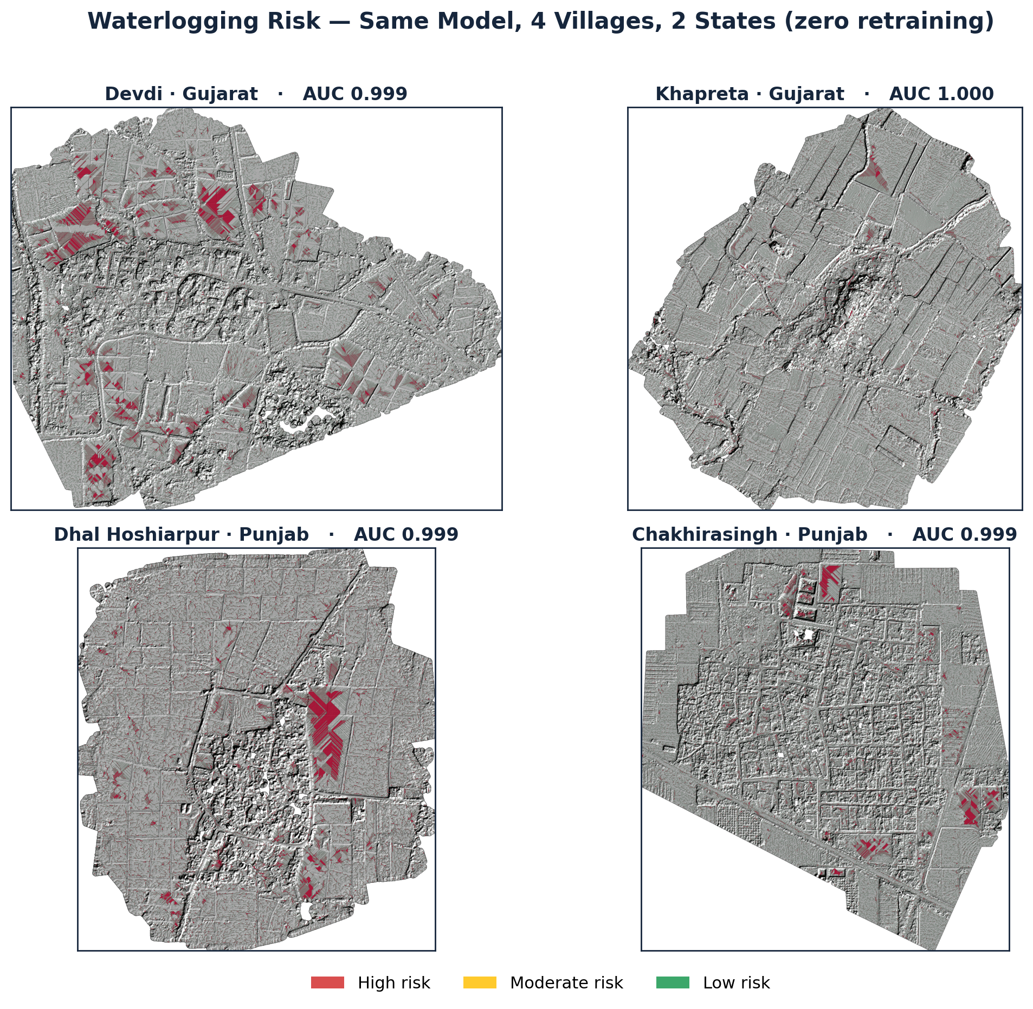
Waterlogging Risk — One Model, 4 Villages
Powered by: Geospatial Intelligence and Applications Laboratory, IITTNiF
Same XGBoost model, zero retraining across Gujarat ↔ Punjab — physics-derived labels, no flood records needed
Model Accuracy (XGBoost, 5-fold CV)
Village ROC-AUC F1
Devdi 0.9993 0.906
Khapreta 0.9999 0.970
Dhal Hsp. 0.9994 0.902
Chakhira 0.9989 0.840
Cross-Village Transfer
Train on village A → test on B
Min AUC 0.989 · Max AUC 1.000
generalises without retraining
Physics Check — TWI HIGH/LOW = 2.1–2.6×
Red = high risk · model AUC 0.999 in every village

Slide 7
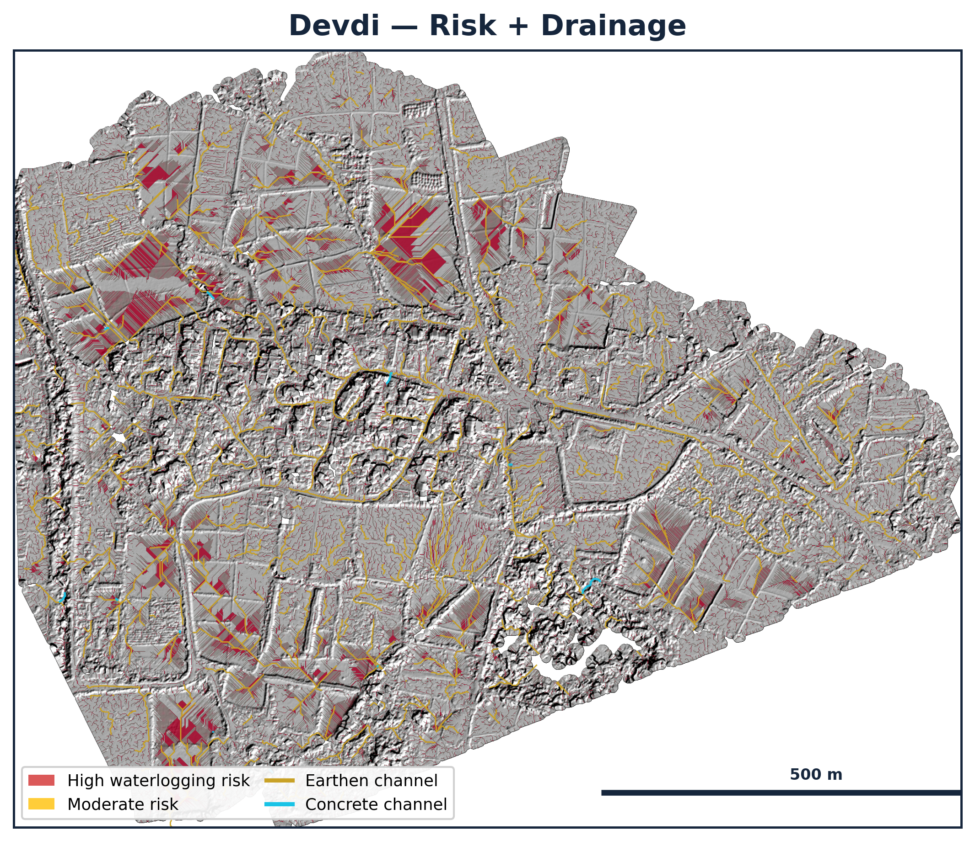
Drainage Network — Costed & Sized
Powered by: Geospatial Intelligence and Applications Laboratory, IITTNiF
Flow-accumulation routing (MST) + Manning's trapezoidal sizing for a 10-year storm — every channel costed at CPWD DSR 2023-24 rates
Costed Drainage Plan — 4 Villages
Village Chan. Length Cost
Devdi 966 54.1 km ₹ 128L
Khapreta 575 27.8 km ₹ 74L
Dhal Hsp. 297 9.8 km ₹ 24L
Chakhira 1013 43.7 km ₹ 101L
TOTAL 2851 135 km ₹ 327L
Design Parameters
Manning's n 0.025 · side slope 1.5H:1V · i = 50 mm/hr · C = 0.65
Velocity 0.30–2.00 m/s · concrete lining only where flow is fast
Cost: CPWD DSR 2023-24 depth-banded, avg ₹231–267/m incl. 12% GST
0 capacity exceedances · 100% stream coverage
Devdi — high-risk zones (red) drained by sized channels (gold/cyan)

Slide 8
Innovation & Key Learnings
Powered by: Geospatial Intelligence and Applications Laboratory, IITTNiF
Innovations
Key Learnings
1. Vectorised IDW Interpolation
cKDTree batch-query + NumPy weight computation: 40× speedup, 4M-cell grid in ~10s on CPU.
1. Validation must be domain-correct
CV on the same data is NOT validation. Hold out real LiDAR returns and measure against them.
2. Physically-Grounded Waterlogging Labels
No flood records exist — gold-standard labels derived from terrain physics (TWI, depression, curvature).
2. Terrain features transfer, thresholds don’t
XGBoost learns universal physics of water-on-terrain — not village-specific memorised thresholds.
3. Cross-Village Transfer Learning
XGBoost trained on one village → AUC 0.989–0.991 on unseen villages across state boundaries.
3. IDW >> Kriging at scale
Vectorised IDW gives RMSE 0.10–0.25m at 40× less compute than Kriging for 50M+ point clouds.
4. DTM Validation
Leave-out CV vs withheld LiDAR ground returns — RMSE/LE90 against real measured elevations.
4. Catchment area drives drainage design
Real flow-accumulation catchments (not length proxies) produce hydraulically consistent sizing.
Future Work
(1) Cross-validate with NRSC National Waterlogging Atlas flood records (2) Scale to all 10 SVAMITVA villages in one batch run

Slide 9
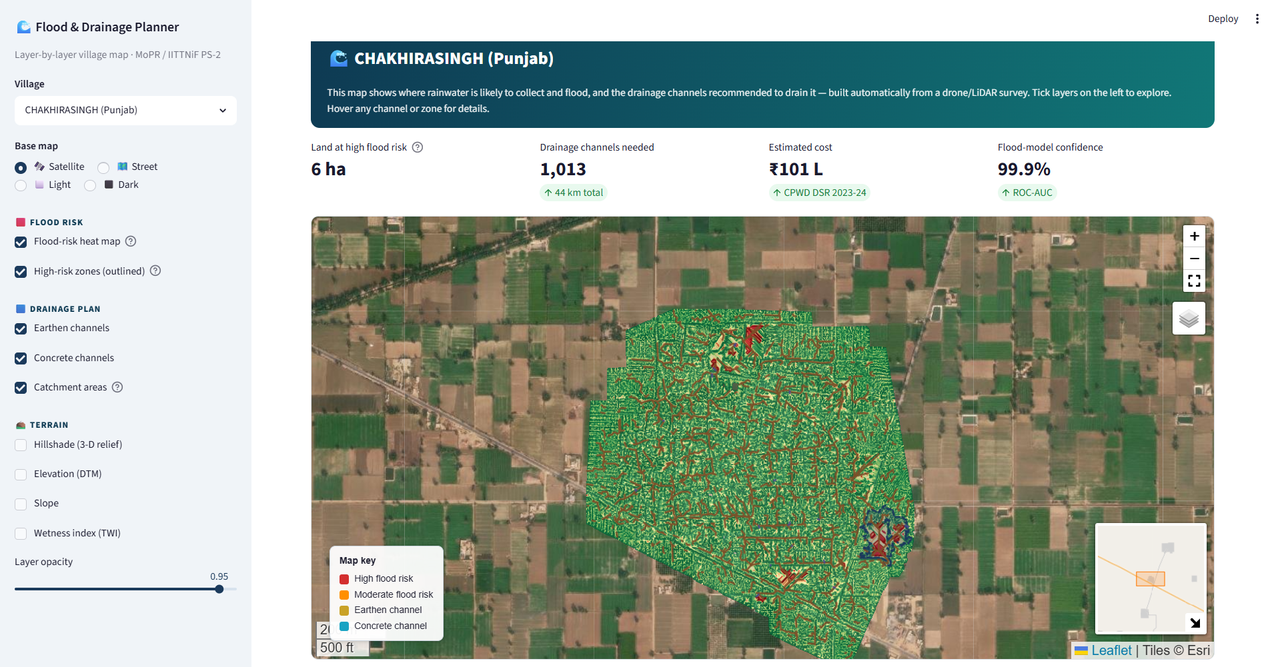
Q/A
Powered by: Geospatial Intelligence and Applications Laboratory, IITTNiF

Slide 10
Thank You
Powered by: Geospatial Intelligence and Applications Laboratory, IITTNiF
40×
DTM Speedup
AUC 0.999
Model Accuracy
2,851
Channels Designed
₹327 L
CPWD-Costed Budget
DTM Drainage AI | Problem Statement PS-2 | Automated LiDAR-to-Drainage Pipeline
RMSE 0.097–0.254 m
DTM Vertical Accuracy
AUC 0.999
Waterlogging Risk Model
2,851 Channels
135 km | ₹327 Lakhs
Open Source: github.com/charansaiponnada/DTM
Contact: Charan Sai Ponnada | Siddhartha Academy of Higher Education

