Slide 1
Mnemosyne
Linear-Time Genomic Sequence Modeling with a Unified Associative Memory
Persistent motifs + sequence registers · reverse-complement equivariant
Charan Sai Ponnada
Research overview · July 2026

Slide 2
Problem statement
DNA function spans enormous distances — a model must satisfy three demands at once
O(L)
A↔
⟲
Linear-time scaling
Content-addressable recall
Reverse-complement symmetry
Reach 10^5–10^6 bp enhancer–promoter contexts at all.
Retrieve sparse motifs & distal elements by content, not position.
DNA is double-stranded: forward and RC strands are the same molecule.
No mainstream architecture does all three.
• Transformers (DNABERT-2): strong recall, but O(L²) — context is capped.
• Selective SSMs (Mamba, HyenaDNA): O(L), but a fixed-width state means recall collapses with distance.
• Caduceus: adds the missing RC symmetry to Mamba — but inherits the fixed-state recall bottleneck.
2

Slide 3
Objectives
Turn the three demands into one linear-cost mechanism — and test it honestly
1
Add a linear-cost associative memory that every token reads by one Hopfield step.
2
Unify two slot types: a learned universal-motif dictionary (persistent) and per-sequence long-range recall (registers).
3
Guarantee exact reverse-complement equivariance by construction.
4
Prove linear time (semiseparable + low-rank) and verify the memory is actually active.
5
Test the falsifiable claim — memory beats a matched SSM at long range — with no fabricated numbers.
3

Slide 4
Related work I — sequence models & associative memory
State-space models
Long convolutions
S4 (Gu '22) → Mamba (Gu & Dao '23) → Mamba-2 / SSD (Dao & Gu '24): linear-time, but a known recall bottleneck.
Hyena (Poli '23), HyenaDNA (Nguyen '23): million-token contexts via implicit convolutions.
Hybrids re-add attention
The recall gap
Jamba (Lieber '24), Griffin (De '24): interleave attention to recover recall — at higher cost.
Zoology / MQAR (Arora '23), Based (Arora '24): efficient models under-recall; MQAR isolates the gap.
Associative memory
Pre-training
Modern Hopfield (Ramsauer '21), Energy Transformer (Hoover '23), optimal capacity (Wu '24), Perceiver bottleneck (Jaegle '21).
Attention Is All You Need (Vaswani '17); Masked Autoencoders (He '22) — our pre-training objective.
4

Slide 5
Related work II — genomic foundation models & benchmarks
Transformer DNA LMs
Efficient / long-range
DNABERT (Ji '21), DNABERT-2 (Zhou '24), Nucleotide Transformer (Dalla-Torre '25), GENA-LM (Fishman '25), GROVER ('24).
HyenaDNA (Nguyen '23); Caduceus (Schiff '24) — RC-equivariant Mamba, the closest prior design.
Frontier generative
Regulatory / functional
Evo (Nguyen '24, 7B); Evo 2 (Brixi '25, 40B, 9.3T nt, 1 Mb ctx) — the scale frontier.
Enformer (Avsec '21), Borzoi (Linder '25), AlphaGenome (Avsec '25) — variant-effect SOTA.
Benchmarks
The gap we target
GUE, Genomic Benchmarks, BEND (Marin '24) — where we will evaluate, fairly.
None combines O(L) + content-addressable recall + RC symmetry. Mnemosyne aims exactly there.
5

Slide 6
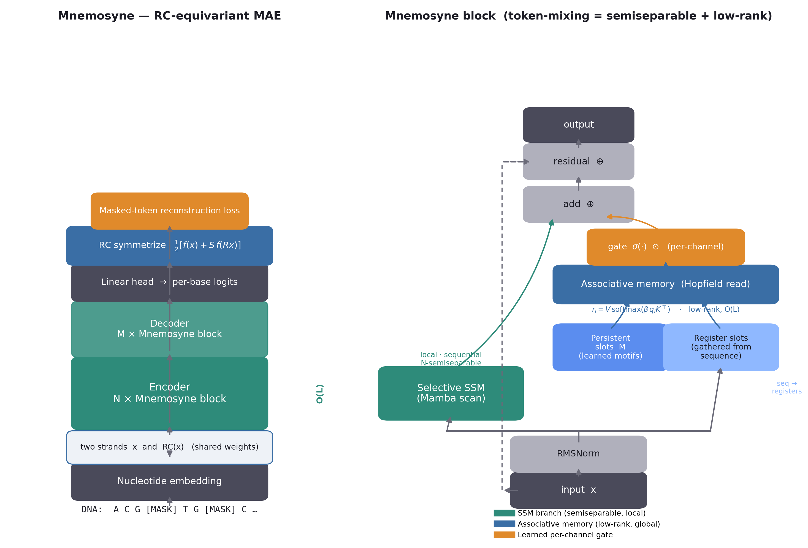
Methodology (1/3) — Architecture
A selective SSM in parallel with a unified associative memory, fused by a learned gate
Left: RC-equivariant masked-autoencoder stack. Right: one Mnemosyne block — token-mixing = semiseparable (SSM) + low-rank (memory), hence O(L).
6

Slide 7
Methodology (2/3) — Unified associative memory
Every token reads S = P_p + P_r slots by one Hopfield step:
Persistent slots M
Learned parameters — a differentiable dictionary of universal motifs, shared across all sequences.
Register slots
Gathered from the current sequence (Perceiver bottleneck) → per-sequence, distance-independent recall.
Learned per-channel gate
σ(·)⊙ — starts closed (negative-bias init), opens as memory earns its place. Cannot be silenced by one logit (v1's failure).
Read: rᵢ = V · softmax( β · qᵢ Kᵀ )
Gather: Reg = softmax( β Z Xᵀ ) · X
β learnable → soft motif-family vs. sharp single-motif recall
Theorem (linear time)
token-mixing = N-semiseparable (SSM) + rank ≤ P_p+P_r (memory)
⇒ O( L · (N + P_p + P_r) · d ), no L×L matrix formed.
Reverse-complement equivariance
output = ½[ f(x) + S·f(Rx) ] — exact; tested to 0.0 error.
7

Slide 8
Methodology (3/3) — Data & experimental protocol
Data collection
Multi-species genomes (UCSC: human, mouse, zebrafish, …)
Sliding windows 1024 bp, stride 512, filter >5% N
Single-nucleotide tokenize {A,C,G,T,N}
MAE objective mask 30%, predict originals
→
→
→
Experiments (controlled — SSM baseline = same backbone, memory OFF)
MQAR long-range
Controlled MAE
Synthetic recall at controllable distance — the falsifiable core test.
Memory ON vs OFF; log gate + Hopfield energy to prove memory is active.
GUE downstream
Ablations
Frozen linear probe on BOTH models (fair); report MCC. No probe-vs-finetune spin.
Sweep P_r, P_p, β, and gate to show which component earns its keep.
All paper numbers are auto-generated from run logs; any unfilled result renders as a red TODO.
8

Slide 9
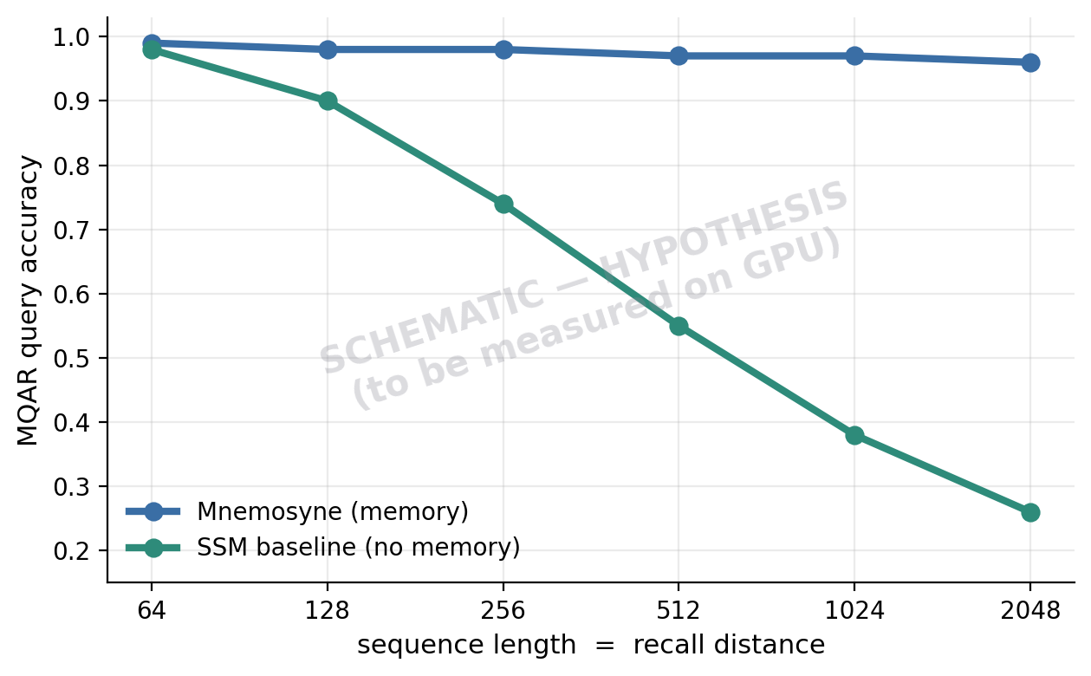
Results — verified now, and the falsifiable prediction
7 / 7
CPU correctness tests pass
0.0
RC-equivariance error (exact)
gate 0.12 · E −27
memory is ACTIVE (not inert — v1's failure)
27M vs 16M
memory vs matched SSM baseline (controlled)
Prediction: SSM recall decays with distance; memory stays flat.
Headline MQAR / GUE numbers pending free-GPU runs — we report only what we measure.
9

Slide 10
Is it working? Groundbreaking? Why might it fail?
Working?
Groundbreaking?
Why it might fail
• Mechanism runs and is active — verified.
• RC-equivariance proven (0.0 error).
• The scientific claim is a ready hypothesis, not yet a measured result.
• Not by out-scaling — ~1000× smaller than Evo 2 / AlphaGenome.
• Yes if the mechanism is rigorously shown to help and others adopt it — as Caduceus did with one idea.
• Wrong bar: 'like AIAYN' = a simple mechanism that scales.
• MQAR may not separate from a tuned SSM.
• Gate may collapse to 0 at scale.
• Persistent slots may be dead weight; registers have a capacity ceiling.
• May not transfer to genome scale.
10

Slide 11
Roadmap
Cheapest decisive signal first, then scale — the real test of the mechanism
1
Run MQAR + ablations on a free GPU (Modal). The cheap, falsifiable signal.
2
Controlled MAE pre-training + fair GUE probes; confirm memory stays active.
3
Scale: human genome → multi-species; 27M → 350M. Show the memory benefit GROWS with scale.
4
Full GUE (28 tasks) + NT benchmarks vs current baselines; 3–5 seeds + confidence intervals.
5
Target a niche SOTA (splice / non-coding variant) where long-range recall is the right tool.
11

Slide 12
References (selected, 25)
1. Vaswani et al. Attention Is All You Need. NeurIPS 2017.
14. Arora et al. Based: Balancing the Recall-Throughput Tradeoff. ICML 2024.
2. He et al. Masked Autoencoders Are Scalable Vision Learners. CVPR 2022.
15. Ji et al. DNABERT. Bioinformatics 2021.
3. Gu et al. Efficiently Modeling Long Sequences with Structured State Spaces (S4). ICLR 2022.
16. Zhou et al. DNABERT-2: Efficient Multi-Species Genome FM. ICLR 2024.
4. Gu & Dao. Mamba: Linear-Time Sequence Modeling with Selective State Spaces. 2023.
17. Dalla-Torre et al. The Nucleotide Transformer. Nature Methods 2025.
5. Dao & Gu. Transformers are SSMs: Structured State Space Duality (Mamba-2). ICML 2024.
18. Nguyen et al. HyenaDNA: Single-Nucleotide Long-Range Modeling. NeurIPS 2023.
6. Poli et al. Hyena Hierarchy: Larger Convolutional Language Models. ICML 2023.
19. Schiff et al. Caduceus: Bi-Directional Equivariant DNA Modeling. ICML 2024.
7. Lieber et al. Jamba: A Hybrid Transformer-Mamba Language Model. 2024.
20. Nguyen et al. Sequence Modeling & Design at Genome Scale (Evo). Science 2024.
8. De et al. Griffin: Gated Linear Recurrences + Local Attention. 2024.
21. Brixi et al. Genome Modeling & Design across Life with Evo 2. 2025.
9. Ramsauer et al. Hopfield Networks is All You Need. ICLR 2021.
22. Avsec et al. Gene Expression Prediction from Sequence (Enformer). Nat. Methods 2021.
10. Hoover et al. Energy Transformer. NeurIPS 2023.
23. Linder et al. Predicting RNA-seq Coverage at Base Resolution (Borzoi). Nat. Genet. 2025.
11. Wu et al. Provably Optimal Memory Capacity for Modern Hopfield Models. NeurIPS 2024.
24. Avsec et al. AlphaGenome: Regulatory Variant-Effect Prediction. Nature 2025.
12. Jaegle et al. Perceiver: General Perception with Iterative Attention. ICML 2021.
25. Marin et al. BEND: Benchmarking DNA LMs on Meaningful Tasks. ICLR 2024.
13. Arora et al. Zoology: Measuring and Improving Recall in Efficient LMs. 2023.
12

Slide 13
Mechanism over scale.
A rigorously-validated associative-memory SSM — every number from a real run.
github.com/charansaiponnada/Genomic-FM

