Slide 1

CANDOR
The assistant that tells you when it's holding back.
A privacy-first AI assistant that runs two quantized small language models entirely on your phone. No server, no subscription, no network permission.
100% on-device
0 network calls
133/133 tests pass
Runs on a mid-range phone
LUMINIX'26 Grand Finale · Charan Sai Ponnada · github.com/charansaiponnada/candor

Slide 2
THE PROBLEM
2 / 14
Cloud AI disappears exactly when you need it.
Villages, tunnels, flights, outages, an empty data pack — and the assistant is gone.
TODAY — RENTED INTELLIGENCE
CANDOR — OWNED INTELLIGENCE
No network, no assistant.
Every answer is a round-trip to someone else's datacentre.
Your words leave the device.
Prompts travel, get logged, get retained.
Premium phones first.
Built-in on-device AI ships mostly on expensive flagships.
Metered and rate-limited.
Stop paying and the intelligence switches off.
Two models ride in the APK.
Qwen2.5 0.5B + 1.5B, 4-bit quantized, run by llama.cpp.
Incapable of phoning home.
The release manifest declares no INTERNET permission.
Runs on the phone you own.
Proven on a mid-range Samsung Galaxy, CPU only.
Honest about its own limits.
Every reply names the model that answered, and why.
Airplane mode is the demo: chat, calculators, converters, notes, timers and drafts all still work.

Slide 3
WHY NOW
3 / 14
A billion Indians online — not everywhere.
The people who most need a helpful assistant are the ones cloud AI serves worst.
48 vs 127
300M
84%
13%
internet subscriptions per 100 people, rural vs urban India (Q1 2026)
people worldwide still live outside any mobile broadband coverage
of GenAI users worry the data they enter could go public
of phones shipped in India in H1 2025 had built-in GenAI
THE MARKET
OUR INSIGHT
$11.8B → $56.8B
87% of new phones in India ship without built-in GenAI.
Candor doesn't wait for a flagship or a signal: a 4-bit model cascade gives any mid-range Android a private, offline assistant today.
Global edge-AI market, 2025 → 2030 (36.9% CAGR).
Smartphones are 80.5% of edge-AI hardware by volume.
Sources: TRAI via The Week (2026) · GSMA SOMIC 2025 · Cisco Privacy Survey 2024 · Counterpoint (H1 2025) · BCC Research (2025) · MarketsandMarkets — full list on the last slide

Slide 4
WHO IT'S FOR
4 / 14
Built for where the network doesn't reach.
Each segment has the same two needs: it must work offline, and the data must stay put.
Frontline field workers
Students off the grid
Travel, defence & disaster
Health, agri-extension and survey staff in low-signal villages: notes, unit maths and quick reference with zero uploads.
A patient explainer that works without a data pack, on the family's shared mid-range phone.
Flights, remote postings and outages — exactly when networks are down or not permitted.
Privacy-bound professionals
Locked-down enterprises
Everyday users
Doctors, lawyers, journalists: drafts and questions that must never touch a third-party server.
Field sales and ops fleets where IT policy forbids sending data to cloud AI.
Anyone tired of subscriptions, rate limits and wondering where their prompts end up.

Slide 5
HOW IT WORKS
5 / 14
One honest router, two tiers, zero packets.
Every query is answered at the cheapest tier that can hold it — and labelled with which one did.
SKILLS ENGINE
calculator · units · dates · notes · dice
USER QUERY
INTENT MATCH
regex classifier
skill / action / model
PLATFORM ACTIONS
typed or spoken
(on-device STT)
timer · apps · SMS · email · settings
TIER-1 · 0.5B
TIER-2 · 1.5B
ROUTER
fast default
self-scored answer
skipped for
multi-step asks
deeper answer
THE OUTPUT CONTRACT
multi-step question?
Tier-1 unsure / refusing?
CONSTRAINED
● Tier-2 · 1.5B answering · 12s
Tier-1 + reason
The chat shows which model is working, live. Comparisons, step-by-step and code go straight to Tier-2 — no wasted 0.5B pass.
DEVICE GATE
battery ≥ 20% · thermal < MODERATE

Slide 6
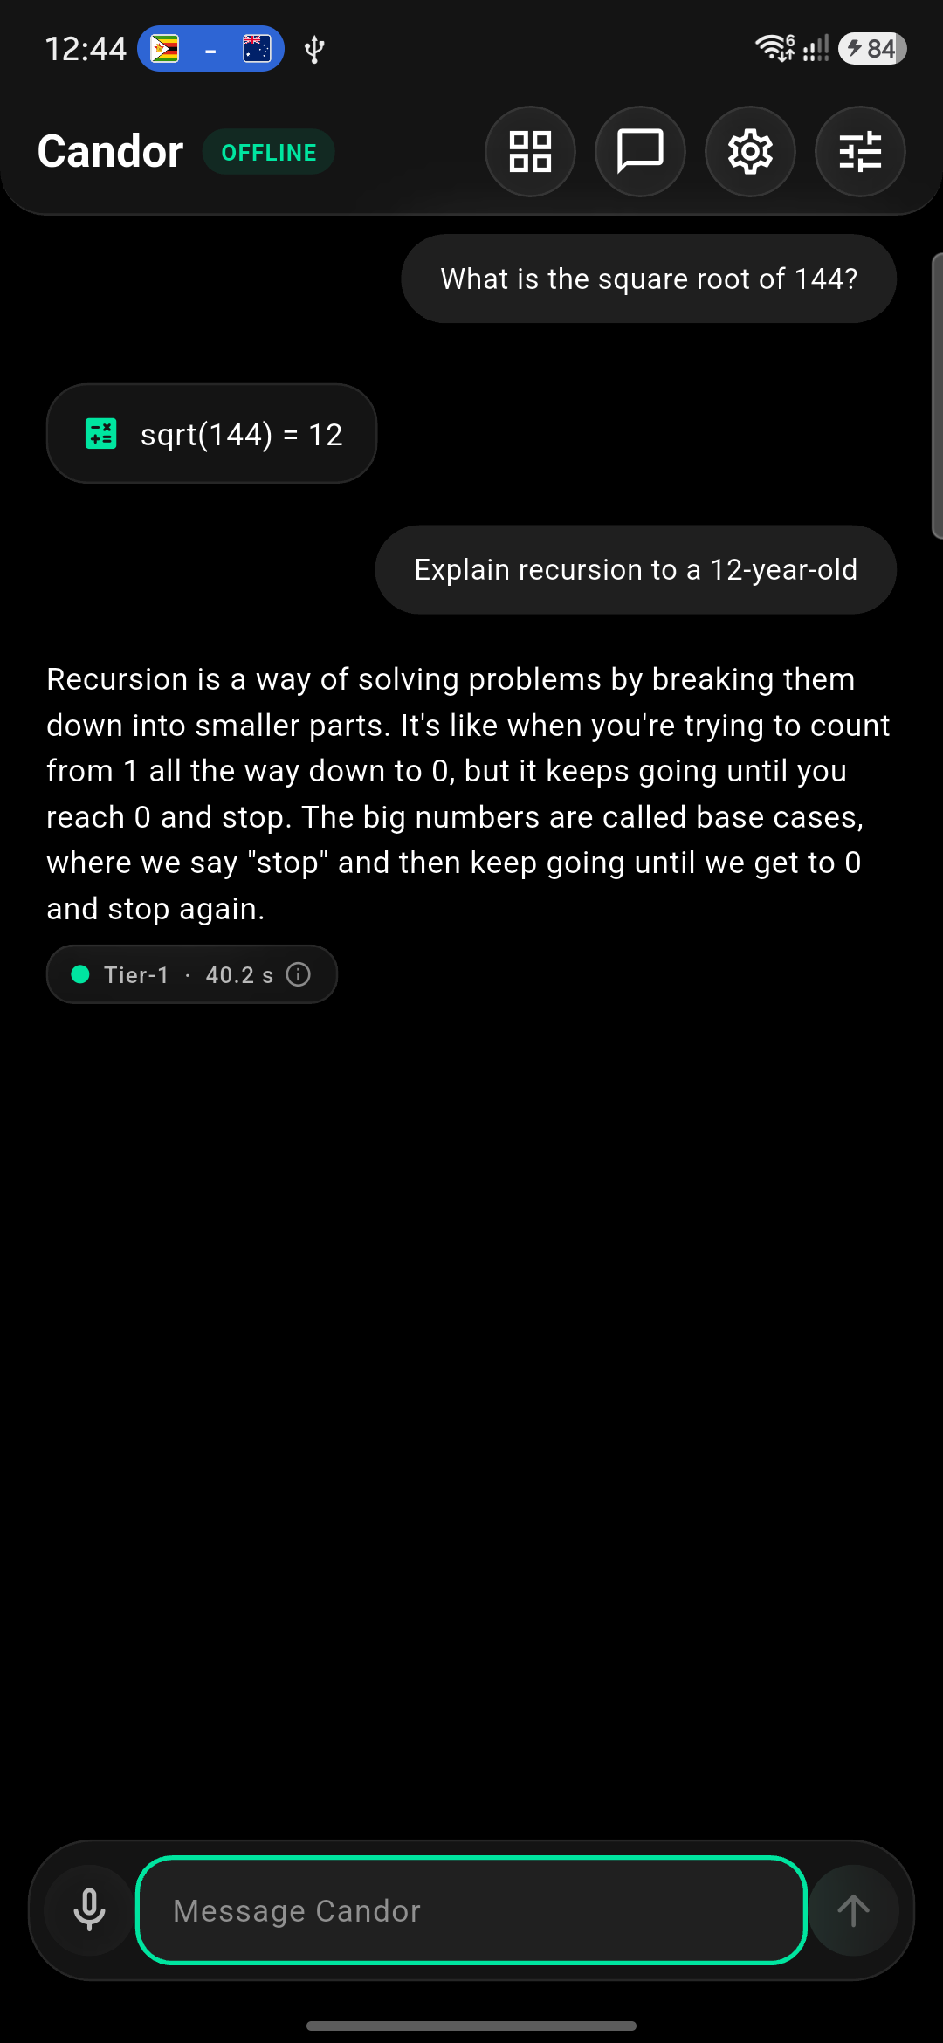
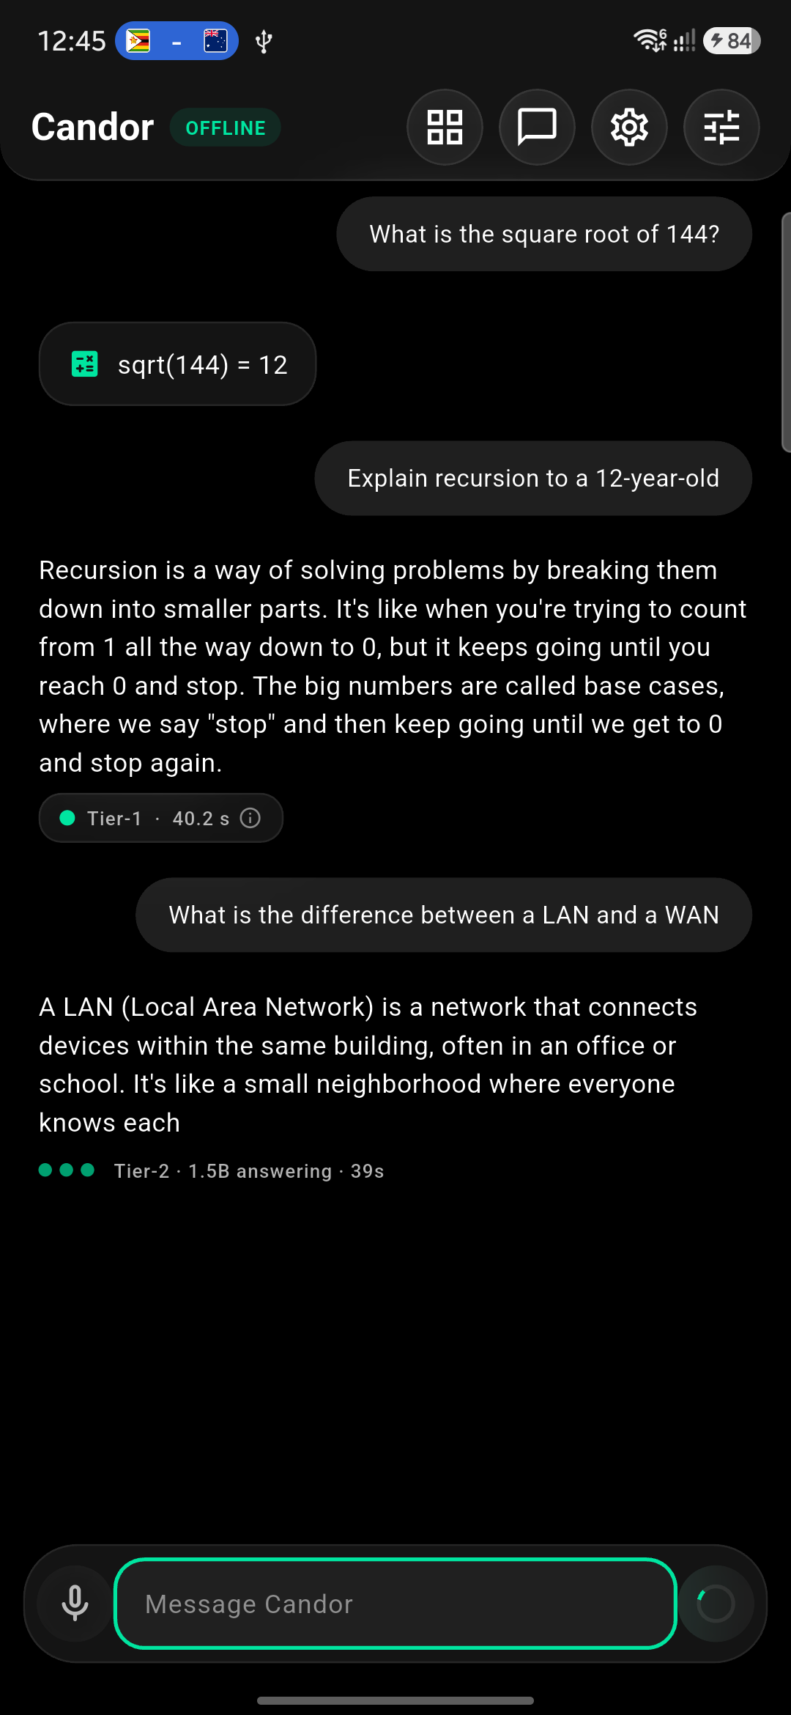
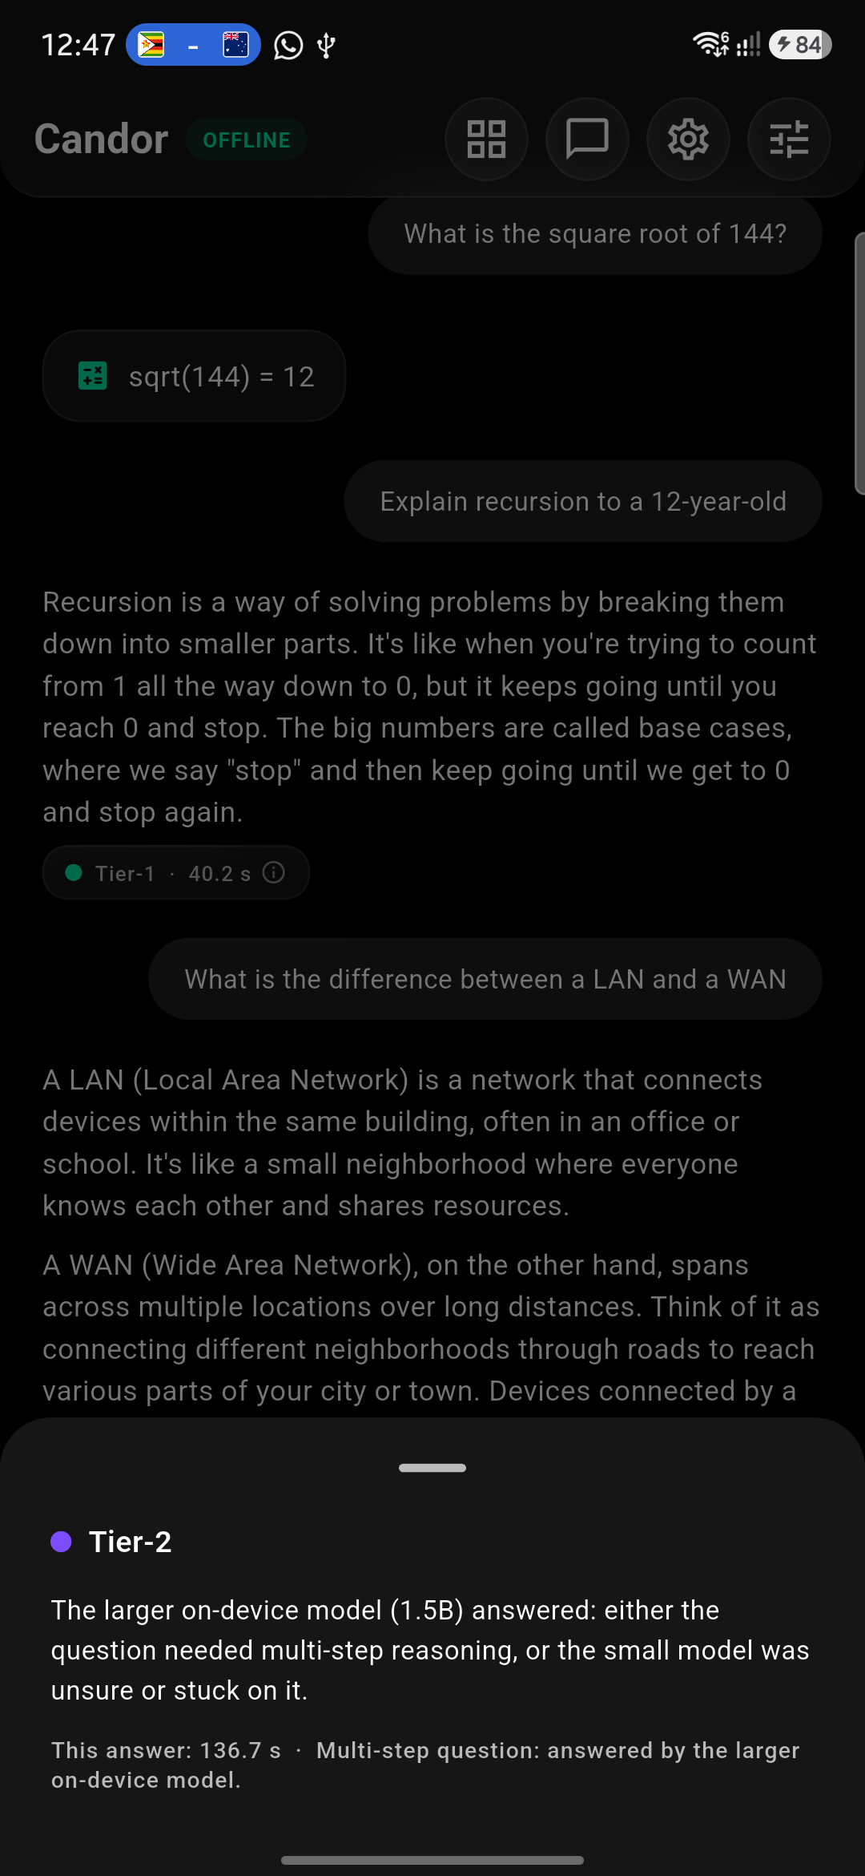
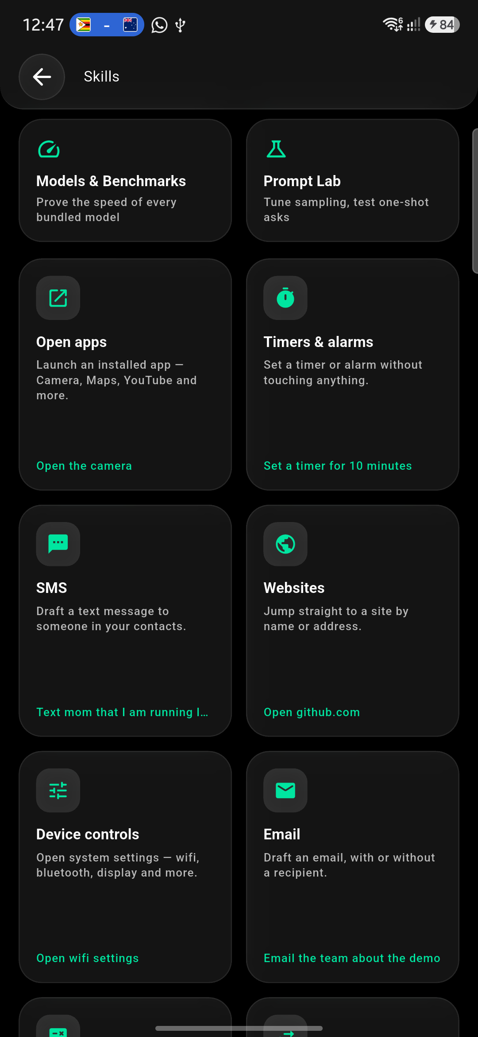
THE PRODUCT
6 / 14
Real screens, captured on the phone.
Tier-1 answer with its honesty pill
Escalated to Tier-2, streaming live
Tap the pill: why this model answered
Deterministic skills, zero tokens

Slide 7
EVIDENCE
7 / 14
Proven, not promised.
Everything below is measurable on a mid-range handset in airplane mode, today.
133/133
0
~1.5 GB
100%
automated tests pass
router · skills · stores · UI
INTERNET permissions
in the release manifest
two 4-bit models in the APK
0.5B + 1.5B, Q4_K_M
offline capability
no feature needs a network
IN THE BOX
THE STACK
Models & Benchmarks — live load time, tokens/sec and size per bundled model, measured on this phone.
Prompt Lab — per-tier temperature, top-k/top-p and penalty sliders with a live sandbox.
Debug panel — real battery and thermal readout, plus a simulated constrained device.
Voice input, chat history, per-tier model pickers, Vulkan GPU toggle.
Flutter / Dart
single codebase, custom glass widget set
llama.cpp
via the llama_flutter_android plugin
Qwen2.5 Q4_K_M
0.5B Tier-1 + 1.5B Tier-2, in the APK
Kotlin channel
battery, thermal, model-file prep
Vulkan offload
optional GPU acceleration

Slide 8
COMPETITIVE LANDSCAPE
8 / 14
Offline, private, affordable — pick all three.
Works fully
offline
Data stays
on device
Runs on mid-
range phones
Says which model
answered
Exact skills &
phone actions
Cloud assistants
○
○
●
○
◐
ChatGPT, Gemini app
Built-in phone AI
◐
◐
○
○
●
Galaxy AI, Gemini Nano
Local LLM apps
●
●
◐
○
◐
AI Edge Gallery, PocketPal
Candor
●
●
●
●
●
this project
● yes ◐ partial / device- or feature-dependent ○ no. Based on public product documentation, Sep 2026.

Slide 9
BUSINESS MODEL
9 / 14
Three ways to earn — and almost no cost to serve.
Proposed model. Inference runs on the user's own phone, so there is no per-query GPU bill.
CONSUMERS
ORGANISATIONS
OEMs & TELCOS
Free + one-time Pro
Offline-AI licence
Preload royalty
• Free: the full offline assistant, both tiers, every skill.
• Pro (one-time, ~₹149 proposed): extra model packs, document Q&A, custom skills.
• No subscription — nothing to meter.
• NGOs, health & agri programs, field fleets, defence.
• Per-device annual licence: private deployment, custom skill packs, MDM-ready builds.
• Priced per seat, not per query.
• Budget-phone makers ship an AI assistant with no cloud contract.
• Small per-unit royalty; differentiates sub-premium devices.
• Distribution at the scale of shipments.
Unit economics: a cloud assistant pays for every token it generates. Candor's marginal cost per answer is ≈ ₹0 — the phone already paid for the compute.

Slide 10
GO-TO-MARKET
10 / 14
Start where the network ends.
Plan: land with mission-driven field programs, prove it, then scale through devices.
0–3 MONTHS
3–9 MONTHS
9–18 MONTHS
Launch
Pilot
Scale
• Open beta: GitHub release + Play Store listing.
• Opt-in, on-device escalation log to tune the router.
• First Indic-language model tier.
• 2–3 pilots with NGOs or health / agri field programs.
• Custom skill packs per program.
• Measure answers delivered offline.
• Organisation licences from pilot results.
• OEM / telco preload conversations.
• Document Q&A (on-device RAG) as Pro.
WHAT WE WILL MEASURE
Offline answers / week
Escalation rate
Battery per answer
Pilot retention
the north-star
how often Tier-2 is needed
cost to the user's phone
do field teams keep using it

Slide 11
WHAT'S NEXT
11 / 14
Same privacy guarantee, more capability.
The hard part — offline inference behind an honest router — already ships.
Indic languages
On-device RAG
Learned router
A multilingual tier so rural users can ask in their own language.
Index notes and documents locally. Grounded answers, zero uploads.
Train the escalation decision on real on-device logs, not keywords.
Bigger tiers
More skills
Play Store
3B+ quantized models as phones catch up. Same cascade, smarter answers.
Calendar, files and offline reference packs. Deterministic, unhallucinatable.
Ship the release pipeline that already builds the APK today.
Known limits we state openly: English-only today · confidence is self-reported (the plugin exposes no logprobs) · one model in RAM at a time.

Slide 12

THE TEAM
12 / 14
One builder, end to end.
Design, Flutter app, on-device inference, router, tests and this deck — built solo.
Edge AI, shipped before
Honest LLMs is the research
Primary author, IEEE ISAECT 2025: a fine-tuned vision-language model deployed on a Raspberry Pi to guide visually impaired pedestrians.
Sole-author paper under review at IEEE InCODE 2026: semantic consistency as an unsupervised hallucination signal.
Production LLM reliability
Proven under pressure
Charan Sai Ponnada
At Aynstyn: black-box test suites that made LLM responses reliable across 3+ production workflows.
2nd place among the Top 10 finalists at YUVAAN 2026, IIT Hyderabad — out of 7,600+ registrants.
Software Engineer (AI), Aynstyn Technologies · B.Tech AI & DS, VRSEC
github.com/charansaiponnada
linkedin.com/in/charansaiponnada
Also building a 3D-chromatin-aware genomic foundation model (Hopfield-Mamba) from scratch.

Slide 13
THE ASK
13 / 14
Private AI on the phone people already own.
Pilot partners
Mentorship & internship
Your hardest question
Field programs in low-connectivity regions willing to trial Candor.
Help taking Candor from hackathon build to Play Store.
Try it in airplane mode — we'll show which model answers.
“An assistant that knows when to hold back — and tells you.”
Thank you.
github.com/charansaiponnada/candor

Slide 14
APPENDIX · SOURCES
14 / 14
Where the numbers come from.
48 vs 127 internet subscriptions / 100 (rural vs urban), 1.09B users, Q1 2026
TRAI data, reported by The Week, 23 Jun 2026 — theweek.in/news/biz-tech/2026/06/23/india-telecom-growth-digital-divide.html
~300 million people (4% of the world) outside mobile broadband coverage
GSMA, The State of Mobile Internet Connectivity 2025, as quoted by connectivity.technology (Oct 2025)
84% of GenAI users concerned their data could go public
Cisco 2024 Consumer Privacy Survey — newsroom.cisco.com (Oct 2024)
13% GenAI smartphones in India H1 2025 (3% H1 2024)
Counterpoint Research, reported by Business Standard, Sep 2025
Edge AI $11.8B (2025) → $56.8B (2030), 36.9% CAGR
BCC Research press release via GlobeNewswire, 2 Oct 2025
Smartphones 80.5% of edge-AI hardware volume (2024)
MarketsandMarkets, Edge AI Hardware Market report

