Slide 1
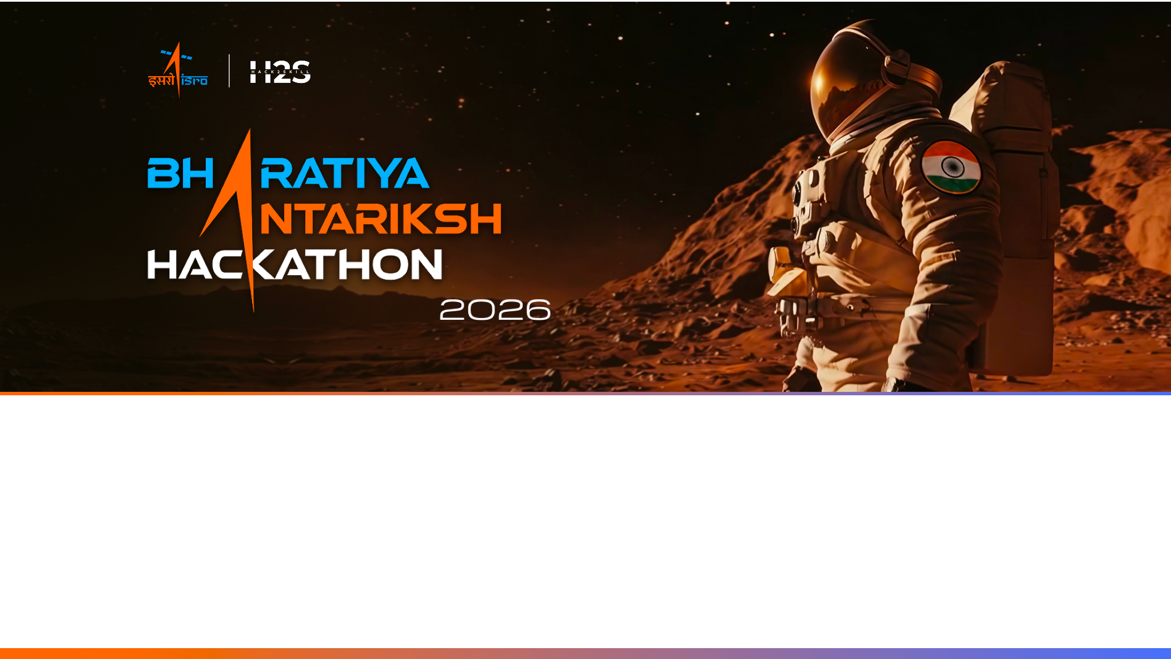
Team Name : [YOUR TEAM NAME]
Team Leader Name : Charan Sai Ponnada
Problem Statement : Challenge 07 — AI-Enabled Detection of Exoplanets from Noisy Astronomical Light Curves

Slide 2

Team Members
Team Leader: Charan Sai Ponnada Name: Charan Sai Ponnada College: VRSEC, Vijayawada (AI & Data Science, B.Tech) | Team Member 1: Name: [Team Member 1 Name] College: [College Name]
Team Member 2: Name: [Team Member 2 Name] College: [College Name] | Team Member 3: Name: [Team Member 3 Name] College: [College Name]

Slide 3
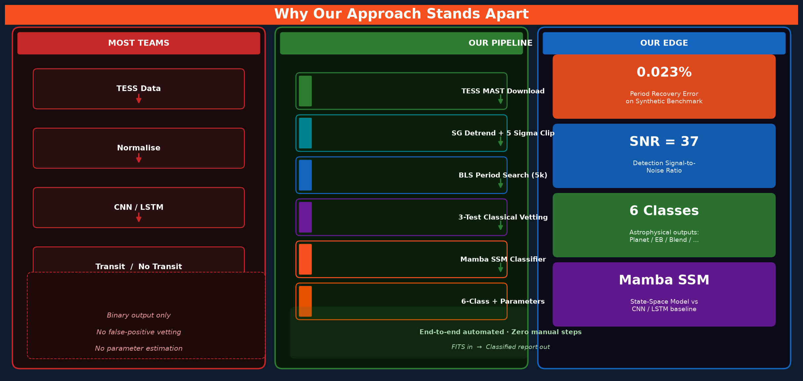

Slide 4
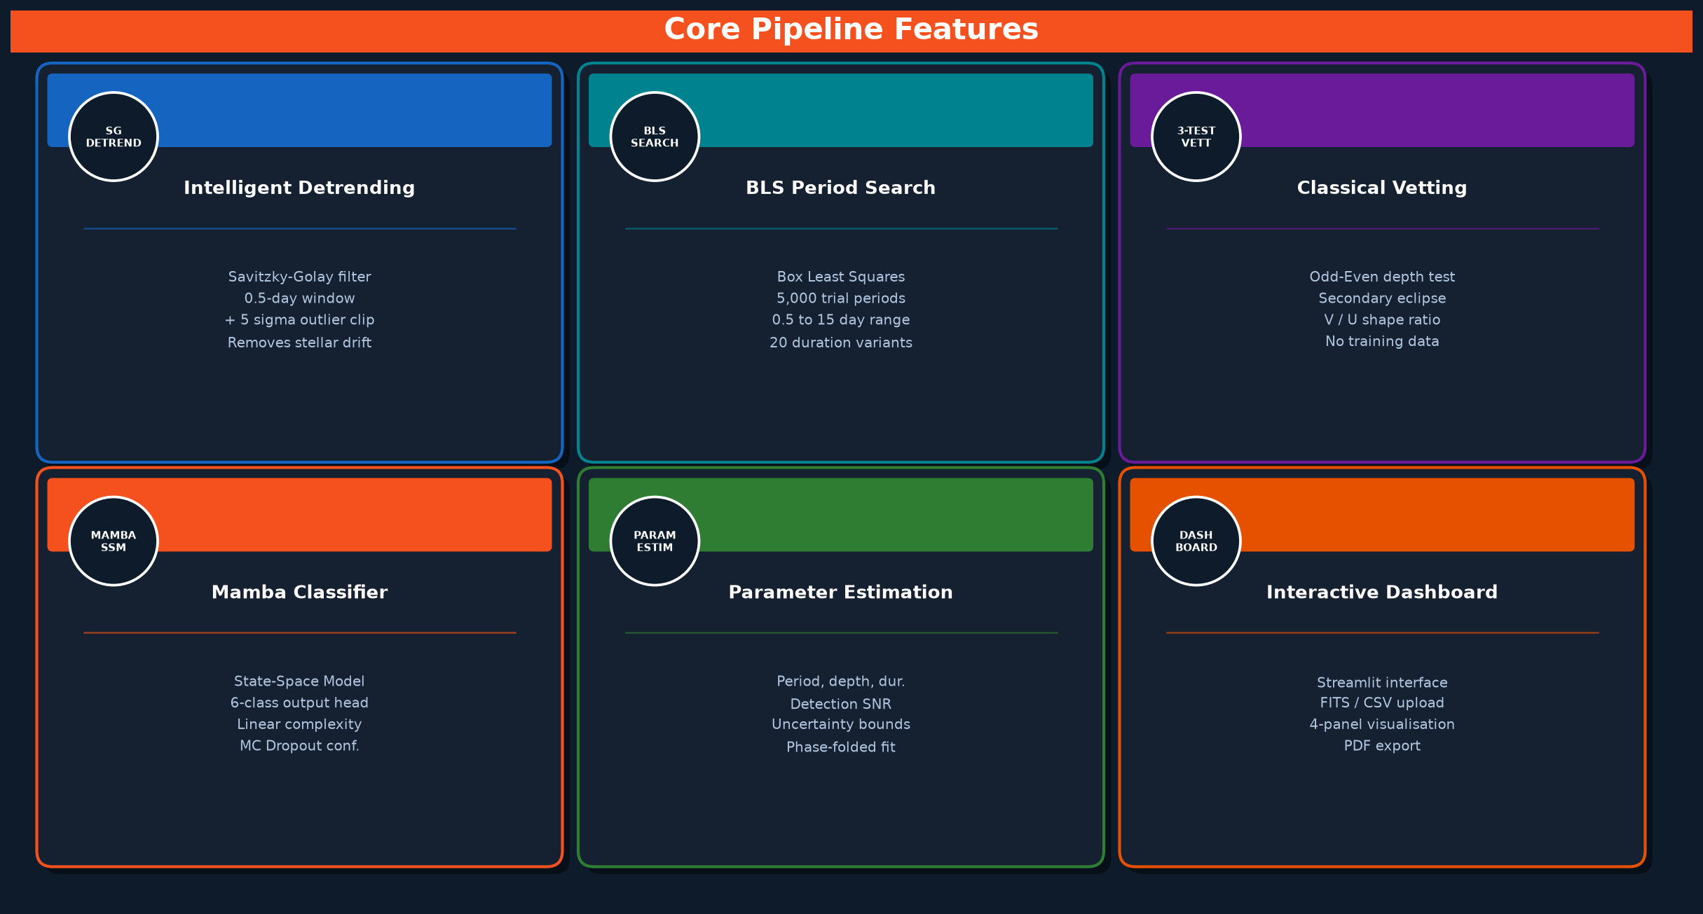

Slide 5
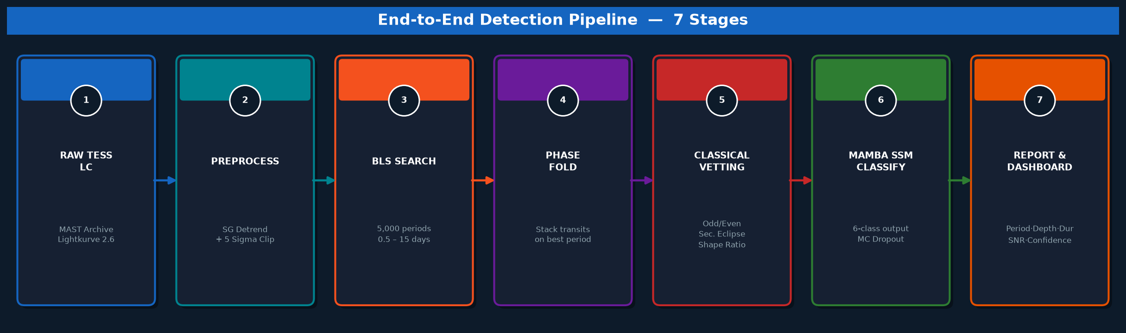
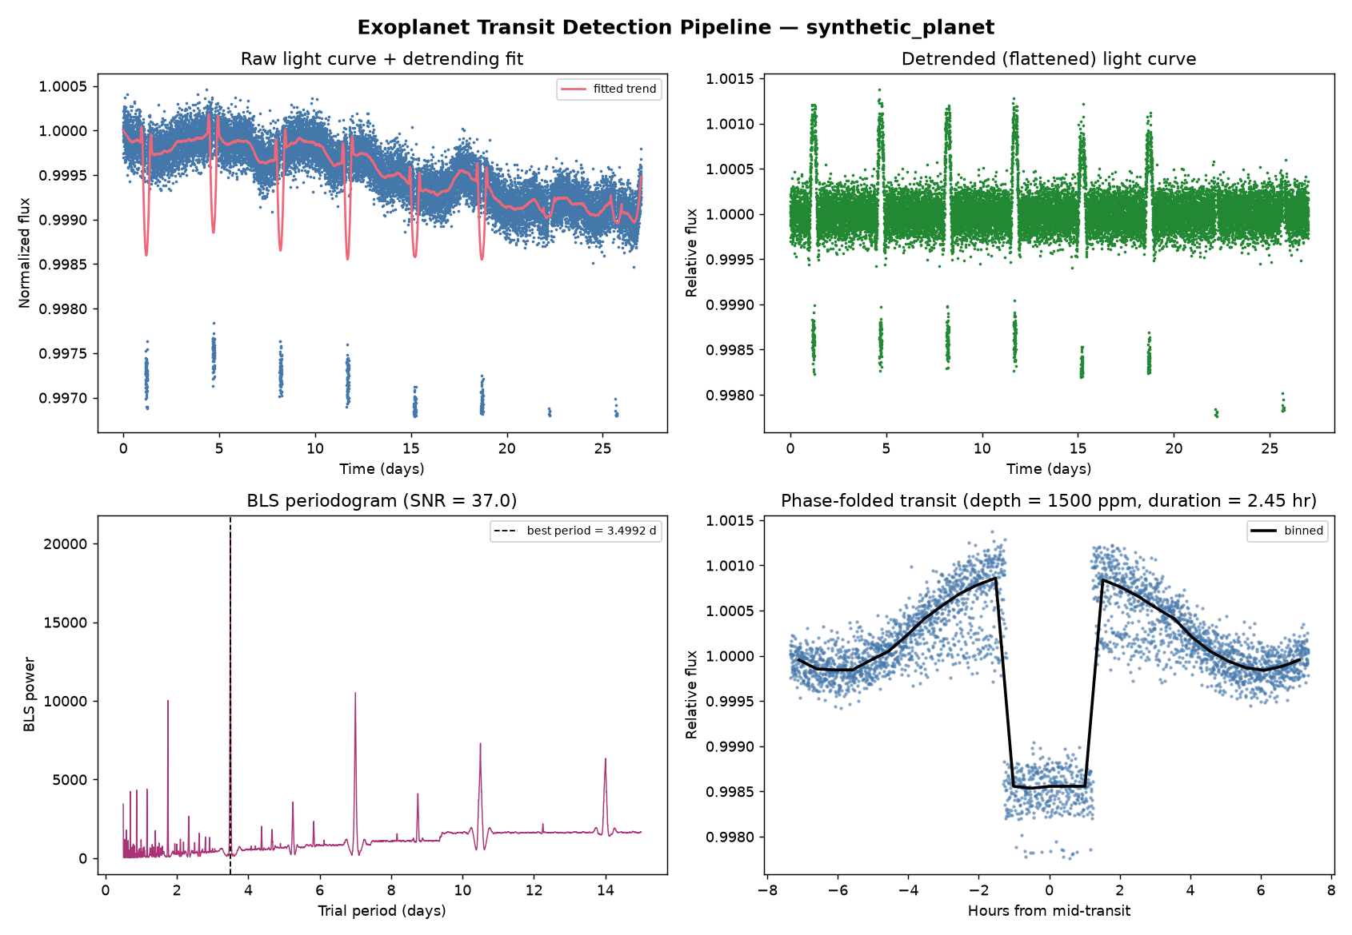

Slide 6
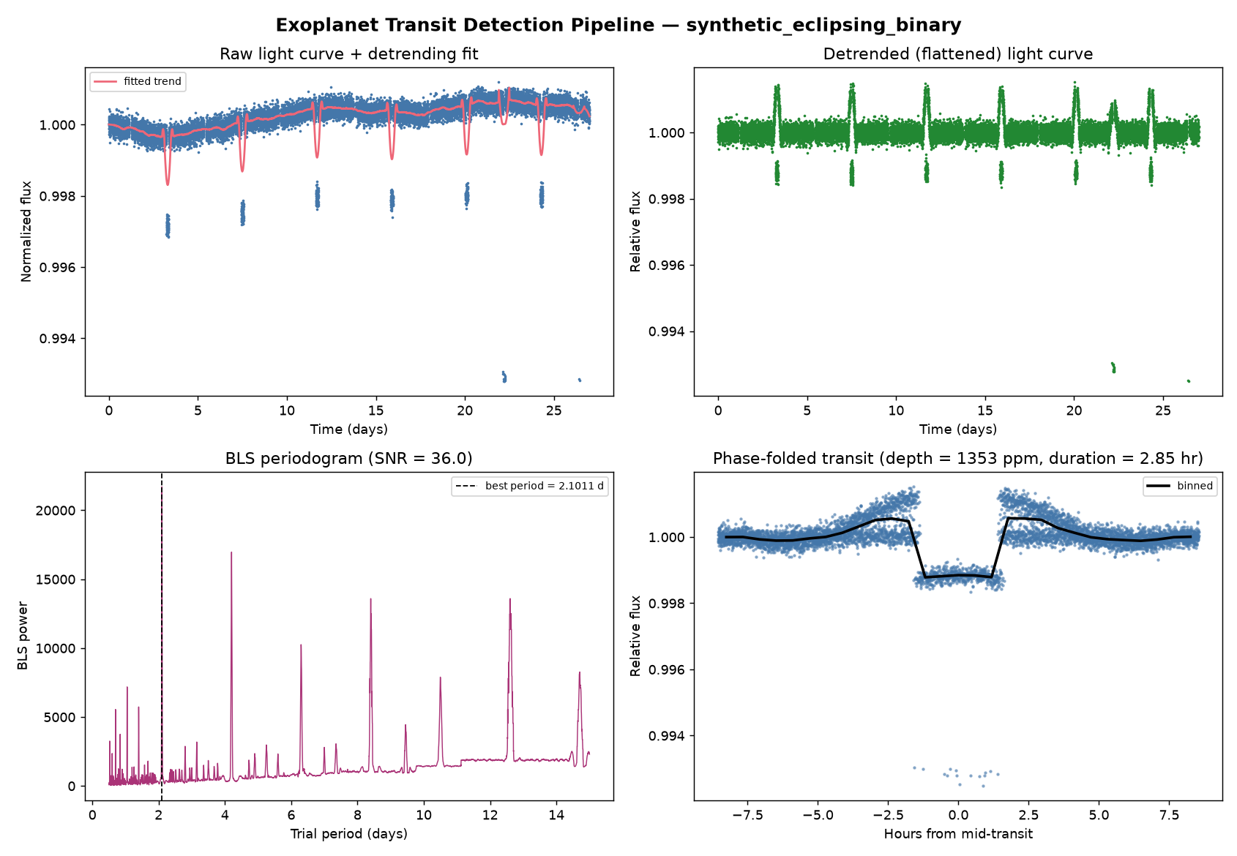
False Positive Vetting — Eclipsing Binary Detection Result
Vetting result: odd-even depth mismatch = 102% → signal flagged as “ambiguous_requires_followup” (possible diluted eclipsing binary). The pipeline correctly prevented a false planet detection without any training data.

Slide 7
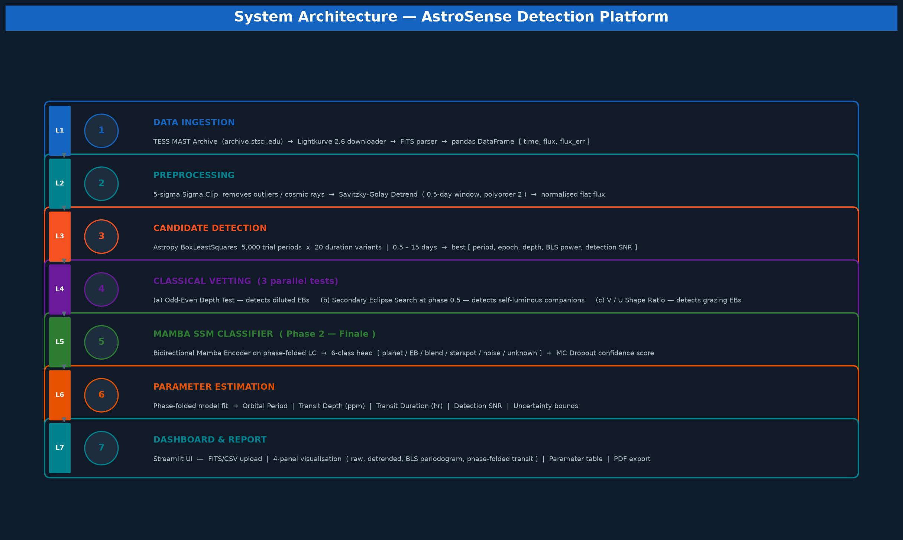

Slide 8
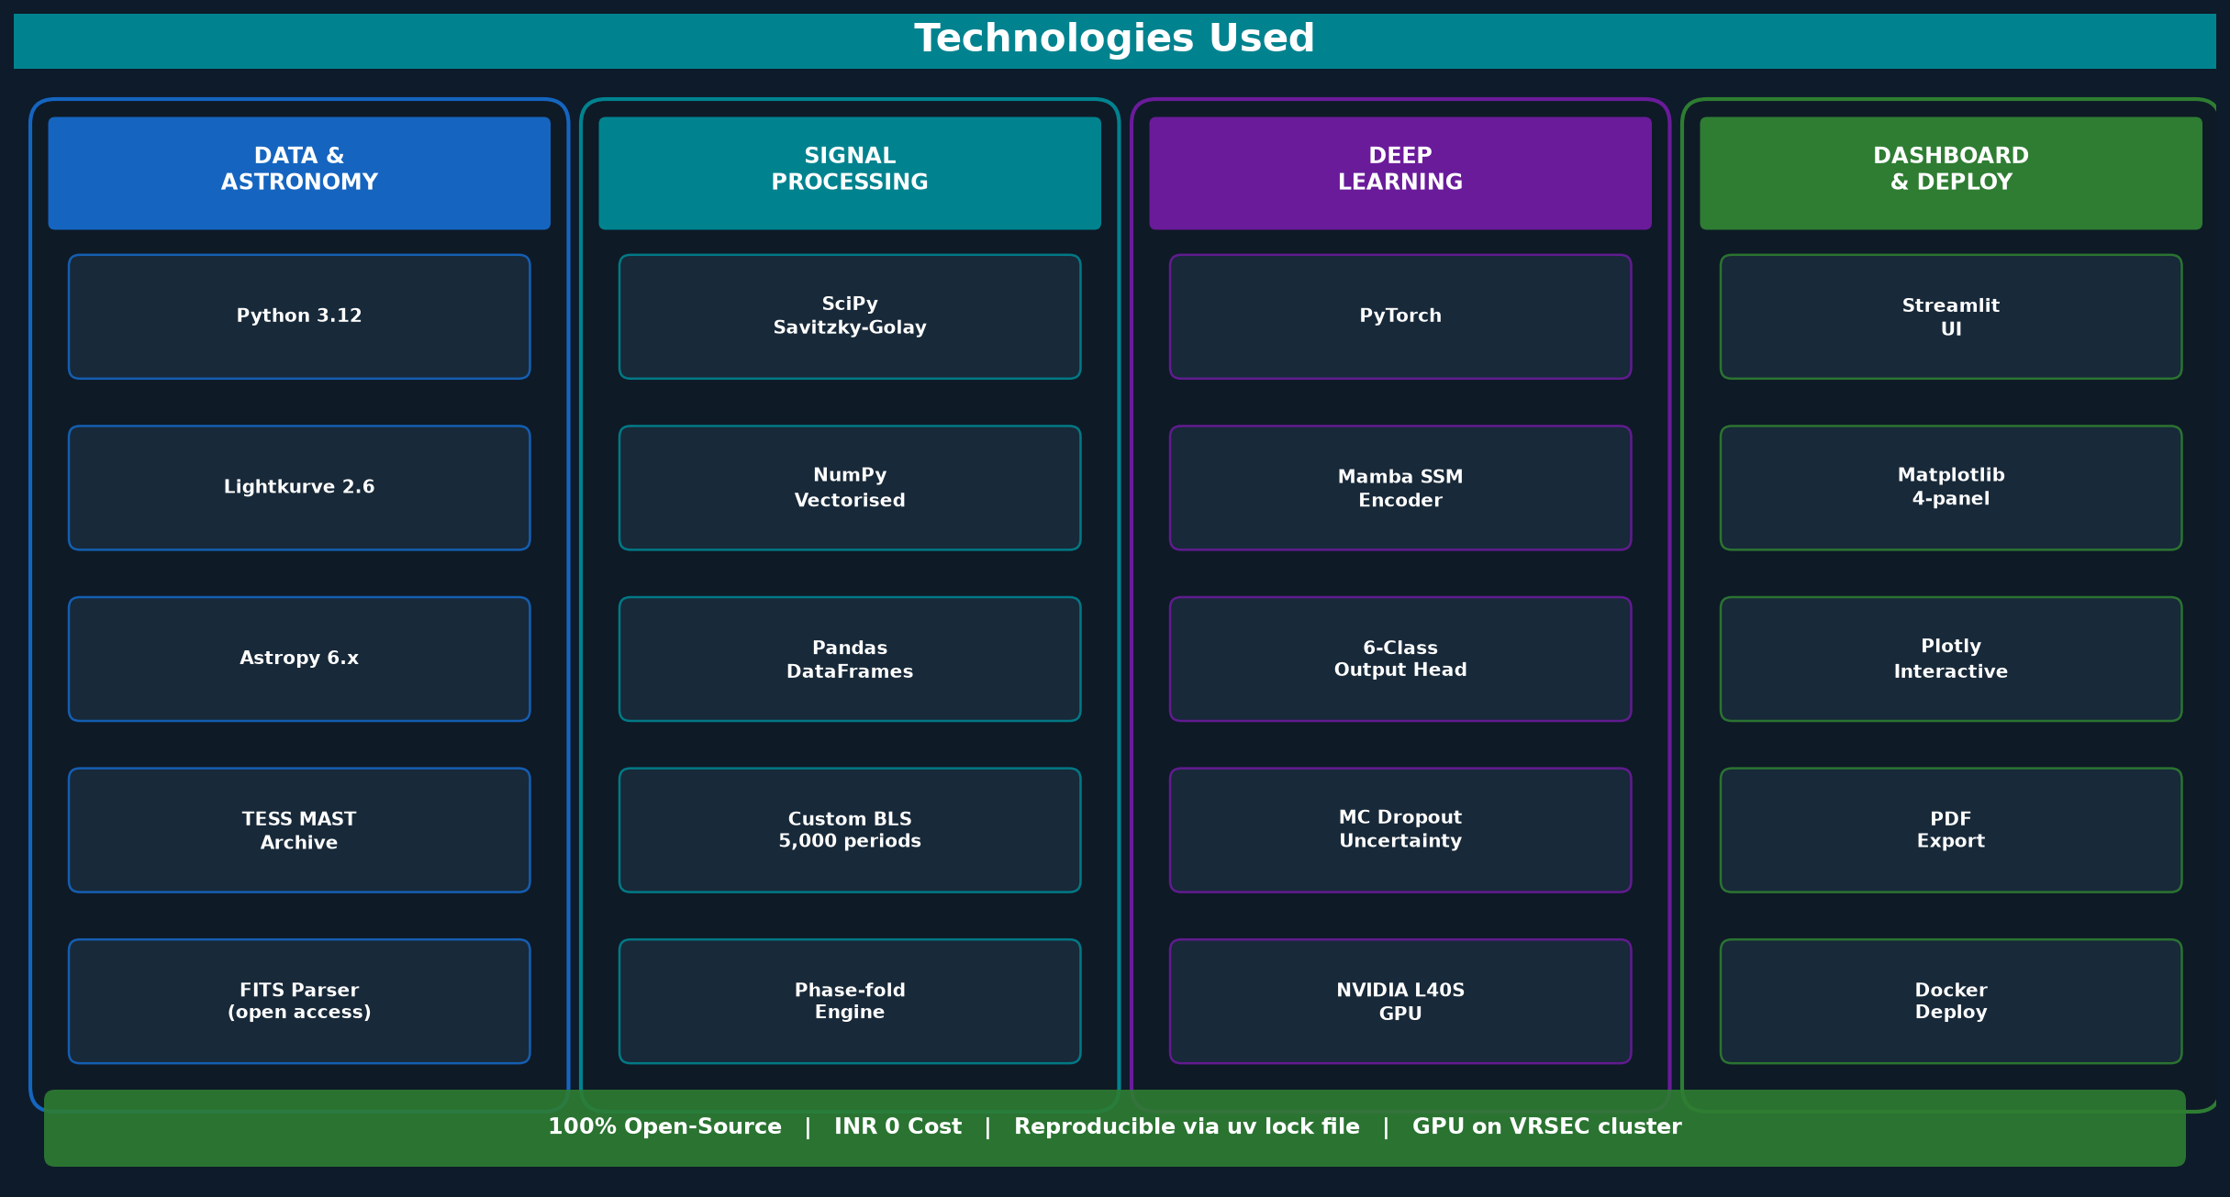

Slide 9
Implementation Cost Estimate DATA: TESS light curves — INR 0. Fully open-access via MAST archive (archive.stsci.edu). No licensing, no API cost, no registration. One Lightkurve function call downloads an entire sector (~20,000-30,000 light curves). SOFTWARE: INR 0. 100% open-source stack (Python, PyTorch, Lightkurve, Astropy, SciPy, Matplotlib, Streamlit). All packages pip/uv-installable with no licensing fees. COMPUTE — DEVELOPMENT: INR 0. Pre-finale pipeline development and testing runs entirely on CPU. The BLS search, vetting, and parameter estimation are lightweight; the synthetic benchmark runs in under 60 seconds on a standard laptop. COMPUTE — FINALE (Mamba training): INR 0. NVIDIA L40S GPU available on university cluster at VRSEC. No cloud GPU spend required during the 30-hour sprint. DEPLOYMENT: INR 0. Streamlit Community Cloud (free tier) hosts the interactive dashboard for demo. Docker image for local deployment requires no paid infrastructure. TOTAL ESTIMATED COST: INR 0 — The entire solution is designed around freely available public datasets, open-source tooling, and existing institutional compute infrastructure. This makes it immediately deployable and scalable without additional budget.

Slide 10
