Slide 1
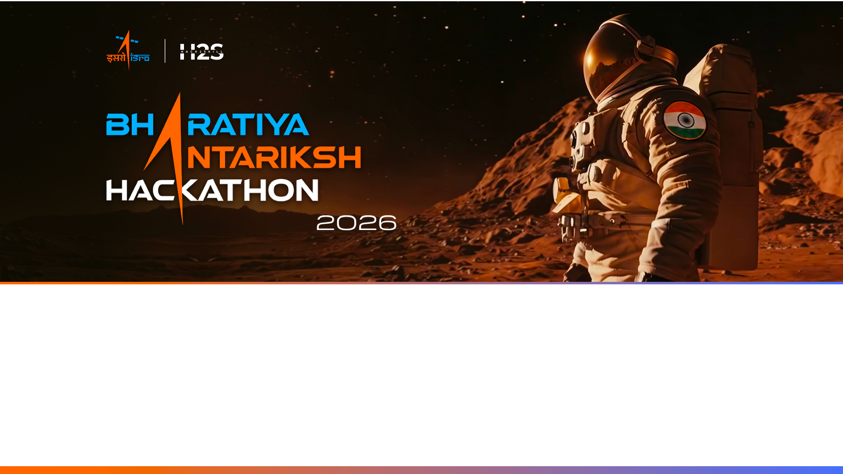
Team Name : AstroSage
Team Leader Name : [Your Name]
Problem Statement : Challenge 07 — Exoplanet Transit Detection from TESS Light Curves

Slide 2

Team Members
Team Leader: [Name] ML Engineer — Deep Learning, Mamba SSM | Member 1: [Name] Data Engineer — TESS, Lightkurve, Signal Processing
Member 2: [Name] Full-Stack — Streamlit Dashboard, Python Pipeline | Member 3: [Name] Domain Expert — Exoplanet Science, Vetting

Slide 3
How It Is Different & USP
Fully explainable pipeline — no black box: every stage produces auditable intermediate artifacts (BLS periodogram, per-transit depths, 17-feature vector)
Dual-classification: rule-based vetting (physically grounded) + Random Forest (data-driven) run in parallel — disagreement triggers human review
Phase 2 ready: Mamba State Space Model (O(n) complexity) planned when ISRO's curated dataset becomes available — scales to million-star surveys
End-to-end in Python: synthetic data generation → detection → dashboard → export in a single uv-managed environment
Validated: 70.7% held-out accuracy, F1=0.91 for eclipsing binaries on synthetic ground truth
Current Status: Phase 1 (built + validated) · Phase 2 (Mamba SSM) ready when labeled data arrives

Slide 4
Pipeline Features
1. TESS Data Ingestion — lightkurve MAST queries + synthetic generator with configurable transit/red-noise/white-noise parameters
2. Intelligent Preprocessing — 5-sigma clipping + Savitzky-Golay detrending (0.5d window) removes stellar variability
3. BLS Period Search — 5000 trial periods (0.5-15 d), 20 durations (0.5-8 h), SNR-based peak selection
4. 17-Dimensional Feature Vector — depth, duration, SNR, odd-even mismatch, secondary eclipse, shape, noise, red-noise ratio, entropy
5. Dual Classifier — rule-based (3 vetting tests) + Random Forest (300 trees, 4 classes) running in parallel
6. Scientific Validation — duty cycle <20%, depth <10%, 2+ transits, confidence score (0-1) with breakdown
7. Interactive Dashboard — Streamlit app, 5 tabs, diagnostic 2x2 figures, JSON/PNG export

Slide 5
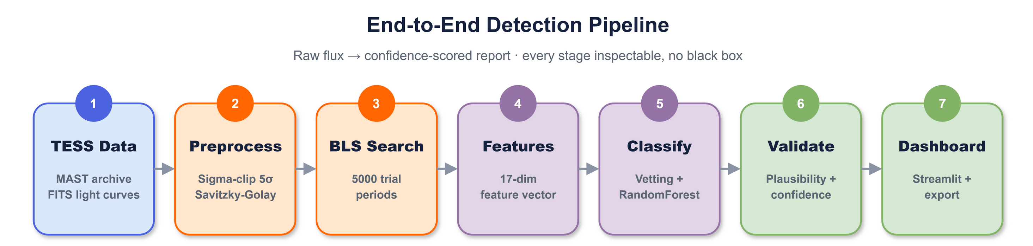

Slide 6
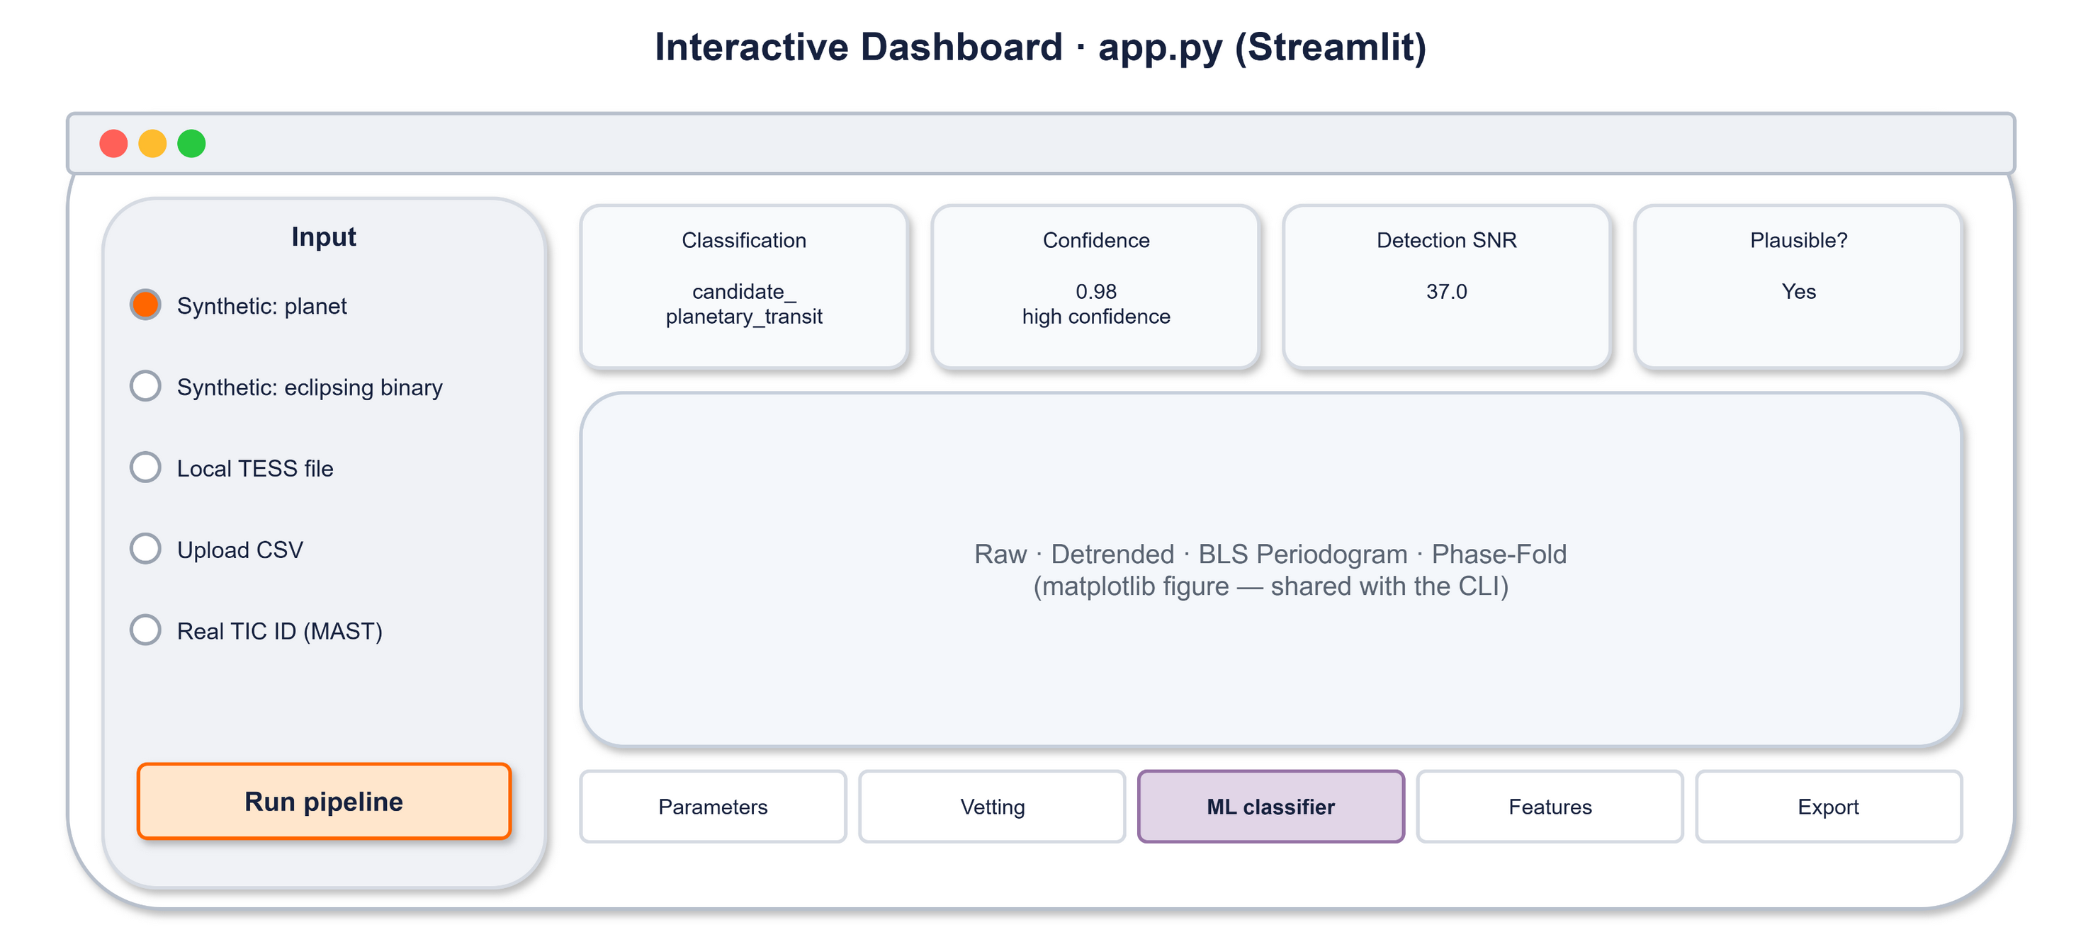

Slide 7
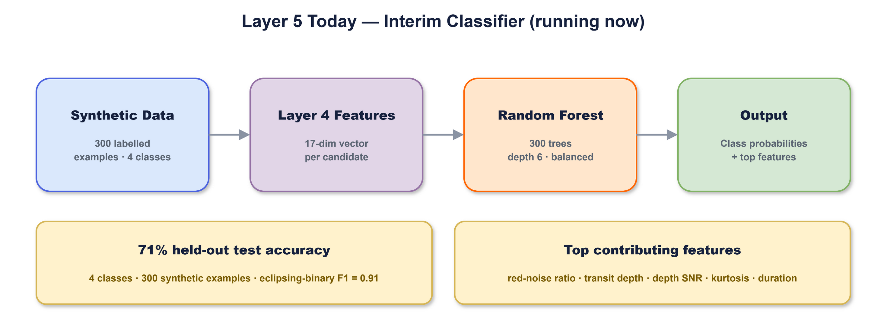

Slide 8
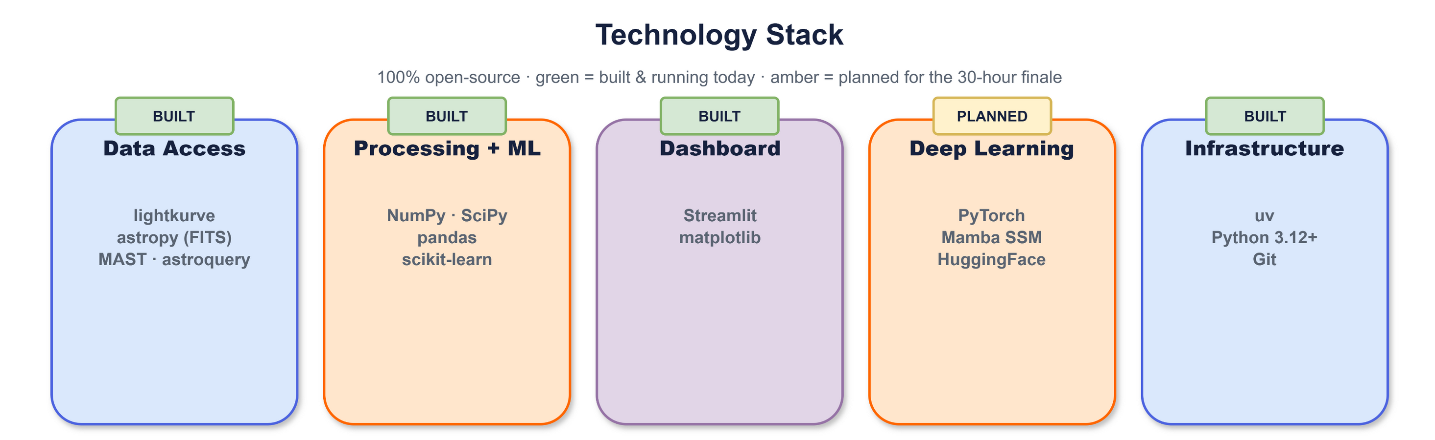

Slide 9
Implementation Cost Estimate
All tools are 100% open-source — no license costs.
Infrastructure (30-hour hackathon):
1 x GPU (T4 or better) ~$0.50-1.00/hr → ~$30 total
1 x CPU for Streamlit dashboard → included or free tier
MAST data access → free (public archive)
Personnel — 4 members x 30 hours
ML / Pipeline development — 2 members
Dashboard & UI — 1 member
Documentation & presentation — 1 member
Total estimated cost: ~$30-50 (GPU compute only)

Slide 10
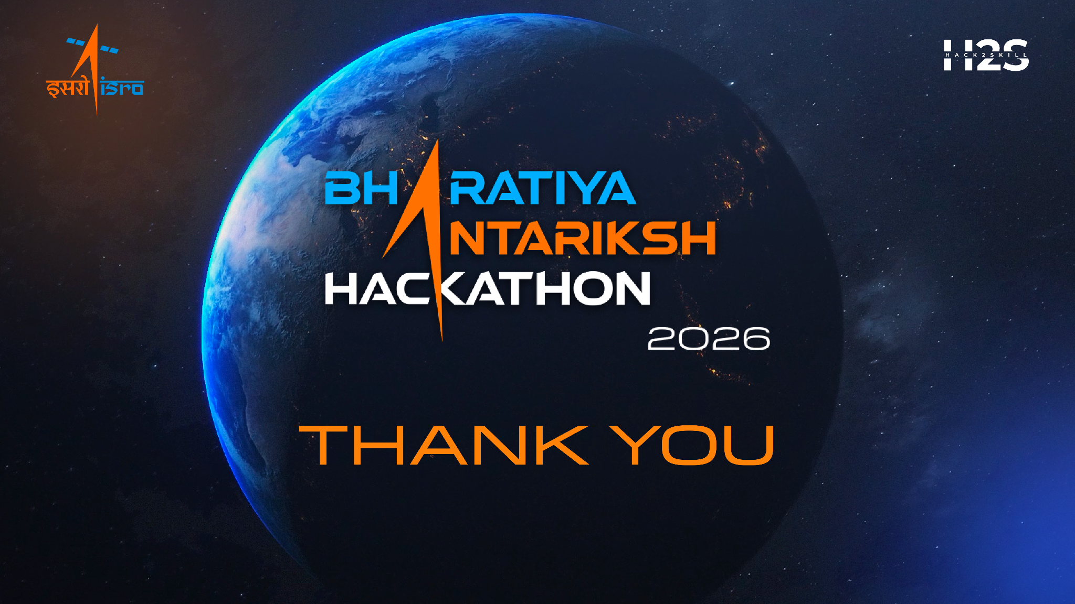
Thank You
AI-Enabled Exoplanet Transit Detection Pipeline
Bharatiya Antariksh Hackathon 2026 — Challenge 07
Stack: Python · lightkurve · astropy · scikit-learn · Streamlit
Mamba SSM (Phase 2) · uv · matplotlib · pandas

