Slide 1
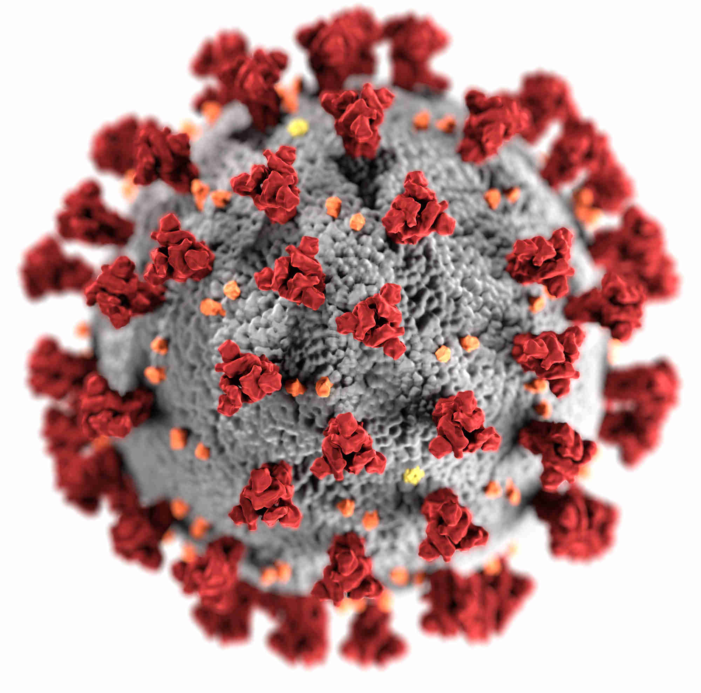
Covid-19
Team: B Charan Naga Santhu Jagadessh
Ardha Jyothsna Reddy
Athar Zahid Usmani
Madala Tejaswi

Slide 2
Outline
Problem Statement
Objective
Microservices
Project Overview
Onboarding-Architecture
Project Flow
Technology and Tools Used
Conclusion

Slide 3

Problem Statement
User is worried in this pandemic time due to rapid increase of Covid cases in his country about infected rate and recovered rate and death rate .
User wants to know recent updates of Covid cases.

Slide 4
Objective
Our objective is to provide best user experience to users to watch the Covid cases and details update to date so that user can take more precautions and they avoid journey’s.
And also user can add their favourite Country to the watchlist so that user can access easily in the watchlist.

Slide 5
Microservices
Authentication API
Favorite API
External API Service

Slide 6
Project Overview

Slide 7
Project Overview
Authentication API
Favorite API
External API Service
Login
Wish list
Home
Register
Search
SQL
Server
Mongo
Db
Internet
External API

Slide 8
Onboarding Architecture

Slide 9
Architecture
Authentication API
JWT validator
SQL Server
Login/Register
POST request
Token generated
Favorite API
Get favorite
Add favorite
Delete favorite
POST /GET/
DELETE
Mongo Db
GET/DELETE
Front End
Angular
GET
Internet
Fetching Country data
GET
Search Country
External API
GET
GET

Slide 10
Project Flow

Slide 11
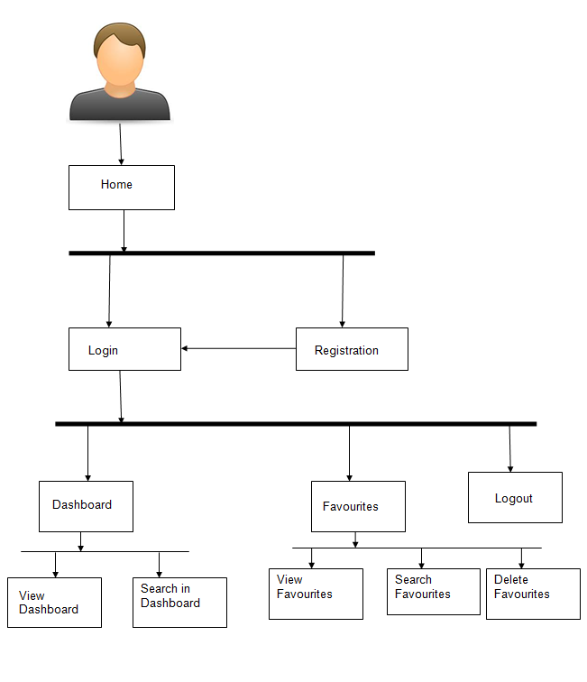
Project Flow
Home
Login
Register
Search
Register Vaccination
Precautions
Add to Favorite
Favourite
Recommends
Edit User Details
View Favourites
Delete Favourite
Change Password
Change User Details
Search Books

Slide 12









Technologies and Tools Used

Slide 13
Conclusion
The Covid-19 Web app helps user to watch entire the World each Country cases with latest data and also user can add to their favourite to access diectly and also user can find the precautions and register for vaccination.

Slide 14
Thank You

Slide 15


