Slide 1
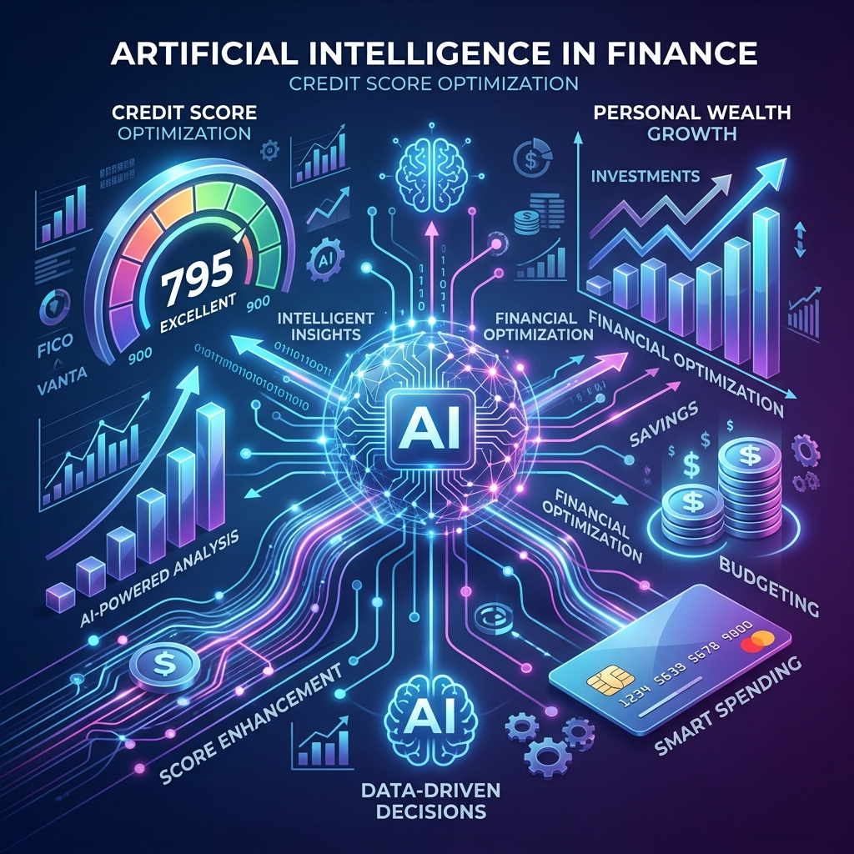
AI-Based Credit Scoring System
Using Alternative Data for Freshers
A New Era of Financial Inclusion

Slide 2

Problem Statement
Traditional loan approval heavily depends on historical credit (CIBIL).
Students, freshers, and freelancers lack this history.
Result: High rejection rates for financially capable users.

Slide 3

Our Solution
An AI-based evaluation system.
Uses Alternative Data instead of past financial records.
Focuses on behavior, digital activity, and mindset.

Slide 4
Evaluation Modules
Our system utilizes six unique data modules:
Behavioral: Savings and Consistency
Career: Job Type, Skill Demand
Goal: Purpose and Feasibility
Digital: Screen Time & Productivity
Transaction: Spending & Wallet Usage
Mindset: Planning & Stress Handling

Slide 5

Machine Learning Integration
Algorithm: Random Forest
Analyzes diverse features from all modules.
Outputs a reliable Risk Level (Safe vs. Risky).
Visualizes final score via dashboard.

Slide 6
Conclusion & Ethics
Ethics & Privacy
Ensures a strict privacy-first framework using user consent.
Impact
Re-imagines financial inclusivity for those previously unbanked.
"We are not judging who the user was in the past, we are predicting who they can become."

