Slide 1

GENOME ASSEMBLY USING BREADTH FIRST SEARCH
TEAM TYRANT
M.TANUJ AIE19041
P.AKHIL AIE19049
V.AISHWARYA AIE19068

Slide 2
CONTENTS
INTRODUCTION
DE- BRUIJN
BFS
GENOME ASSEMBLY

Slide 3
INTRODUCTION
Aim of our project
Breadth First Search Method in graphs
de-Bruijn graphs using Breadth First Search algorithm.

Slide 4
DE - BRUIJN
The de Bruijn graph is a directed graph used for representing overlapping strings in a collection of k-mers.
It represents every k-mer as an edge between its prefix and suffix. And then all nodes with identical nodes are glued.
These sequences can be reconstructed by moving between nodes in graph.
Each De Bruijn graph is Eulerian and Hamiltonian.

Slide 5
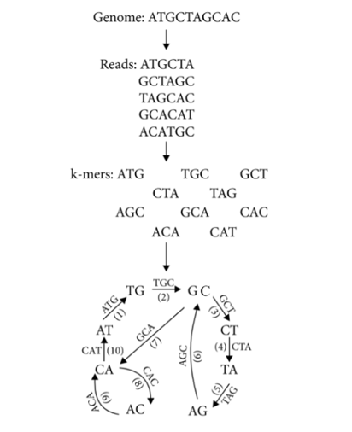

Slide 6
BFS
Breadth-first search (BFS) is an algorithm that is used to graph data or searching tree or traversing structures. The full form of BFS is the Breadth-first search.
Efficiently visits and marks all the key nodes in a graph.
selects a single node (initial or source point) in a graph and then visits all the nodes adjacent to the selected node.
The algorithm visits and marks the starting node, then it moves towards the nearest unvisited nodes and analyses them. Once visited, all nodes are marked.

Slide 7
Steps involved in BFS Traversal:
A queue (FIFO-First in First Out) data structure is used by BFS.
You mark any node in the graph as root and start traversing the data from it.
BFS traverses all the nodes in the graph and keeps dropping them as completed.
BFS visits an adjacent unvisited node, marks it as done, and inserts it into a queue.
Removes the previous vertex from the queue in case no adjacent vertex is found.
BFS algorithm iterates until all the vertices in the graph are successfully traversed and marked as completed.

Slide 8
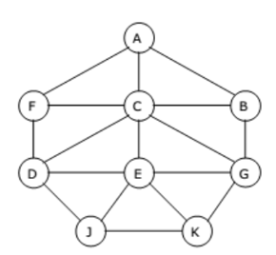
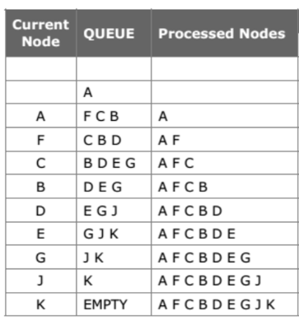

Slide 9
GENOME ASSEMBLY
The assembly process consists of
(1) building the de Bruijn graph with the n-kmers
(2) graph traversal.
Here, we explore the linkage or adjacency relations and branching information of the n-k-mers for reconstructing the genome.
A new traverse begins at an n-kmer not visited in previous traverses, and breaks when branching bases are detected. The separate traverses form the contigs.

Slide 10
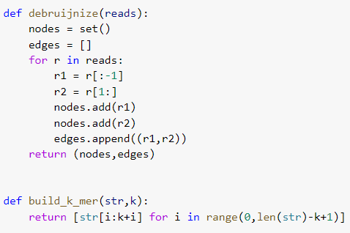

Slide 11
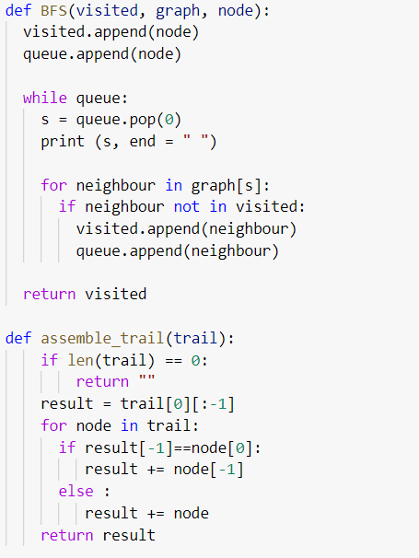

Slide 12
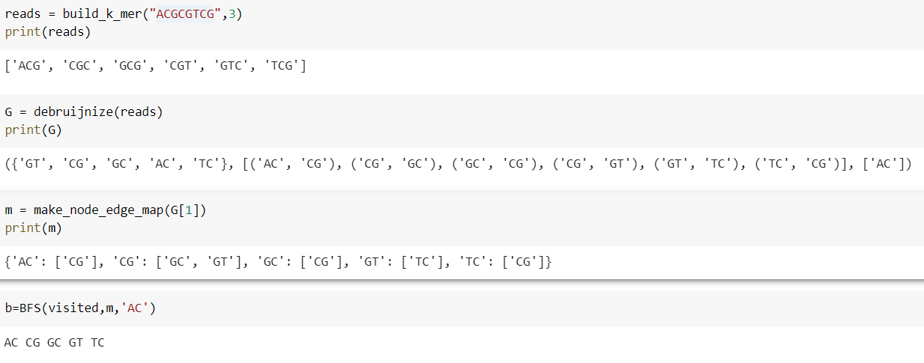

Slide 13
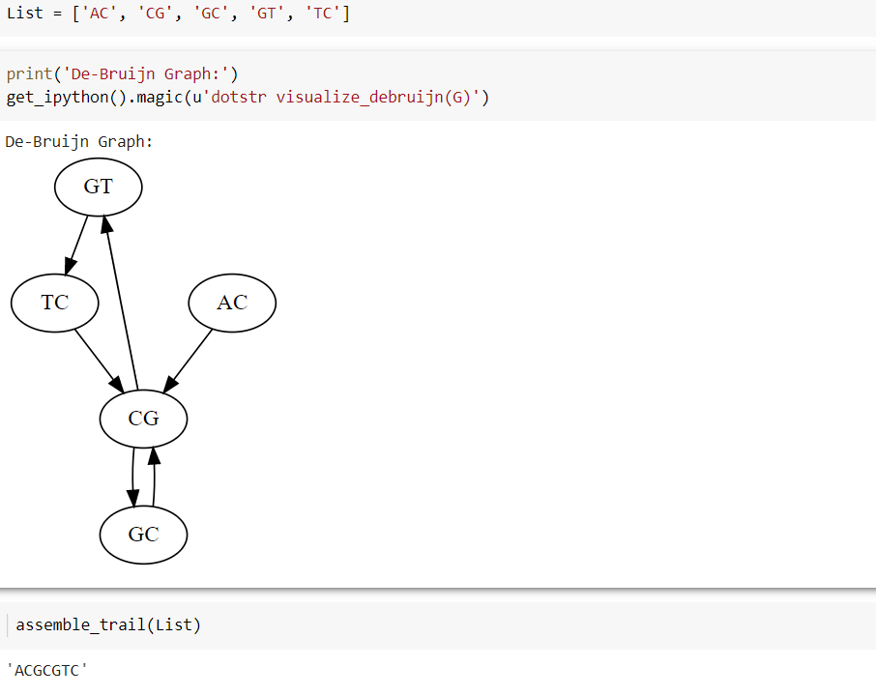

Slide 14
THANK YOU

