Slide 1

COMPARITIVE STUDY OF GRADIENT DOMIN BASED IMAGE BLENDING APPROACHES
ICSES-2021 IEEE CONFERENCE
AUTHORS:
TANUJ M
AISHWARYA V
APOORVA M

Slide 2
ABSTRACT
Comparing 3 different gradient domain-based approaches.
Portraying the importance of considering gradients in image blending.
Approaches that have been taken under consideration:
(a)Naive Blending
(b)Poisson Blending
(c)Mixed Gradient

Slide 3
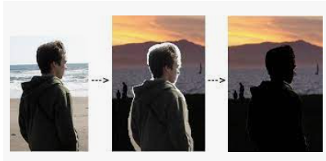
INTRODUCTION
Upcoming technologies have made image blending using gradient more efficient.
Classification of Image Editing: Global and Local changes.
Importance of image gradients in image manipulation

Slide 4
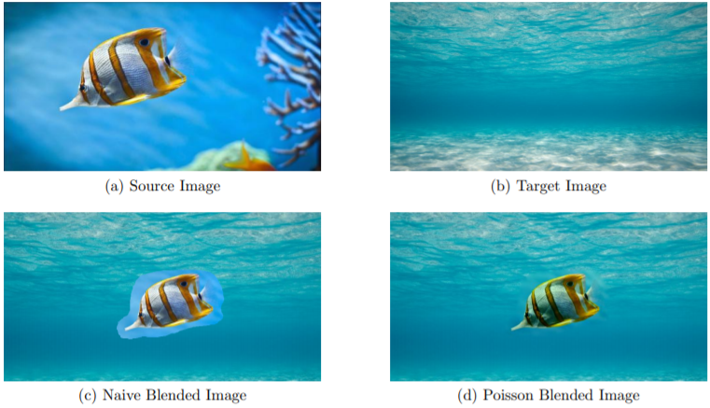
NAIVE BLENDING

Slide 5
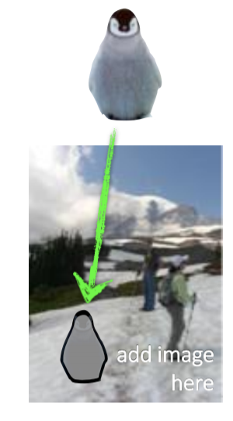
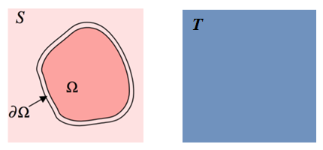
POISSON BLENDING
Reduce colour mismatch between Source and Target images.
Makes sure that the color of the inserted image is also shifted, so that the inserted object feels as if it is part of the environment of the target image

Slide 6
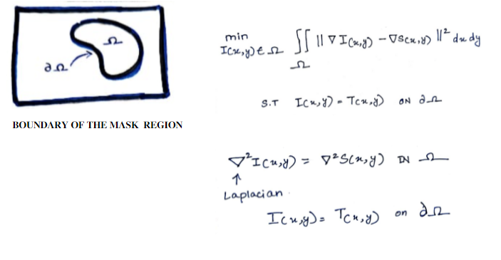
POISSON BLENDING

Slide 7
IMPLEMENTATION
Taking source image and target image from user
Create mask for region of interest in source image
Adjust the position of bounding box of the mask on target image
Naïve copy paste of source on target using mask
Doing Poisson/Mixed Gradient Blending to get a proper blending of cropped source image on target image
Displaying the results of Naïve blending and Poisson/Mixed Gradient blending

Slide 8
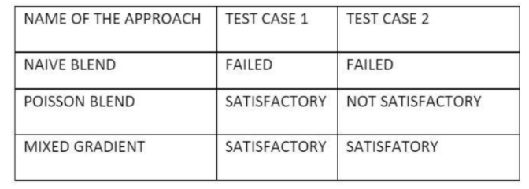
RESULT

Slide 9
COUNCLUSION
Compared all the approaches under study and analyzed the strengths and shortcomings of each approach.
Mixed Gradient seems to have outperformed the other 2 approaches across all test cases

Slide 10
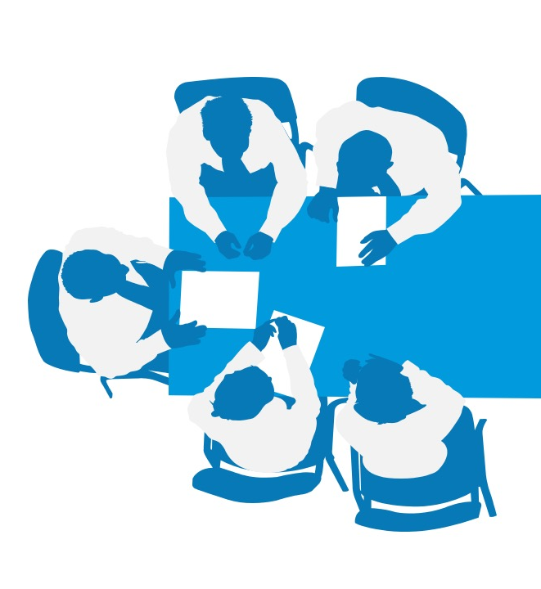
THANK YOU

