Slide 1

GARBAGE CLASSIFIYING SYSTEM
19AIE442 – RV
TEAM MEMBERS:
Apoorva M
Tanuj M
Aishwarya V

Slide 2
PROBLEM STATEMENT
Recycling is necessary for a sustainable society
Detecting and tracking the Waste and their activities accurately
Make it easy for the waste management department to monitor the waste and Robots
Computer vision approach to classifying garbage into recycling categories could be an efficient way to process waste.

Slide 3
DATASET
We have taken 2700 images of daily waste
2500 images for training and 200 images for test
We have categorized waste into 6 classes :
1) cardboard
2) glass,
3) metal
4) paper
5) plastic
6) Trash

Slide 4
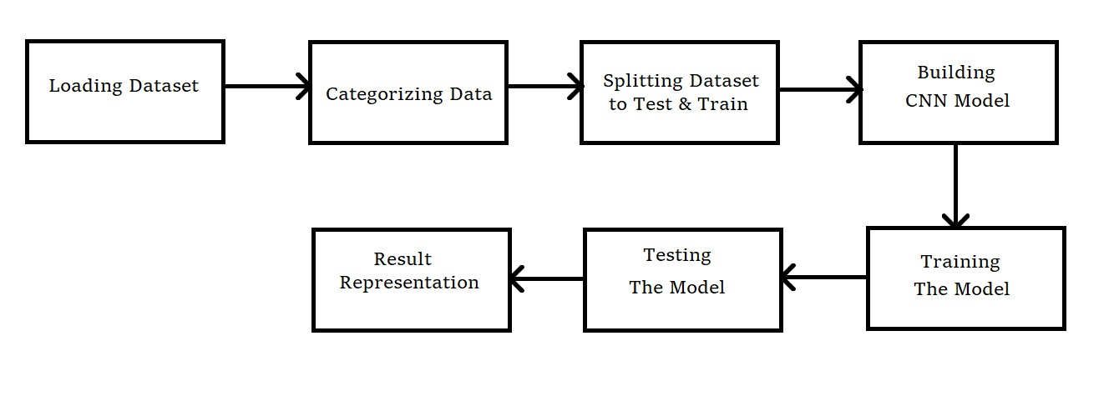
SYSTEM DESIGN OF MODEL

Slide 5

IMAGE CLASSIFICATION

Slide 6
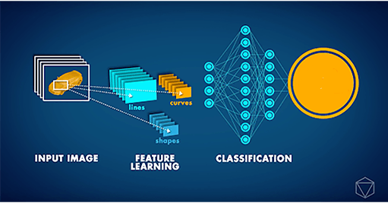
CONVOLUTIONAL NEURAL NETWORKS

Slide 7
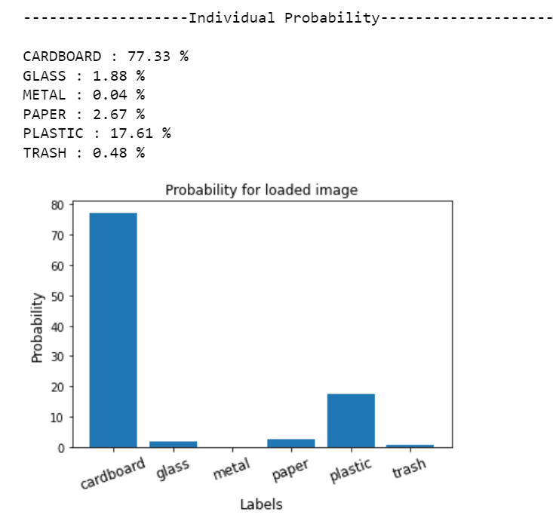
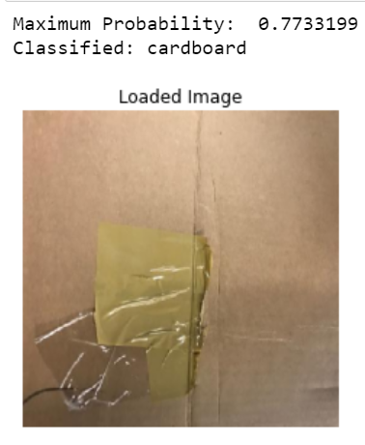
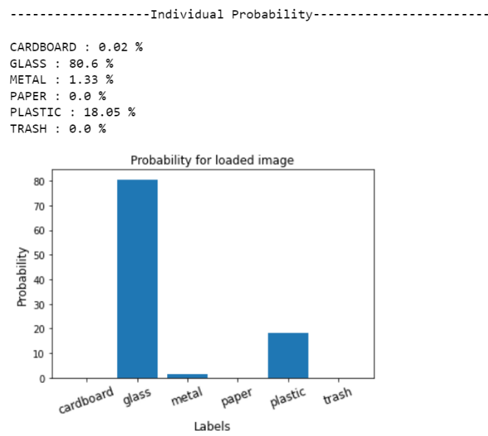
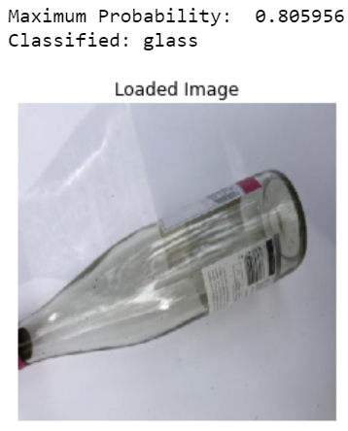
RESULTS

Slide 8
CONCLUSION AND FUTURE SCOPE
The model was able to classify the object into one of the six waste categories.
Important addition could be multiple object detection and classification.
Improve large scale classification of recycling materials.

Slide 9

THANK YOU

