Slide 1

19BIO212 – Intelligence of Biological Systems
GREEDY SORTING OF PERMUTATIONS BY REVERSALS
TEAM INFINITY
APOORVA.M BL.ENU4AIE19007
TANUJ.M BL.ENU4AIE19041
AISHWARYA.V BL.ENU4AIE19068

Slide 2
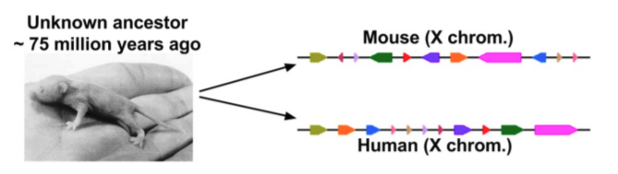
Genomic Rearrangements
The differences result from genomic rearrangement events - “ Rare evolutionary events”
The number of such events can be used for estimating the evolutionary distance between species.
COMPARING MOUSE AND HUMAN CHROMOSOMES

Slide 3
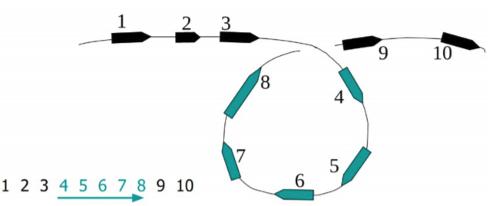
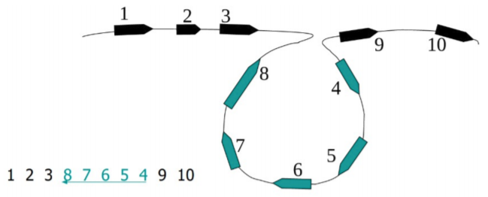
REVERSALS
Blocks represent conserved genes.
Reversals, or inversions, are particularly relevant to speciation.
Recombination's cannot occur between reversed and normally ordered segments.
The inversion introduced two breakpoints.

Slide 4
REVERSAL DISTANCE PROBLEM
Goal: Given two permutations over n elements, find the shortest series of reversals that transforms one into another.
Input: Permutations Π and Σ
Output: A series of reversals ρ1 (s1 ,e1 ), ρ2 (s2 ,e2 ), . . . ρt (st ,et ) transforming Π to Σ such that t is minimal
t - reversal distance between Π and Σ

Slide 5

SORTING BY REVERSALS PROBLEM
Goal: Given one permutations find the shortest series of reversals that transforms it into the identity permutations1,2,3……n .
Input: Permutations Π
Output: A series of reversals ρ1 (s1 ,e1 ), ρ2 (s2 ,e2 ), . . . ρt (st ,et ) transforming Π to the identity permutation such that t is minimal
t = d(Π) -reversal distance of Π

Slide 6
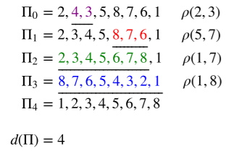
Sorting by reversals example
But is 4 the minimum number of reversals?
Can it be done in 3?

Slide 7

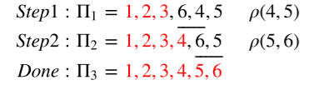
Greedy Algorithm for Sorting by Reversals
When sorting the permutation, Π = 1, 2, 3, 6, 4, 5 , one notices that the first three elements are already in order.
So, it does not make sense to break them apart.
The length of the already sorted prefix of Π is denoted as prefix(Π) = 3
This inspires the following simple greedy algorithm
while : prefix(Π) < len(Π)
perform a reversal ρ(prefix(Π) + 1, k) such that prefix(Π) increases by at least 1.
Such a reversal must always exist
Finding k, is as simple as finding the index of the minimum value of the remaining unsorted part

Slide 8
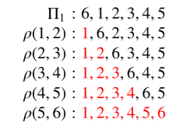

Analyzing GreedyReversalSort()

Slide 9
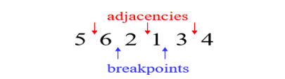

Adjacencies and Breakpoints
Extending Permutations

Slide 10
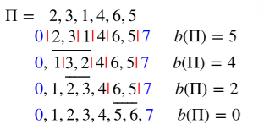
How Reversals Effect Breakpoints
Breakpoints are the targets for sorting by reversals.
Once they are removed, the permutation is sorted.

Slide 11

Strips
An interval between two consecutive breakpoints in a permutation
Decreasing strip: strip of elements in decreasing order
Increasing strip: strip of elements in increasing order

Slide 12
Reducing the Number of Breakpoints
If permutation p contains at least one decreasing strip, then there exists a reversal r which decreases the number of breakpoints (i.e. b(p • r) < b(p) )
Choose decreasing strip with the smallest element k in p
Find k – 1 in the permutation
Reverse the segment between k and k-1

Slide 13
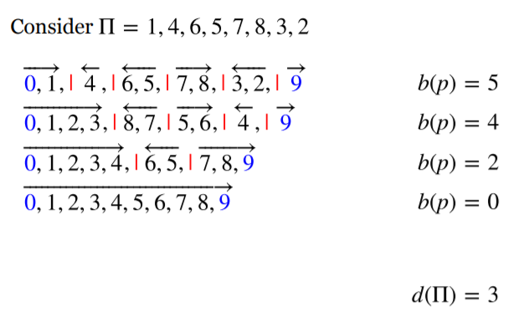
BREAKPOINTS EXAMPLE -1

Slide 14

BREAKPOINTS EXAMPLE -2
If there is no decreasing strip, there may be no reversal r that
reduces the number of breakpoints (i.e. b(p • r) ≥ b(p) for any
reversal r).

Slide 15
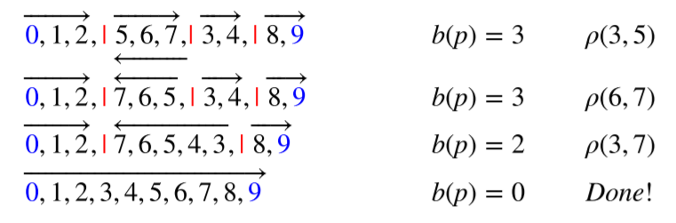
With each reversal, one can remove at most 2 breakpoints
If there is any decreasing strip there exists a reversal that will remove at least one breakpoint
If breakpoints remain and there is no decreasing strip one can be created by reserving any remaining strip

Slide 16
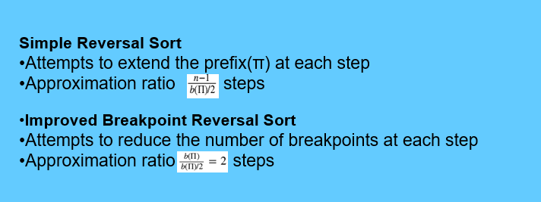


Comparing Greedy Algorithms

Slide 17
THANK YOU

