Slide 1

Image Steganography Using LSB and DCT
19AIE435 – cyber
Guided By Dr. Prakash
TEAM 4-INFINITY
APOORVA M
TANUJ M
AISHWARYA V

Slide 2
INTRODUCTION
Steganography is the practice of embedding message data (text, image, audio, etc.) within a target data file such that it is imperceptible to the human visual system.
This distinguishes steganography from cryptography, where the observer can detect that a hidden message exists but may or may not have the means or knowledge required to extract it.

Slide 3
INTRODUCTION-APPLICATIONS OF STEGANOGRAPHY
Physical Steganography dates as far back as 5th century BC—King Histiaeus tattooed a warning onto a courier’s scalp of an impending Persian invasion. When the courier’s hair grew back, the message was obscured.
The first use of the term steganography stems appears in 1499 in Steganographia by Johannes Trithemius – a treatise on cryptography and steganography disguised as a book about magic and communication with spirits.
Modern Applications
Digital Watermarking
Printing
Secure Communications
Recreation --alternate-reality games (Cicada 3301)

Slide 4
PROBLEM STATEMENT
Aim : Pixel matching using image steganography
Implement steganography using LSB and DCT as the embeding function
Hiding data in image
Obtaing decoded resutlts in images

Slide 5
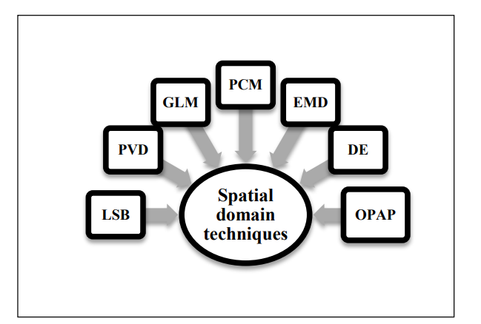
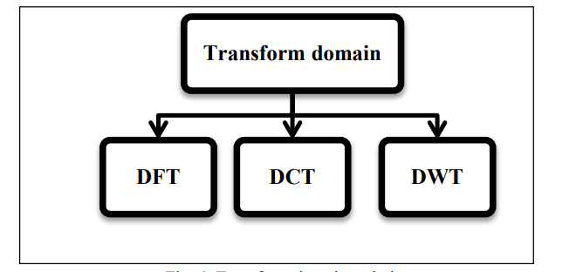
Literature Survey and Summary

Slide 6
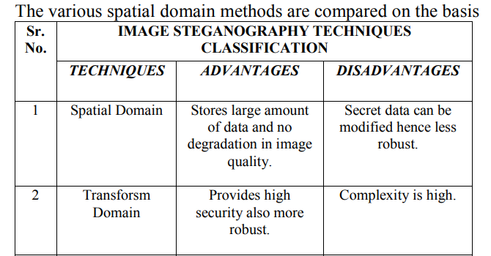
Literature Survey and Summary

Slide 7
Gaps and Challenges
DCT:
You can see blue tint on the DCT encoded images.
This code is now working on the blue channel of the images.
If I specify any other RGB channel, like red or green, It gets tinted with that exact channel color.

Slide 8
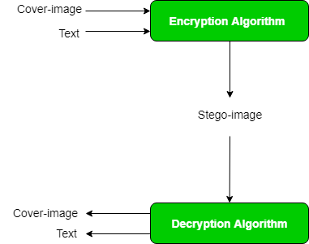
Architecture

Slide 9
IMPLEMENTATION
DCT Based Steganography Algorithm to embed text message:-
Step 1: Read cover image.
Step 2: Read secret message and convert it in binary.
Step 3: The cover image is broken into 8×8 block of pixels.
Step 4: Working from left to right, top to bottom subtract128 in each block of pixels.
Step 5: DCT is applied to each block.
Step 6: Each block is compressed through quantizationtable.
Step 7: Calculate LSB of each DC coefficient and replace with each bit of secret message.
Step 8: Write stego image.
Algorithm to retrieve text message:-
Step 1: Read stego image.
Step 2: Stego image is broken into 8×8 block of pixels.
Step 3: Working from left to right, top to bottom subtract128 in each block of pixels.
Step 4: DCT is applied to each block.
Step 5: Each block is compressed through quantizationtable.
Step 6: Calculate LSB of each DC coefficient.
Step 7: Retrieve and convert each 8 bit into character

Slide 10
IMPLEMENTATION
LSB Based Steganography Algorithm to embed text message:-
Step 1: Read the cover image and text message which is to be hidden in the cover image.
Step 2: Convert text message in binary.
Step 3: Calculate LSB of each pixels of cover image.
Step 4: Replace LSB of cover image with each bit of secret message one by one
Step 5: Write stego image
Algorithm to retrieve text message:-
Step 1: Read the stego image.
Step 2: Calculate LSB of each pixels of stego image.
Step 3: Retrieve bits and convert each 8 bit into character.

Slide 11

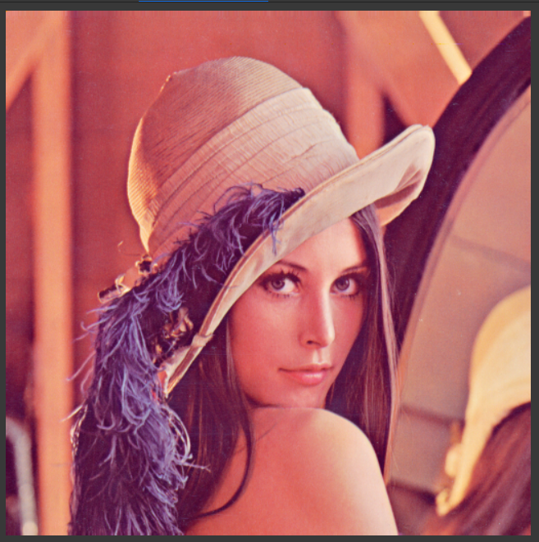
RESULTS
DCT
LSB

Slide 12
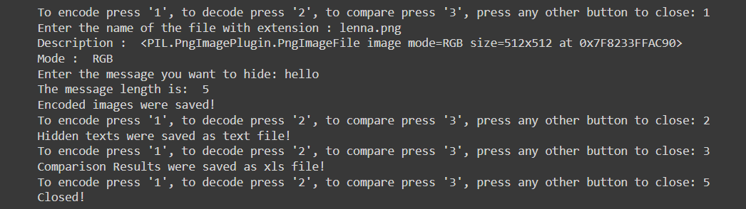
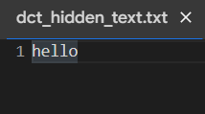
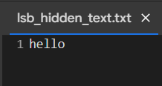
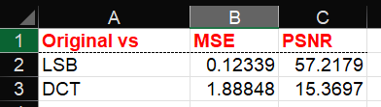
RESULTS

Slide 13
CONCLUSION AND FUTURE SCOPE
This project discusses in detail about the LSB and DCT algorithms on steganography application. The LSB and DCT algorithms are implemented for steganography application. In this experiment, performance analysis of LSB and DCT methods are successfully completed, and experimental results are discussed.
We have kept the DWT implementation for future work.
The MSE and PSNR values are compared for the LSB and DCT algorithms. From the experiment results it is observed that the PSNR of DCT is high as compared to the other two algorithms.
Thus, the experiment concludes the DCT algorithm is more suitable for the steganography application compared to the LSB based algorithms.

Slide 14
REFERENCES
[1] Saravanan Chandran, Koushik Bhattacharyya, “Performance Analysis of LSB, DCT, and DWT for Digital Watermarking Application using Steganography” - International Conference on Electrical, Electronics, Signals, Communication and Optimization (EESCO) - 2015.
[2] Gurmeet Kaurand Aarti Kochhar, “A Steganography Implementation based on LSB & DCT”, “International Journal for Science and Emerging, Technologies with Latest Trends” 4(1), ISSN No. (Online):2250-3641, ISSN No. (Print): 2277-8136, 35-41 (2012).
[3] Zakir khan, “What is the PSNR ratio value for steganography image?”, available at the following link: https://www.researchgate.net/post/What_is_the_PSNR_ratio_v alue_for_steganography_image
[4] Krasimir Kordov and Borislav Stoyanov, “Least Significant Bit Steganography using Hitzl-Zele Chaotic Map”, - INTL JOURNAL OF ELECTRONICS AND TELECOMMUNICATIONS, 2017, VOL. 63, NO. 4, PP. 417–422
[5] Neivin Mathew, Robyn Rintjema and Steven Kalapos, “Comparison of Image Steganography Techniques (DCT vs LSB)”

Slide 15
THANK YOU

